Slide 1
Topic 6: Network and Transport Layers
- Chapter 4 : TCP/IP and OSI
Business Data Communications, 4e

Slide 2
Outline
Introduction
OSI Model
TCP/IP Model
IPv4 vs. IPv6

Slide 3
What is a Protocol?
A standard that allows entities (i.e. application programs) from different systems to communicate
Shared conventions for communicating information
Includes syntax, semantics, and timing

Slide 4
Standardized Protocol Architectures
Vendors like standards because they make their products more marketable
Customers like standards because they enable products from different vendors to interoperate
Two protocol standards are well-known:
  TCP/IP: widely implemented
  OSI: less used, still useful for modeling/conceptualizing

Slide 5
Internet Standards
Email related standards
  IMAP, POP, X.400, SMTP, CMC, MIME, binhex, uuencode
Web related standards
  http, CGI, html/xml/vrml/sgml
Internet directory standards
  X.500, LDAP
Application standards
  http, FTP, telnet, gopher, wais
Videoconferencing standards
  H.320, H.323, Mpeg-1, Mpeg-2

Slide 6
*Telecommunication Standards Organizations
International Telecommunications Union - Telecommunication Standardization Sector (ITU-TSS). Formerly called the Consultative Committee on International Telegraph and Telephone (CCITT)
International Organization for Standards (ISO). Member of the ITU, makes technical recommendations about data communications interfaces.
American National Standards Institute (ANSI)
Institute of Electrical and Electronics Engineers (IEEE)
Internet Engineering Task Force (IETF)
Electronic Industries Association (EIA)
National Institute of Standards and Technology (NIST)
National Exchange Carriers Association (NECA)
Corporation for Open Systems (COS)
Electronic Data Interchange -(EDI) of Electronic Data Interchange for Administration Commerce and Transport (EDIFACT).

Slide 7
*Internet Engineering Task Force
A protocol proposed by a vendor
IETF working group study the proposal
IETF issues a request for comment (RFC)
IETF reviews the comments
IETF proposes an improved RFC
The RFC becomes a proposed standard
The proposed standard becomes a draft
standard if two or more vendors adopt it

Slide 8
What is OSI?
Developed by the International Organization for Standardization (ISO) in 1984
The primary architectural model for intercomputer communications.
A conceptual model composed of seven layers, each specifying particular network functions.
Describes how information from a software application in one computer moves through a network medium to a software application in another computer.

Slide 9
Why Study OSI?
Still an excellent model for conceptualizing and understanding protocol architectures
Key points:
  Modular
  Hierarchical
  Boundaries between layers=interfaces

Slide 10
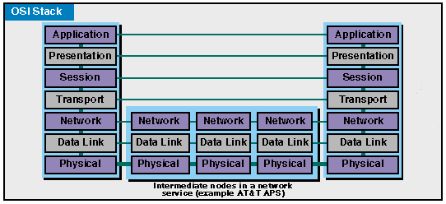

Slide 11
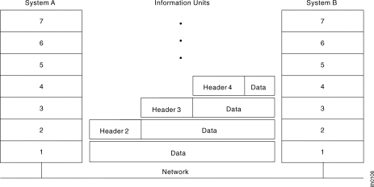
Headers and Data

Slide 12
OSI Lower Layers
Physical – Layer 1
Data Link – Layer 2
Network – Layer 3

Slide 13
OSI Physical Layer
Responsible for transmission of bits
Always implemented through hardware
Encompasses mechanical, electrical, and functional interfaces
e.g. RS-232

Slide 14
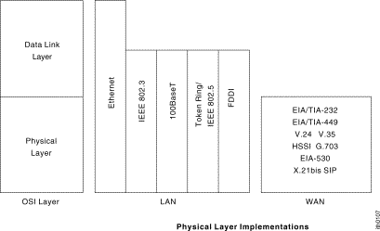
*Physical-layer Implementation

Slide 15
OSI Data Link Layer
Responsible for error-free, reliable transmission of data
Flow control, error correction
e.g. HDLC

Slide 16
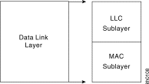
OSI Data Link Layer
IEEE has subdivided data link layer into two sub-layers.

Slide 17
OSI Network Layer
Responsible for routing of messages through network
Concerned with type of switching used (circuit v. packet)
Handles routing between networks, as well as through packet-switching networks

Slide 18
Network Access Layer
Concerned with exchange of data between computer and network
Includes addressing, routing, prioritizing, etc
Different networks require different software at this layer
Example: X.25 standard for network access procedures on packet-switching networks

Slide 19
OSI Upper Layers
Transport
Session
Presentation
Application

Slide 20
OSI Transport Layer
Isolates messages from lower and upper layers
Breaks down message size
Monitors quality of communications channel
Selects most efficient communication service necessary for a given transmission

Slide 21
Transport Layer
Concerned with reliable transfer of information between applications
Independent of the nature of the application
Includes aspects like flow control and error checking

Slide 22
OSI Session Layer
Establishes logical connections between systems
Manages log-ons, password exchange, log-offs
Terminates connection at end of session

Slide 23
OSI Presentation Layer
Provides format and code conversion services
Examples
  File conversion from ASCII to EBDIC
  Invoking character sequences to generate bold, italics, etc on a printer

Slide 24
OSI Application Layer
Provides access to network for end-user
User’s capabilities are determined by what items are available on this layer
Logic needed to support various applications
Each type of application (file transfer, remote access) requires different software on this layer

Slide 25
Application Viewpoint of a Network
Distributed data communications involves three primary components:
  Networks
  Computers
  Applications
Three corresponding layers
  Network access layer
  Transport layer
  Application layer

Slide 26
TCP/IP
Transmission control Protocol/Internet Protocol
Developed by DARPA
No official protocol standard
Can identify five layers
  Application
  Host-to-Host (transport)
  Internet
  Network Access
  Physical

Slide 27
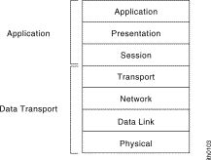
An OSI View of TCP/IP
Internet Model
OSI Model
F-D’s Model
Application
(http, telnet, snmp,
smtp, nfs, ftp)
Application
layer
Transport
(TCP, UDP)
Network
layer
Internet (IPv4/IPv6)
Network Access
(HDLC)
Data Link layer
Physical layer
Physical layer

Slide 28
Sender
Receiver
Application
Layer
Application
Layer
HTTP
Request
HTTP
Request
Transport
Layer
Transport
Layer
TCP
HTTP
Request
TCP
HTTP
Request
Network
Layer
Network
Layer
IP
TCP
HTTP
Request
IP
TCP
HTTP
Request
Data Link
Layer
Data Link
Layer
Ethernet
IP
TCP
HTTP
Request
Ethernet
IP
TCP
HTTP
Request
Physical
Layer
Physical
Layer

Slide 29
TCP/IP Network Access Layer
Exchange of data between end system and network
Address of host and destination
Prioritization of transmission
Software at this layer depends on network (e.g. X.25 vs. Ethernet)
Segregation means that no other software needs to be concerned about net specifics

Slide 30
TCP/IP Internet Layer
An Internet is an interconnection of two or more networks
Internet layer handles tasks similar to network access layer, but between networks rather than between nodes on a network
Uses IP for addressing and routing across networks
Implemented in workstations and routers

Slide 31
TCP/IP Transport Layer
Also called host-to-host layer
Reliable exchange of data between applications
Uses TCP protocols for transmission

Slide 32
TCP/IP Application Layer
Logic needed to support variety of applications
Separate module supports each type of application (e.g. file transfer)
  FTP
  HTTP
  Telnet
  News
  SMTP

Slide 33
*TCP/IP
Application
Presentation
Session
TELNET FTP SMTP DNS SNMP DHCP
RIP
Transport
RTP
RTCP
Transmission
Control Protocol
User Datagram
Protocol
OSPF
IGMP
ICMP
Network
Internet Protocol
ARP
Data link
Physical
Ethernet
Token Bus
Token Ring
FDDI

Slide 34
TCP & UDP
Most TCP/IP applications use TCP for transport layer
TCP provides a connection (logical association) between two entities to regulate flow check errors
UDP (User Datagram Protocol) does not maintain a connection, and therefore does not guarantee delivery, preserve sequences, or protect against duplication

Slide 35
Internetworking
Interconnected networks, usually implies TCP/IP
Can appear to users as a single large network
The global Internet is the largest example, but intranets and extranets are also examples

Slide 36
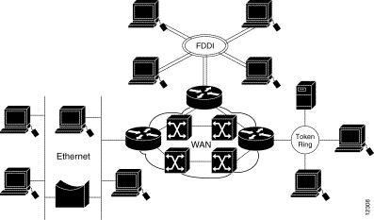
Internetworking

Slide 37
TCP Segment (TCP PDU)
Source port (16 bits)
Destination port (16 bits)
Sequence number (32 bits)
Acknowledgment number (32 bits)
Data Offset (4 bits)
Reserved (6 bits)
Flags (6 bits) : URG, ACK, PSH, RST, SYN, FIN
Window (16 bits)
Checksum (16 bits)
Urgent Pointer (16 bits)
Options (variable)
The size of TCP header is 192 bits = 24 byes.

Slide 38
IPv4 and IPv6
IP (IPv4) provides for 32-bit source and destination addresses, using a 192-bit header
IPv6 (1996 standard) provides for 128-bit addresses, using a 320-bit header.
Migration to IPv6 will be a very slow process

Slide 39
*History of IPng Effort
By the Winter of 1992 the Internet community had developed four separate proposals for IPng. These were "CNAT", "IP Encaps", "Nimrod", and "Simple CLNP". By December 1992 three more proposals followed; "The P Internet Protocol" (PIP), "The Simple Internet Protocol" (SIP) and "TP/IX". In the Spring of 1992 the "Simple CLNP" evolved into "TCP and UDP with Bigger Addresses" (TUBA) and "IP Encaps" evolved into "IP Address Encapsulation" (IPAE).
By the fall of 1993, IPAE merged with SIP while still maintaining the name SIP. This group later merged with PIP and the resulting working group called themselves "Simple Internet Protocol Plus" (SIPP). At about the same time the TP/IX Working Group changed its name to "Common Architecture for the Internet" (CATNIP).
The IPng area directors made a recommendation for an IPng in July of 1994 [RFC 1752].
The formal name of IPng is IPv6

Slide 40
Why Need IPv6?
Internet Growth
  Network numbers and size
  Traffic management
Quality of Services (QoS)
Internet Transition
  Routing
  Addressing
No question that an IPv6 is needed, but when

Slide 41
IP Packet version
IP4
1
2
3
4
5
6
7
8
9
10
11
12
13
14
1 Version number 4 bits
2 Header length 4 bits
3 Type of Service 8 bits
4 Total length 16 bits
5 Identifiers 16 bits
6 Flags 3 bits
7 Packet offset 13 bits
8 Hop limit 8 bits
9 Protocol 8 bits
10 CRC 16 16 bits
11 Source address 32 bits
12 Destination Address 32 bits
13 Options varies
14 User data varies
15 Flow name 24 bits
16 Next header 8 bits
IP6
1
15
4
16
8
11 (128 bits)
12 (128 bits)
14

Slide 42
IPv4 Header
Version (4 bits)
Internet header length (4 bits)
Type of Service (8 bits)
Total Length (16 bits)
Identification (16 bits)
Flags (3 bits
Fragment Offset (13 bits)
Time to Live (8 bits)
Protocol (8 bits
Header Checksum (16 bits)
Source Address ( 32 bits)
Destination Address (32 bits)
Options (variable)
Padding (variable)

