Slide 1
7 Layer OSI Model
EECE 542
August 25, 2003

Slide 2
History
Rapid growth of computer networks caused compatibility problems
ISO recognized the problem and released the OSI model in 1984
OSI stands for Open Systems Interconnection and consists of 7 Layers
The use of layers is designed to reduce complexity and make standardization easier

Slide 3
7 Layers of the OSI Model
Layer | Responsible For:
7.) Application | Provides Services to User Apps
6.) Presentation | Data Representation
5.) Session | Communication Between Hosts
4.) Transport | Flow Ctrl, Error Detection/Correction
3.) Network | End to End Delivery, Logical Addr
2.) Data Link | Media Access Ctrl, Physical Addr
1.) Physical | Medium, Interfaces, Puts Bits on Med.

Slide 4
Examples
Layer | Example
7.) Application | HTTP, FTP, SMTP
6.) Presentation | ASCII, JPEG, PGP
5.) Session | BOOTP, NetBIOS, DHCP, DNS
4.) Transport | TCP, UDP, SPX
3.) Network | IP, IPX, ICMP
2.) Data Link | Ethernet, Token Ring, Frame Relay
1.) Physical | Bits, Interfaces, Hubs

Slide 5
Mnemonics
(A)ll | 7.) (A)pplication | (A)way
(P)eople | 6.) (P)resentation | (P)izza
(S)eem | 5.) (S)ession | (S)ausage
(T)o | 4.) (T)ransport | (T)hrow
(N)eed | 3.) (N)etwork | (N)ot
(D)ata | 2.) (D)ata Link | (D)o
(P)rocessing | 1.) (P)hysical | (P)lease

Slide 6
Flat Addressing
Flat addressing schemes do not provide anything other than a unique identifier. They provide no real information about where the object being addressed resides.
Example: SSN# (may provide insight to where the person was born, but not to where they are now)

Slide 7
Hierarchical Addressing
Hierarchical addressing schemes provide layers or a hierarchy to the address that provide information about where the addressed object exists within the hierarchy.
Example: phone numbers (area code, local prefix, and four digit number unique to that area code/prefix combination).

Slide 8
Talking to Everyone
Special kinds of addresses exist at both layer #2 and #3 called broadcast addresses
Typically network devices are interested in only traffic addressed directly for them and any traffic addressed with the destination address set to broadcast
If they are paying attention to other traffic, they are said to be in promiscuous mode

Slide 9
Encapsulation
Data exists at each layer contained within a unit called a Protocol Data Unit (PDU).
PDU’s are referred two ways: N-PDU, and by special names.
The process by which data moves between PDU types is called Encapsulation
PDU move through interfaces between layers using Service Access Points (SAP)

Slide 10
PDU’s And the OSI Model
Layer | PDU Name
7.) Application | Data
6.) Presentation | Data
5.) Session | Data
4.) Transport | Segment
3.) Network | Packet
2.) Data Link | Frame
1.) Physical | Bits
Decapsulation
Encapsulation

Slide 11
Layer 1: The Physical Layer
Defines physical medium and interfaces
Determines how bits are represented
Controls transmission rate & bit synchronization
Controls transmission mode: simplex, half-duplex, & full duplex
PDU: Bits
Devices: hubs, cables, connectors, etc…

Slide 12
Layer 2: The Data Link Layer
PDU: Frames
Keeps Link alive & provides connection for upper layer protocols
Based on physical (flat) address space
Physical addresses are fixed and don’t change when the node is moved
Medium/media access control

Slide 13
The Data Link Layer (cont.)
Flow control and error detection/correction at the frame level. Think collisions…
Topology
Ex: Ethernet, Token Ring, ISDN
Sublayers: MAC (framing, addressing, & MAC) & LLC (logical link control – gives error control & flow control)
Devices: switches, bridges, NIC’s

Slide 14
Layer 3: The Network Layer
PDU: Packet
End to end delivery of packets
Creates logical paths
Path determination (routing)
Hides the lower layers making things hardware independent
Uses logical hierarchical addresses

Slide 15
The Network Layer (cont.)
Logical hierarchical addresses do change when a node is moved to a new subnet
Devices: routers, firewalls

Slide 16
Layer 4: The Transport Layer
PDU: Segment
Service Point Address (more often called a port) used to track multiple sessions between the same systems. SPA’s are used to allow a node to offer more than one service (i.e. it could offer both mail and web services)
This layer is why you have to specify TCP or UDP when dealing with TCP/IP

Slide 17
The Transport Layer (cont.)
Must reassemble segments into data using sequence numbers
Can use either connectionless or connection oriented sessions
Connectionless sessions rely on upper layer protocols for error control and are often used for faster less reliable links
Ex: UDP (used by things like NFS & DNS)

Slide 18
The Transport Layer (cont.)
Connection oriented sessions require the sender to first request a connection, the receiver to acknowledge the connection, and that they negotiate how much data can be sent/received before its reception is acknowledged
Uses acknowledgements & retransmission for error correction
Example: TCP (used by things like telnet, http)

Slide 19
Layer 5: The Session Layer
PDU: Data (from here on up)
Sometimes called the dialog controller, this layer establishes, maintains, and terminates sessions between applications
Sets duplex between applications
Defines checkpoints for acknowledgements during sessions between applications

Slide 20
The Session Layer (cont.)
Provides atomization – Multiple connections can be treated as one virtual session. If one fails or is terminated, all should be terminated.
Identifies raw data as either application data or session control information
Uses fields provided by layers 3 & 4 to track dialogs between applications / services
Provides translations for naming services
Ex: RPC, X-Windows, LDAP, NFS

Slide 21
Layer 6: The Presentation Layer
Data formatting, translation, encryption, and compression
Ex: ASCII, EBCDIC, HTML, JPEG

Slide 22
Layer 7: The Application Layer
Provides communication services to applications
Ex: HTTP, FTP, SMTP

Slide 23
Encapsulation Review
Example of the encapsulation / decapsulation process

Slide 24
Address Resolution
Two problems:
#1 Layer 3 address resolution
#2 Layer 3 to Layer 2 resolution
IP vs IPX approaches

Slide 25
Larger Example
Scenario: sending a message between subnets.
Source and Destination Layer 3 addresses don’t change
Source and Destination Layer 2 addresses do
How are addresses resolved?

Slide 26
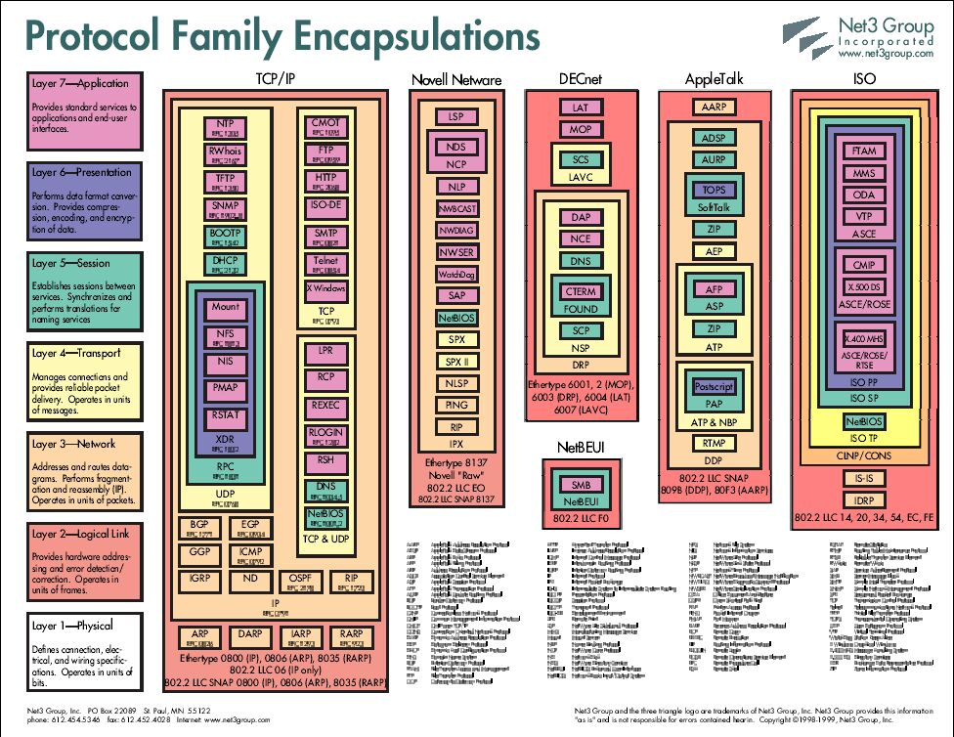

Slide 27
The Practical Benefits Of Understanding The OSI Model
Helps with packet analysis
Helps foresee problems
Aides in network design (especially on large scale networks)

Slide 28
Network Design & Admin Issues
Examining network protocols and how they relate to the OSI model help aide network administers design networks and help admins troubleshoot strange behavior.
If you don’t understand what mechanisms your network is using to communicate, you are more likely to introduce new problems while trying to fix old ones.

Slide 29
Example #1
Admin wants to play around with DHCP so they put the machines that they want to use on “private IP addresses”.
What will happen to “normal” DHCP users?

Slide 30
Example #2
Network congestion: Admin notices that he is seeing to much traffic on his network. He decides to break his network in two using a router.
What are some potential problems associated with this?
What might be some better solutions?

Slide 31
TCP/IP Model
Much older than OSI model
Consists of 4 layers instead of 7
TCP/IP model can be mapped to the OSI model

Slide 32
TCP/IP vs OSI
TCP/IP | OSI
Application | Application Presentation Session (Layers 7-5)
Transport | Transport (Layer 4)
Internet | Network (Layer 3)
Network Interface | Data Link Physical (Layers 1-2)

Slide 33
IEEE Standards
IEEE project 802 started in 1985
Adopted by ANSI in 1987
Recognized as an international standard by the ISO as ISO 8802
Deals with layers 1 & 2

Slide 34
IEEE Standards (cont.)
At the data link layer (layer 2), defines MAC and LLC sublayers
LLC covers media independent topics (802.2 is the LLC standard)
MAC topics are dependent on media (802.3, 802.11, 802.5)
At the physical layer (layer 1), defines a PMI and PMD

