Slide 1
UNIT-1
18CSC302J-COMPUTER NETWORKS

Slide 2
Contents
IP HEADER
IP FRAGMENTATION
ARP RARP
ICMP –INTRODUCTION
DEBUGGING TOOLS
ICMP PACKAGE
UDP DATAGRAM
UDP CHARACTERISTICS
TCP CONNECTION ESTABLISHMENT PROCESS
TCP ERROR CONTROL
TCP CONGESTION CONTROL
TCP FLOW CONTROL
MULTICASTING
MULTICASTING AND MULTICAST ROUTING PROTOCOL
STREAM CONTROL TRANSMISSION PROTOCOL
SIMPLE TCP/IP CLIENT SERVER COMMUNICATION

Slide 3
IP -HEADER
An IP header is header information at the beginning of an IP packet which contains information about IP version, source IP address, destination IP address, time-to-live
the Internet Protocol has a place in the OSI Model
When a computer receives a packet from the network, the computer will firstly check the destination MAC address of the packet at the Data link layer (2) and if it passes, it's then passed on to the Network layer
At the Network layer it will check the packet to see if the destination IP Address matches with the computer's IP Address (if the packet is a broadcast, it will pass the network layer anyway
if the computer is generating a packet to send to the network then, as the packet travels down the OSI model and reaches the Network layer, the destination and source IP Address of this packet are added in the IP Header

Slide 4
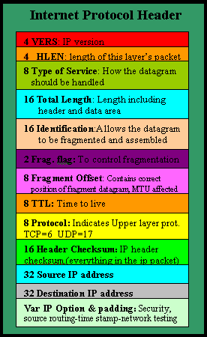
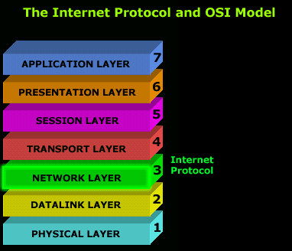
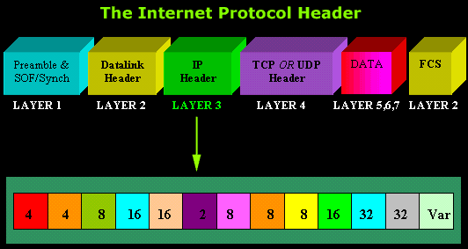

Slide 5
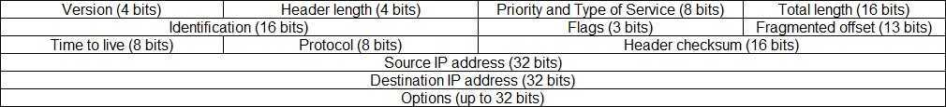

Slide 6
Version – the version of the IP protocol. For IPv4, this field has a value of 4.
Header length – the length of the header in 32-bit words. The minumum value is 20 bytes, and the maximum value is 60 bytes.
Priority and Type of Service – specifies how the datagram should be handled. The first 3 bits are the priority bits.
Total length – the length of the entire packet (header + data). The minimum length is 20 bytes, and the maximum is 65,535 bytes.
Identification – used to differentiate fragmented packets from different datagrams.
Flags – used to control or identify fragments.
Fragmented offset – used for fragmentation and reassembly if the packet is too large to put in a frame.
Time to live – limits a datagram’s lifetime. If the packet doesn’t get to its destination before the TTL expires, it is discarded.
Protocol – defines the protocol used in the data portion of the IP datagram. For example, TCP is represented by the number 6 and UDP by 17.
Header checksum – used for error-checking of the header. If a packet arrives at a router and the router calculates a different checksum than the one specified in this field, the packet will be discarded.
Source IP address – the IP address of the host that sent the packet.
Destination IP address – the IP address of the host that should receive the packet.
Options – used for network testing, debugging, security, and more. This field is usually empty

Slide 7
ARP
To show how the address resolution protocol (ARP) is used todynamically map a logical address to a physical address
A logical address is unique universally. It is called a logical address because it is usually implemented in software
The logical addresses in the TCP/IP protocol suite are called IP addresses and are 32 bits long.
the hosts and routers are recognized by their physical addresses
Examples of physical addresses are 48-bit MAC addresses in the Ethernet protocol, which are imprinted on the NIC installed in the host or router
Static Mapping
1. A machine could change its NIC, resulting in a new physical address.
2. In some LANs, such as LocalTalk, the physical address changes every time the
computer is turned on.
3. A mobile computer can move from one physical network to another, resulting in a
change in its physical address.

Slide 8
Dynamic Mapping
In dynamic mapping, each time a machine knows the logical address of another machine,
it can use a protocol to find the physical address
Two protocols have been designed to perform dynamic mapping:
Address Resolution Protocol (ARP) and Reverse Address Resolution Protocol (RARP).
ARP maps a logical address to a physical address;
RARP maps a physical address to a logical address.
A mapping corresponds a logical address to a physical ddress
ARP accepts a logical address from the IP protocol, maps the address to the corresponding
physical address and pass it to the data link layer.
ARP associates an IP address with its physical address
Anytime a host, or a router, needs to find the physical address of another host or
router on its network, it sends an ARP query packet

Slide 9
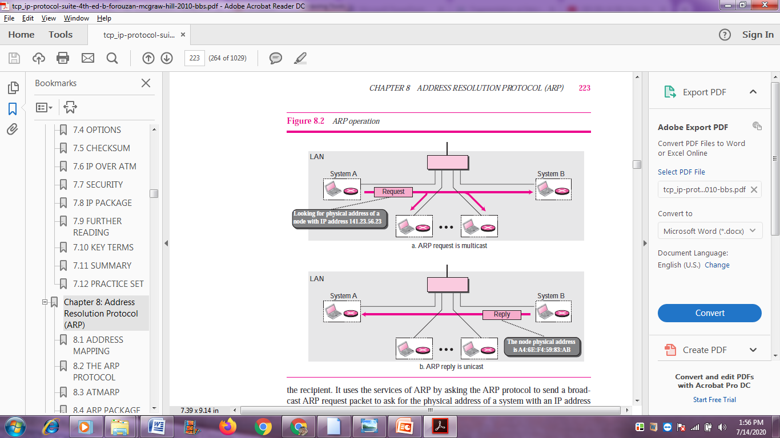

Slide 10
Every host or router on the network receives and processes the ARP query packet,
but only the intended recipient recognizes its IP address and sends back an ARP
response packet.
The response packet contains the recipient’s IP and physical
Addresses
The packet is unicast directly to the inquirer using the physical address
received in the query packet

Slide 11
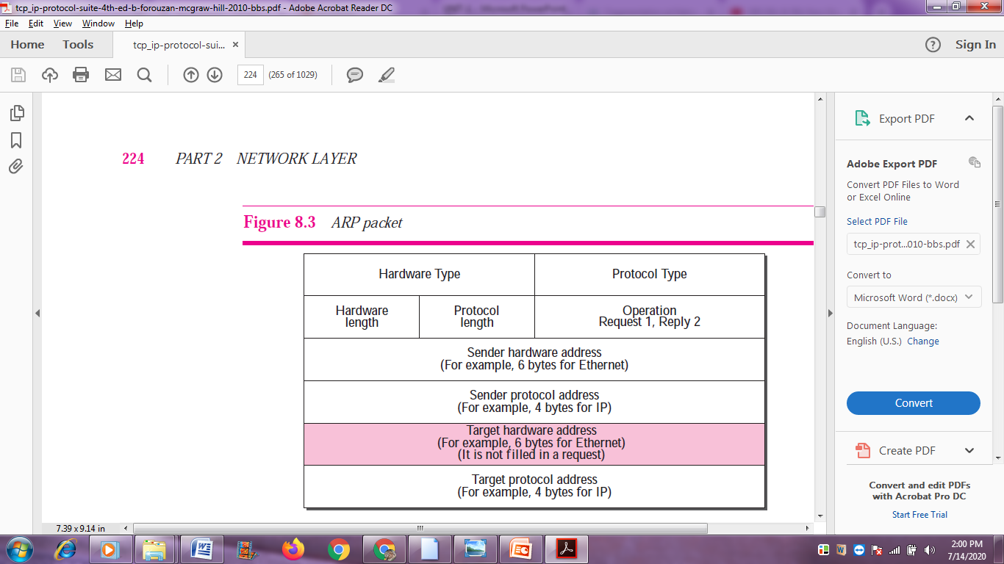
Packet Format

Slide 12
❑ Hardware type. This is a 16-bit field defining the type of the network on which
ARP is running. Each LAN has been assigned an integer based on its type. For
example, Ethernet is given the type 1. ARP can be used on any physical network.
❑ Protocol type. This is a 16-bit field defining the protocol. For example, the value
of this field for the IPv4 protocol is 080016. ARP can be used with any higher-level
protocol.
❑ Hardware length. This is an 8-bit field defining the length of the physical address
in bytes. For example, for Ethernet the value is 6.
❑ Protocol length. This is an 8-bit field defining the length of the logical address in
bytes. For example, for the IPv4 protocol the value is 4.
❑ Operation. This is a 16-bit field defining the type of packet. Two packet types are
defined: ARP request (1), ARP reply (2).
❑ Sender hardware address. This is a variable-length field defining the physical
address of the sender. For example, for Ethernet this field is 6 bytes long.
❑ Sender protocol address. This is a variable-length field defining the logical (for
example, IP) address of the sender. For the IP protocol, this field is 4 bytes long.
❑ Target hardware address. This is a variable-length field defining the physical
address of the target. For example, for Ethernet this field is 6 bytes long. For an
ARP request message, this field is all 0s because the sender does not know the
physical address of the target.
❑ Target protocol address. This is a variable-length field defining the logical (for
example, IP) address of the target. For the IPv4 protocol, this field is 4 bytes long

Slide 13
Encapsulation
An ARP packet is encapsulated directly into a data link frame.
ARP packet is encapsulated in an Ethernet frame
Operation
Steps Involved These are seven steps involved in an ARP process

Slide 14
STEPS
1. The sender knows the IP address of the target. We will see how the sender obtains this shortly.
2. IP asks ARP to create an ARP request message, filling in the sender physical address, the sender IP address, and the target IP address. The target physical address field is filled with 0s.
3. The message is passed to the data link layer where it is encapsulated in a frame using the physical address of the sender as the source address and the physical broadcast address as the destination address
4. Every host or router receives the frame. Because the frame contains a broadcast destinationaddress, all stations remove the message and pass it to ARP. All machines except the one targeted drop the packet. The target machine recognizes the IP address
5. The target machine replies with an ARP reply message that contains its physical address. The message is unicast.
6.The sender receives the reply message. It now knows the physical address of the target machine
7. The IP datagram, which carries data for the target machine, is now encapsulated in
a frame and is unicast to the destination

Slide 15
QUESTIONS
ANALYSIS NEXT SLIDE IDENTIFY THE UNIQUE IDENTITY IN THE DIAGRM CASE

Slide 16
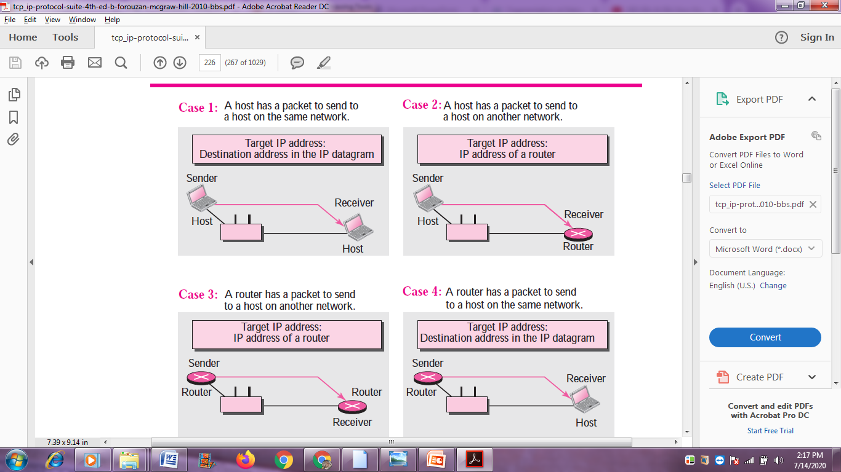

Slide 17
❑ Case 1: The sender is a host and wants to send a packet to another host on the same
network. In this case, the logical address that must be mapped to a physical address
is the destination IP address in the datagram header.
❑ Case 2: The sender is a host and wants to send a packet to another host on another
network. In this case, the host looks at its routing table and finds the IP address of
the next hop (router) for this destination. If it does not have a routing table, it looks
for the IP address of the default router. The IP address of the router becomes the
logical address that must be mapped to a physical address.
❑ Case 3: The sender is a router that has received a datagram destined for a host on
another network. It checks its routing table and finds the IP address of the next
router. The IP address of the next router becomes the logical address that must be
mapped to a physical address.
❑ Case 4: The sender is a router that has received a datagram destined for a host in
the same network. The destination IP address of the datagram becomes the logical
address that must be mapped to a physical address

Slide 18
Proxy ARP
A technique called proxy ARP is used to create a subnetting effect
proxy ARP is an ARP that acts on behalf of a set of hosts.
Whenever a router running a proxy ARP receives an ARP request looking for the IP address of one of these hosts, the router sends an ARP reply announcing its own hardware (physical) address.
After the router receives the actual IP packet, it sends the packet to the appropriate host or router

Slide 19
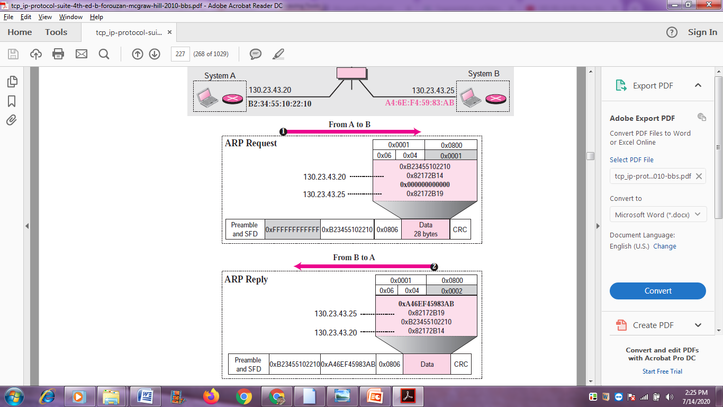

Slide 20
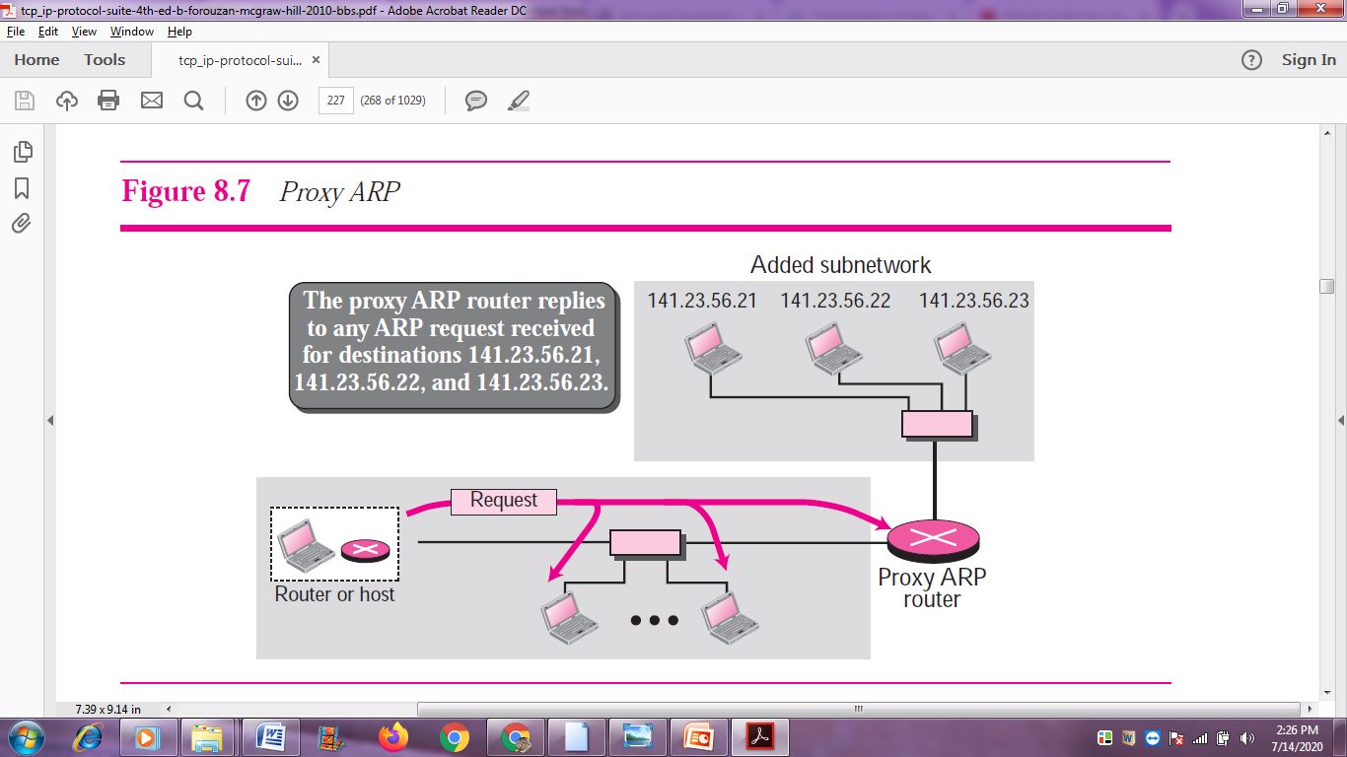

Slide 21
ARP PACKAGE
The purpose is to show the components of a hypothetical ARP package and the relationships between the components
ARP package involves five components:
a cache table,
queues,
an output module,
an input module,
a cache-control module.

Slide 22
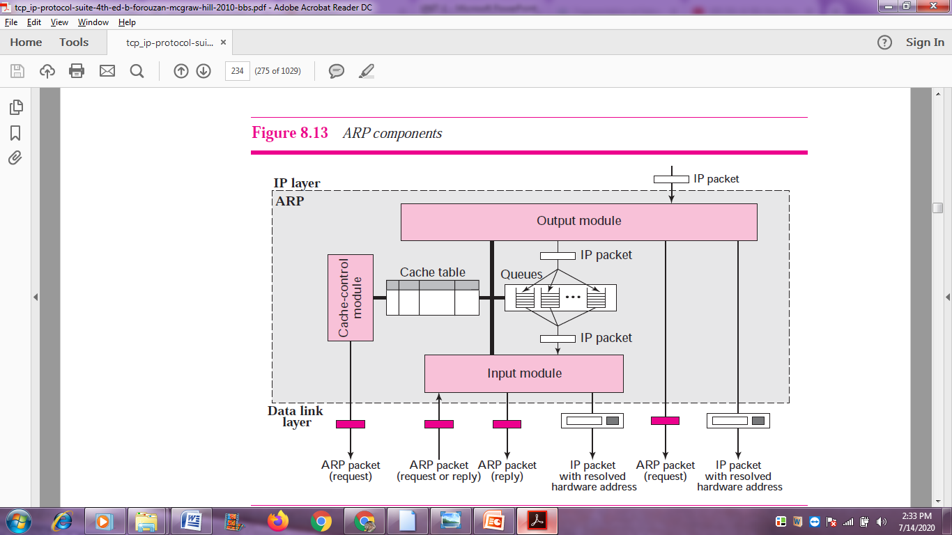

Slide 23
Cache Table
When a host or router receives the corresponding physical address for an IP datagram, the address can be saved in the cache table. This address can be used for the data grams destined for the same receiver within the next few minutes
State. This column shows the state of the entry. It can have one of three values:
FREE, PENDING, or RESOLVED. The FREE state means that the time-to-live for this entry has expired. The space can be used for a new entry.
The PENDING state means a request for this entry has been sent, but the reply has not yet been received.
The RESOLVED state means that the entry is complete. The entry now has the physical (hardware) address of the destination.
❑ Hardware type. This column is the same as the corresponding field in the ARP packet.
❑ Protocol type. This column is the same as the corresponding field in the ARP packet.
❑ Hardware length. This column is the same as the corresponding field in the ARP
packet.
❑ Protocol length. This column is the same as the corresponding field in the ARP packet.
❑ Interface number. A router (or a multihomed host) can be connected to different
networks, each with a different interface number. Each network can have different
hardware and protocol types.
❑ Queue number. ARP uses numbered queues to enqueue the packets waiting for
address resolution. Packets for the same destination are usually enqueued in the
same queue.
❑ Attempts. This column shows the number of times an ARP request is sent out for
this entry.
❑ Time-out. This column shows the lifetime of an entry in seconds.
❑ Hardware address. This column shows the destination hardware address. It
remains empty until resolved by an ARP reply.
❑ Protocol address. This column shows the destination IP address.

Slide 24
ICMP
The IP protocol has no error-reporting or error-correcting mechanism
The IP protocol also lacks a mechanism for host and management queries
to determine if a router or another host is alive
a network manager needs information from another host or router.
ICMP itself is a network layer protocol
the messages are first Encapsulated inside IP data grams before going to the lower layer
ICMP –MESSAGES INTO TWO CATEGORIES
error-reporting messages- The error-reporting messages report problems that a router or a host(destination) may encounter when it processes an IP packet.
query messages- help a host or a network manager get specific information from a router or another host

Slide 25
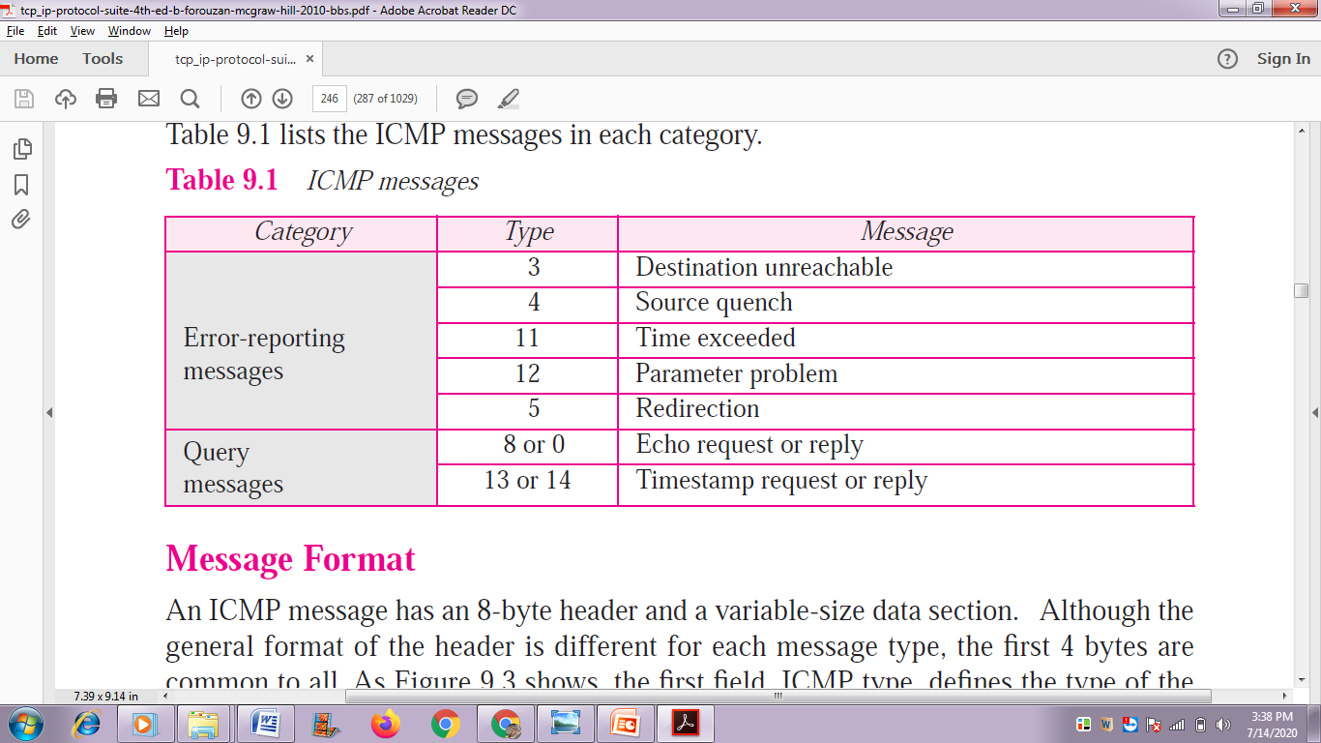

Slide 26
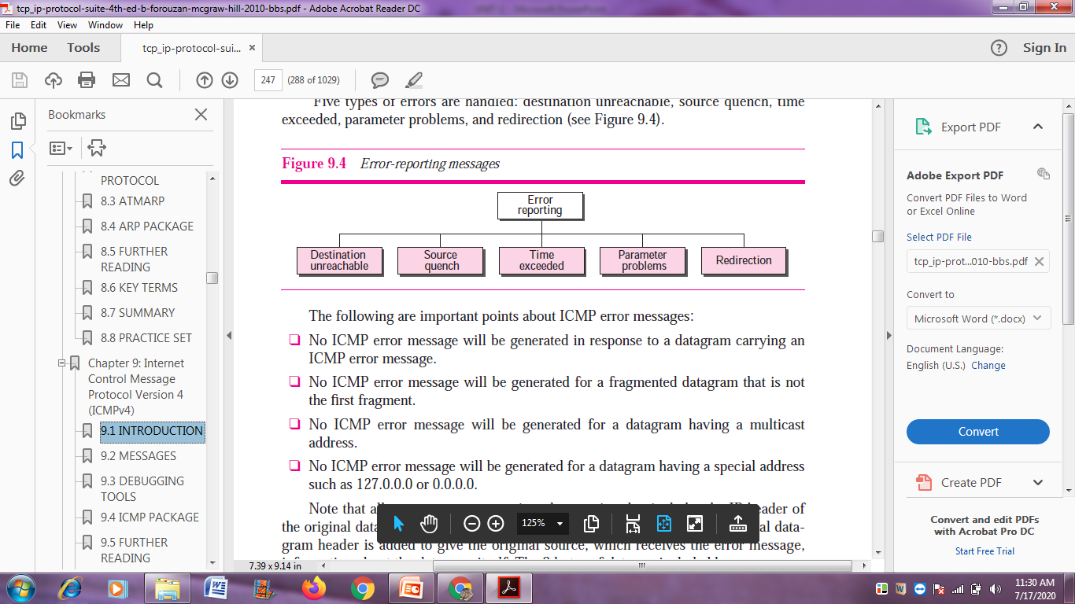

Slide 27
DEBUGGING TOOLS
To find out router is running or alive
Trace the packet of router
Icmp debugging ping and traceroute
Ping :Ping is computer network administration software utility used to test the reachability of a host on an Internet Protocol (IP) network
Ping measures the round-trip time for messages sent from the originating host to a destination computer that are echoed back to the source.
Traceroute is a network diagnostic tool used to track in real-time the pathway taken by a packet on an IP network from source to destination, reporting the IP addresses of all the routers it p
Traceroute also records the time taken for each hop the packet makes during its route to the destinationinged in between.

Slide 28
ping
The ping program sets the identifier field in the echo request and reply message and starts the sequence number from 0
This number is incremented by one each time a new message is sent
When the packet arrives it subtracts the arrival time from the departuretime to get the round-trip time (RTT).
Ping 192.168.2.1
64 bytes from tiptoe.fhda.edu (153.18.8.1): icmp_seq=0 ttl=62 time=1.91 ms
64 bytes from tiptoe.fhda.edu (153.18.8.1): icmp_seq=1 ttl=62 time=2.04 ms
64 bytes from tiptoe.fhda.edu (153.18.8.1): icmp_seq=2 ttl=62 time=1.90 ms
64 bytes from tiptoe.fhda.edu (153.18.8.1): icmp_seq=3 ttl=62 time=1.97 ms
64 bytes from tiptoe.fhda.edu (153.18.8.1): icmp_seq=4 ttl=62 time=1.93 ms
64 bytes from tiptoe.fhda.edu (153.18.8.1): icmp_seq=5 ttl=62 time=2.00 ms
64 bytes from tiptoe.fhda.edu (153.18.8.1): icmp_seq=6 ttl=62 time=1.94 ms
64 bytes from tiptoe.fhda.edu (153.18.8.1): icmp_seq=7 ttl=62 time=1.94 ms

Slide 29
The TTL (time to live) field in the IP datagram that encapsulates an
ICMP message has been set to 62, which means the packet cannot travel more than 62 hops
ping defines the number of data bytes as 56 and the total number of bytes as 84.
It is obvious that if we add 8 bytes of ICMP header and 20 bytes of IP header to 56, the result is 84.
ping defines the number of bytes as 64.
This is the total number of bytes in the ICMP packet (56 + 8).

Slide 30
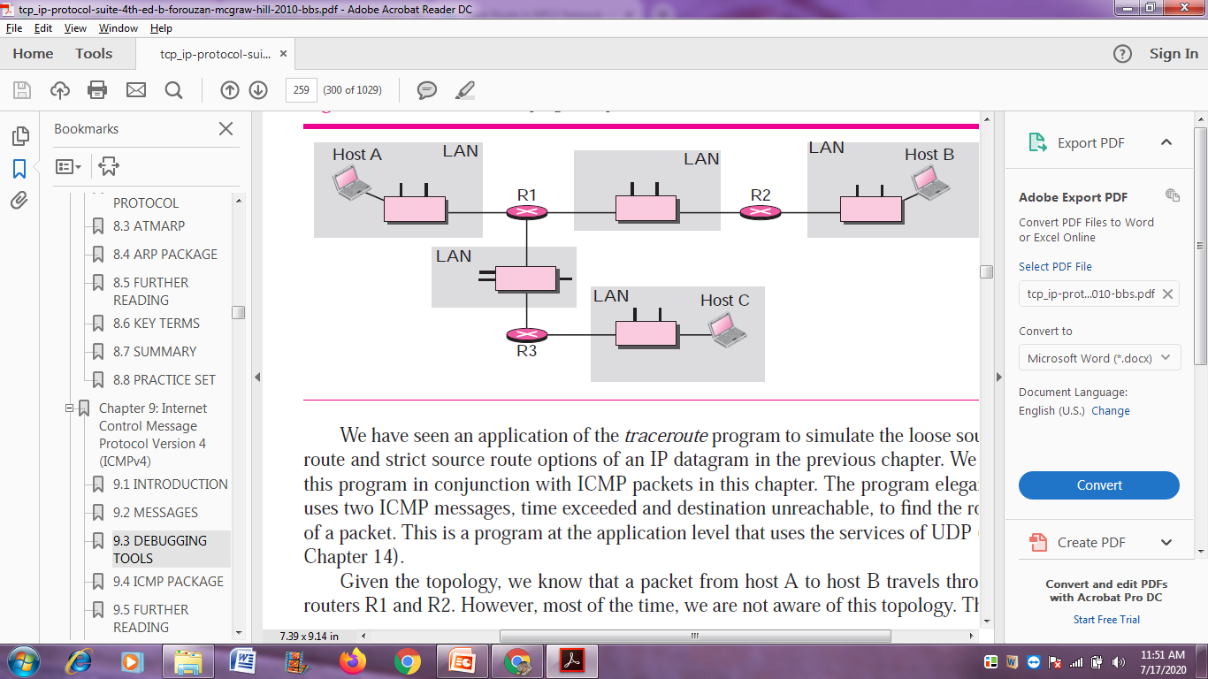
Traceroute

Slide 31
The traceroute program uses the following steps to find the address of the router
R1 and the round trip time between host A and router R1. The traceroute program
repeats steps a to c three times to get a better average round-trip time. The first trip
time may be much longer than the second or third because it takes time for the
ARP program to find the physical address of router R1. For the second and third
trip, ARP has the address in its cache
The traceroute application at host A sends a packet to destination B using UDP;the message is encapsulated in an IP packet with a TTL value of 1. The program notes the time the packet is sent.
Router R1 receives the packet and decrements the value of TTL to 0. It then discards the packet (because TTL is 0). The router, however, sends a timeexceeded ICMP message (type: 11, code: 0) to show that the TTL value is 0 and the packet was discarded.
The traceroute program receives the ICMP messages and uses the source address of the IP packet encapsulating ICMP to find the IP address of router R1. The program also makes note of the time the packet has arrived. The difference between this time and the time at step a is the round-trip time.
The traceroute program repeats the previous steps to find the address of router R2
and the round-trip time between host A and router R2. However, in this step, the
value of TTL is set to 2. So router R1 forwards the message, while router R2 discards
it and sends a time-exceeded ICMP message.

Slide 32
The traceroute program repeats the previous step to find the address of host B and
the round-trip time between host A and host B. When host B receives the packet,
it decrements the value of TTL, but it does not discard the message since it has
reached its final destination. How can an ICMP message be sent back to host A?
The traceroute program uses a different strategy here. The destination port of the
UDP packet is set to one that is not supported by the UDP protocol. When host B
receives the packet, it cannot find an application program to accept the delivery. It
discards the packet and sends an ICMP destination-unreachable message (type: 3,
code: 3) to host A. Note that this situation does not happen at router R1 or R2
because a router does not check the UDP header. The traceroute program records the
destination address of the arrived IP datagram and makes note of the round-trip time.
Receiving the destination-unreachable message with a code value 3 is an indication
that the whole route has been found and there is no need to send more packets.

Slide 33
ICMP PACKAGE
ICMP package made of two modules: an input module and an output module.
The input module handles all received ICMP messages
If the received packet is a request, the modulecreates a reply and sends it out
If the received packet is a redirection message, the module uses the information to update the routing table.
If the received packet is an error message, the module informs the protocol about the situation that caused the error.
{REQUEST,REDIRECT , ERROR MESSAGE }

Slide 34
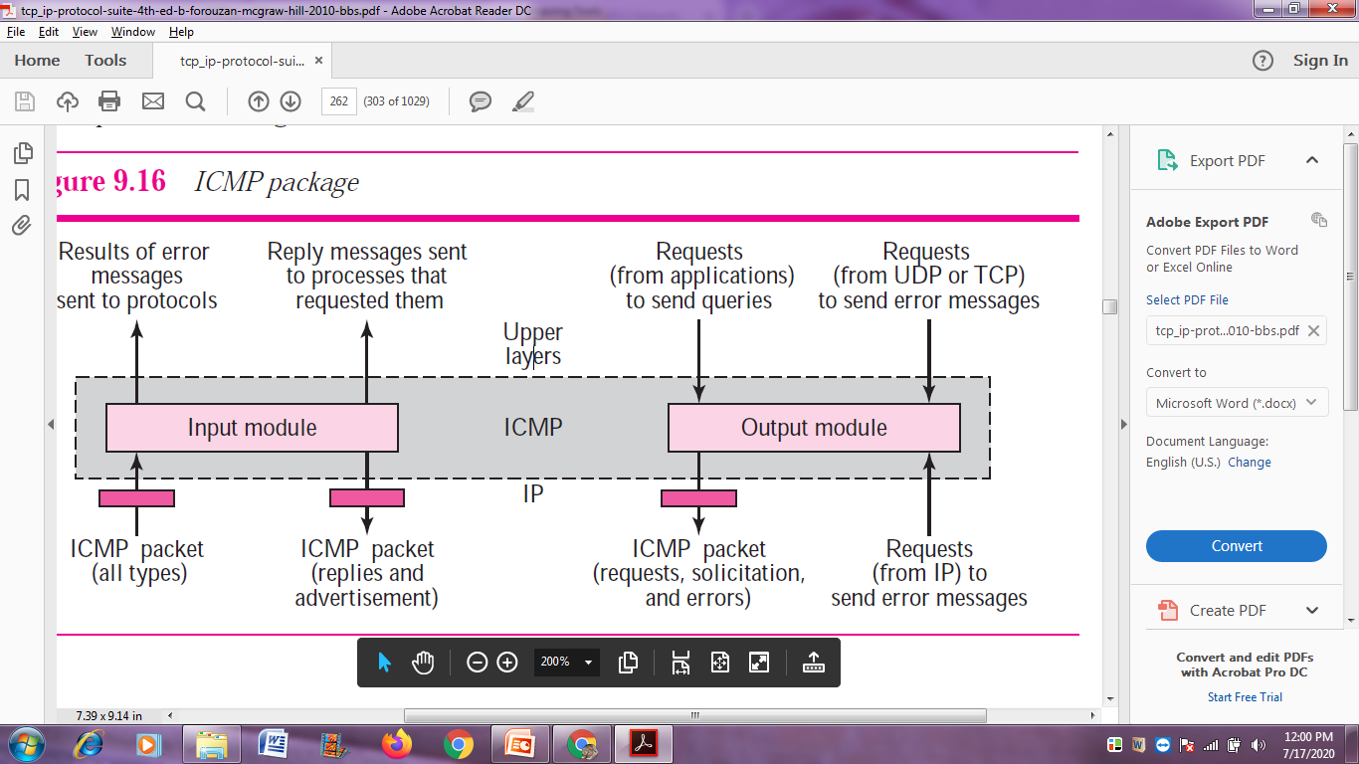

Slide 35
Output Module
The output module is responsible for creating request, solicitation, or error messages requested by a higher level or the IP protocol
The module receives a demand from IP, UDP, or TCP to send one of the ICMP error messages.
If the demand is from IP, the output module must first check that the request is allowed.
ICMPmessage cannot be created for four situations
an IP packet carrying an ICMP error message
a fragmented IP packet,
a multicast IP packet
an IP packet having IP address 0.0.0.0 or 127.X.Y. Z

Slide 36
references
Text book
Behrouz A. Forouzan, “TCP IP Protocol Suite ” 4th edition, 2010, McGraw-HillISBN: 0073376043

