Slide 1
18CSE390T-COMPUTER VISION
Unit – V : Session – 1 : SLO – 1

Slide 2
MOTION MODELS

Slide 3
What is a motion model?
A motion model is defined as an algorithm f, which, from a collection of agent states , derives new states for these agents, representing their motion over a timestep toward the agents' immediate goals G, (17.8) Motion algorithms tend to use several parameters that can be tuned in order to change the agents' behaviors

Slide 4
MOTION MODELS
Algorithms for aligning images and stitching them into seamless photo-mosaics are among the oldest and most widely used in computer vision.
Image stitching algorithms create the high-resolution photo-mosaics used to produce today’s digital maps and satellite photos. They are also now a standard mode in smartphone cameras and can be used to create beautiful ultra wide-angle panoramas. Image stitching originated in the photogrammetry community, where more manually intensive methods based on surveyed ground control points or manually registered tie points have long been used to register aerial photos into large-scale photo-mosaics

Slide 5
MOTION MODELS
There are two main approaches to finding feature points and their correspondences.
The first is to find features in one image that can be accurately tracked using a local search technique, such as correlation or least squares
The second is to independently detect features in all the images under consideration and then match features based on their local appearance .
The former approach is more suitable when images are taken from nearby viewpoints or in rapid succession (e.g., video sequences), while the latter is more suitable when a large amount of motion or appearance change is expected, e.g., in stitching together panoramas

Slide 6
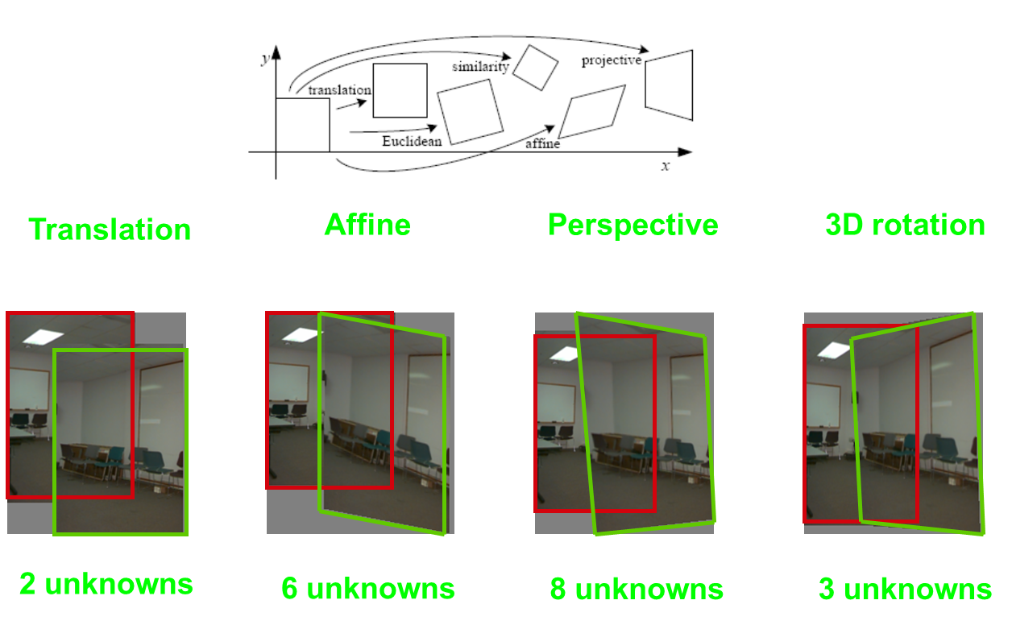

Slide 7
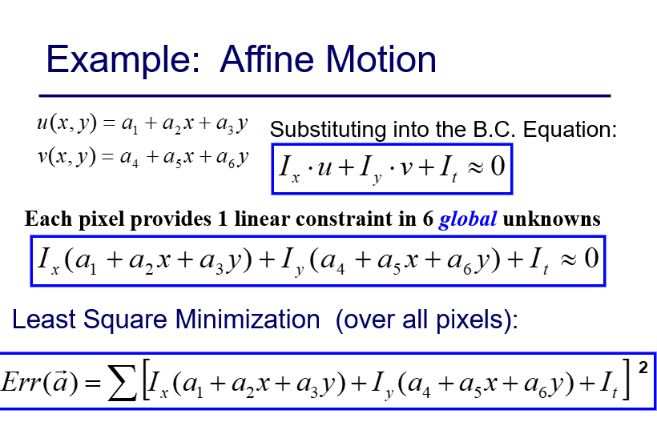

Slide 8
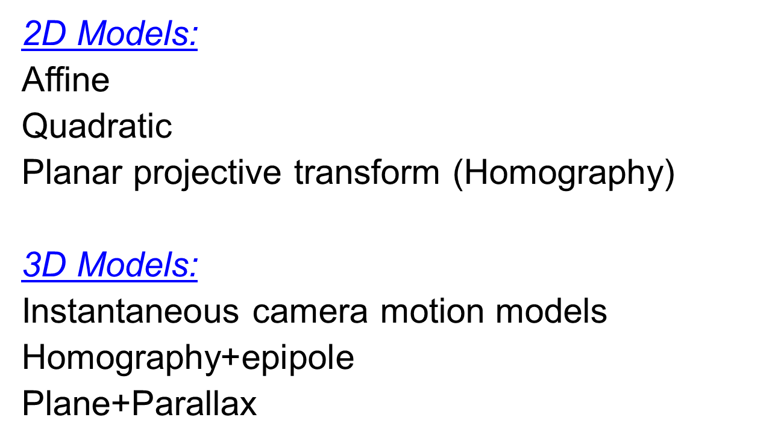

Slide 9
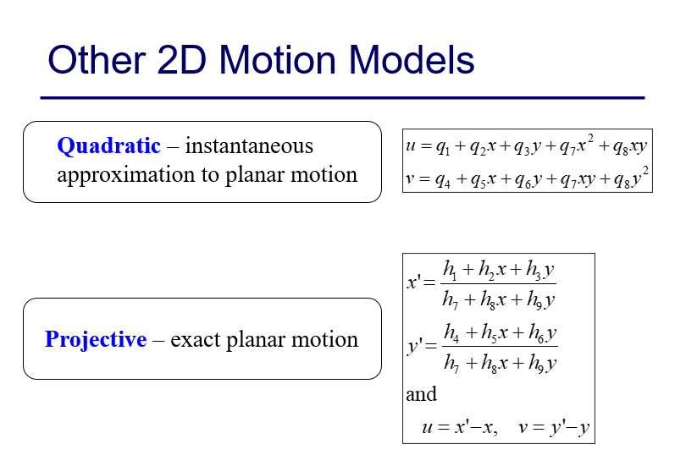

Slide 10
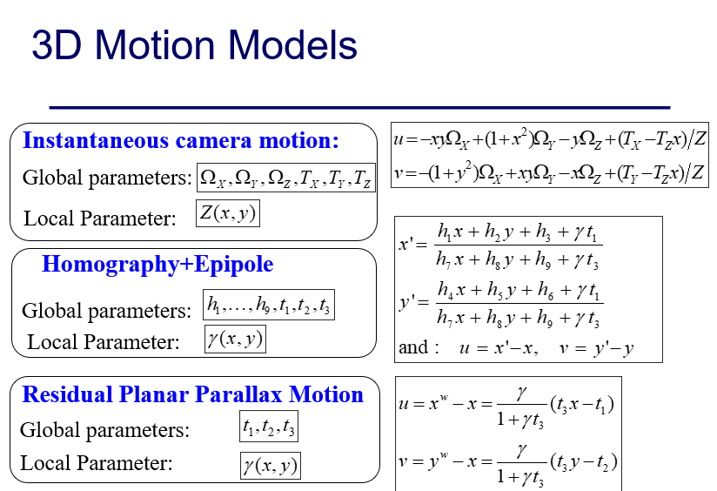

Slide 11
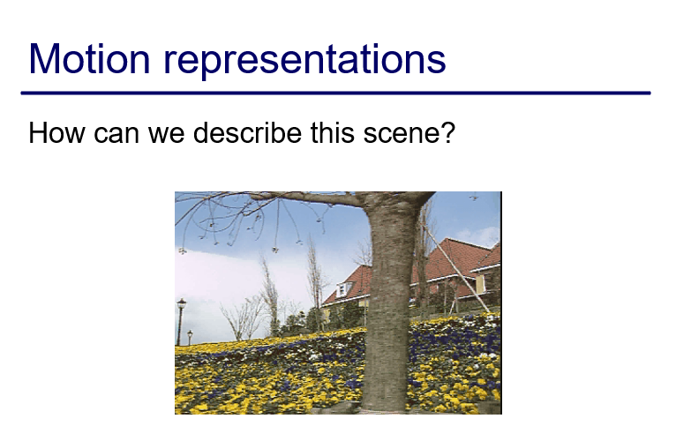

Slide 12
