Slide 1

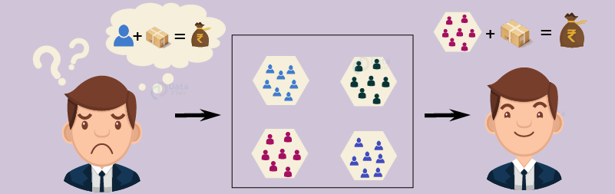
Customer Segmentation using K-means Clustering method
SRM Institute of Science and Technology,
Ramapuram Campus, Chennai-89
DEPARTMENT OF COMPUTER SCIENCE AND ENGINEERING
Batch No: 12
DETAILS OF THE PROJECT MEMBERS
Bharathwaj.M(RA2011026020065)
Harshit(RA2011026020086)
Madhesh(RA2011026020098)
SUPERVISOR DETAILS
Mr.Ragu G,AP/CSE
Ms.P.Preethy Jemima,AP/CSE

Slide 2
OBJECTIVE
The Objective is to decide how to relate to customers in each segment in order to maximize the value of each customer to the business.
Customer segmentation is the practice of dividing a company’s customers into groups that reflect similarity among customers in each group.
Marketers and brands leverage this process to determine what campaigns, offers, or products to leverage when communicating with specific segments.
The customer segmentation has the importance as it includes, the ability to modify the programs of market so that it is suitable to each of the customer segment, support in business decision; identification of products associated with each customer segment.
and to mange the demand and supply of that product; identifying and targeting the potential customer base, and predicting customer defection, providing directions in finding the solutions.

Slide 3
SCOPE
In general, the methods used to gather the data for this project can easily be extended into other relevant contexts/analyses. While there is clear value in using the same data to investigate purchasing patterns or to build an item-based collaborative filtering recommender system, neither of these is the focus for this paper. The scope of the paper is limited to the following four intertwined Goals:
To cluster customers based on common purchasing behaviors for future operations/marketing projects
To incorporate best mathematical, visual, programming, and business practices into a thoughtful analysis that is understood across a variety of contexts and disciplines
To investigate how similar data and algorithms could be used in future data mining projects.
To create an understanding and inspiration of how data science can be used to solve real-world problems.
Before delving into the details of the project and its implications, the next chapter discusses what customer segmentation analysis actually is and the reasons for its importance.

Slide 4
ABSTRACT
With the development of big data technologies in recent years, companies that can efficiently use customer data are gaining an edge in the market competition. For e-commerce platforms, by customer segmentation, the cost of marketing can be effectively reduced, customer satisfaction can be improved, and customer lifecycle value (CLV) can be increased.
However, in the past RFM models and K-means algorithms, high-dimensional data could not be taken into consideration and the accuracy rate is low.
Here we propose a new method that employs entity embedding to handle the category variables and uses the GBDT algorithm for feature extraction and then uses MLP for prediction to classify customers into eight categories. This new method can significantly improve the accuracy rate.
Furthermore, this class label is based on the RFM model, which can efficiently identify customers’ value by supervised learning and provide strong support for the customer segmentation strategy of e-commerce platforms. We validate the effectiveness of the proposed approach on a real-world dataset of customer consumption information.

Slide 5
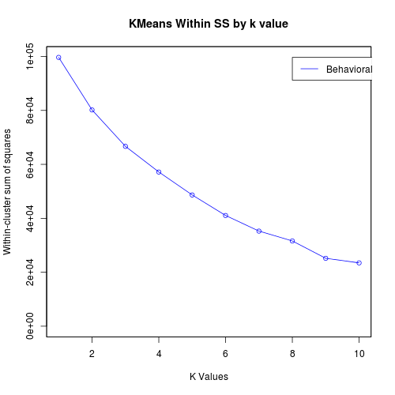
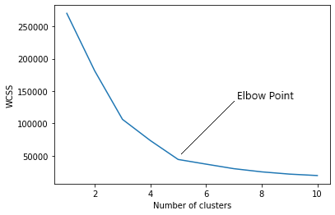
EXISTING SYSTEM
In the current system, the K Means Initialization method and Elbow method are used to find the optimal no of clusters (k).
The elbow method doesn't always work well, especially if the data is not very clustered.
Because of that it will produce a smooth curve which makes difficult to find the optimal no of clusters (k).
Also RFM technique (which is specifically used in customer segmentation) is not implemented in the current system.

Slide 6
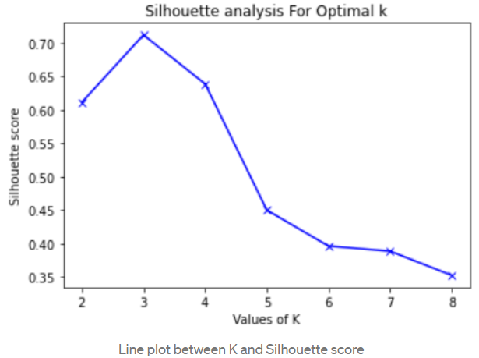
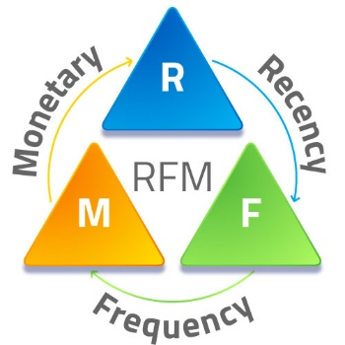
PROPOSED SYSTEM
In our system we are using K Means silhouette method to find the optimal clusters (k) and RFM technique to improve the accuracy of the clustering the based on the customer history, and then it’s visualized.
RFM technique is a cost-efficient marketing strategy based on customer behavior segmentation.
RFM stands for Recency, Frequency, Monetary. Simply, It groups customers based on their purchase history.
Recency - How recent was the customer's last purchase?
Frequency - How often did this customer make a purchase in a given period?
Monetary - How much money did the customer spend in a given period?
With this system the accuracy can be increased by about 20.4% than the existing system.

Slide 7
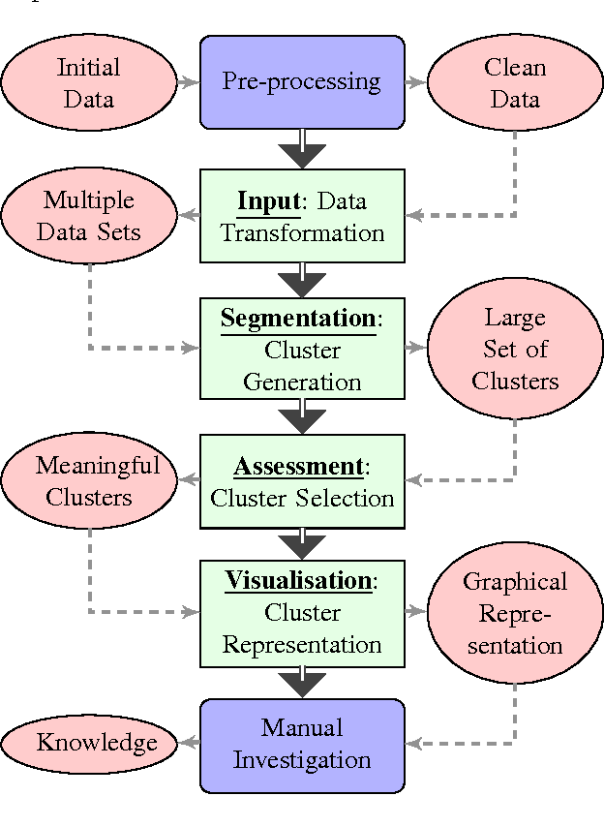
SYSTEM ARCHITECTURE

Slide 8
LITERATURE SURVEY PAPER -1
TITLE | AUTHOR | YEAR OF PUBLISH | PROPOSAL APPROACH | ADVANTAGES | DISADVANTAGES
User Value Identification Based on Improved RFM Model and K-Means++ Algorithm for Complex Data Analysis | W. Jun, S. Li, Y. Liping, N. Xiaxia, L. Yuanyuan, C. Xiaodong | 2021 | K Means Initialization method with RFM analysis | RFM analysis used for better customer history analysis | Sihoultee method with RFM model can perform better

Slide 9
LITERATURE SURVEY PAPER -2
TITLE | AUTHOR | YEAR OF PUBLISH | PROPOSAL APPROACH | ADVANTAGES | DISADVANTAGES
Customer Segmentation using K-Means Clustering | Yash Kushwaha and Deepak Prajapati | 2021 | K Means Clustering Elbow method | Finding the optimal no of clusters (k) | This method doesn't always work well, especially if the data is not very clustered.

Slide 10
LITERATURE SURVEY PAPER -3
TITLE | AUTHOR | YEAR OF PUBLISH | PROPOSAL APPROACH | ADVANTAGES | DISADVANTAGES
Customer Segmentation using K-Means Clustering | Jaswanth Reddy Vulchi | 2021 | Data pre-processing and K Means Clustering Elbow method | Same as Literature paper 2 | Same as Literature paper 2

Slide 11
LITERATURE SURVEY PAPER -4
TITLE | AUTHOR | YEAR OF PUBLISH | PROPOSAL APPROACH | ADVANTAGES | DISADVANTAGES
Customer Purchase Prediction Based on Improved Gradient Boosting Decision Tree Algorithm | H. Wu and B. Li | 2022 | Using Gradient Boosting Decision Tree Algorithm (GBDT) | - | The Clustering Accuracy is less compared to RFM model

Slide 12
LITERATURE SURVEY PAPER -5
TITLE | AUTHOR | YEAR OF PUBLISH | PROPOSAL APPROACH | ADVANTAGES | DISADVANTAGES
K-Means Clustering Approach for Intelligent Customer Segmentation Using Customer Purchase Behavior Data | Kayalvily Tabianan, Shubashini Velu and Vinayakumar Ravi | 2022 | Data Mining and K Means Clustering Elbow method used | Same as Literature paper 2 | Same as Literature paper 2

Slide 13
LITERATURE SURVEY PAPER -6
TITLE | AUTHOR | YEAR OF PUBLISH | PROPOSAL APPROACH | ADVANTAGES | DISADVANTAGES
Customer Segmentation using K-Means Algorithm | Hemashree Kilari, Sailesh Edara, Guna Ratna Sai Yarra, Dileep Varma Gadhiraju | 2022 | K Means Clustering Silhouette method | Better than the K Means Elbow method | No techniques used for improving the clustering.

Slide 14
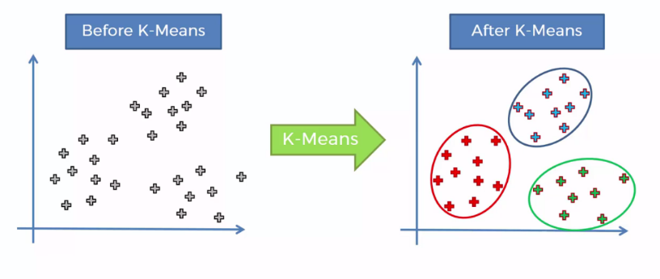
ALGOROTHM
K-Means clustering is an unsupervised learning algorithm. In K-Means, it performs the division of objects into clusters that share similarities and are dissimilar to the objects belonging to another cluster.
The ways by which we can select an optimal number of clusters (K). There are several methods to find the best value of K.
One of them being silhouette method which helps us to find the optimal clusters and interpretation and validation of consistency within clusters of data.

Slide 15

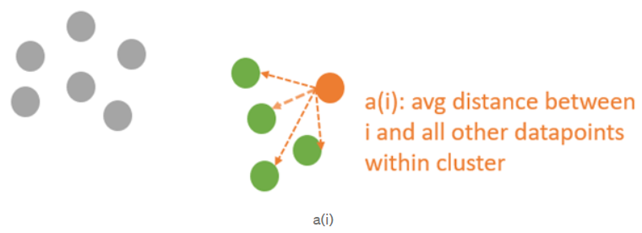
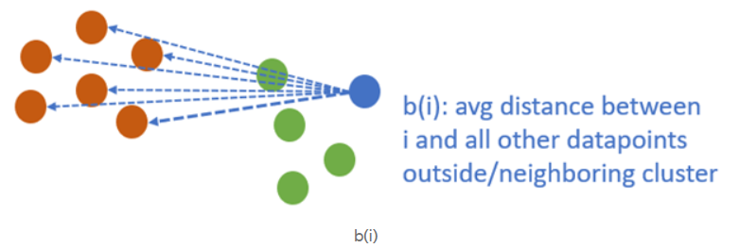
ALGOROTHM (CONT.)
The silhouette method computes silhouette coefficients of each point that measure how much a point is similar to its own cluster compared to other clusters.
S(i) is the silhouette coefficient of the data point i.
a(i) is the average distance between i and all the other data points in the cluster to which l belongs.
b(i) is the average distance from i to all clusters to which i does not belong

Slide 16
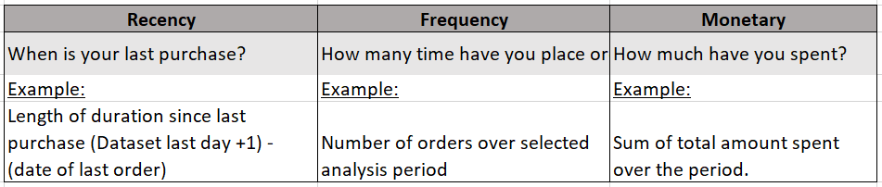
METHODOLOGY
When we are provided with raw data extracted from database, it might be messy and non-informative to look at individual records.
RFM analysis is applied to present data at aggregate level and is used to segment customers into homogenous groups.
These three values are important as F and M indicate value of customers, and R indicate customers’ engagement and satisfaction.
The values are easy to obtain from the basic set of information for each purchasing history.
RFM technique is a cost-efficient marketing strategy based on customer behaviour segmentation.
With this system the accuracy can be increased by about 20.4% than the existing system.

Slide 17
REFERENCES
W. Jo-Ting, L. Shih-Yen and W Hsin-Hung, "A review of the application of RFM model", 2010.
K. Su-Yeon, J. Tae-Soo, Suh. Eui-Ho and Hyun-Seok Hwang, "Customer segmentation and strategy development based on customer lifetime value: A case study", 2006.
H. Fadly, B. Harry, de R. Mark and K. Maarten, "Mobile customer segmentation based on smartphone measurement", 2014.
R. Haidi, S. Xianzhang, Kouassi R. Ahoussou, F. Juanjuan, X. Yingchun, E. Mohamed, et al., "Feature selection based on artificial bee colony and gradient boosting decision tree", 2019.
P. Anitha and M. P Malini, "RFM model for customer purchase behavior using K-Means algorithm", 2019.
C. Ching-Hsue and C. You-Shyang, "Classifying the segmentation of customer value via RFM model and RS theory", 2009.
F. Safari, N. Safari and G.A. Montazer, "Customer lifetime value determination based on RFM model", 2016.

Slide 18
REFERENCES
Mahboubeh Khajvand et al., "Estimating customer lifetime value based on RFM analysis of customer purchase behavior: case study", 2010.
W. Jun, S. Li, Y. Liping, N. Xiaxia, L. Yuanyuan, C. Xiaodong, et al., "User Value Identification Based on Improved RFM Model and -Means++ Algorithm for Complex Data Analysis", 2021.
J H. Friedman, "Greedy function approximation: a gradient boosting machine", 2001.
C Guo and F. Berkhahn, "Entity embeddings of categorical variables", 2016.
T Chen and C. Guestrin, "Xgboost: A scalable tree boosting system", 2016.
T M Oshiro, P S Perez and J A. Baranauskas, "How many trees in a random forest?", 2012.
H. Wu and B. Li, "Customer Purchase Prediction Based on Improved Gradient Boosting Decision Tree Algorithm", 2022.

