Slide 1
18PDM301L
Analytical and Logical Thinking Skills

Slide 2
Data Interpretation

Slide 3
Directions for Questions 1 to 6: The bar graph shown below indicates admission of students in four departments CSE, ECE, EEE, MECH in an Engineering college for three years, 2008 to 2010. Study the bar graph carefully and answer the questions given below:

Slide 4
2008
2009
2010
CSE
200
175
125
ECE
150
175
200
EEE
100
125
175
MECH
50
75
100

Slide 5
1. What is the percentage increase in the total intake of the college from the year 2008 to 2010?
a) 15% b) 20% c) 12.5% d) 16.67%
2008
2009
2010
100 Increased from 500
100 * 100
500
= 20 %
Answer : b
CSE
200
175
125
ECE
150
175
200
EEE
100
125
175
MECH
50
75
100
500
600

Slide 6
2. What was the percentage of CSE students out of the total students admitted for the year 2008?
a) 40% b) 30% c) 50% d) 25%
2008
2009
2010
200 out of 500
200 * 100
500
= 40 %
Answer : a
CSE
200
175
125
ECE
150
175
200
EEE
100
125
175
MECH
50
75
100
500
600

Slide 7
3. Which department showed highest percentage increase from year 2008 to 2010?
a) CSE b) ECE c) EEE d) MECH
ECE 150 to 200
(50 / 150) * 100
= 33.33%
EEE 100 to 175
= (75 / 100) * 100
= 75 %
MECH 50 to 100
= (50 / 50) * 100
= 100 %
Answer : d
2008
2009
2010
CSE
200
175
125
ECE
150
175
200
EEE
100
125
175
MECH
50
75
100
500
600

Slide 8
4. Which department showed a steady decline in the intake of students?
a) CSE b) ECE c) EEE d) MECH
Answer : a
5. In which year is the strength of CSE the lowest compared to the total strength?
a) 2008 b) 2009 c) 2010 d) Cannot be determined
Answer : c
6. Which department showed the highest increase in number of students in 2010 compared to 2008?
a) CSE b) ECE c) EEE d) MECH
Answer : c

Slide 9
Directions for Questions 7 to 10: The marks of four students, A, B, C and D, in four model tests 1, 2, 3 and 4 are tabulated below. Study the table carefully and answer the questions
Tests/ Students | 1 | 2 | 3 | 4
A | 142 | 243 | 47 | 260
B | 116 | 102 | 53 | 184
C | 150 | 147 | 78 | 256
D | 168 | 231 | 65 | 280
Maximum Marks | 200 | 300 | 100 | 400

Slide 10
7. Who has scored the maximum total marks?
a) A b) B c) C d) D
Tests/ Students | 1 | 2 | 3 | 4
A | 142 | 243 | 47 | 260
B | 116 | 102 | 53 | 184
C | 150 | 147 | 78 | 256
D | 168 | 231 | 65 | 280
Maximum Marks | 200 | 300 | 100 | 400
692
455
631
744
Answer : d

Slide 11
8. What is the difference between the maximum and minimum total marks scored?
a) 227 b) 289 c) 176 d) 113
Tests/ Students | 1 | 2 | 3 | 4
A | 142 | 243 | 47 | 260
B | 116 | 102 | 53 | 184
C | 150 | 147 | 78 | 256
D | 168 | 231 | 65 | 280
Maximum Marks | 200 | 300 | 100 | 400
692
455
744 – 455
= 289
Answer : b
631
744

Slide 12
9. A student who gets below 55% in a paper is to appear for a re-exam in that paper. How many of these students have to appear for the re-exam?
a) 3 b) 2 c) 1 d) None of these
Tests/ Students | 1 | 2 | 3 | 4
A | 142 | 243 | 47 | 260
B | 116 | 102 | 53 | 184
C | 150 | 147 | 78 | 256
D | 168 | 231 | 65 | 280
Maximum Marks | 200 | 300 | 100 | 400
A in test 3
B in test 2, 3 and 4
C in test 2
So 3 Students
Answer : a
55%
110
165
55
220

Slide 13
10. If above 70% is considered as distinction, how many instances are there where the candidate has got a distinction?
a) 7 b) 4 c) 6 d) 3
Tests/ Students | 1 | 2 | 3 | 4
A | 142 | 243 | 47 | 260
B | 116 | 102 | 53 | 184
C | 150 | 147 | 78 | 256
D | 168 | 231 | 65 | 280
Maximum Marks | 200 | 300 | 100 | 400
1
4
2
6
3
5
Answer : c
70%
140
210
70
280

Slide 14
Directions for Questions 11 to 15: Pie Chart 1 shows the percentage break up of the number of employees in a multinational organization whose strength in that particular year is 50,000. Pie Chart 2 shows the percentage break up of women employees in different departments in the same year. It is also known that the ratio of the numbers of female and male employees is 2:3. Study the pie chart carefully and answer the questions given below:

Slide 15
Total Employees = 50000
f : m = 2 : 3
5x = 50000
f = 20000; m = 30000
12% of 50000
(12/100)*50000
= 12 * 500
= 6000
Total
Female
Male
Development
6000
5600
400
Marketing
9000
2000
7000
28% of 20000
(28/100)*20000
= 28 * 200
= 5600
Support
9000
6000
3000
Accounts
8000
4800
3200
Production
18000
1600
16400
Total
50000
20000
30000

Slide 16
11. In how many departments do women outnumber men?
a) 2 b) 3 c) 1 d) None of these
Answer : b
12. What percentage of the number of men working in accounts is the number of men working in development?
a) 12.5% b) 20% c) 10% d) 25%
(x / 100) * 3200 = 400
(x / 100) = (4 / 32)
(x / 100) = (1 / 8)
x = 100 / 8
X = 12.5
Answer : a
Total
Female
Male
Development
6000
5600
400
Marketing
9000
2000
7000
Support
9000
6000
3000
Accounts
8000
4800
3200
Production
18000
1600
16400
Total
50000
20000
30000

Slide 17
13. What percentage of the number of women working in support services is the number of women working in marketing?
a) 33% b) 25% c) 50% d) 20%
(x / 100) * 6000 = 2000
(x / 100) = (1 / 3)
33.33%
Answer : a
14. Across all departments, what is the highest ratio of female and male employees?
a) 4:41 b) 14:1 c) 2:7 d) 3:2
Answer : b
Total
Female
Male
Development
6000
5600
400
14 : 1
Marketing
9000
2000
7000
Support
9000
6000
3000
2 : 1
Accounts
8000
4800
3200
3 : 2
Production
18000
1600
16400
Total
50000
20000
30000

Slide 18
15. If the company has plans to reduce manpower by 20% in the next three years with 40% of the reduction planned in production and the balance divided equally among the other four departments, how many women employees will be working in the accounts department after the reduction?
a) 4080 b) 4000 c) 6800 d) Cannot be determined
Answer : d
Total
Female
Male
Development
6000
5600
400
Marketing
9000
2000
7000
Support
9000
6000
3000
Accounts
8000
4800
3200
Production
18000
1600
16400
Total
50000
20000
30000

Slide 19
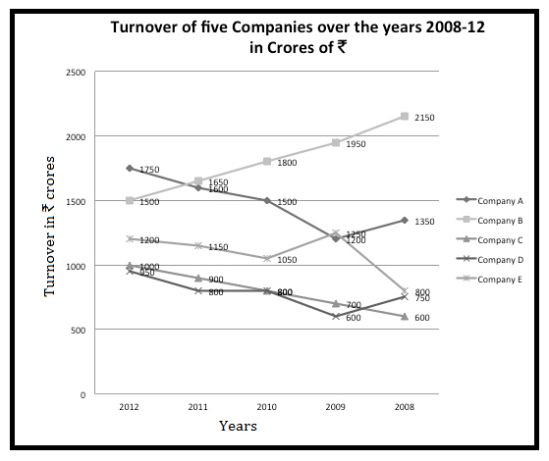
Directions for Questions 16 - 20: Answer the questions on the basis of the information given below.

Slide 20
16. Which company has shown the highest percentage increase in turnover during the given period?
a) Company A b) Company B c) Company C d) Company E
Company A – 1350 - 1750
= (400 / 1350) * 100
= 30% approx
Company C – 600 – 1000
= (400 / 600) * 100
= 66.67%
Company E – 800 – 1200
= (400 / 800) * 100
= 50 %
Answer : c

Slide 21
17. The total turnover of all five companies in 2012 is approximately what
percentage more that their total turnover in the year 2008?
a) 14% b) 15% c) 16% d) 13%
2008
600
750
800
1350
2150
5650
2012
950
1000
1200
1500
1750
6400
6400 – 5650
= 750
(750 / 5650) * 100
= (15 / 113) * 100
= 13 %
Answer : d

Slide 22
18. What is ratio of the combined turnover of company B and C in 2012 to the combined turnover of B, C and D in the year 2010?
a) 25 : 34 b) 5 : 6 c) 6 : 5 d) 34 : 25
2012
Company B 1500
Company C 1000
2500
2010
Company B 1800
Company C 800
Company D 800
3400
2500 : 3400
25 : 34
Answer : a

Slide 23
19. Company A expects its turnover to increase by 15% in the year 2013. What should be the percentage increase in the turnover of Company B if it desires to have the same turnover as Company A in the year 2013?
a) 40% b) 34% c) 36% d) Cannot be determined
Company A
2012 - 1750
2013
15 % increase
10 % = 175
5 % = 87.5
15% = 262.5
1750 + 262.5 = 2012.5
Company B
2013 - 2012.5
2012 - 1500
2012.5 - 1500
= 512.5
% increase
= (512.5 / 1500) * 100
= 512.5 / 15
= 34 %
Answer : b

Slide 24
20. In the year 2012, Company C manufactures only three products X,Yand Z. The revenue generated by the sales of products X, Y and Z are in ratio 2:3:5. Find the ratio of the profit generated by each product if the profit of Company C is 20% of their turnover in 2012?
a) 2:3:5 b) 1:2:3 c) 3:2:5 d) Cannot be determined
Answer : d

Slide 25
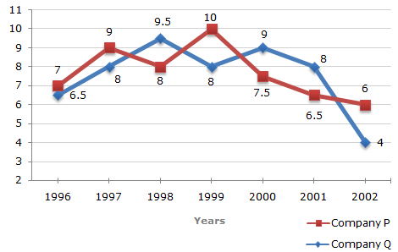
Directions for Questions 21 to 25: Two different finance companies declare fixed annual rate of interest on the amounts invested with them by investors. The rate of interest offered by these companies may differ from year to year depending on the variation in the economy of the country and the banks rate of interest. The annual rate of interest offered by the two Companies P and Q over the years are shown by the line graph provided below
Annual Rate of Interest Offered by Two Finance Companies Over the Years.

Slide 26
21. A sum of Rs. 4.75 lakhs was invested in Company Q in 1999 for one year. How much more interest would have been earned if the sum was invested in Company P?
a) 19,000 b) 14,250 c) 11,750 d) 9,500
22. If two different amounts in the ratio 8:9 are invested in Companies P and Q respectively in 2002, then the amounts received after one year as interests from Companies P and Q are respectively in the ratio?
a) 2:3 b) 3:4 c) 6:7 d) 4:3
23. In 2000, a part of Rs. 30 lakhs was invested in Company P and the rest was invested in Company Q for one year. The total interest received was Rs. 2.43 lakhs. What was the amount invested in Company P?
a) Rs. 9 Laksh b) Rs. 11 Laksh c) Rs. 12 Laksh d) Rs. 18 Laksh
24. An investor invested a sum of Rs. 12 lakhs in Company P in 1998. The total amount received after one year was re-invested in the same Company for one more year. The total appreciation received by the investor on his investment was?
a) 296200 b) 242200 c) 225600 d) 216000
25. An investor invested Rs. 5 lakhs in Company Q in 1996. After one year, the entire amount along with the interest was transferred as investment to Company P in 1997 for one year. What amount will be received from Company P, by the investor?
a) 594550 b) 580425 c) 577800 d) 577500

Slide 27
Doubts . . .
Thank you . . .

