Slide 1
18PDM301L
Analytical and Logical Thinking Skills

Slide 2
Geometry Mensuration Trigonometry

Slide 3
Let the sides of a triangle a, b and c
a + b > c
b + c > a
c + a > b
If one side of a Right angle triangle = 7 (not hypotenuse)
We can find the remaining 2 sides
7² = 49
49 / 2 = 24.5
24 and 25 are the 2 sides

Slide 4
1. If two sides of a triangle measure 7 units and9 units, then the measure of the third side is
a) Greater than 16 b) Any value between 2 and 16
c) The difference between 7 and 9 d) None of the above
9 – 7 = 2
9 + 7 = 16
Any value between 2 and 16
Answer : b

Slide 5
2. If three sides of a triangle measure 9 units,40 units & 41 units, find the area of the triangle.
a) 240 sq.units b) 180 sq.units c) 360 sq.units d) 270 sq.units
41² = 1681
40² = 1600
9² = 81
It is a right angle triangle
b = 9
h = 40
Area = (1/2) x 9 x 40
= 180 square units
40
41
9
Answer : b

Slide 6
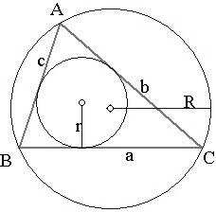
3. For the triangle in question above, how many times its in-radius(r) is its circum-radius(R)?
a) 5.332 b) 5.125 c) 5.374 d) 5.089
Area = r x s
r – in radius ; s – semi perimeter
s = (9 + 40 + 41) / 2
= 90 / 2
= 45
Area = 180
= 45 x r
r = 4
Circum circle diameter = hypotenuse
Circum radius = 41 / 2
= 20.5
= 20.5 / 4
= 5.125
Answer : b

Slide 7
4. Two triangles ABC and DEF are similar to each other. Sides BC and DF are the corresponding sides of the triangles and are in the ratio 3: 5. Find the area of the triangle ABC if the area of triangle DEF is 100square units.
a) 90 sq.units b) 36 sq.units c) 60 sq.units d) None of these
Area ratio is square of corresponding sides ratio
Corresponding side ratio = 3 : 5
Area ratio = 9 : 25
25x = 100
9x = 36
Answer : b

Slide 8
5. A rectangle becomes a square when its length and breadth are reduced by 10 units and 5 units respectively. By this process the area of the rectangle reduces by 650 square units. What is the area of the rectangle?
a) 2150 b) 2250 c) 2300 d) 2200
x
10
10x + 5x + 50 = 650
15x + 50 = 650
15x = 600
x = 40
x² = 1600
1600 + 650 = 2250
Answer : b
5
5x
5
50
5
x
10
x
x
10x
x
x
10

Slide 9
6. A blacksmith bent a steel wire in the form of a square encloses an area of 121 sq.cm. If the same wire he bent in the form of a circle, find the area of the circle.
a) 145 b) 150 c) 154 d) 175
Area of the square a² = 121
= 11²
Side of the square a = 11
Perimeter 4a = 44
= Circumference of the circle
2∏r = 44
2 * (22/7) r = 44
2r = 14
r = 7
Answer : c
∏ r² = (22/7)*7*7
= 22 * 7
= 154
2

Slide 10
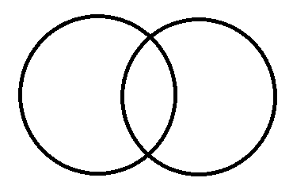
7. Two identical circles intersect so that their centres, and the points at which they intersect, form a square of side 1cm. The area in sq. cm of the portion that is common to the two circles is: a) π/2 b) π-1 c) 4 d) (π/2)-1
Required area
= O1AB + O2AB – O1AO2B
Angle O1 = 90⁰
O1A = radius = 1
Area O1AB = (1/4)th of a circle
= (∏ / 4)
Area O2AB = (∏ / 4)
Area of Square O1 A B O2 = 1
A
O1
O2
B
Required area
= (∏ / 4) + (∏ / 4) – 1
= (∏ / 2) – 1
Answer : d

Slide 11
8. ABCD is a rectangle. E & F are midpoints of BC & CD respectively .If the area of the triangle AEF is 15sq cm, area of the rectangle in sq cm is,
a) 36 b) 40 c)44 d)150
D
l/2
F
l/2
C
Area ABE = (1/2) * l * (b/2)
= (lb / 4)
Area ECF = (1/2)*(l/2)*(b/2)
= (lb / 8)
Area ADF = (1/2) * b * (l/2)
= (lb / 4)
b/2
b
15
E
b/2
A
l
B
Area of the ABCD lb = (lb/4) + (lb/8) + (lb/4) + 15
= (2lb + lb + 2lb) / 8 + 15
8 lb = (5 lb + 120)
3 lb = 120 lb = 40
Answer : b

Slide 12
9. A square and an equilateral triangle have the same perimeter. What is the ratio of the area of the circle circumscribing the square to the area of the circle circumscribing the triangle?
a) 6:1 b) 27:8 c) 27:32 d) 16:27
Let side of the square = 3
Diagonal = diameter of the
circumcircle
= 3 √2
Radius Rs = (3 √2) / 2
= 3 / √2
side of equilateral triangle = 4
area = (√3 / 4) * 16
= 4 √3
4 √3 = abc / 4Rt
4 √3 = 4*4*4 / 4Rt
Rt = 4 / √3
∏ Rs² : ∏ Rt²
(9 / 2) : (16 / 3)
(9 * 3) : ( 16 * 2)
27 : 32
Answer : c

Slide 13
10. There is a rectangular garden whose length and width are 60m x 20m. There is a walkway of uniform width around the garden. Area of walkway is 516 m², Find the width of the walkway.
a)1m b) 2m c) 3m d) 4m
Area of the garden = 1200
Area of walk way = 516
Total area = 1716
(60 + 2x) (20 + 2x) = 1716
Option a 62 x 22
Option b
64 x 24 = 1536
Option c
66 x 26 = 1716
x
x
60 x 20
x
516
x
Answer : c

Slide 14
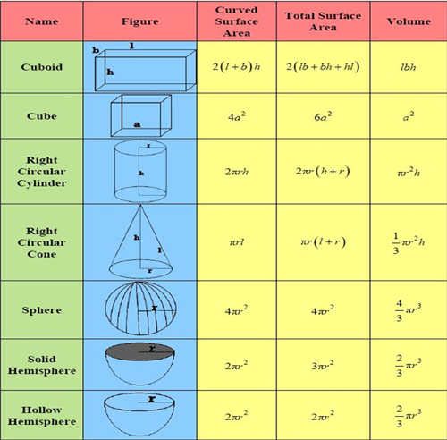
MENSURATION (3D)

Slide 15
1. A sphere of radius 6 cm is cast into three small spheres. If the radii of two of these spheres are 4 and 3 respectively, then find the radius of the third sphere?
a) 2.5 cm b) 3.2 cm c) 5 cm d) None of these
Volume of a Sphere = (4/3) ∏ r³
(4/3) ∏ 6³ = (4/3) ∏ 4³ + (4/3) ∏ 3³ + (4/3) ∏ r³
(4/3) ∏ 6³ = (4/3) ∏ (4³ + 3³ + r³ )
216 = 64 + 27 + r³
r³ = 125
r = 5
Answer : c

Slide 16
2. A conical tent has a base radius of 14 metres and a height of 48 metres. Find the quantity of canvas used to construct the tent.
a) 1100 m² b) 4800 m² c) 1400 m² d) 2200 m²
Curved Surface area of a cone = ∏ rl
l = √ ( r² + h²)
= √ ( 14² + 48²)
= √ ( 196 + 2304)
= √ 2500
= 50
Curved Surface area of a cone = (22 / 7) * 14 * 50
= 22 * 2 *50
= 2200
Answer : d

Slide 17
3. A cone and a cylinder have the same volume. If their heights are same then the ratio of the base radii of the cone to the cylinder is,
a) 1 : √3 b) √3 : 1 c) 1 : 1 d) None of these
Volume of Cone = (1/3) ∏ r²h
Volume of Cylinder = ∏ r²h
(1/3) ∏ r1²h = ∏ r2²h
(1/3) r1² = r2²
r1² / r2² = (3/1)
r1 / r2 = √3 : 1
Answer : b

Slide 18
4. If the volume and surface area of a sphere are numerically same, then its diameter is
a) 3 units b) 6 units c) 9 units d) 10 units
(4/3) ∏ r³ = 4 ∏ r²
(1 / 3) r = 1
r = 3
2r = 6
Answer : b

Slide 19
5. A cylindrical jar of height 60 cm and base radius 15 cm is full of mercury. One third of the contents of this vessel are to be exactly held in a spherical vessel. Find the radius of this vessel?
a) 17 cm b) 20 cm c) 19 cm d) 15 cm
(1/3) Volume of Cylinder = Volume of Sphere
(1/3) ∏ r²h = (4/3) ∏ r³
15² x 60 = 4 r³
15³ = r³
r = 15
Answer : d

Slide 20
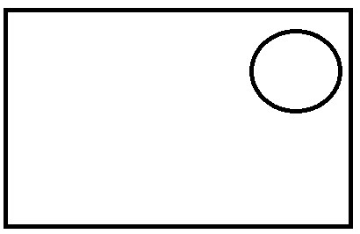
6. A man purchased a rectangular plot land measuring 49 m x 46 m to construct a house. As a first step he dug a well which had a radius of 7 metres and a depth of 40 metres. The earth dug out during the operation was evenly spread on the field. Find the increase in the height of the field.
a) 2.8 metres b) 3.2 metres c) 2.933 metres d) None of these
Area of the plot
49 x 46 = 2254
Volume of the well
(22 / 7) x 7² x 40 = 6160
Area covered by the well
(22 / 7) x 7² = 154
Area of the field
= 2254 – 154
= 2100
2100 x h = 6160
7
40
46
49
h = 6160 / 2100
= 2.933
Answer : c

Slide 21
7. The maximum length of a rod that can be kept in a rectangular box dimensions 16cm x 14cm x 22 cm is
a) 5 √26 cm b) 2 √26 cm c) 3 √6 cm d) 6 √26 cm
Maximum length = AB
length AC = √(16² + 14²)
= √ 256 + 196
= √ 452
length AB = √ 22² + (√452)²
= √484 + 452
= √ 936
= √ 26 x 36
= 6 √26
Answer : d
B
22
C
14
A
16

Slide 22
8. If each side of a cube is increased by 30% then the percentage increase in its surface area is
a) 25% b) 50% c) 69% d) 56.25%
Let side of a cube a = 10 cm
Surface area = 6 a²
= 6 x 100
30% increased a = 13
Surface area 6 a² = 6 x 169
6 x 169
6 x 100
= 169
100
69% increased
Answer : c

Slide 23
9. The base of a glass prism is an equilateral triangle of side 4 cm. If its height is 10 cm, find the quantity of glass used to manufacture this prism, given that density of flint glass is 3700 kg/m3.
a) 162√3 grams b) 132√3 grams c) 144√3 grams d) 148√3 grams
Volume of a prism = base area x height
= (√3 / 4) 4² x 10 cm³
= 40 √3 cm³
= 40 √3 / 1000000 m³
= 4 √3 / 100000 m³
Glass density = 3700 kg / m³
Required glass = 3700 x 40 √3 kg
1000000
= 148√3 / 1000 kg
= 148√3 g
Answer : d

Slide 24
10. A solid wooden toy is in the shape of right circular cone mounted on the base of a hemisphere of radius 4.2 cm. If the total height of the toy is10.2 cm, find the volume of the wooden toy
a) 104cm3 b) 162 cm3 c) 427 cm3 d) 266 cm3
Volume of the toy
= (2/3) ∏ r³ + (1/3) ∏ r²h
= (1/3) ∏ r² ( 2r + h)
= (1/3) (22/7) 4.2² (8.4 + 6)
= 22 x 4.2 x 4.2 x 14.4
3 x 7
= 22 x 1.4 x 0.6 x 14.4
= 266.112
Answer : d
6
10.2
4.2

Slide 25
11. A square of side 2 cm is cut from each of the four corners of a rectangular sheet of dimension 16 cm X 8 cm. The sheet is then folded to form an open box. What is the volume of the box?
a) 144 cu.cm b) 180 cu.cm c) 168 cu.cm d)96 cu.cm
12
2
Volume of the box
= 12 x 4 x 2
= 96
Answer : d
2
4
8
2
2
16

Slide 26
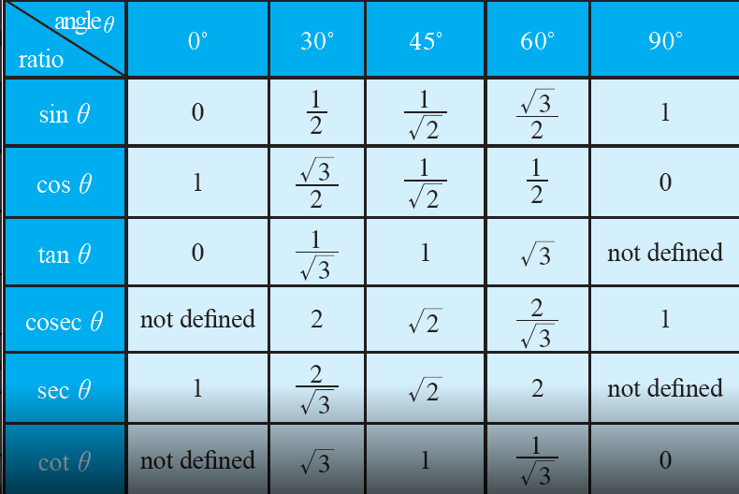
Trigonometry

Slide 27
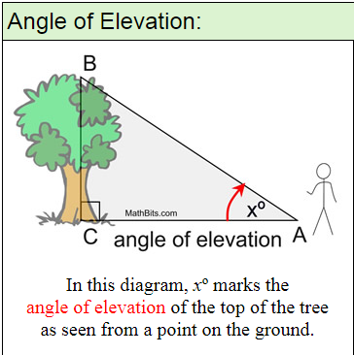
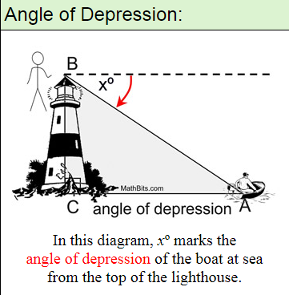
Angle of Elevation
Angle of Depression

Slide 28
1. A tower stands on a horizontal plane, a man on the ground 100m from the base of the tower finds the angle of elevation of the top of the tower to be 30 degrees. What is the height of the tower?
a)100m b) 100√3 c)100/√3 d) None of these
tan θ = opp / adj
tan 30 = h / 100
1 / √3 = h / 100
= 100 / √3
Answer : c
h
30⁰
100

Slide 29
2. A pole being broken by the wind , the top struck the ground at an angle of 30˚ and at a distance of 21m from the foot of the pole. Find the total height of the pole.
a)21m b) 21√3 c) 21/√3 d) None of these
tan θ = opp / adj
tan 30 = AB / 21
1 / √3 = AB / 21
AB = 21 / √3
cos θ = adj / hyp
cos 30 = 21 / BC
√3 / 2 = 21 / BC
BC = 42 / √3
B
Height = AB + BC
= (21/ √3) + (42/ √3)
= 63 / √3
= (21 x 3) / √3
= 21 √3
30⁰
A
C
21
Answer : b

Slide 30
3. In a rectangle if the angle between a diagonal and a side is 60˚ and the length of the diagonal is 6cm, the area of the rectangle is
a) 9 cm² b) 9√3 cm² c) 27 cm² d) 36 cm²
D
C
Sin 60 = AD / DB
√3 / 2 = AD / 6
AD = 6√3 / 2
AD = 3√3
cos 60 = AB / 6
1 / 2 = AB / 6
AB = 6 / 2
AB = 3
6
60⁰
A
B
Area of the rectangle = AB x AD
= 3 x 3 √3
= 9 √3
Answer : b

Slide 31
4. From the top of a light house, 50m above the sea, the angle of depression of an incoming boat is 30˚. How far is the boat from the light house?
a) 25√3 m b) 25/√3 m c) 50√3 m d) 50/√3 m
tan 60 = AB / 50
√3 = AB / 50
AB = 50√3
Answer : c
C
30⁰
50
60⁰
A
B

Slide 32
5. A tower stands at the end of straight road, the angle of elevation of the top of the tower from two points on the road 500m apart are 45˚ and 60˚ respectively . Find the height of the tower.
(500√3) / (√3 – 1) b) 500√3
c) (500√3) / (√3 + 1) d) None of these
cot 45 = AB / BC
1 = AB / BC
cot 60 = BD / BC
1 / √3 = BD / BC
cot 45 – cot 60 = AB / BC - BD / BC
1 – (1 / √3 ) = (AB – BD) / BC
(√3 – 1) / √3 = AD / BC
(√3 – 1) / √3 = 500 / BC
BC = (500 √3) / (√3 – 1)
Answer : a
C
45⁰
60⁰
A
500
D
B

Slide 33
Doubts . . .
Thank you . . .

