Slide 1

Myntra
E-commerce store product analysis
Vijaya Bharati Samatham

Slide 2
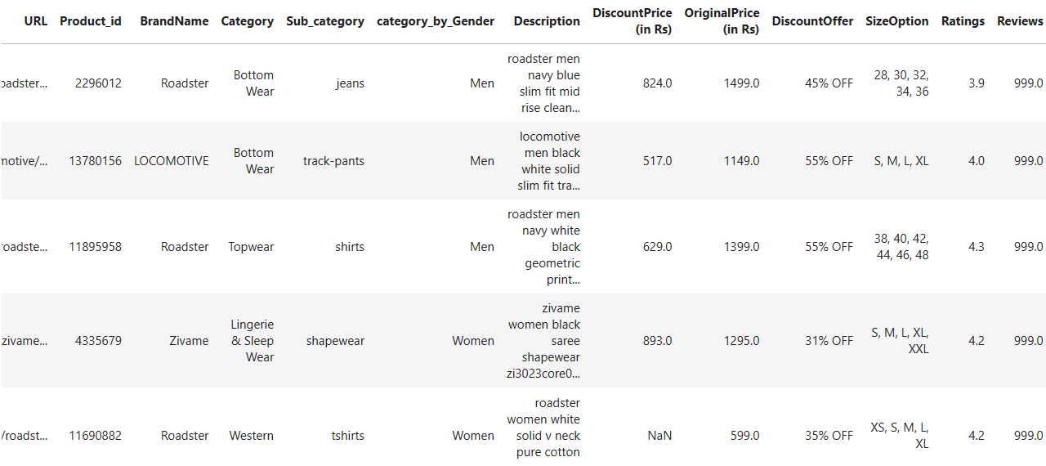
Data Collection
Before cleaning the data, dataset consisted of 526,564 rows and 14 columns

Slide 3
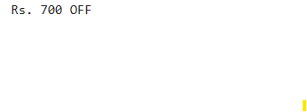
Data cleaning
Filled null values in DiscountOffer column with ‘0% OFF’
In discount DiscountOffer columns there are also values like ‘Rs 700 OFF’
Extracted 700 from ‘Rs 700 OFF’ and used ‘OriginalPrice’ to calculate discount percentage.
Added column ‘Discount’ to extract value 45 from string like ‘45% OFF’
Filled null values in ‘DiscountPrice’ by calculating DiscountPrice from OriginalPrice and discount columns
Filled ‘Rating’ and ‘Review’ columns with mean value.

Slide 4
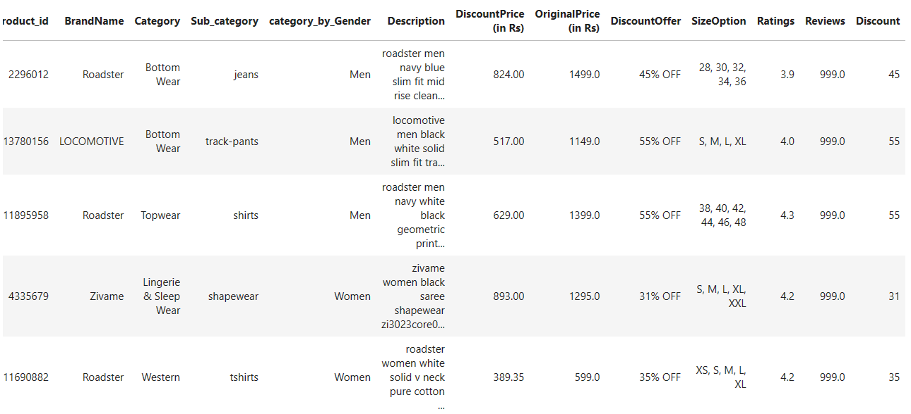
After Data cleaning
After cleaning dataset contains 526,564 rows and 15 columns

Slide 5
Have you ever wondered what drives consumer preferences in online shopping?

Slide 6
Wide range of products
Better prices
Convenance

Slide 7
Which gender do you think is dominating?

Slide 8
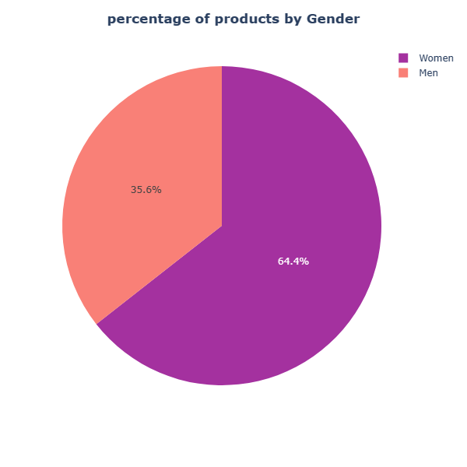
Women are dominant gender, they are having 64.4% of products while men are having 35.6% of products

Slide 9
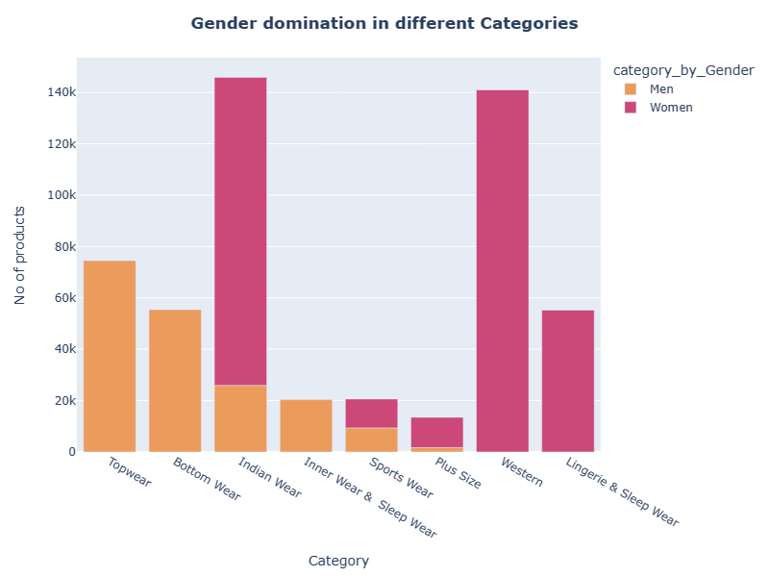
Tapware , Bottom ware and Inner ware & sleep ware are Men specific Categories.
Western and Lingerie & Sleep Ware are women specific categories.
If we combine both Tapware and Bottom ware and compare it with Western even then women are dominating

Slide 10
Products

Slide 11
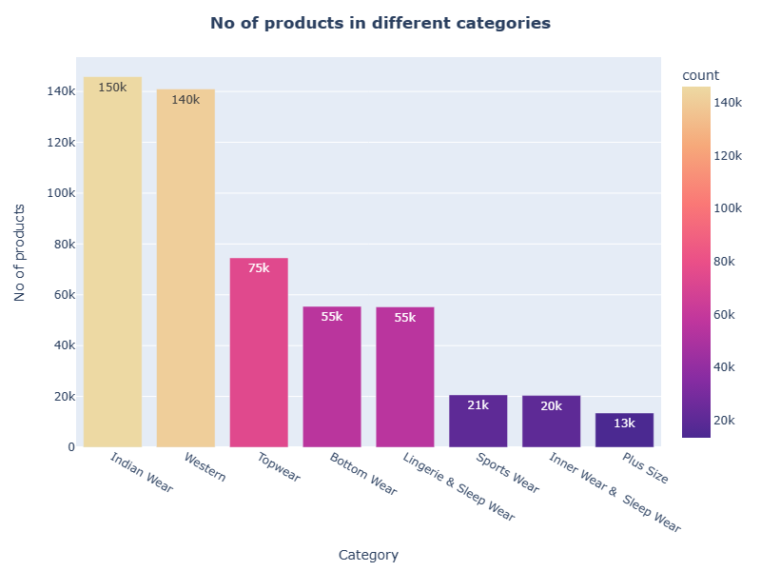
Indian ware is the most dominant category with more than 150k products
In total there are 526k products

Slide 12
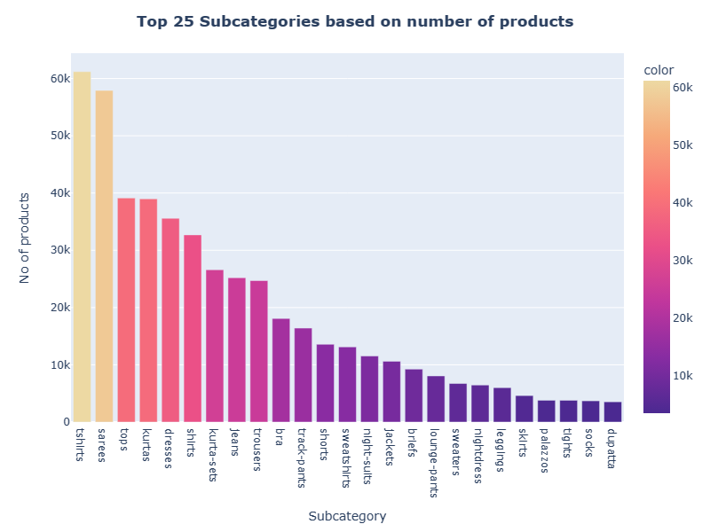
The bar chart shows top 25 Subcategories out of 92 subcategories.
T-shirts is on top with 61k products followed by Sarees with 58k products

Slide 13
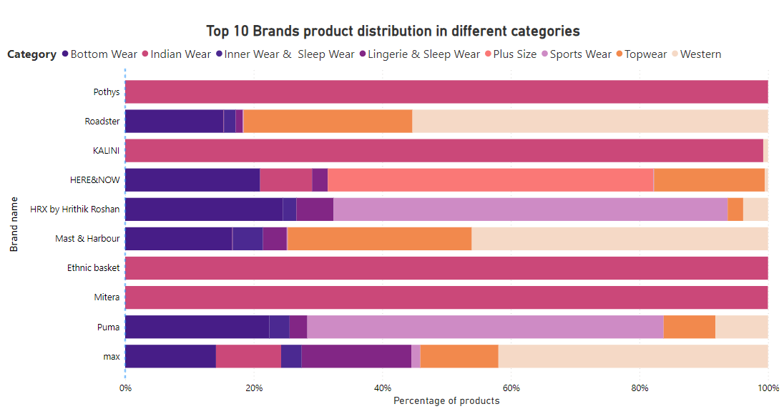
Out of top 10 Brands, 4 brands are having more than 95% of products in Indian ware category

Slide 14
Prices & Discounts

Slide 15
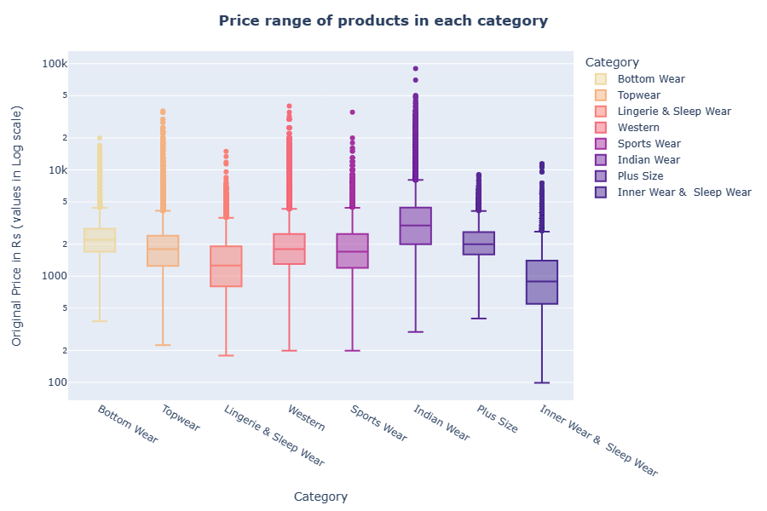
The box plot shows price range of products in each category .
Indian ware is the highest priced category and Inner ware and sleep ware is lowest priced.
Highest price is 90k and lowest is 99.

Slide 16
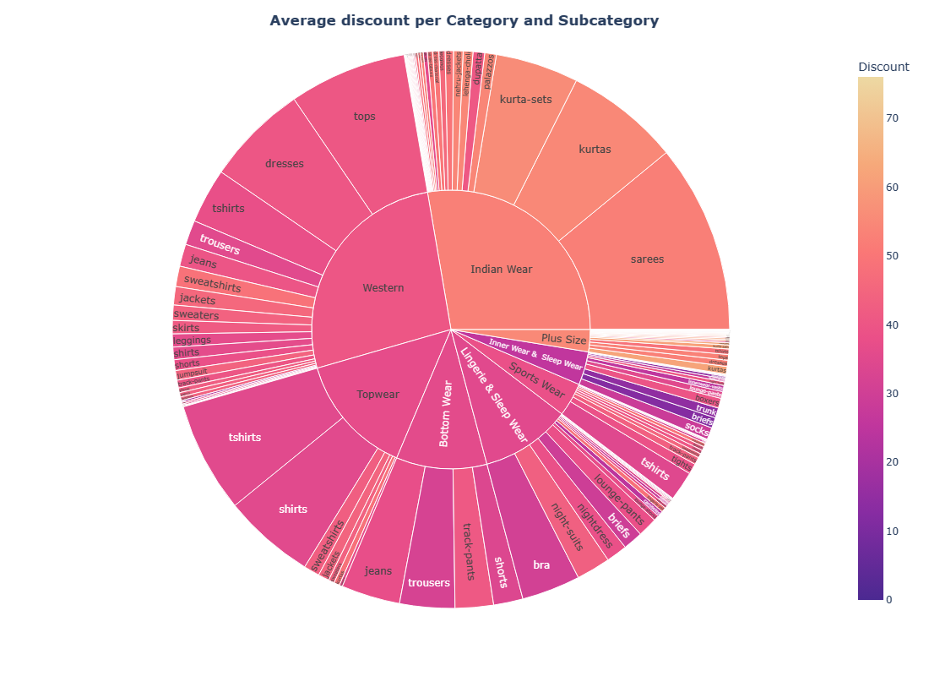
This chats shows the average discount percentage of all categories and subcategories

Slide 17
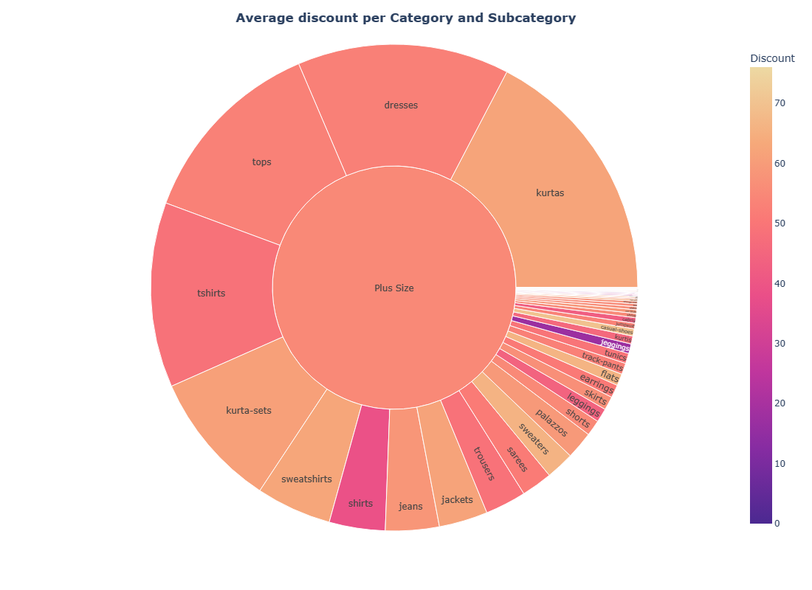
Plus size is the most discounted category with average of 58% discount across category
Flip flops is most discounted subcategory with 70% of discount.

Slide 18
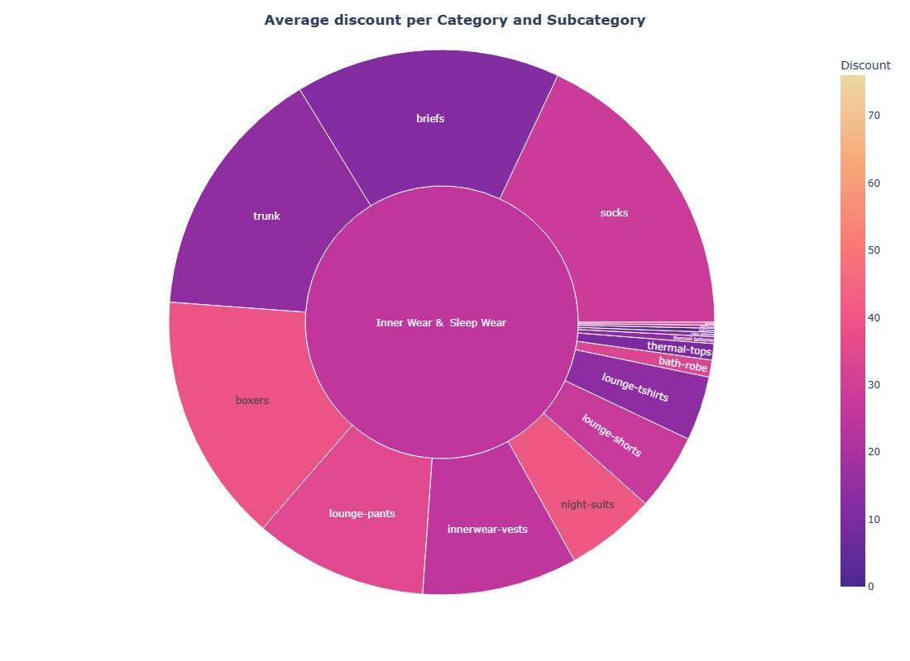
Inner ware & Sleep ware is the least discounted category with average of 25% discount across category.
Swim ware is least discounted subcategory with 0.8% discount

Slide 19
Ratings & Reviews

Slide 20
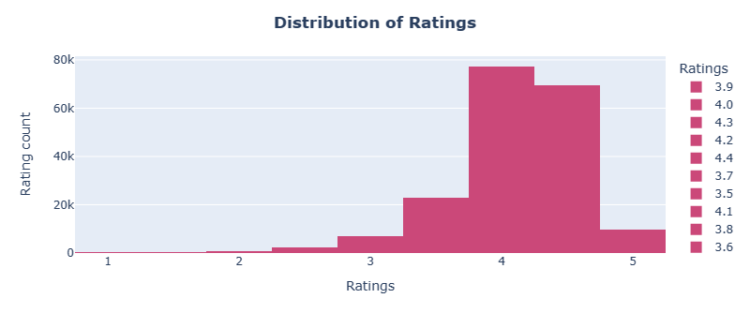
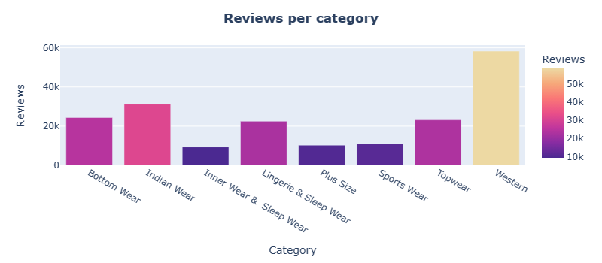
The hist plot shows rating distribution most rating are concentrated around 4 and 4.5
The bar chart showing reviews count across different categories

Slide 21
Conclusion
Women are the dominant gender.
Indian ware is the most dominated category with 27.7% of products.
Plus size is the least dominated category with 2.56% of products.
Indian ware is the most priciest category.
Inner ware and sleep ware is least priciest category.
Plus size is the most discounted category.
Inner ware and sleep ware is the least discounted category.
Customers are happy with their purchases.

Slide 22
Thank you
☺

