Slide 1
WINDOWS

Slide 2
Kernal Architecture

Slide 3
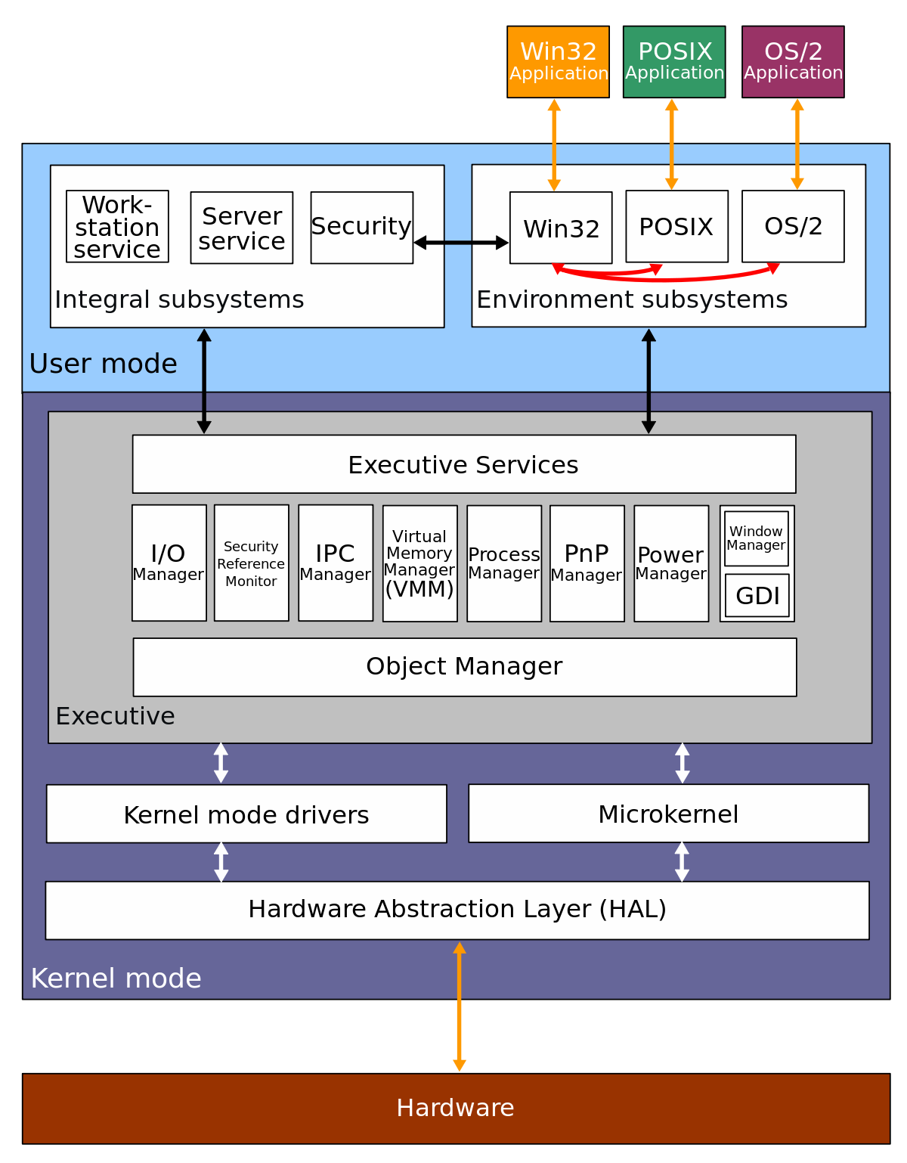

Slide 4
BOOTING PROCESS

Slide 5
BIOS
SMPS
PROCESSOR
BIOS
MBR
Boot Sector

Slide 6
OS LOADER
Boot Sector
Boot Manager
Boot Loader
Winload.exe
Winresume.exe (If hibernation is enabled
Load Kernal
Ntoskernal.exe
Phase 0
Initialize Kernal
Initialize Hal.dll
Bootvid.dll
Phase 1
System Drivers

Slide 7
SESSION INITIALIZATION
SMSS.exe
CSRSS.exe
Wininit.exe
Winlogon.exe
Login UI.exe

Slide 8
EXPLORER INITIALIZATION
Logon UI.exe
Loads registry
Desktop window manager
Explores.exe
Initiates users
HKCU
dwm.exe
Userinit.exe

Slide 9
SAFE BOOT OPTION
Safe Mode
Safe mode with networking
Safe mode with command prompt
Last known good configuration
Start windows normally

Slide 10
MEMORY MANAGEMENT

Slide 11
VIRTUAL MEMORY
Virtual Memory is a storage allocation scheme in which secondary memory can be addressed as though it were part of main memory.
Working Set : Amount of physical memory currently used by the process is called working set.
Private Working Set
Private Working Set
Working Set= Private Working Set + Private Working Set
The total amount of virtual address space available to a process is limited by physical memory
Physical storage and the virtual address space of each process are organized into pages

Slide 12
PAGING
paging is a memory management scheme by which a computer stores and retrieves data from secondary storage for use in main memory.
the operating system retrieves data from secondary storage in same-size blocks called pages.
Thrashing

Slide 13
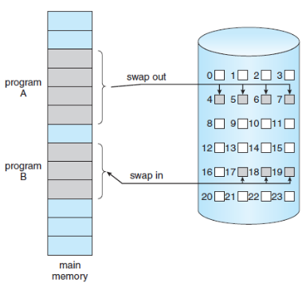
PAGE STATE SWAPPING
Free | The page is neither committed nor reserved. The page is not accessible to the process
Reserved | The page has been reserved for future use.
Committed | The page is accessible

Slide 14
FRAGMENTATION
As processes are loaded and removed from memory, the free memory space is broken into little pieces. It happens after sometimes that processes cannot be allocated to memory blocks considering their small size and memory blocks remains unused. This problem is known as Fragmentation.
Fragmentation is of two types −
External fragmentation
Total memory space is enough to satisfy a request or to reside a process in it, but it is not contiguous, so it cannot be used.
Internal fragmentation
Memory block assigned to process is bigger. Some portion of memory is left unused, as it cannot be used by another process.

Slide 15
MEMORY POOL
Memory pools, also called fixed-size blocks allocation, is the use of pools for memory management that allows dynamic memory allocation
nonpaged pool :
2. paged pool.

Slide 16
LINUX

Slide 17
Linux Directory Strucure

Slide 18
Folder | Use
/boot | This folder contains important files to boot the computer, including the bootloader configuration and the kernel.
/dev | Each device on your system (such as sound cards, Webcams, etc.) has an entry in this folder. Each application accesses the device by using the relevant items inside /dev.
/etc | Systemwide configuration files for the software installed on your system are stored here.
/home | Each user account on the system has a home directory that is stored here.
/lib | Important system software libraries are stored here. You should never need to delve into this world of the unknown.
/media | Media devices such as CD drives and USB sticks are referenced here when they are plugged in. More on this later.
/mnt | Other devices can be mounted too. Again, more on this later.
/opt | Optional software can be installed here. This folder is usually used when you want to build your own software. If you don’t build your own software, you ignore this folder.
/proc/sys | Information about the current running status of the system is stored here.
/root | This is the home directory for the main superuser.
/bin | Software that is vital for the system to be able to boot is stored here.
/sbin | Software that should be run only by the superuser is stored here.
/usr | General software is installed here.
/var | This folder contains log files about the software on your computer.

Slide 19
Basics of file system

Slide 20
How files are stored on hard disk
When your computer stores data on its hard drive, it doesn't just throw magnetized nails into a box, all jumbled up together. The data is stored in a very orderly pattern on each platter. Bits of data are arranged in concentric, circular paths called tracks. Each track is broken up into smaller areas called sectors.

Slide 21
Types of file system
Ext2
Ext2Ext2 stands for second extended file system.
It was introduced in 1993. Developed by Rémy Card.
This was developed to overcome the limitation of the original ext file system.
Ext2 does not have journaling feature.
On flash drives, usb drives, ext2 is recommended, as it doesn’t need to do the over head of journaling.
Maximum individual file size can be from 16 GB to 2 TB

Slide 22
Types of file system cont..
Ext3
Ext3 stands for third extended file system.
It was introduced in 2001. Developed by Stephen Tweedie.
The main benefit of ext3 is that it allows journaling.
Journaling has a dedicated area in the file system, where all the changes are tracked. When the system crashes, the possibility of file system corruption is less because of journaling.
Maximum individual file size can be from 16 GB to 2 TB
There are three types of journaling available in ext3 file system.
Journal – Metadata and content are saved in the journal.
Ordered – Only metadata is saved in the journal. Metadata are journaled only after writing the content to disk. This is the default.
Writeback – Only metadata is saved in the journal. Metadata might be journaled either before or after the content is written to the disk.
You can convert a ext2 file system to ext3 file system directly (without backup/restore)

Slide 23
Types of file system cont..
Ext4
Ext4 stands for fourth extended file system.
It was introduced in 2008.
Maximum individual file size can be from 16 GB to 16 TB
Directory can contain a maximum of 64,000 subdirectories (as opposed to 32,000 in ext3)
You can also mount an existing ext3 fs as ext4 fs (without having to upgrade it).
Several other new features are introduced in ext4: multiblock allocation, delayed allocation, journal checksum. fast fsck, etc.
In ext4, you also have the option of turning the journaling feature “off”.

Slide 24
Disk partitioning
A hard disk can be divided into several partitions. Each partition functions as if it were a separate hard disk . This way the two operating systems can co-exist peacefully on the same hard disk. Without partitions one would have to buy a hard disk for each operating system. Floppies are not usually partitioned.

Slide 25
Blocks
In simple, it's a way we write data on to Disks is called as file-system. There are many File-systems supported by Linux. What is block size in Linux? A block is a sequence of bit or Bytes with a fixed length ie 512 bytes, 4kB, 8kB, 16kB, 32kB etc.

