Slide 1
Journalism

Slide 2
Definition
Journalism is the activity of gathering, assessing, creating, and presenting news and information. It is also the product of these activities.

Slide 3
Need and Importance
The primary purpose of journalism is to provide citizens with the information they need to be free and self-governing.
Journalism is important to the world because it is current and relevant. This is also what makes it entertaining.

Slide 4
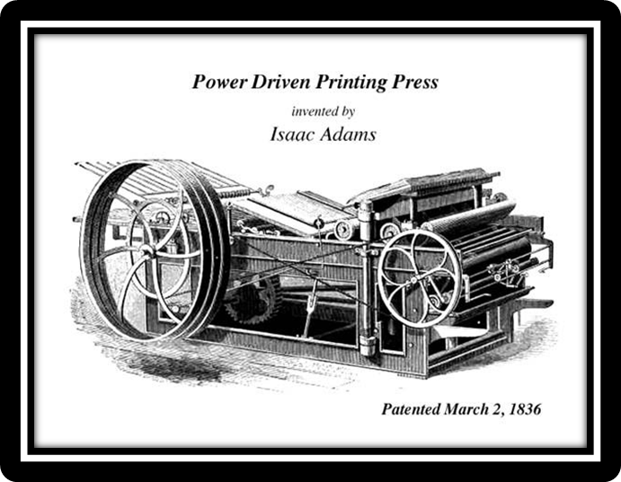
History of Journalism
Evolution of Journalism since 18th century
Emergence of the penny press
Innovations in printing
Rise of modern news room
Evolution in 19th century
Radio
Television

Slide 5
Marketing to the Masses
Independent political parties
Local news, Crime coverage, human interest stories

Slide 6
Technology
Online journalism
Every major paper has an online version
Less ads in papers = Less money to print
What is the best way to get money to post online?

Slide 7
Types of Journalists
Print Journalism
TV Journalism
Social Media/Internet Journalism
Risk Journalism

Slide 8
Print Journalism
Print journalism is the journalism practiced in newspapers and magazines.
It is the practice of investigation and reporting of events in newspaper or in printed form to a broad audience. The aim of print journalism is to inform the intended audience.

Slide 9
Print Journalism
The first regularly published newspaper was “The Daily Courant.” published in England, in 1702.
First English newspaper in India "Bengal Gazette" in 1780 at Calcutta.
The first newspaper in an Indian language was the “Samachar Darpan” in Bengali in 1818

Slide 10
Roles of printed journalism
• Informing the public
• Educating the public
• Entertaining the public
The print journalism in any democratic country plays a vital role in creating, moulding and reflecting the public opinion and shaping political, social and economic development in the country. The print media has been largely responsible in bringing the world closer.

Slide 11
TV Journalism
TV journalism is the field of news and journals which are "broadcast", that is, published by electrical methods .
Television are designed to be seen and heard sooner and more often than a daily or weekly newspaper.

Slide 12
Social media/Internet Journalism
Internet journalism also known as online journalism is a contemporary form of journalism where editorial content is distributed via the Internet as opposed to publishing via print or broadcast.

