Slide 1
THREADS
Team 3 : MindSpace Invaders

Slide 2






Ajay
Aaqib
Laveena
Dileep
Bhavana
Praveen
The Team

Slide 3
THREADS
A Thread is a path of execution within a process. Also, a process can contain multiple threads.
Thread is also known as lightweight process.
The idea is achieve parallelism by dividing a process into multiple threads.
Example:
In a browser, multiple tabs can be different threads.
MS word uses multiple threads, one thread to format the text, other thread to process inputs etc.

Slide 4
Process
Vs
Thread
Process | Thread
Process is heavy weight or resource intensive. | Thread is light weight, taking lesser resources than a process.
Process switching needs interaction with operating system. | Thread switching does not need to interact with operating system.
In multiple processing environments, each process executes the same code but has its own memory and file resources. | All threads can share same set of open files, child processes.
If one process is blocked, then no other process can execute until the first process is unblocked. | While one thread is blocked and waiting, a second thread in the same task can run.
Multiple processes without using threads use more resources. | Multiple threaded processes use fewer resources.
In multiple processes each process operates independently of the others. | One thread can read, write or change another thread's data.

Slide 5
Adv. of
Thread
Over
Process
Responsiveness
Faster context switch
Effective Utilization of Multiprocessor system
Resource sharing
Communication

Slide 6
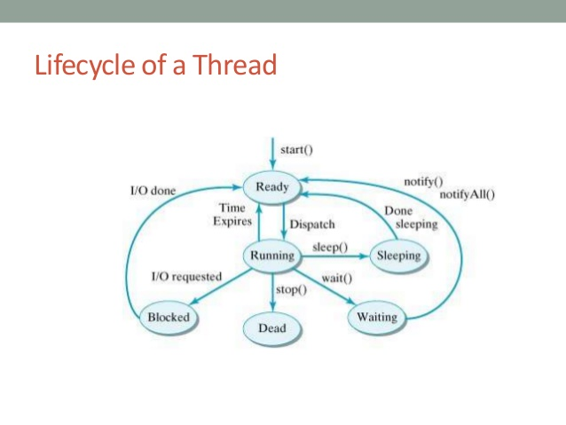
Life
Cycle
Of a
Thread

Slide 7
Types
Of
Threads
User Level Threads − User managed threads.
Kernel Level Threads − Operating System managed threads acting on kernel, an operating system core.

Slide 8
User Level Thread
Vs
Kernel Level Thread
USER LEVEL THREAD | KERNEL LEVEL THREAD
User thread are implemented by users. | kernel threads are implemented by OS.
OS doesn’t recognized user level threads. | Kernel threads are recognized by OS.
Implementation of User threads is easy. | Implementation of Kernel thread is complicated.
Context switch time is less. | Context switch time is more.
Context switch requires no hardware support. | Hardware support is needed.
If one user level thread perform blocking operation then entire process will be blocked. | If one kernel thread perform blocking operation then another thread can continue execution.
Example : Java thread, POSIX threads. | Example : Window Solaris.

