Slide 1
THREADS
Team 3 : MindSpace Invaders

Slide 2






Ajay
Aaqib
Laveena
Dileep
Bhavana
Praveen
The Team

Slide 3
THREADS
A Thread is a path of execution within a process. Also, a process can contain multiple threads.
Thread is also known as lightweight process.
The idea is achieve parallelism by dividing a process into multiple threads.
Example:
In a browser, multiple tabs can be different threads.
MS word uses multiple threads, one thread to format the text, other thread to process inputs etc.

Slide 4
Process
Vs
Thread
Process | Thread
Process is heavy weight or resource intensive. | Thread is light weight, taking lesser resources than a process.
Process switching needs interaction with operating system. | Thread switching does not need to interact with operating system.
In multiple processing environments, each process executes the same code but has its own memory and file resources. | All threads can share same set of open files, child processes.
If one process is blocked, then no other process can execute until the first process is unblocked. | While one thread is blocked and waiting, a second thread in the same task can run.
Multiple processes without using threads use more resources. | Multiple threaded processes use fewer resources.
In multiple processes each process operates independently of the others. | One thread can read, write or change another thread's data.

Slide 5
Adv. of
Thread
Over
Process
Responsiveness
Faster context switch
Effective Utilization of Multiprocessor system
Resource sharing
Communication

Slide 6
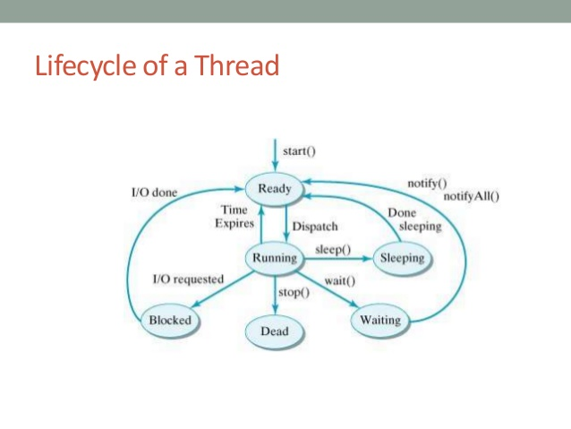
Life
Cycle
Of a
Thread

Slide 7
Types
Of
Threads
User Level Threads − User managed threads.
Kernel Level Threads − Operating System managed threads acting on kernel, an operating system core.

Slide 8
User Level Thread
Vs
Kernel Level Thread
USER LEVEL THREAD | KERNEL LEVEL THREAD
User thread are implemented by users. | kernel threads are implemented by OS.
OS doesn’t recognized user level threads. | Kernel threads are recognized by OS.
Implementation of User threads is easy. | Implementation of Kernel thread is complicated.
Context switch time is less. | Context switch time is more.
Context switch requires no hardware support. | Hardware support is needed.
If one user level thread perform blocking operation then entire process will be blocked. | If one kernel thread perform blocking operation then another thread can continue execution.
Example : Java thread, POSIX threads. | Example : Window Solaris.

Slide 9
A thread is a flow of execution through the process code, with its own program counter that keeps track of which instruction to execute next, system registers which hold its current working variables, and a stack which contains the execution history.
A thread shares with its peer threads few information like code segment, data segment and open files. When one thread alters a code segment memory item, all other threads see that.
A thread is also called a lightweight process. Threads provide a way to improve application performance through parallelism. Threads represent a software approach to improving performance of operating system by reducing the overhead thread is equivalent to a classical process.

Slide 10
Lightweight and heavyweight processes refer the mechanics of a multi-processing system.
In a lightweight process, threads are used to divvy up the workload. Here you would see one process executing in the OS (for this application or service.) This process would posess 1 or more threads. Each of the threads in this process shares the same address space. Because threads share their address space, communication between the threads is simple and efficient. Each thread could be compared to a process in a heavyweight scenario.
In a heavyweight process, new processes are created to perform the work in parallel. Here (for the same application or service), you would see multiple processes running. Each heavyweight process contains its own address space. Communication between these processes would involve additional communications mechanisms such as sockets or pipes. The benefits of a lightweight process come from the conservation of resources. Since threads use the same code section, data section and OS resources, less overall resources are used. The drawback is now you have to ensure your system is thread-safe. You have to make sure the threads don't step on each other. Fortunately, Java provides the necessary tools to allow you to do this.

Slide 11
States of thread- A thread has one of the following States.
New-A new thread begins its life cycle in the new state. It remains in this state until the program starts the thread. It is also referred to as a born thread.
1-Runnable- After invocation of start() method on new thread, the thread becomes runnable.After a newly born thread is started, the thread becomes runnable. A thread in this state is considered to be executing its task. 2-Running-A thread is in running state that means the thread is currently executing. There are several ways to enter in Runnable state but there is only one way to enter in Running state: the scheduler select a thread from runnable pool. 3-Blocked- This is the state when a thread is waiting for a lock to access an object. 4-Waiting-Sometimes a thread transitions to the waiting state while the thread waits for another thread to perform a task. A thread transitions back to the runnable state only when another thread signals the waiting thread to continue executing.
5-Timed waiting- A runnable thread can enter the timed waiting state for a specified interval of time. A thread in this state transitions back to the runnable state when that time interval expires or when the event it is waiting for occurs. 6-Not Runnable- after Runnable states these three states are assumed to be in a not Runnable state. These three states are waiting, Timed_waiting(sleeping) and Terminated. 7-Terminated- In this state the thread is dead.

Slide 12
Thread Scheduler
Thread scheduler is part of JVM whose primary responsibility is to decide which thread should run and also when to move a thread out of running state etc. There is no guarantee that the Thread Scheduler chooses a particular thread to run, however we can influence this behaviour using methods like sleep(), yield(), join() and setPriority() from Thread class, and also by using methods like wait(), notify() and notifyAll() from Object class.
Waiting, sleeping or blocked
A thread is not eligible to run if it is in waiting, sleeping or blocked state. But the thread is alive, and it is not in runnable state. A thread can transition back to runnable state when particular event occurs. Thread can move into waiting, sleeping or blocked state for various reasons like waiting for I/O, or call to sleep() method is invoked explicitly to put the thread into sleep etc. Once the I/O is available or sleep period expires the thread can move back to Runnable state. From this point the thread becomes eligible to run again, however Thread Scheduler ultimately decides which runnable thread becomes thread of execution.

Slide 13
Thread Priorities
Though we cannot control Thread Scheduler which decides which thread is chosen to run, we can recommend the order in which threads are scheduled to run. Each thread has a priority range between MIN_PRIORITY (constant value of 1), MAX_PRIORITY (a constant value of 10) and NORM_PRIORITY (constant value of 5). Usually threads with higher priority will be allocated processor time to execute before threads with lower priority, but this behavior is not guaranteed. Our program logic should never depend on thread priorities, the reason being we cannot fully control the order of thread execution but we can only influence it by setting priorities.

Slide 14
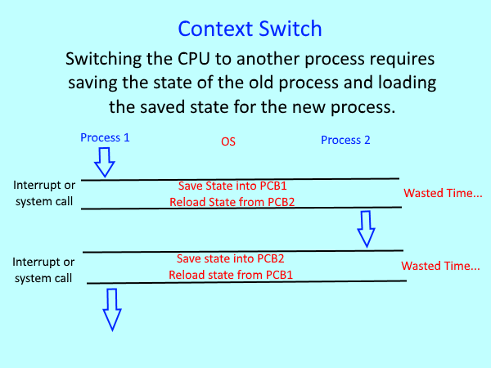

Slide 15
S.N. | User-Level Threads | Kernel-Level Thread
1 | User-level threads are faster to create and manage. | Kernel-level threads are slower to create and manage.
2 | Implementation is by a thread library at the user level. | Operating system supports creation of Kernel threads.
3 | User-level thread is generic and can run on any operating system. | Kernel-level thread is specific to the operating system.
4 | Multi-threaded applications cannot take advantage of multiprocessing. | Kernel routines themselves can be multithreaded.

