Slide 1
HARDWARE
FUNDAMENTALS
Team 3 : MindSpace Invaders

Slide 2






Ajay
Aaqib
Laveena
Dilip
Bhavana
Praveen
The Team

Slide 3
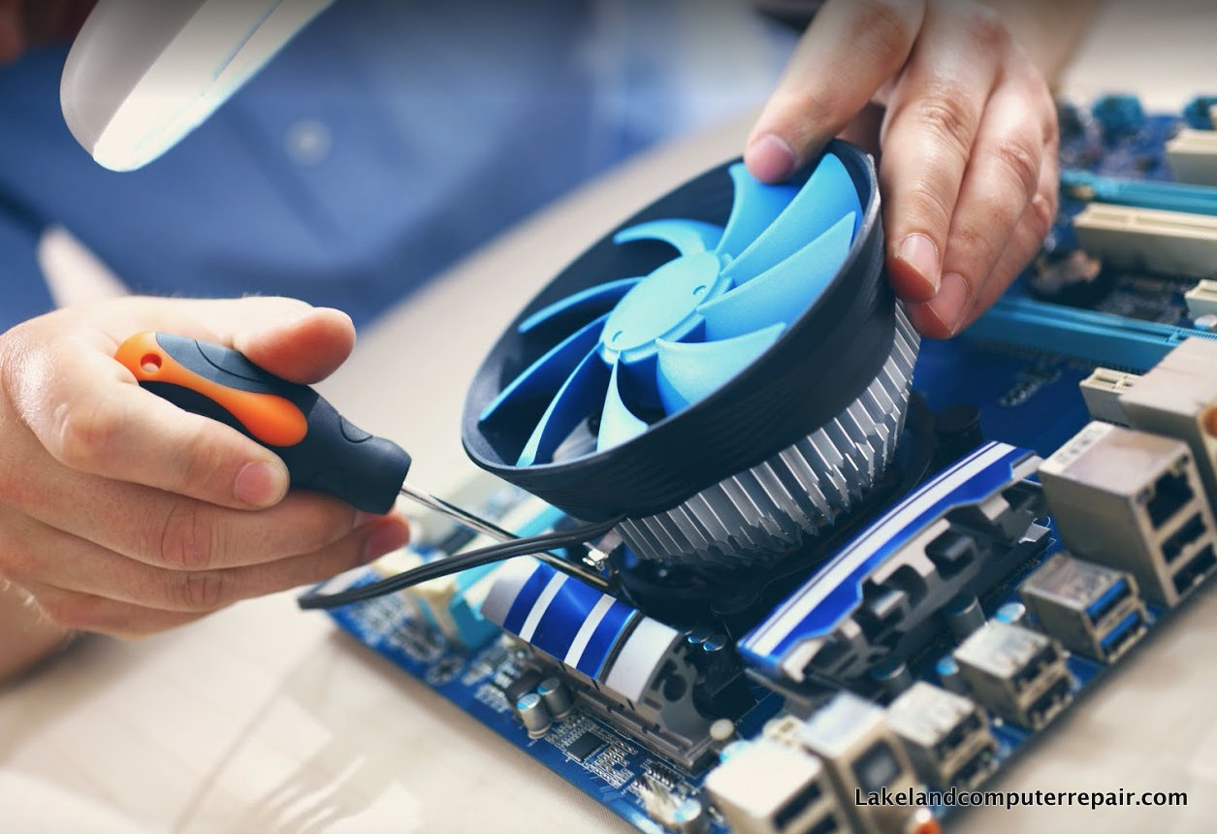
Hardware Fundamentals
What is Hardware?
Hardware is the physical aspect of the computer, the thing we can touch.
A Computer is a Hardware and is an electronic device that manipulates information, or data using different input and output devices.

Slide 4
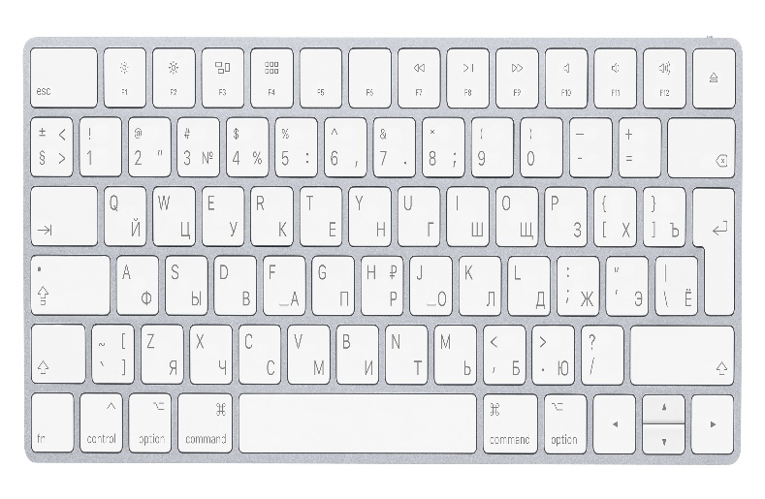

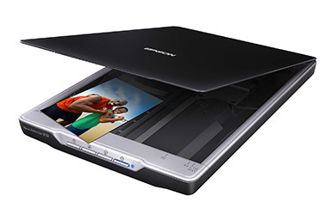

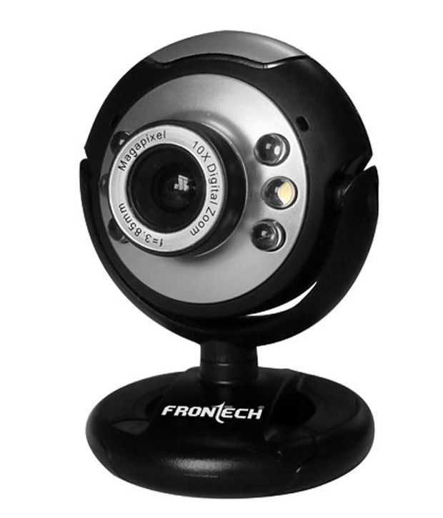

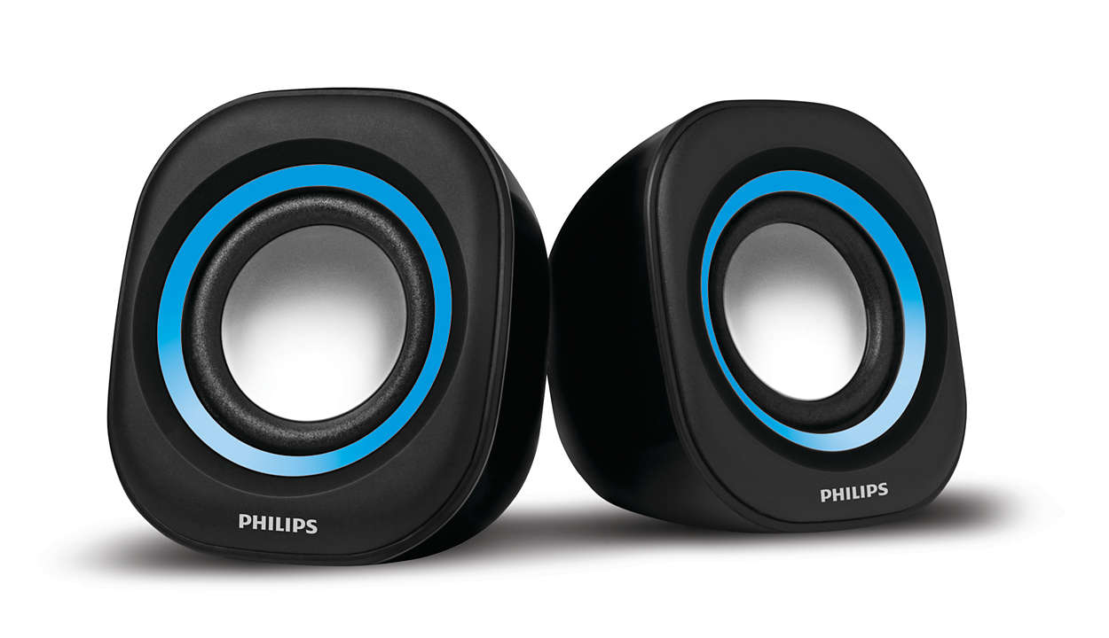
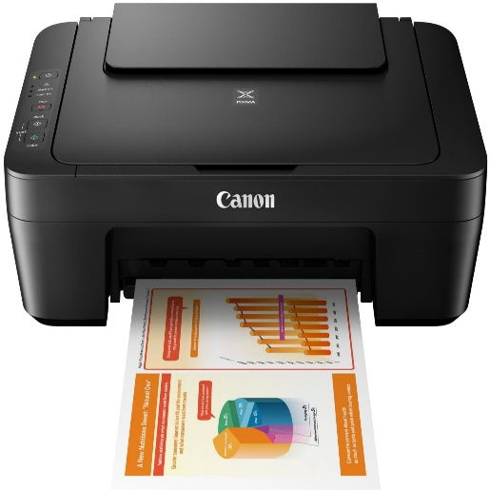
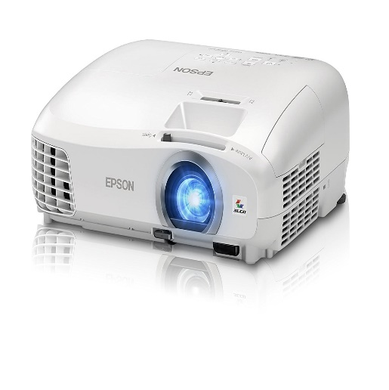
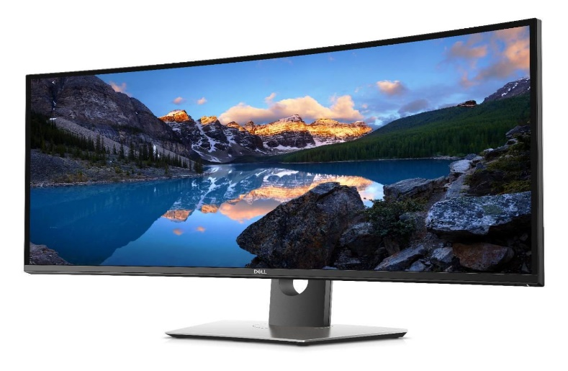
Input Devices
Computer Devices
Output Devices

Slide 5
MONITOR
Monitor is an output devices which displays the information or output into pictorial form.
Monitors are connected to the computer via VGA,HDMI or other proprietary connectors through DB5 connector of motherboard.
Multiple technologies have been used for computer monitors like CRT, LCD and LED.

Slide 6
Cathode Ray Tube (CRT)
The CRT is a vacuum tube that contain one or more electron guns and a phosphorescent screen, and is used to display images.
It modulates, accelerates, and deflects electron beams onto the screen to create the images.

Slide 7
The CRT's produces images with softer edges that are not as sharp as an LCD at its native resolution.
Imperfect focus and color registration also reduce sharpness.
Relatively bright but not as bright as LCDs.
Produces electrostatics radiation which is harmful for eye’s
CRT’s monitors acquire more space as compared to LCD’s.
Disadvantages
of
CRT

Slide 8
Liquid Crystal Display (LCD)
A LCD is a flat-panel display that uses the light-modulating properties of liquid crystals.
Liquid crystals do not emit light directly, instead using a backlight or reflector to produce images in color or monochrome.

Slide 9
Resolution Each panel has a fixed pixel resolution format determined at the time of manufacture that can not be changed. All other image resolutions require rescaling, which generally results in significant image degradation, particularly for fine text and graphics. For most applications should only be used at the native resolution of the panel. If you need fine text and graphics at more than one resolution do not get an LCD display.
Viewing Angle Limited viewing angle. Brightness, contrast, gamma and color mixtures vary with the viewing angle. Can lead to contrast and color reversal at large angles. Need to be viewed as close to straight ahead as possible.
Cost Considerably more expensive than comparable CRTs which forces the use of LED.
Need
For
LED

Slide 10
Light-Emitting Diode (LED)
A LED is a two-lead semiconductor light source. It is a p-n junction diode that emits light when activated.
When a suitable current is applied to the leads,[electrons are able to recombine with electron holes within the device, releasing energy in the form of photons.
This effect is called electroluminescence, and the color of the light (corresponding to the energy of the photon) is determined by the energy bandgap of the semiconductor.
LEDs are typically small (less than 1 mm2) and integrated optical components may be used to shape the radiation pattern.

Slide 16
Text
1
Text goes here
2
Text goes here
3
Text goes here
4
Text goes here
5
Text goes here

Slide 17
Add an image
Text goes here
Text goes here
Icon
Icon
Icon
Text goes here
Text goes here
Text goes here
Text goes here
Icon
Icon
Icon
Text goes here
Text goes here
Text goes here

Slide 18


Word
Word
Text goes here
Text goes here
Text goes here
Text goes here
Text goes here
Text goes here
Text goes here
Description goes here

Slide 19



Add an image
Add an image
Add an image
Text goes here
Description goes here

