Slide 1
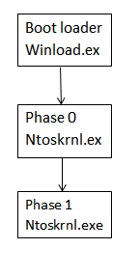
Kernel Initialization:
Kernel acts as a layer between software and hardware.
1. Initialize kernel
2. Initialize hal.dll
3. Start the Debugger
4. Initialize routines for executives services
After executing the functions of boot files the control
is passed to Kernel.
ntoskrnal.exe is the kernel file in a Windows machine.
The library file hal.dll helps Kernel to interact with hardware's.
hal.dll file is machine specific.
Now the drivers for hardware's are loaded from the file and
the Kernel is loaded to primary memory
Once the kernel is fully initialized it takes over control of the
computer and continues initialization with the file-systems and
Processes.

Slide 2
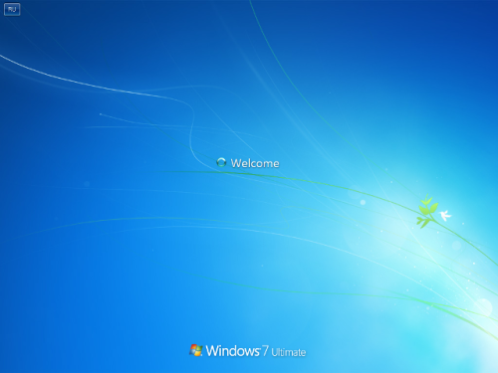
Session initialization
Loads the subsystem drivers
Loads kernel mode part of windows subsystem
(win32k.sys)
Initialize Client Server runtime subsystem
Csrss.exe
Create additional paging file
Session 0 Initialization
Wininit.exe
Initialize the registry security
Session 1 & beyond initialization
Winlogon.exe
Creates system environment variable

