Slide 1
WORK STATION SERVER
WINDOWS WORKSTATION:
Workstation operating system are for example, Windows XP, Windows Vista, Windows 7, Windows 8 and similar. Workstation operating system is primarily designed to run applications.
Those applications can be text processor, a spreadsheet application, presentation software, video or audio editors, games, etc.

Slide 2
WINDOWS SERVER OS:
Microsoft Windows Server operating system is a series of enterprise-class server operating systems designed to share services with multiple users and provide extensive administrative control of data storage, applications and corporate networks.
Development for Windows Server started in the early 1980s when Microsoft produced two operating system lines: MS-DOS and Windows NT.

Slide 3
VERSIONS OF
WORKSTATION AND SERVER OS

Slide 4
Operating System | Version Number
Windows 1.0 | 1.04
Windows 2.0 | 2.11
Windows 3.0 | 3
Windows NT 3.1 | 3.10.528
Windows for Workgroups 3.11 | 3.11
Windows NT Workstation 3.5 | 3.5.807
Windows NT Workstation 3.51 | 3.51.1057
Windows 95 | 4.0.950
Windows NT Workstation 4.0 | 4.0.1381
Windows 98 | 4.1.1998
Windows 98 Second Edition | 4.1.2222
Windows Me | 4.90.3000
Windows 2000 Professional | 5.0.2195
Windows XP | 5.1.2600
Windows Vista | 6.0.6000
Windows 7 | 6.1.7600
Windows 8.1 | 6.3.9600
Windows 10 | 10.0.10240

Slide 5
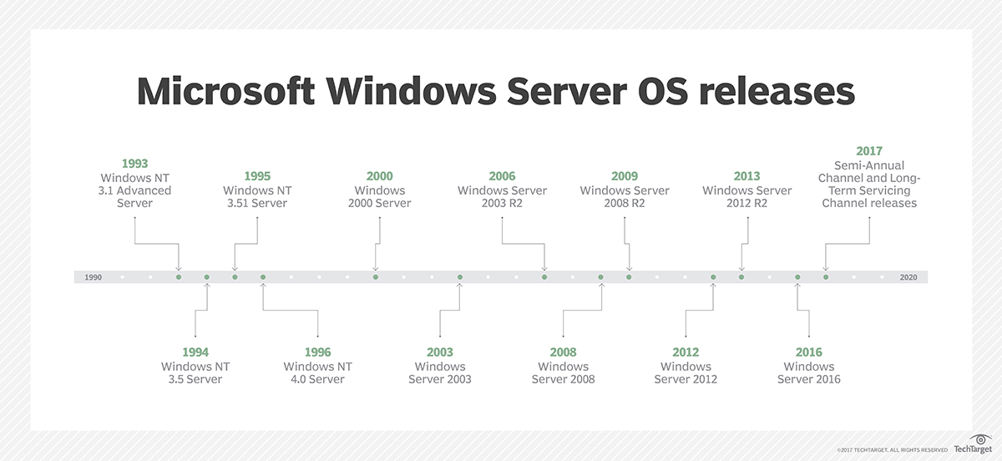

Slide 6
REQUIREMENTS NEED TO INSTALL WINDOWS WORKSTATION OS :
Processor: 1 gigahertz (GHz) or faster
RAM: 1 gigabyte (GB) (32-bit) or 2 GB (64-bit)
Free hard disk space: 16 GB
Graphics card: Microsoft DirectX 9 graphics device with WDDM driver
A Microsoft account and Internet access

Slide 7
REQUIREMENTS NEED TO INSTALL WINDOWS SERVER OS :
Component | Minimum | Recommended* | Maximum
CPU socket | 1.4 GHz (64-bit processor) or faster for single core 1.3 GHz (64-bit processor) or faster for multi-core | 3.1 GHz (64-bit processor) or faster multi-core | 2 sockets
Memory (RAM) | 2 GB 4 GB if you deploy Windows Server Essentials as a virtual machine | 16 GB | 64 GB
Hard disks and available storage space | 160-GB hard disk with a 60-GB system partition |  | No limit

Slide 8
FEATURES OF WINDOWS7
Start Menu – The Start Menu provides the primary access point for programs and applications on your ThinkPad.
Taskbar and Notification Area – The Taskbar contains 3 main components, the Start button, the Task/Quick launch bar and the System Notification Area.
Windows Snipping Tool – Windows 7 includes an application to capture, save and share “snipped” images from your desktop.

Slide 9
Displaying to a External Monitor or Projector – The ThinkPad is equipped with one or more external display connectors so that you may connect to an external monitor or the multimedia projector.
Using Local Area Networks (LAN/ WiFi) – The ThinkPad is configured to access both wired and wireless network resources.
Windows Explorer Favorites – File system favorites are quick links to specific directories (folders) located on your hard drive.
Windows Explorer Libraries – Libraries are an easy way to collect and track documents on your computer that are related to one another but are not necessarily located in the same directories (folders).

Slide 10
FEATURES OF SERVER 2008 R2
Active Directory Administrative Center:
For administrators, the biggest change in Server 2008 R2 is undoubtedly the new Active Directory Administrative Center, which replaces the older Active Directory, Domains and Trusts, Sites and Services, and Users and Computers management tools.
Remote server management:
Server Manager was one of the best improvements in Server 2008 because it provides a centralized and useful console for managing Windows Server.

Slide 11
Core Parking:
Windows Server 2008 R2's new Core Parking functionality enables improved power management.
Support for 256 cores:
Improved scalability is another important feature in Server 2008 R2, which will be able to utilize up to 256 cores.
64-bit only:
Windows Server 2008 R2 marks the first time that the Windows Server OS will be 64-bit only, meaning that Server 2008 R2 must run on x64-compatible hardware.

