Slide 1
A Java Web-App for talent based Employee Matching
Implementing IBM’s Bluemix services/tools

Slide 2
Existing Problems
Employees quitting job without prior notice.
Work assigned to the employee is left pending if he/she suddenly quits the job.
Burden on other employees to complete the pending tasks.
Reduces the efficiency of the entire organization.
Difficulties in manually finding the person who can suit the credibility of the employee who just quit.

Slide 3
Proposed Solution
A Web-App that can find an employee with the same credibility as any specific employee in the organization.
This app can be accessed from all over the world with the help of internet.
The database can be updated at any time and it comprises of employees in the organization as well as those who have applied for jobs
Easy to use Web interface.

Slide 4
Implementation
The code for the Web-App was written in Java.
Eclipse software was used for compiling, simulating and executing the java web-app.
IBM’s bluemix services were used to build the website, user interface and database

Slide 5
Bluemix services
Bluemix provides many services which are really helpful to develop apps.
The services used to implement this particular web app were:
Liberty for Java.
Watson – Personality insights.
Cloudant NoSql db.

Slide 6
Liberty for Java.
Our web app was created using java language.
This platform helped us to execute the java code and create the web app.
IBM WebSphere Liberty Profile is a highly composable, ultra-fast, ultra-light profile of IBM WebSphere Application Server designed for the cloud.

Slide 7
Cloudant NoSQL DB.
Cloudant NoSQL DB provides access to a fully managed NoSQL JSON data layer that's always on. This service is compatible with CouchDB, and accessible through a simple to use HTTP interface for mobile and web application models
This service from IBM was used to create a database for our website.
This service is crucial for our project since the database has to be constatantly updated and requires cloud storage.

Slide 8
Watson – Personality insights
Personality Insights derives insights from transactional and social media data to identify psychological traits which determine purchase decisions, intent and behavioral traits; utilized to improve conversion rates.
This service was used in our web-app to provide the most accurate match for the employee being replaced.
Again, this service was crucial for our web-app since our app involves identification of psychological traits etc.

Slide 9
Launching our App
Cloud foundry was used for the deployment of the app using the CF-Push command in the terminal.
The app can also be deployed using Bluemix.
Web-App URL: http://employee-match.au-syd.mybluemix.net/

Slide 10
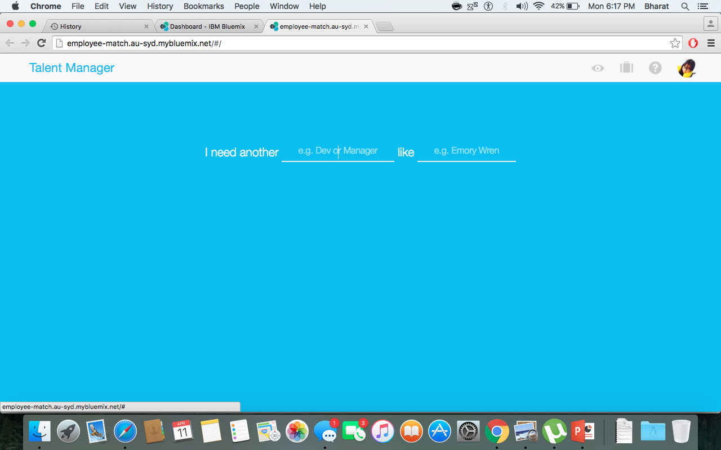
Here’s how our web app looks like.

Slide 11
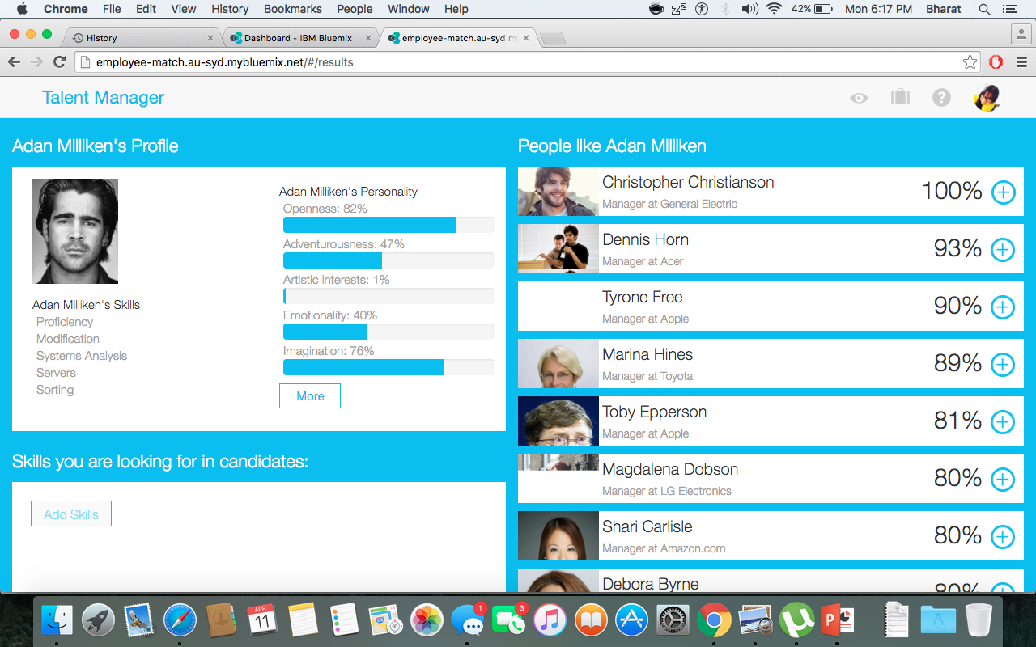
Screenshots

Slide 12
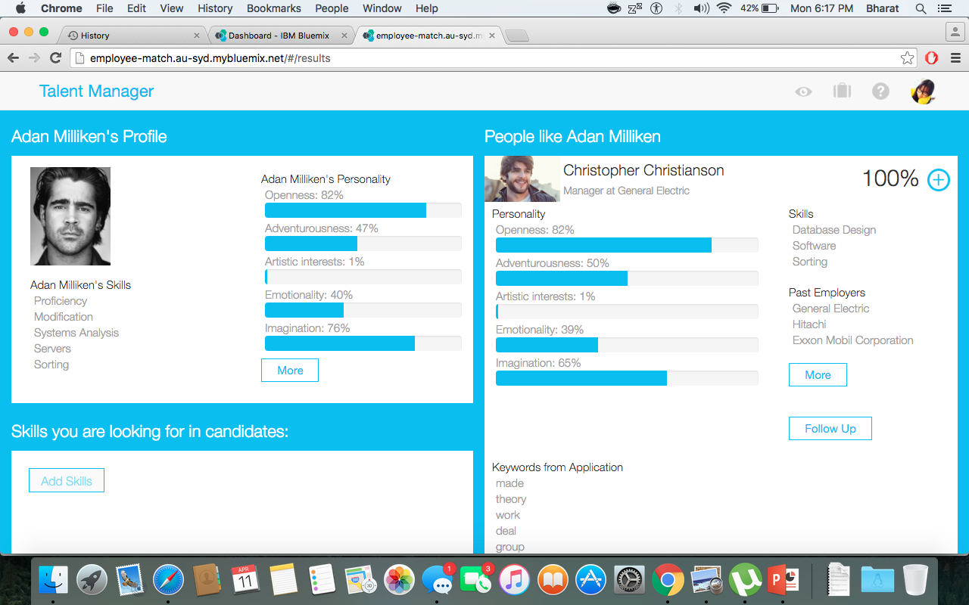
More Screenshots

Slide 13
THANK YOU

