Slide 1
SUMMER TRAINING PROJECT -
Income Category Prediction using Adult Census Data
By Kallakuri SSS Lakshmi Bharadwaj {12318329}

Slide 2

Predicting Income Categories with Machine Learning
This project focuses on building a machine learning model to predict income categories using the UCI Adult Income dataset. The goal is to classify whether an individual's income is above or below $50K based on various features. This predictive modeling has significant applications in financial analysis, job market forecasting, and social sciences.

Slide 3
Understanding the Dataset
The UCI Adult Income dataset provides comprehensive information about individuals, including key attributes used for income prediction:
1
2
3
Age
Education Number
Capital Gain/Loss
The age of the person.
Number of years of education completed.
Capital gains and losses from investments.
4
5
Hours Per Week
Income
Number of hours worked per week.
The target variable: <=50K or >50K.

Slide 4
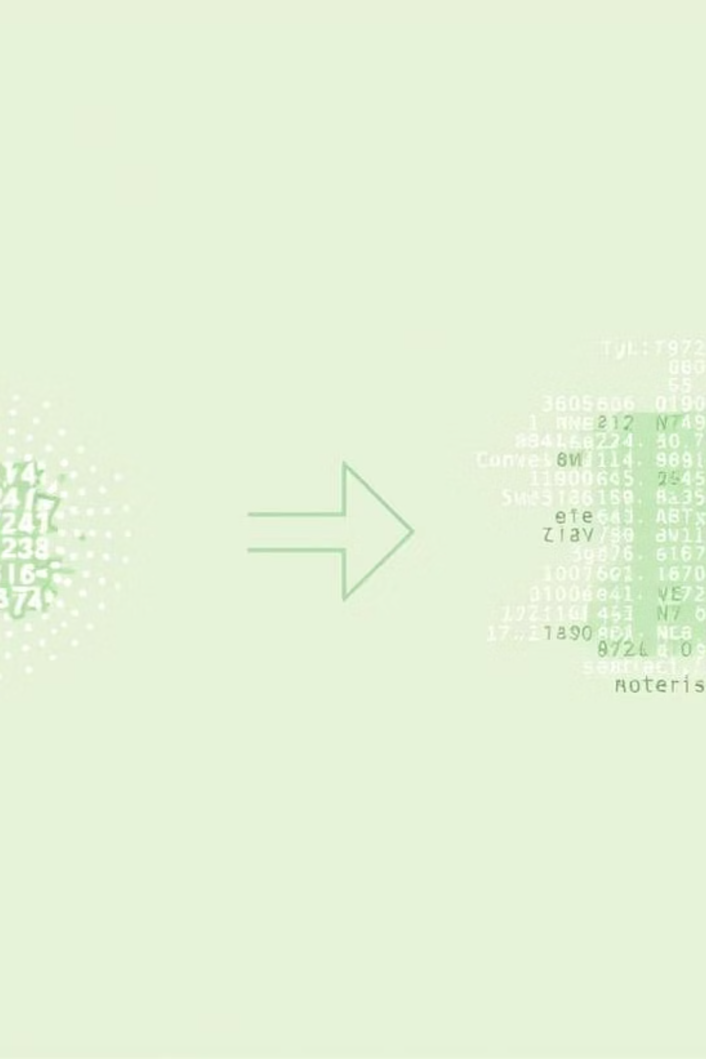
Data Preprocessing
Effective data preprocessing is crucial for building robust machine learning models.
Loading and Cleaning
Feature Selection
Target Transformation
Selected numerical features: age, education.num, capital.gain, capital.loss, and hours.per.week.
Loaded data using Pandas from a CSV.
Mapped categorical income values (<=50K, >50K) to numerical (0, 1) for model compatibility.
Replaced "?" with NaN and dropped rows with missing values.
These features have a direct relationship with income levels.

Slide 5
Data Splitting for Training and Testing
To ensure unbiased model evaluation, the dataset was split into distinct training and testing sets.
Training Set (80%)
Testing Set (20%)
Used to train the machine learning models, allowing them to learn patterns from the data.
Used to evaluate the performance of the trained models on unseen data, assessing their generalization ability.
Stratification was applied during splitting to preserve the distribution of the target variable (income) in both sets, preventing evaluation bias.

Slide 6



Creating Machine Learning Pipelines
Pipelines in Scikit-learn streamline the machine learning workflow by integrating preprocessing and model training.
Pipeline Creation
Preprocessing Steps
Modeling Step
Integrated preprocessing steps with model training to ensure consistent transformations and prevent data leakage.
Imputation (SimpleImputer with median) and Scaling (StandardScaler) were included to prepare numerical features.
Multiple classifiers (XGBoost, Logistic Regression, Decision Tree, Random Forest) were included for performance comparison.
This approach ensures that the same transformations are applied to both training and testing data.

Slide 7
Hyperparameter Tuning
Hyperparameter tuning is essential for optimizing model performance.
RandomizedSearchCV
GridSearchCV
Used for XGBoost and other models to efficiently search over hyperparameter grids, identifying optimal settings.
Applied to Logistic Regression, Decision Tree, and Random Forest for an exhaustive search of all possible hyperparameters.
These methods significantly improved model performance by selecting the best parameters for each model.

Slide 8



Model Evaluation
After training, models were rigorously evaluated using key metrics to assess their effectiveness.
Accuracy
Confusion Matrix
Classification Report
Measures the percentage of correct predictions made by the model.
Provides a detailed breakdown of true positives, true negatives, false positives, and false negatives.
Offers precision, recall, F1-score, and support, giving a comprehensive view of performance across classes.
Models were compared based on these metrics to determine the best performer for income prediction.

Slide 9
Model Interpretation and Saving
Understanding model predictions and ensuring reusability are crucial steps in the machine learning workflow.
SHAP Interpretation
Model Saving
Used SHAP (SHapley Additive exPlanations) to interpret XGBoost predictions, identifying feature contributions (e.g., education.num, capital.gain) to income outcomes.
The entire Pipeline, including preprocessing and the trained model, was saved using Joblib for future use without retraining.

Slide 10
Challenges Faced and Solutions
The project presented several challenges, each addressed with specific solutions to improve model robustness.
Learning Pipelines
1
Initially unfamiliar with Scikit-learn Pipelines, I learned to automate preprocessing and training, streamlining the workflow.
Model Overfitting
2
The Decision Tree model overfitted; this was resolved by pruning the tree and implementing cross-validation.
Class Imbalance
3
The dataset's imbalance (more <=50K examples) caused bias; class weights were used to mitigate this, focusing on the minority class.

Slide 11

Conclusion and Key Learnings
This project provided valuable experience in applying various machine learning techniques.
Learned and applied data preprocessing, feature engineering, model selection, hyperparameter tuning, and model interpretation.
Built and compared multiple models for income category prediction, optimizing their performance.
Ensured transparency with SHAP for model interpretation.
Utilized Pipelines and model saving techniques for efficient and reproducible workflows.

