Slide 1

Instructor Kick-off
Analyze A/B Test Results
© 2019 Udacity. All rights reserved.

Slide 2
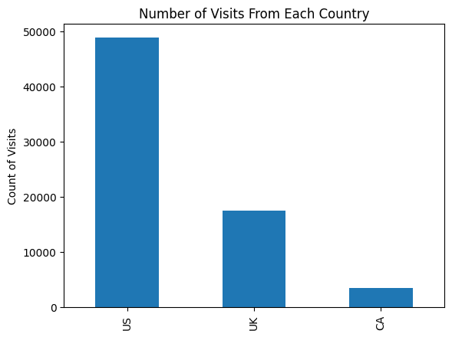
How Was The Experiment Implemented?​
Total Variant Visitors: 69889
Total Control Participants:​ 34678​
Chart shows where users are from
US – 48850
UK - 17551
CA - 348

Slide 3
Conversion Rates
 | U.S. | U.K. | CA
Control | 10.7% | 10.2% | 9.4%
Treatment | 15.8% | 14.9% | 15.4%
Executive Summary: In all three countries, Treatment group has a higher conversion rates compared to the control group and US Treatment group has highest conversion rate (15.8%).
The data indicates a positive association between the Treatment group and higher conversion rates.

Slide 4
Experiment Results
Treatment Conversion Rate: 0.155
Control Conversion Rate:​ 0.105
Delta in Treatment vs. Control Conversion Rate:​ 0.05
p-value:​ 0.00
Conclusion:​ As the p-values is less than 0.05 (alpha), we can reject the null hypothesis, which means we have evidence that the treatment page has better conversion than control page.

Slide 5
Country Results
Conclusion:​
For each 1 visitor increase from US, conversion is 1.00 times as likely, holding all other variables (visitors from UK) constant.
For each 1 visitor increase from UK, conversion is 1.06 times as likely, holding all other variables (visitors from US) constant.

