Slide 1

AI-Based Smart Waste Management System
BCSE316L – Design of Smart Cities | Winter Semester 2025–26
Gunin Bhardwaj | Registration No: 22BCE2866
SMART CITIES
AI & IOT
SUSTAINABILITY

Slide 2
Abstract & Problem Statement
The Challenge
As urban populations grow, waste management becomes harder. Most cities still use fixed collection schedules that don't reflect actual need — resulting in overflowing bins and wasted resources.
The Solution
This project uses AI and machine learning to predict bin fill rates, optimise collection routes dynamically, and incorporate citizen feedback for priority collection. Tested on simulated data, it demonstrates a clear improvement over traditional methods.
PREDICTIVE ANALYSIS
ROUTE OPTIMISATION
CITIZEN FEEDBACK

Slide 3
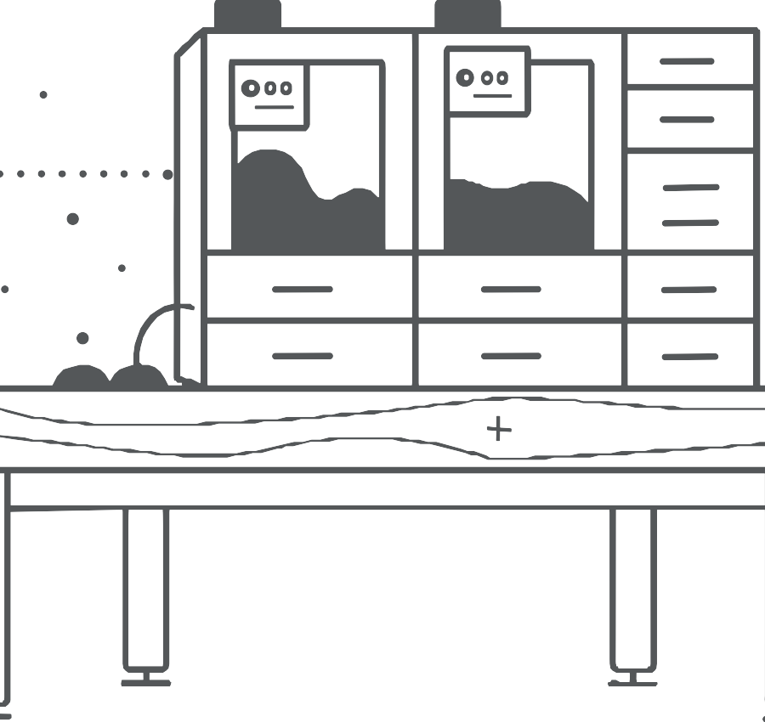
Literature Survey
Early Research
Initial studies focused on sensors to monitor bin fill levels, reducing unnecessary collection trips. Technologies like RFID and image processing improved tracking and detection.
Recent Advances
Newer research applies machine learning and AI for smarter prediction and planning. These systems adapt over time and make data-driven decisions.
Key Consensus
Existing studies confirm that combining AI, IoT, and citizen input significantly improves urban waste management outcomes.

Slide 4





Project Objectives
Predict Fill Levels
Estimate how full each waste bin will get before overflow occurs.
Optimise Routes
Dynamically adjust collection routes based on predicted priority levels.
Reduce Overflow
Prevent bins from overflowing by acting before problems arise.
Citizen Feedback
Incorporate public complaints into real-time decision-making.
Scalability
Build a system ready for real-world smart city deployment at scale.

Slide 5
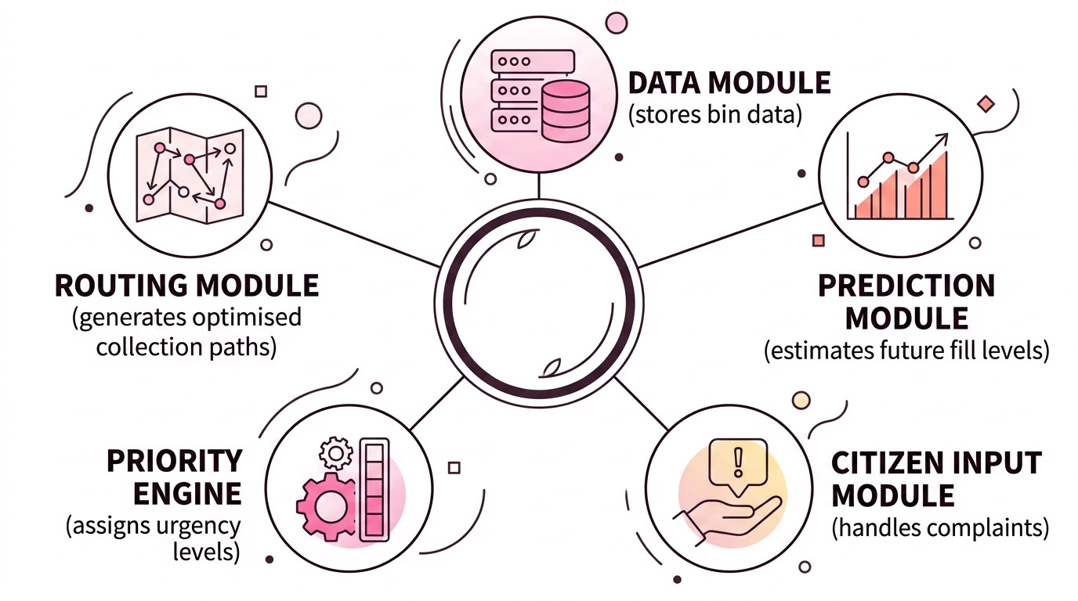
System Architecture
All five modules work in concert to ensure real-time responsiveness, accurate prediction, and efficient collection routing across the city.

Slide 6
Methodology & Dataset
How the System Works
01
Dataset Snapshot
Bin ID
Location
Current Fill (%)
Time (Hour)
Simulate Data
A dataset of 25 bins across markets, hospitals, residential areas, and public spaces is loaded with current fill percentages.
1
Market Area
78%
10:00
4
Bus Stand
91%
12:00
02
Predict Fill Levels
Each bin's fill is projected forward by +15%, capped at 100%, to estimate near- future status.
5
Railway Station
95%
13:00
7
Hospital Area
88%
11:00
14
Shopping Complex
92%
20:00
03
Assign Priority
Bins with complaints and predicted fill ≥80% → Very High; complaints or fill
≥80% → High; otherwise → Low.
16
Food Street
97%
21:00
20
Tourist Spot
89%
14:00
22
Slum Area
83%
16:00
04
Generate Route
Bins are sorted by priority and an optimised collection sequence is output for the waste vehicle.
25 bins total across diverse urban location types.

Slide 7
Results & Analysis
25
Total Bins
Simulated across diverse urban locations
3
Citizen Complaints
Bins 2, 10, and 18 flagged for priority response
+15%
Prediction Buffer
Applied to each bin's current fill level
Traditional Method
Fixed schedules led to multiple overflow cases as the system could not account for changing real-world conditions. Bins at high-traffic locations were consistently neglected.
AI-Based Method
The predictive system prevented overflow by prioritising high-fill bins proactively. Dynamic routing ensured collection vehicles addressed the most urgent bins first, improving efficiency significantly.

Slide 8

Testing, Validation & Advantages
Validation Approach
Each module tested independently for correctness Predictions verified to stay within 0–100% bounds Priority assignment checked against known cases Routing confirmed bins ordered correctly by priority
Full dataset tested with consistent results across multiple runs
Key Advantages
Reduces bin overflow
Saves fuel via optimised routing Responds to real-world issues Scalable for larger cities
Supports sustainable environments

Slide 9



Limitations & Future Scope
Current Limitations
Future Enhancements
Simulated Data
Uses generated data instead of real IoT sensors
Basic Prediction
Simple +15% model; no advanced ML algorithms
Advanced ML Models
Deep learning for more accurate predictions
Real IoT Sensors
Live bin data from deployed hardware
No External Factors
Traffic, weather, and events are not considered
Smart City Integration
Full integration with city-wide IoT infrastructure and waste segregation features
Mobile Application
User-facing app for complaints and tracking

Slide 10

Conclusion
This project demonstrates how AI can make waste management smarter and more efficient. By predicting fill levels and dynamically optimising collection routes, the system reduces overflow and improves overall urban cleanliness.
While still a prototype using simulated data, it provides a solid foundation for building advanced, practical smart city solutions.
Predict
Anticipate bin fill levels before overflow
Prioritise
Rank bins using AI and citizen input
Optimise
Route collection vehicles efficiently
Scale
Expand to full smart city deployment
Keywords: Smart Waste Management · Artificial Intelligence · Route Optimisation · Predictive Analysis · IoT · Smart Cities · Sustainability

