Slide 1
Big Mountain Resort
Guided Capstone

Slide 2
Problem Statement
“For Big Mountain Ski Resort to select a better valuation for their ticket prices what changes do they need to make in order to, cut costs that won’t undermine ticket prices or that will support higher ticket prices?”
350,000 visitors (skiers and snowboarders) each season
Tickets are currently underpriced ($81.00)
Lack of facility utilization compared to other resorts

Slide 3
Recommendations
Capitalize on resorts target features (i.e. vertical drop)
Raise ticket price to its projected value of $95.87 based on modeled results
Investigate options further regarding cost-cutting options such as run closings

Slide 4
Key Points
Target Features:
Vertical Drop (2353ft)
Longest run (3.3mi)
Snow making area (600 acres)
Fast quads (3)
Random forest regressor model
4 possible scenarios to achieve goal

Slide 5
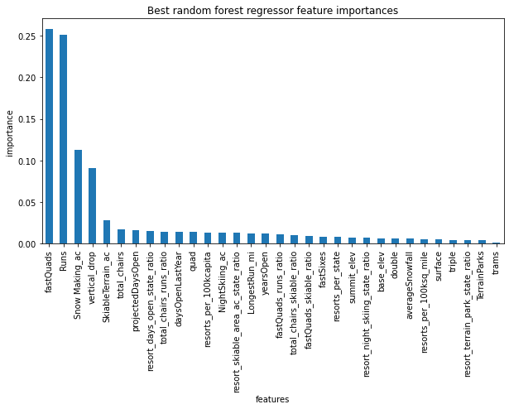
Identified Target Features
This is a plot of features and their respective importance
This plot suggest that ‘FastQuads’ is the most important feature.
After ‘FastQuads’, ‘Runs’ and ‘Snow Making_ac’ are most import feature respectively

Slide 6
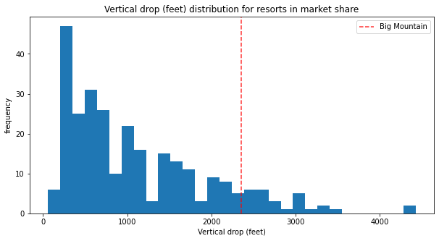
Big Mountain Resort VS Market Segment (Vertical Drop)
This plot shows Vertical resort distribution.
According to this plot vertical drop between 200 to 400 feet are most common.
Red dotted line shows the standing of Big Mountain Resort in current market.

Slide 7
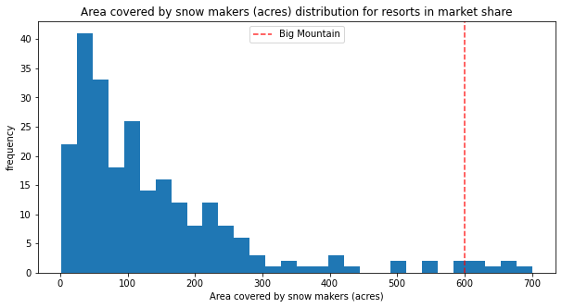
Big Mountain Resort VS Market Segment (Snow Makers)
This plot depicts the distribution of area covered by snow makers and their marker share.
Snow makers with covered area of less than 300 acres are much more numerous than those who with area covered higher than 300 acres.

Slide 8
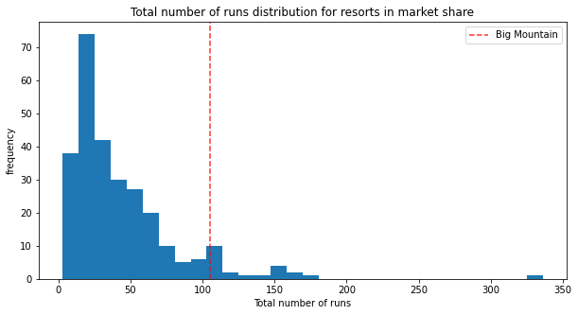
Big Mountain Resort VS Market Segment (# of Runs)
This plot depicts the total number of run distribution for resorts.
The red dotted line shows standing of Big Market Resort in current market.

Slide 9
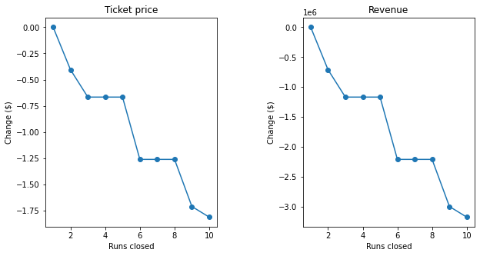
Summary
Least Profitable Scenario:
Close least 10 used runs
Most Profitable Scenario:
Increase vertical drop by 150 ft
Add run
Install chair lift
Operating costs
Supported Ticket Price Increase: $8.61
Additional Chair Lift Cost: $1.5 million
Expected Total From Ticket Increase: $15,065,471

