Slide 1

Customer Churn Analysis

Slide 2
ANNUAL SUMMARY
Total Revenue count crossed the mark of $21M . It is a comparable amount that can sustain the competitive market.
Average Customer Age is 47 while, Male and Female Customers have almost equal share in revenue. Both, of these indicates that our customer base has fair amount of diversity.
Average Monthly charge accounts for $64.7 which is very low as compared to national average of $166 and $144 for the State of California.
Customer who didn’t opt for an offer contributes almost 53.7% of revenue share, which a sign of trust among our regular customers. Among those who took offers, B contributes to maximum revenue share of 42.8%, followed by Offer A which is around 38% . Both, the offers are well accepted by customers. Offer E contributes to 1.1% of revenue share.
Total Number of referrals are 13,747 with 15% of customers at least referred once in their lifetime.
Average customer tenure is 44 months , which should be getting to the mark of 60 months to reach the minimum customer life-time target. However, Customers who took Offer A has an average tenure of 70 months, followed by Offer B having 53.3, which indicates that both the Offers are very well accepted by our customers, and we should produce similar type of offers.
Payment Method that is most preferred by the customer is Bank Withdrawal contributing 60.3% of total payment, followed by Credit Card holder contributing 38% of the total pay. However, mailed check is least preferred method.

Slide 3
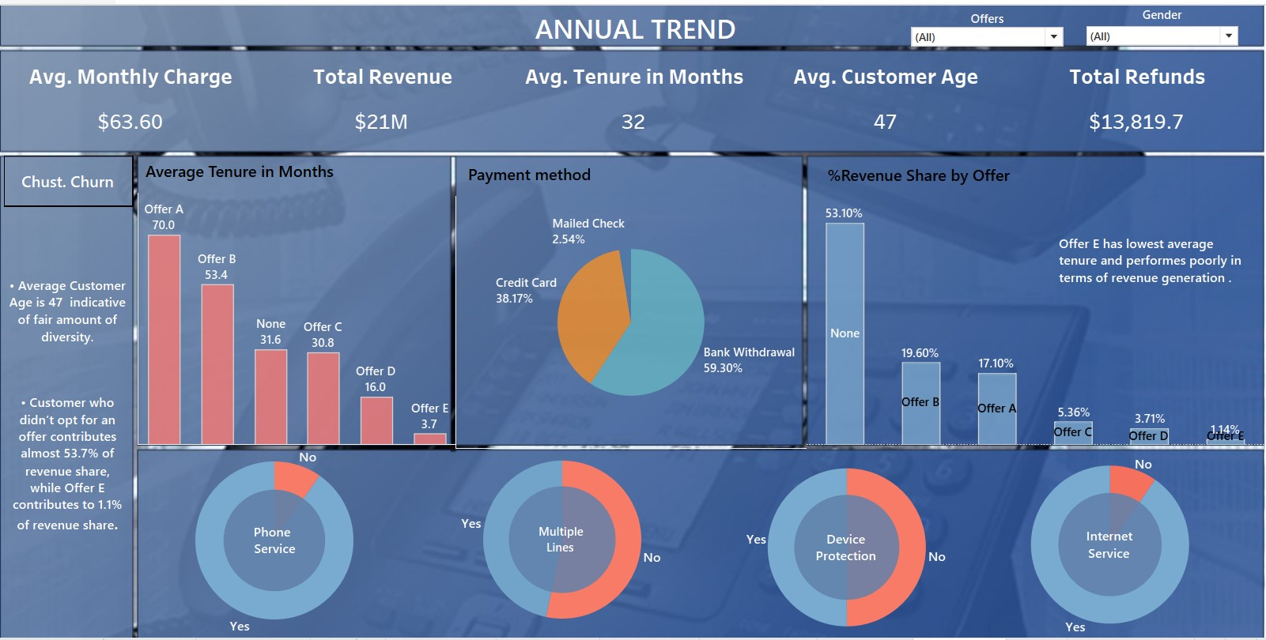

Slide 4
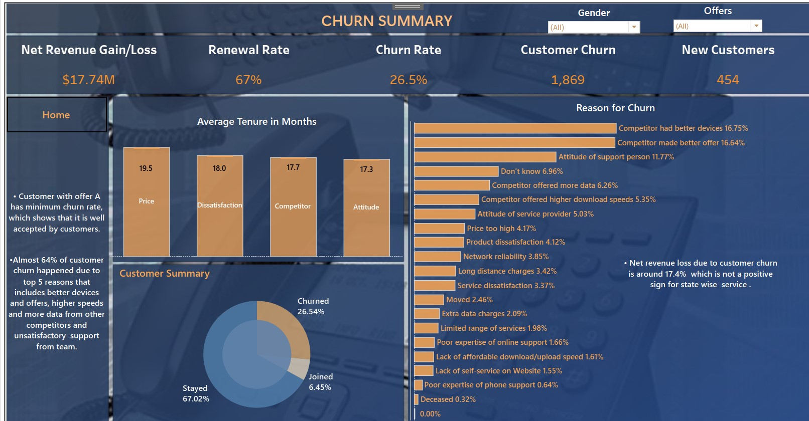

Slide 5
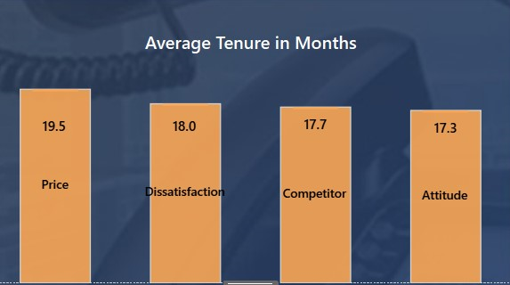
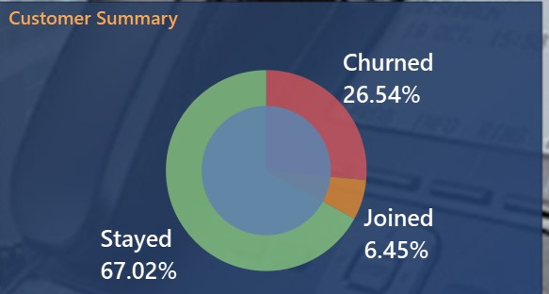
Total Customer churn is around 1870 which accounts for 26% of our customers. Both male and Female customers contribute equally to the churning rate showing no bias in the service.
Customer who chose offer E contributes to maximum churning rate shows that they contribute to non-regular customer section.
Customer with offer A has minimum churning rate, which shows that it is well accepted by customers.
However, most of the new customers opted for offer E , which shows that it only requires some changes that will reduce the variations in service.
Average customer lifespan is 32 months, but for the customers churn it is below 20.
Clearly, price point is not the issue for customers, and it can be observed that market research should be more strongly performed to compete with other providers.

Slide 6
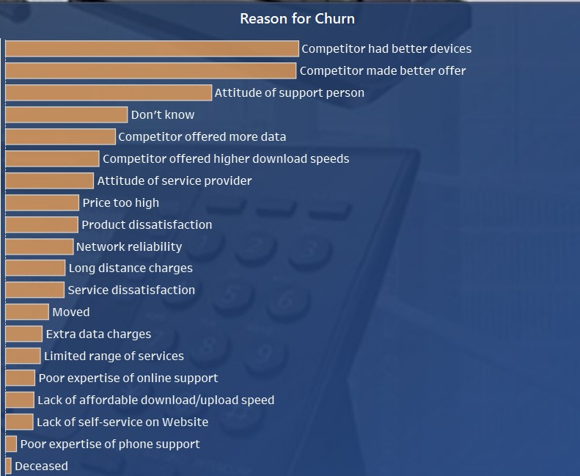
Almost 64% of customer churn happened due to top 5 reasons that includes better devices and offers, higher speeds and more data from other competitors and unsatisfactory support from team.
Other reasons for churn include product dissatisfaction, high price point, network reliability and long-distance charges.
Net revenue loss is around 17.4% which is not a positive sign for multi-channel service model. Urgent need for improvement is recommended.
No change in price point is recommended until planning to expand in other states.
Strong market research is recommended ,maybe hiring more experienced people in market research team for enhanced performance will be a good decision. Better offering from competitors is the primary reason for churn.
Regular training and evaluation of support team should be mandatory.
Need for expand in other states is recommended for more growth opportunities and that will also help us in organisational change management on large scale.

