Slide 1
Campus Mate
Prepared By-
S.Bhargav(23211a67a7)
T.Nikitha(23211a67b6)
S.Vinod(23211a67a6)
Guide Name
Dr. R.Venkata Ramana Chary,Professor
version
valid until
0.0.1
24/01/2026
2026-mini-B-4

Slide 2
contents
8
Conclusion
1
Justification of Title
7
2
Abstract
3
Existing System
4
Literature Survey
5
Proposed System
6
Technology Stack
7
Outcomes of Project

Slide 3
Justification of Title
The term “Campus” represents the primary users, focusing on their academic, emotional, and productivity needs throughout their educational journey.
“Mate” signifies a companion-like system that supports, guides, and assists students continuously, rather than acting as a simple question-answer chatbot.
The title reflects the system’s role as a personalized assistant that understands student behavior, learning patterns, and challenges.
“AI” highlights the use of Generative Artificial Intelligence and multi-agent architecture, enabling intelligent decision-making, contextual understanding, and adaptive responses.
The title accurately conveys the project’s goal of providing holistic student support using voice-enabled, agent-based AI technology.

Slide 4
Abstract
In the contemporary academic environment, students face multiple challenges such as complex curriculum demands, high cognitive load, emotional stress, and ineffective time management.
Existing educational tools and generic AI chatbots provide static and generalized responses, lacking personalization, contextual understanding, and emotional intelligence.
To overcome these limitations, this project proposes Campus Mate, a voice-enabled intelligent academic companion designed to support students throughout their Learning Life Flow (LLF).
The system is based on a Multi-Agent Architecture, where a central Agent Router analyzes user intent and dynamically delegates tasks to specialized agents for expert-level handling.
By integrating academic, emotional, and behavioral intelligence, Student Mate AI acts as a proactive AI partner that enhances student performance, well-being, and productivity.

Slide 5
Existing System
General-Purpose AI Chatbots (e.g., ChatGPT, Gemini, Claude)
Functionality:
These are powerful Large Language Models (LLMs) capable of answering questions, summarizing text, and generating code.
Limitations:
Lack of Context: They treat every query as a new session and do not maintain a long-term memory of the student's specific syllabus, weak areas, or past failures.
Session-Bound Memory: Although modern LLMs support large context windows (up to 200k tokens for sending and receiving), this memory is typically isolated to a single chat session. Once the session ends or the limit is reached, the context is lost. They do not retain a persistent, long-term memory of the student's history across the entire academic year.
Generic Responses: A query like "Explain this concept" yields a standard textbook answer, without adapting to the student's specific learning style (e.g., visual vs. theoretical).
No Emotional Intelligence: They cannot detect stress or burnout and will continue to push content even when a student is cognitively overloaded.

Slide 6
Existing System
Learning Management Systems (LMS) (e.g., Moodle, Canvas, Google Classroom)
Functionality: These platforms are excellent for content delivery, assignment submission, and grading.
Limitations:
Passive Tools: They are repositories of information, not active assistants. They do not "nudge" a student to study or warn them about procrastination.
Rigid Structure: They follow a "one-size-fits-all" approach and cannot personalize the learning path based on an individual student's pace or gaps in understanding.
Disadvantages of the Existing System
Fragmentation: Students must switch between 4-5 different apps (Chatbot for doubts, LMS for syllabus, Calendar for dates, Notes for planning).
Reactive, Not Proactive: Current tools wait for the student to ask or act. They do not proactively identify failure patterns or cognitive overload.
Lack of Voice Interaction: Most educational tools are text-heavy and require constant typing/reading, which can be fatiguing.
No "Human" Connection: There is no sense of a "companion" or "mate" that understands the emotional rollercoaster of student life.

Slide 7
Literature Survey
S No | Ref Paper Name | Author & Year | Objectives | Techniques/Algorithms used | Limitations
1 | Chatbots for Academic Stress and Student Support (ARU Case Study) | Nelekar et al. (2021) | To manage academic stress using conversational agents in university environments | Rule-based + AI Chatbots • Cultural Personalization • Short CBT Interventions | • Single-session interaction • No long-term memory • Limited scalability
2 | Effectiveness of Artificial Intelligence Chatbots on Mental Health & Well-Being in College Students: A Rapid Systematic Review | Shahzadhi Nyakhar, Hongwu Wang (2025) | To evaluate the effectiveness of AI chatbots in reducing anxiety, depression, and academic stress among college students. | AI Chatbots • Cognitive Behavioral Therapy (CBT) • Mood Tracking • Conversational Agents • Validated Scales (PHQ-9, GAD-7) | • High dropout rates • Limited emergency escalation • Mostly short-term interventions • No academic task integration

Slide 8
Literature Survey
S No | Ref Paper Name | Author & Year | Objectives | Techniques/Algorithms used | Limitations
3 | Agentic AI for Personalized Education and Adaptive Learning Environments | Pramod Appa Babar (2025) | To study agentic AI systems that autonomously adapt learning content and improve engagement, retention, and equity in education. | • Agentic AI • Multi-Agent Architectures • Reinforcement Learning • Bayesian Knowledge Tracing • Multimodal sensing | • High computational cost • Ethical & bias challenges • Requires strong infrastructure for real-time deployment

Slide 9
Proposed System
🧠
💾
🎙️
Multi-Agent Brain
Smart Memory
Voice-First
5-tier persistent system
Hands-free interaction
6 specialized agents

Slide 10
Proposed System
Multi-Agent Architecture (The "Brain")
Instead of relying on a single monolithic chatbot, Campus Mate adopts a multi-agent AI architecture, where each agent is optimized for a specific aspect of a student’s learning life:
Cognitive Load Balancer: Detects when a student is overwhelmed and suggests prioritizing tasks or taking breaks, rather than just adding more to the to-do list.
Personal Switch Agent: Adapts the teaching style based on the student's preference (e.g., explaining a complex topic like a "Friend," "Teacher," or "Interviewer").
Failure Pattern Analyzer: Proactively identifies recurring mistakes (e.g., "You always struggle with Calculus 3 days before the exam") and suggests corrective actions before failure occurs.
Concept Gap Detector: Identifies specific missing pieces of knowledge that are blocking understanding, rather than re-explaining the entire topic.
2. Voice-First Interface
The system integrates the Web Speech API for seamless Speech-to-Text and Text-to-Speech interaction.
This allows for hands-free learning, making it accessible and reducing screen fatigue. Students can converse naturally, just as they would with a human study partner.

Slide 11
Proposed System
3. Long-Term Context & Memory
Unlike general chatbots that lose context after a session, Student Mate AI maintains a persistent memory of the student's academic history, goals, and past interactions.
This allows for continuous personalization (e.g., "Remember you found this topic hard last week? Let's review it.").
4. Holistic "Learning Life Flow" (LLF) Support
The system goes beyond just academics. It integrates Emotional Support to handle exam stress and anxiety, ensuring the student's mental well-being is prioritized alongside their grades.
Advantages of the Proposed System:-
Hyper-Personalization: Adapts to the user's learning style, pace, and emotional state.
Proactive Assistance: Warns students about potential pitfalls (burnout, failure patterns) before they happen.
Unified Platform: Combines the functions of a tutor, counselor, planner, and friend into a single interface.
Accessibility: Voice interaction makes education more inclusive and engaging.

Slide 12
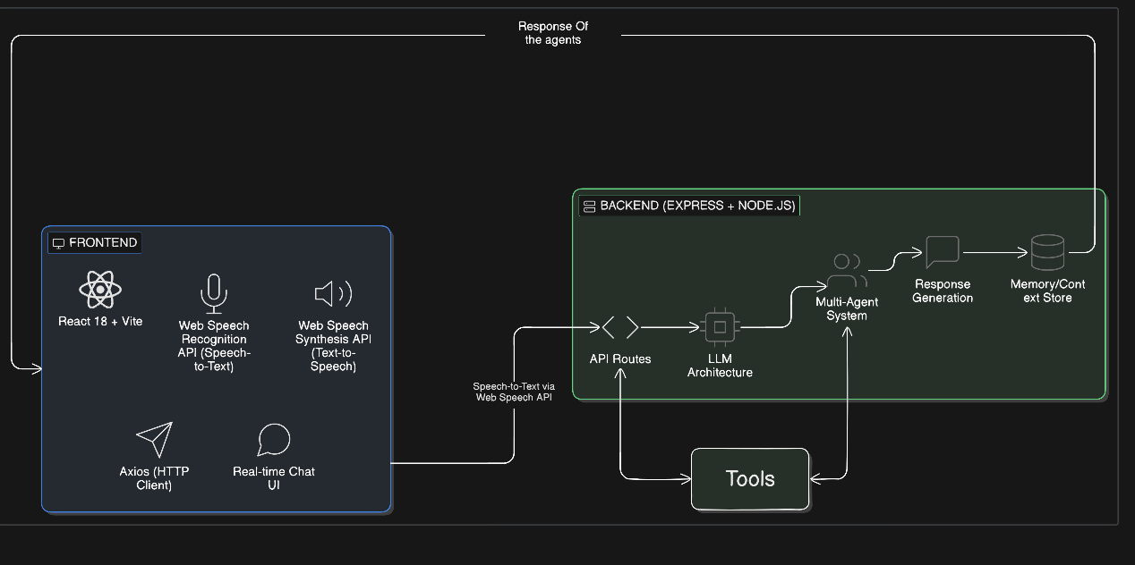
Architecture

Slide 13
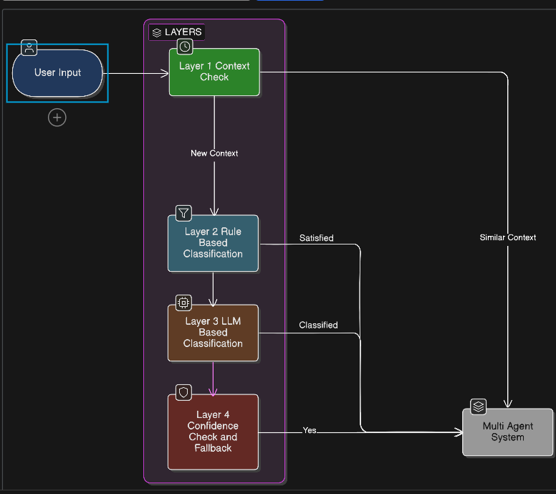
LLM Architecture

Slide 14
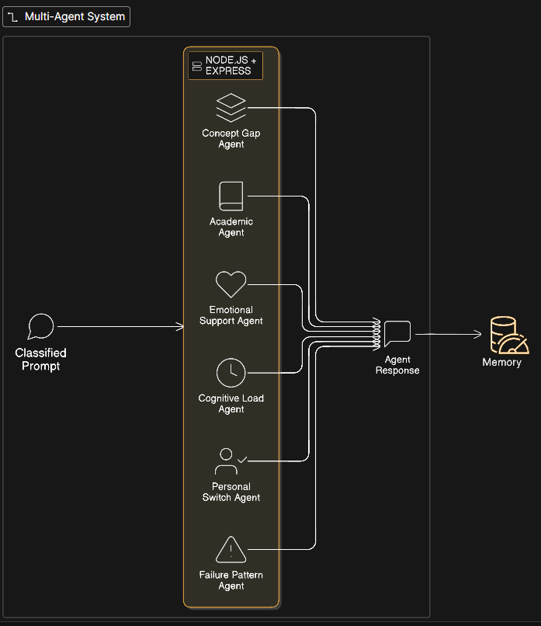
Multi-Agent Architecture

Slide 15
Agents
📚 Academic Agent
😊 Emotional
Support
🧘 Cognitive Load
Task Prioritization & Overwhelm Prevention
Concept Explanation & Problem-Solving
Mental Health & Stress Management
• Detects overwhelm signals in real-time
• Breaks complex topics into digestible steps
• Detects stress/anxiety via sentiment analysis
• Creates prioritized, manageable schedules
• Adapts depth to student's knowledge level
• Validates emotions empathetically
• Suggests breaks before burnout occurs
• Delivers evidence-based coping strategies
• Recommends resources progressively
🎭 Personal Switch
📉 Failure Pattern
🔍 Concept Gap
Predictive Failure Analytics
Prerequisite Knowledge Detection
Adaptive Communication Style
• Identifies recurring mistakes in episodic memory
• Friend-like (casual, encouraging)
• Detects missing foundational concepts
• Teacher-like (structured, detailed)
• Predicts struggles 3+ days before exams
• Mentor-like (strategic, growth-focused)
• Traces knowledge graph backward
• Recommends targeted practice interventions
• Fills gaps progressively before advancing

Slide 16
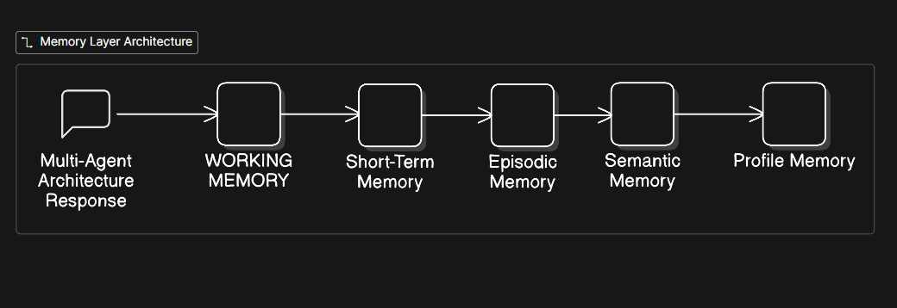
Memory Layer Architecture

Slide 17
Intelligent 5-Tier Memory System
Working Memory (5 messages) - Immediate context <1ms access
Short-Term Memory (20 messages) - Recent conversation with importance scoring
Episodic Memory - LLM-generated summaries of past conversations
Semantic Memory - Extracted facts (goals, struggles, learning patterns)
Profile Memory - Persistent user identity & preferences
Unlike generic chatbots, Campus Mate remembers everything across sessions—enabling continuous personalization

Slide 18
Outcomes of Project
1. Personalized Learning Experience The system adapts to individual learning styles using the Personal Switch Agent, ensuring complex concepts are explained in a way that matches the student's preference (e.g., as a friend or teacher), leading to deeper understanding.
2. Proactive Academic Improvement By utilizing the Failure Pattern Analyzer, the system identifies recurring mistakes and warns students before exams, shifting the focus from reactive correction to proactive prevention of low grades.
3. Optimized Mental Well-being The Cognitive Load Balancer detects signs of burnout and suggests prioritizing tasks or taking breaks, helping students maintain a healthy balance between high academic performance and mental health.
4. Hands-Free Accessibility The integration of the Web Speech API allows for natural voice interaction, reducing screen fatigue and making the tool accessible to auditory learners or those who prefer conversational study methods.
5. Scalable Technical Architecture The project successfully demonstrates a Multi-Agent System, proving that a modular network of specialized agents is more effective and scalable than a single generic chatbot for complex educational tasks.

Slide 19
Technology Stack
Layer | Technology | Purpose
Frontend | React | Dynamic and interactive UI
Voice Interface | Web Speech API | Voice input and speech output
Backend | Node.js, Express.js | Server-side runtime and API handling and routing
AI & Agents | Open Router | Building and managing AI agents
AI Model | Large Language Model (LLM) | Natural language understanding and generation
Architecture | Multi-Agent System | Task delegation and intelligent decision-making
Database | Vector Database | User data and interaction storage
Tools | Git, GitHub, Postman | Version control and API testing
Deployment | Vercel / Render | Hosting and deployment

Slide 20
Conclusion
In conclusion, this project successfully realizes the vision of Student Mate, an intelligent, voice-enabled academic companion tailored to the multifaceted needs of modern students. By moving beyond the constraints of static educational tools and generic chatbots, the system leverages a robust Multi-Agent Generative AI architecture to deliver a truly personalized experience.
The integration of specialized agents—capable of managing cognitive load, adapting teaching personas, and analyzing failure patterns—ensures that support is not just reactive, but proactive and
context-aware.
Furthermore, the inclusion of a voice-first interface significantly enhances accessibility and user engagement. Ultimately, Student Mate demonstrates the transformative potential of agent-based AI in education, offering a holistic solution that simultaneously enhances academic performance, fosters mental well-being, and drives long-term student productivity.

