Slide 1
Telugu Handwritten Word Recognition using Transformer Decoder Architecture with Script-Specific Decoding Constraints
Prepared By
S.Bhargav - 23211A67A7
T.Nikitha - 23211a67B6
S.Vinod - 23211a67A6
Guide Name
Dr. R.Venkata Ramana Chary,Professor
version
valid until
0.0.3
01/08/2026
2026-major-B-4

Slide 2
contents
8
Conclusion
1
Justification of Title
7
2
Abstract
3
Existing System
4
Proposed System
5
Outcomes of Project
6
Methodology / Algorithm
7
Datasets

Slide 3
Justification of Title
"Telugu Handwritten Word Recognition": Defines the exact problem domain.
"Transformer Decoder Architecture": Specifies the core autoregressive model used, contrasting with older RNN/LSTM approaches.
“CTC” — Connectionist Temporal Classification (A loss function used to train models like BiLSTM when the alignment between the input image and output text is unknown)
"Joint CTC Loss": Highlights the training innovation (using CTC as an auxiliary regularizer for the encoder).
"Script-Specific Decoding Constraints": Highlights the primary novelty—incorporating Telugu linguistic rules (Akshara bigrams) to prevent orthographically impossible predictions.

Slide 4
Abstract
Handwritten Text Recognition (HTR) for Indic scripts like Telugu is a challenging task. Telugu script has a complex, non-linear structure.
Frequent use of conjunct consonants (compound characters) increases recognition difficulty.
High intra-class variation in handwriting affects model performance. Traditional HTR systems rely on Connectionist Temporal Classification (CTC) with Recurrent Neural Networks (RNNs).
The proposed architecture uses a ResNet-18 Convolutional Encoder with an autoregressive Transformer Decoder. I
ntroduces a Script-Specific Decoding Constraint using a valid-bigram transition matrix based on Telugu linguistic rules (Aksharas).
Achieves better recognition of complex compound characters, especially those containing the virama (్).

Slide 5
Literature Survey
S No | Ref Paper Name | Author & Year | Objectives | Techniques/Algorithms used | Limitations
1 | Offline Handwritten Text Recognition for Indic Scripts | Dutta et al., 2020 | To create a benchmark dataset (IIIT-HW-Dev / IIIT-HW-Telugu) and evaluate baseline HTR performance for Indic scripts | CRNN (Convolutional Recurrent Neural Network) + CTC loss. | CTC assumes conditional independence; struggles with compound characters, matras, and complex Telugu ligatures.
2 | End-to-End Offline Handwritten Text Recognition for Telugu | IIT-M Thesis, 2021 | To improve Telugu HTR accuracy over basic models by using multidimensional sequence learning. | CNN + MDLSTM (Multi-Dimensional LSTM) + CTC. | LSTMs have limited global context; relies purely on data without hard orthographic rules; achieved 7.48% CER on Telugu datasets.

Slide 6
Literature Survey
S No | Ref Paper Name | Author & Year | Objectives | Techniques/Algorithms used | Limitations
3 | PARSeq: Scene Text Recognition with Permuted Autoregressive Sequence Models | Bautista et al., 2022 / 2024 | To achieve SOTA text recognition by learning internal language models through permutation-based autoregressive decoding. | Vision Transformer (ViT) encoder + autoregressive decoder + attention. | Designed for general/Latin scene text; does not inherently model strict grammatical and orthographic constraints of Indic scripts.
4 | Recent Advancements in Telugu OCR and HTR | Various (2024–2025 papers) | To improve accuracy on Telugu historical documents and modern handwriting. | Standard CNN–RNN pipelines with CTC + data augmentation. | Still largely reliant on sequential RNNs; critical gap in enforcing hard constraints to prevent impossible Telugu character sequences.

Slide 7
Existing System
Architecture: Convolutional Neural Network (CNN) feature extractor + Bidirectional Long Short-Term Memory (BiLSTM) sequence model + CTC Loss.
Drawbacks / Limitations:
Conditional Independence Assumption: CTC predicts characters independently at each time step. It does not "remember" the previous character when predicting the current one.
Orthographic Violations: Because it lacks memory, the CTC model frequently outputs text that violates Telugu spelling rules (e.g., predicting a vowel modifier directly after a virama, which is impossible in Telugu).
Poor on Compound Characters: Conjunct characters (like క్ష, త్ర) require precise sequencing of consonants and viramas. The existing system struggles heavily here.

Slide 8
Proposed System
Architecture: ResNet-18 CNN Encoder + Autoregressive Transformer Decoder + Auxiliary CTC Head.
Key Innovations :
Autoregressive Decoding: The Transformer decoder predicts the next character based on the image features and all previously predicted characters, capturing complex dependencies.
Linguistic Constraints: We inject a Telugu bigram transition matrix during the decoding phase. If the model tries to predict an invalid character combination (e.g., EOS after a virama), the constraint heavily penalizes it, forcing a grammatically valid prediction.
Joint CTC-Attention Training: We train the model with both Cross-Entropy (CE) loss on the decoder (weight: 0.7) and CTC loss on the encoder (weight: 0.3). The CTC loss forces the encoder to learn better character-level visual features early in training, stabilizing the Transformer.

Slide 9
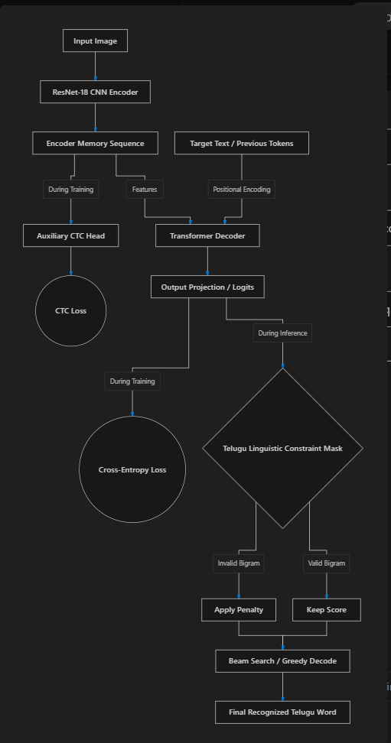
Architecture
Diagram

Slide 10
Methodology/Algorithm
Data Ingestion & Preprocessing:
Load images and labels.
Apply Unicode Normalization (NFC) to ensure consistent character representation.
Apply image transformations (grayscale conversion, elastic distortion for augmentation, aspect-ratio-preserving resize to 64x512).
Feature Extraction:
The ResNet-18 encoder processes the image and compresses the height dimension, outputting a sequence of feature vectors (e.g., 64 timesteps of size 256).
Joint Training Phase:
The encoder output goes to an auxiliary CTC head to compute CTC Loss.
The encoder output and the target text sequence go into the Transformer Decoder using "Teacher Forcing".
The decoder outputs logits, and Cross-Entropy (CE) loss is computed.
Total Loss = (0.7 * CE) + (0.3 * CTC).
Constrained Decoding (Inference):
The model predicts character by character.
At step t, the model outputs probabilities for the next character.
The Telugu Masking Algorithm checks the prediction at t-1. It applies a massive penalty (-10.0) to any character at step t that is linguistically invalid to follow t-1.
Beam Search (k=5) is used to find the most likely overall sequence.

Slide 11
Datasets
Primary Dataset: IIIT-INDIC-HW-WORDS (Telugu Split)
A publicly available, standard benchmark dataset containing handwritten Telugu words.
Ensures our results are comparable to published literature.
Data Structure: Grayscale images of cropped words paired with their ground-truth Unicode text labels.
Preprocessing: Labels undergo NFC Unicode normalization to prevent encoding mismatches. Images are resized to a fixed height of 64px while maintaining aspect ratio (up to a max width of 512px).
Augmentation: Elastic distortion and random affine transformations are applied during training to improve robustness against varying handwriting styles.

Slide 12
Technologies Used
Language: Python 3.10+
Deep Learning Framework: PyTorch 2.x (with Torchvision)
Environment Management: uv (Fast, isolated Python package manager)
Hardware / Infrastructure: Remote SSH Server with NVIDIA GPU (CUDA accelerated)
Metrics & Logging: TensorBoard (for real-time tracking), editdistance (for CER calculation)
Data Processing: NumPy, Pandas, Pillow (PIL), OpenCV, SciPy

Slide 13
Implementation
Step 1: Dataset Collection & Preprocessing
Downloaded and organized the IIIT-HW-Telugu dataset containing 1,18,651 handwritten Telugu word images.
Split data into Training (80,693), Validation (20,048), and Test (17,910) sets.
Applied Unicode NFC normalization to ensure consistent Telugu character representation.
Designed a custom Telugu vocabulary with 91 tokens including special symbols (PAD, SOS, EOS, UNK).
Created a data-driven grammar matrix by learning valid Telugu character transitions from the training data.
Step 2: Image Processing & Data Augmentation
Standardized all images to a fixed size of 64 × 512 pixels.
Converted images to grayscale and normalized pixel values.
Applied augmentation techniques:
Elastic distortion
Rotation
Perspective transformation
Stroke thickening/thinning
Brightness and contrast variation
Generated robust training samples to handle different handwriting styles.

Slide 14
Implementation
Step 3: Feature Extraction using Modified ResNet-18
Developed a customized ResNet-18 CNN encoder.
Modified stride operations ("stride surgery") to preserve horizontal information required for text recognition.
Converted grayscale images into 3-channel format for compatibility with ImageNet-pretrained weights.
Extracted 64 sequential visual feature vectors, each representing a portion of the handwritten word.
Step 4: Model Development
Two recognition models were implemented:
A. CTC Baseline Model
ResNet-18 Encoder
2-layer BiLSTM
CTC Loss for alignment-free sequence learning
B. Autoregressive Transformer Model
Transformer Encoder–Decoder architecture
Joint training using:
Cross-Entropy Loss (70%)
Auxiliary CTC Loss (30%)
Teacher forcing and label smoothing applied for stable learning.

Slide 15
Implementation
Step 5: Telugu Grammar-Constrained Decoding & Training
Implemented a Telugu Grammar Mask using the learned character transition matrix.
During decoding, invalid Telugu character sequences were penalized.
Trained both models on an RTX 3090 Ti GPU using:
AdamW optimizer
Learning rate scheduling
Gradient clipping
Saved best-performing checkpoints automatically.
Step 6: Evaluation, Analysis & Results
Evaluated models using:
Character Error Rate (CER)
Word Error Rate (WER)
Bootstrap Confidence Intervals
Conducting ablation studies on:
Grammar Mask
Beam Search
Auxiliary CTC Loss
Generating performance graphs, confusion matrices, and error analyses.

Slide 16
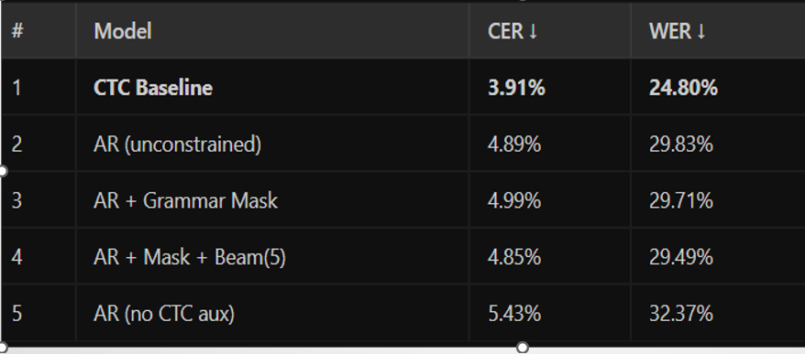
Results

Slide 17
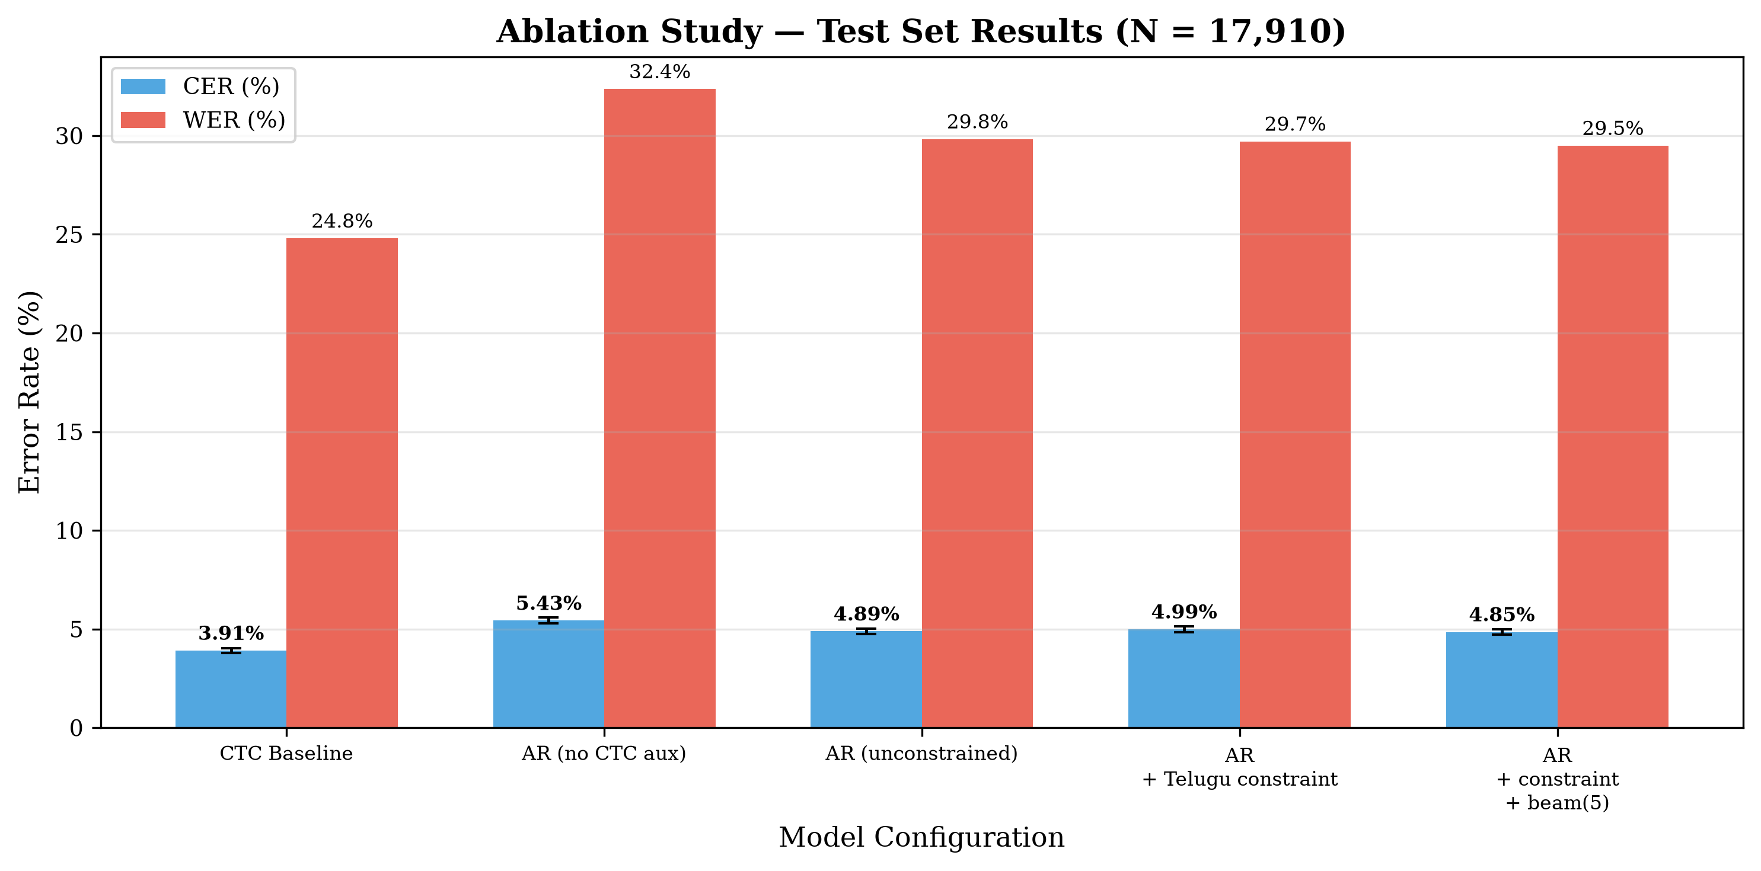
Results

Slide 18
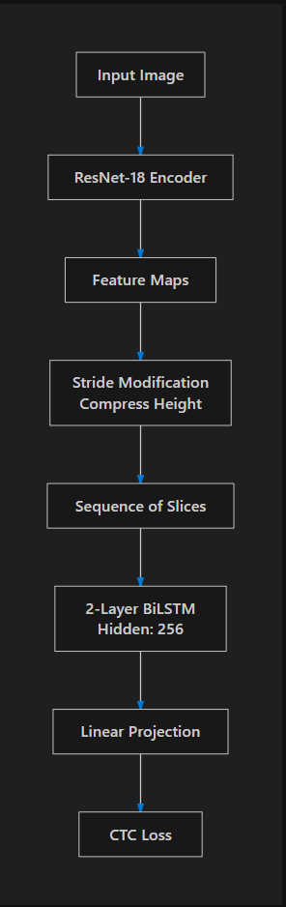
Baseline
Architecture

Slide 19
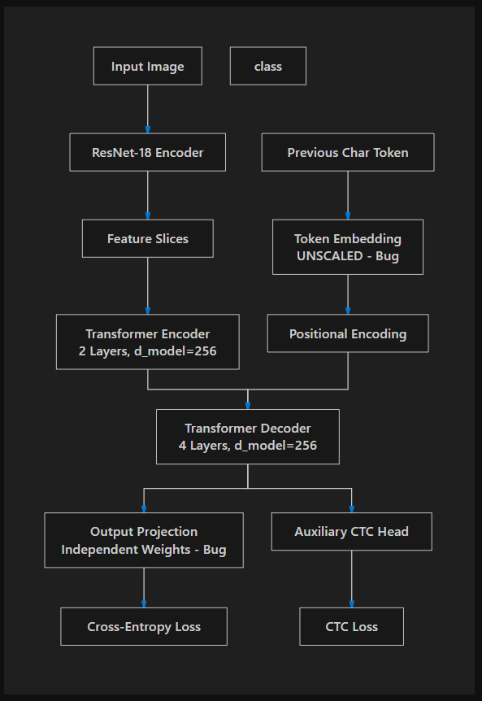
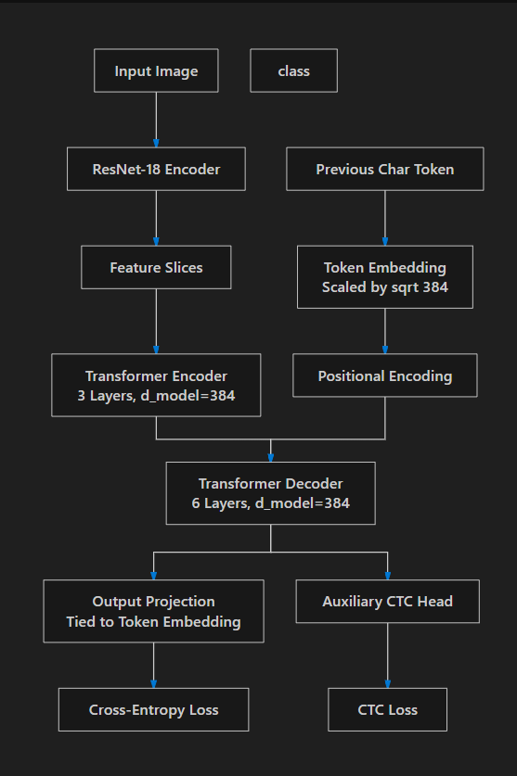
OLD
NEW
AR
Architecture

Slide 20
IMPROVEMENTS
1. Embedding Scaling Restored
The model converts each character/token into a numerical representation called an embedding. These embeddings are now multiplied by a scaling factor before being sent into the Transformer. This helps the model learn more smoothly and keeps the training process stable, especially in the attention layers.
2. Weight Tying
The model now uses the same weights for both:
Converting tokens into embeddings (input side)
Predicting output tokens (output side)
Instead of learning two separate sets of parameters, it shares one set. This reduces the number of parameters, improves learning efficiency, and usually helps the model converge faster and achieve better accuracy.
3. Improved Regularization Settings
Batch Size Reduced to 64
The model now processes 64 samples at a time instead of a larger batch size. Smaller batches often help the model find more robust solutions and generalize better to unseen handwriting.
Dropout Reduced to 0.15
Dropout randomly disables a small percentage of neurons during training to prevent overfitting. Lowering dropout to 0.15 retains more information during training while still providing regularization.

Slide 21
Outcomes of Project
By generating an Ablation Table, we will prove the following outcomes:
Baseline: CTC-BiLSTM model achieves a baseline Character Error Rate (CER) (e.g., ~15%).
Architecture Improvement: The AR Transformer alone (without constraints or CTC aux) outperforms the CTC baseline due to its autoregressive nature.
Auxiliary Loss Impact: Adding the Joint CTC loss (weight 0.3) to the AR model improves convergence speed and overall CER.
Constraint Impact (Core Outcome): Applying the Telugu Linguistic Constraints drastically reduces errors on compound characters (Virama breakdown), achieving the lowest overall CER and WER (Word Error Rate).

Slide 22
Conclusion
Successfully addresses the limitations of standard CTC-based HTR systems for complex Indic scripts.
Utilizes an autoregressive Transformer decoder for improved contextual character prediction.
Incorporates Telugu script grammatical rules through script-specific constrained decoding.
Significantly reduces orthographic (spelling) errors in recognized text.
Employs Joint CTC-Attention Training for stable and efficient model learning.
Combines modern deep learning architectures with domain-specific linguistic knowledge.
Achieves robust and highly accurate Telugu handwritten word recognition.
Facilitates improved digitization of historical and modern Telugu handwritten documents.

