Slide 1
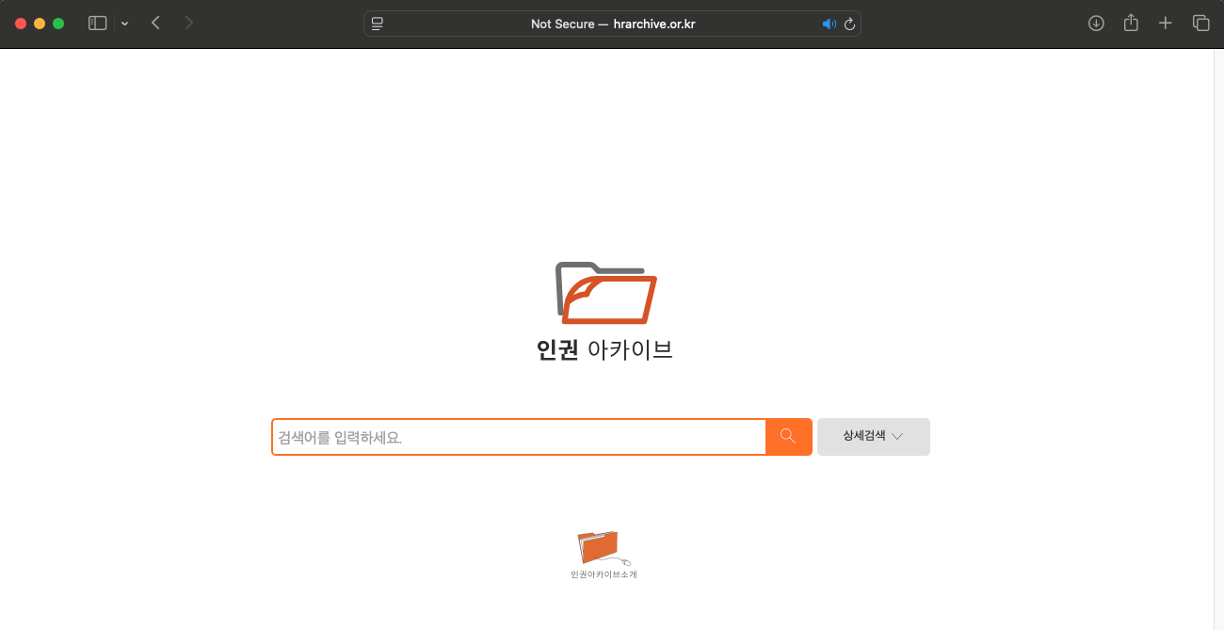
www.hrarchive.or.kr
Two search terms: 인권 (human rights), 권리 (rights)
1990.1.1 ~ 2024.12.31
Some conditions to be added (see next slides)
Goal:
Collecting Metadata
Download the pdf files of the items listed in the metadata
Advanced search
Phase I & II

Slide 2
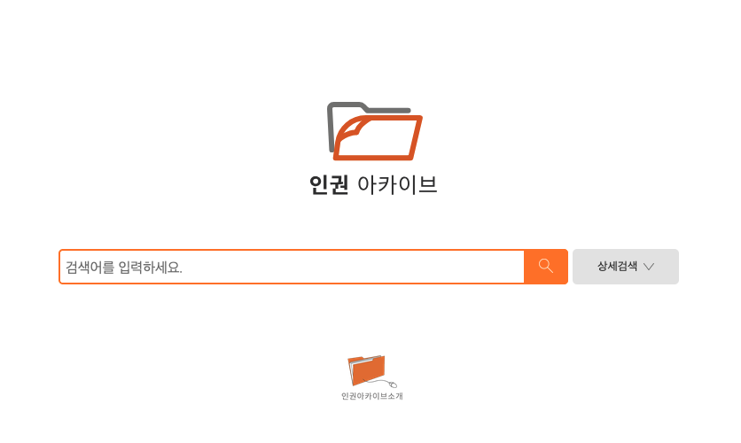
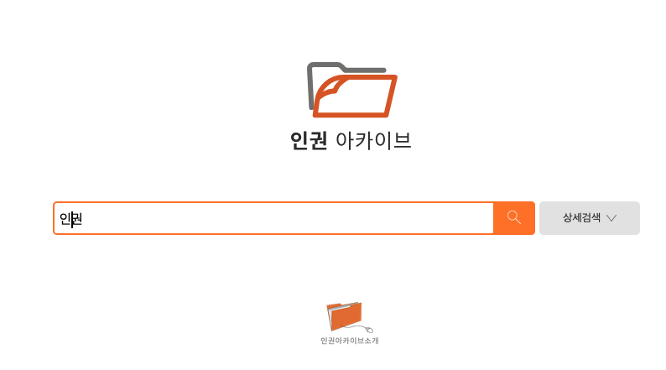
Phase I: Creating a metadta for documents containing 인권 or 권리

Slide 3
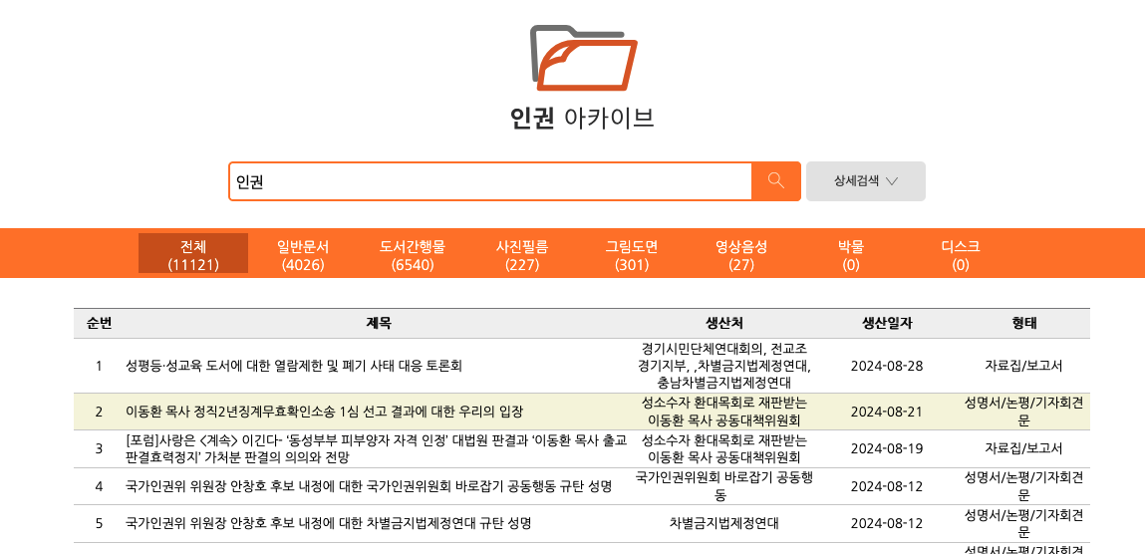
Use search term : 인권, then scrape the result table for ‘전체문서’ (all)
(1121 documents)
Scrape this table!
Repeat this process for the second search term 권리

Slide 4
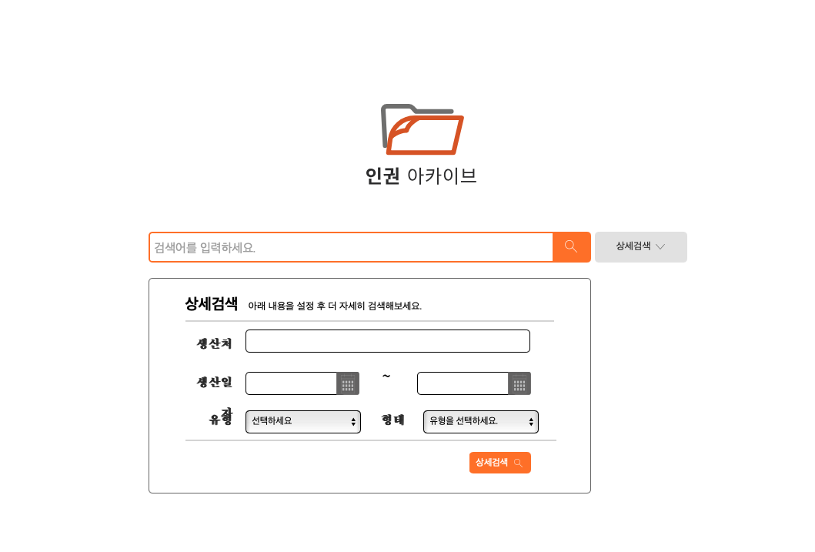
Phase II
Click “advanced search,” then this window pops up

Slide 5
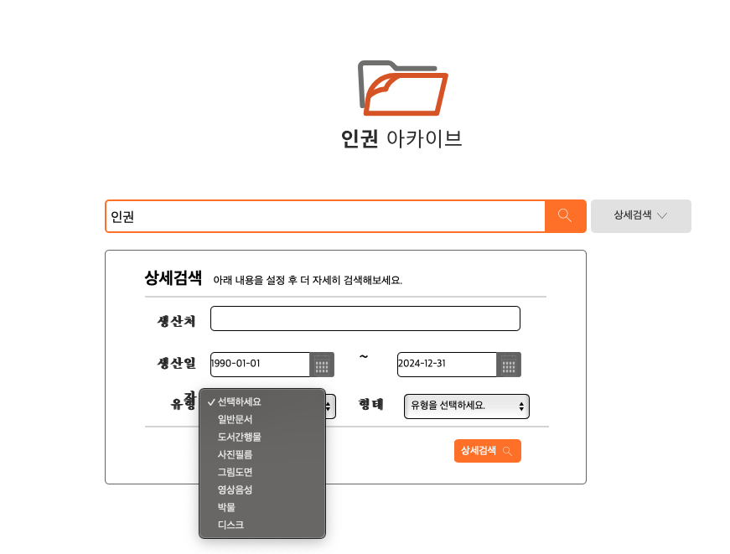
1. 인권
2.Date: 1990-01-01 ~ 2024-12-31
3. Filter 1: Choose the first item: 일반문서 (documents)

Slide 6
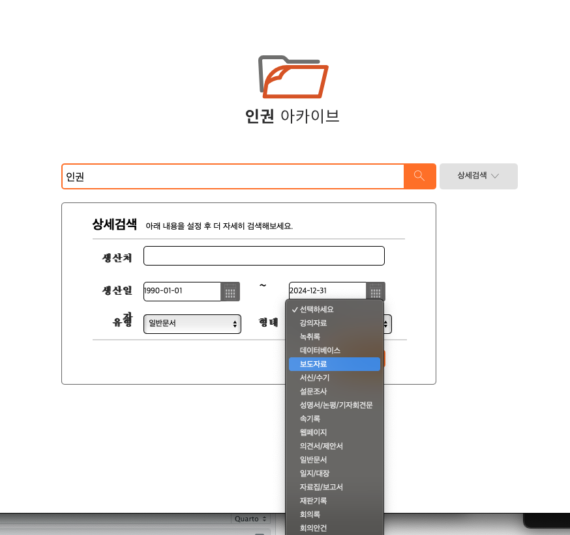
Filter 2: Choose one option at a time.
보도자료: press release
성명서/논평/기자회견문: statement/commentary/press release
자료집/보고서: brochure/report

Slide 7
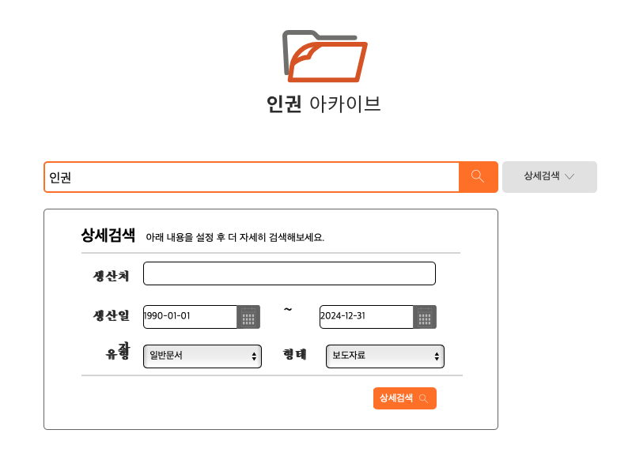
Then, click

Slide 8
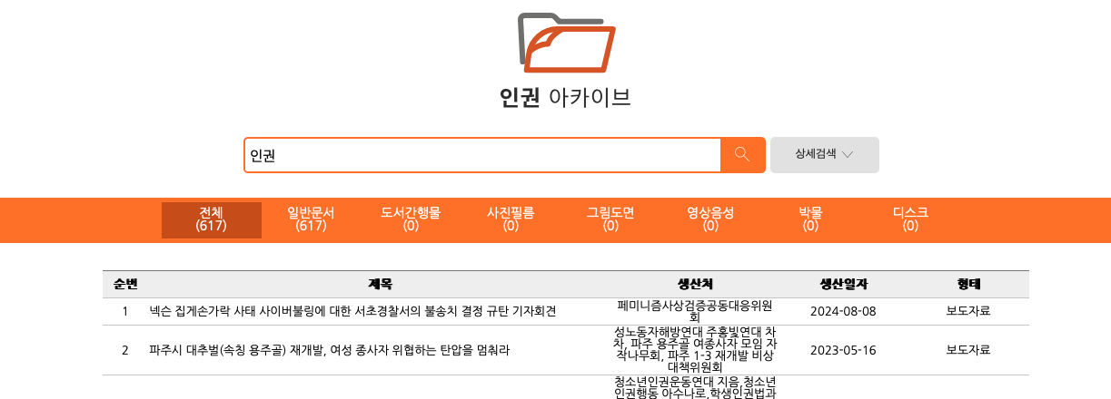
Output:
Click (일반문서): 617 documents are found. 일반문서 > 보도자료
Search term: 인권
Check whether your second filter is used correctly (here, 보도자료)

Slide 9
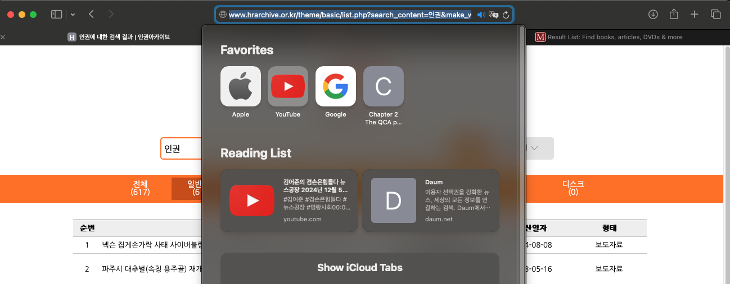
Copy this url to scrape the result table that contains the meta data of the 617 documents
http://www.hrarchive.or.kr/theme/basic/list.php?search_content=인권&make_where=&make_start_date=1990-01-01&make_end_date=2024-12-31&category=100&shape=111&navigation_menu=100

Slide 10
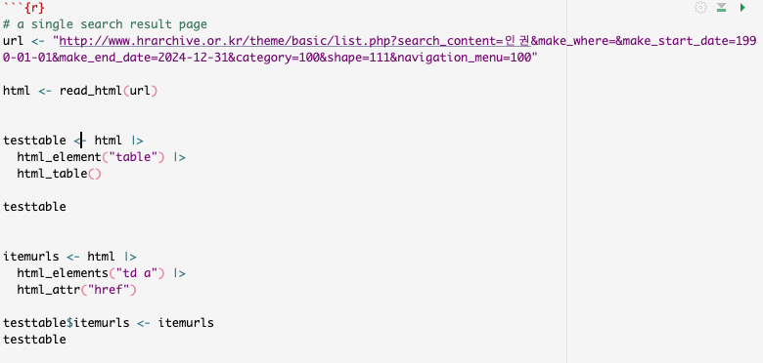
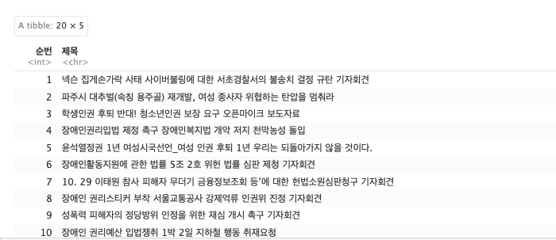
This first trial generates 5 columns: 순번 (id), 제목 (title), 생산처 (author), 생산일자 (date), 형태 (type)
Type should be one of the followings:
보도자료: press release
성명서/논평/기자회견문: statement/commentary/press release
자료집/보고서: brochure/report

Slide 11
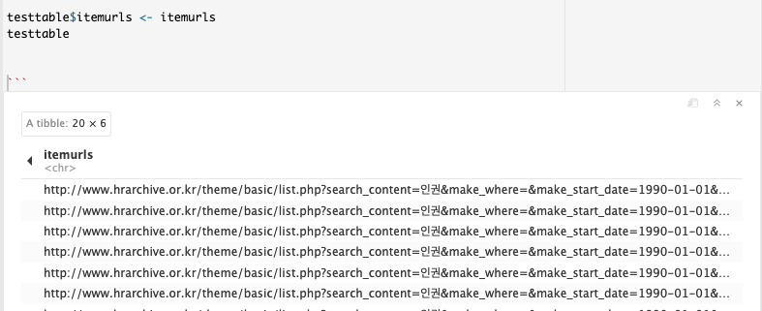
To add a url that has the actual pdf document

Slide 12
If you click the first item in the table (slide #6),

Slide 13
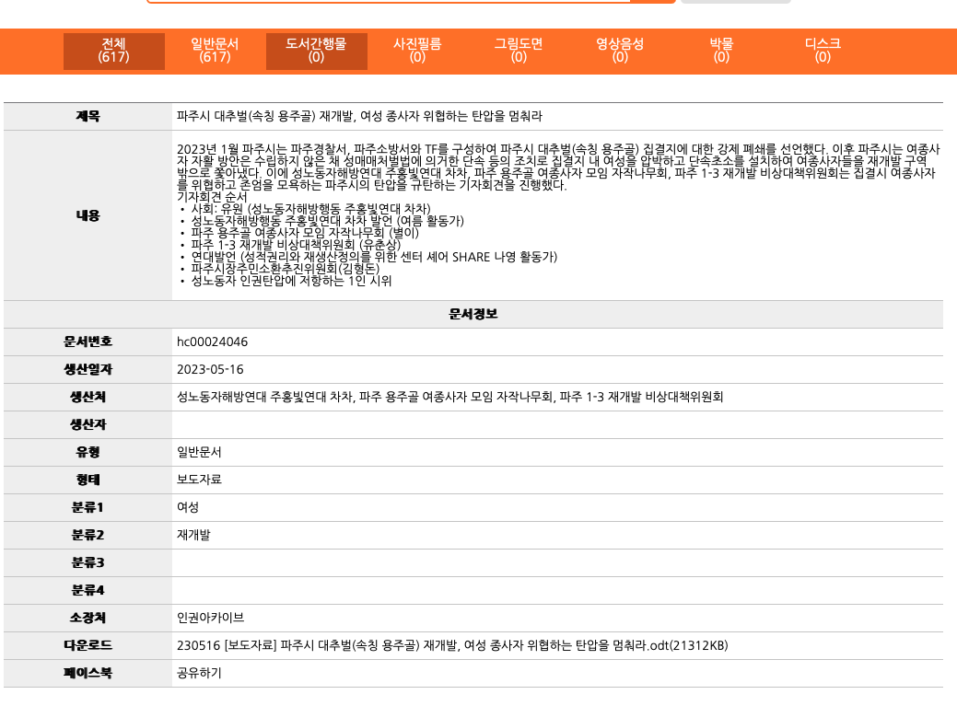
You will see this second table with more details about the document
title
summary
Document information
Document id
Date of publication
Author (organization)
Author (individual)
Filter 1:
Can you scrape some items from this table and put them together in the metadata table?
Filter 2:
Category 1
Category 2
Category 3
Category 4
Download

Slide 14
To Dos:
Phase I: creating two metadata tables for the two keywords 인권 & 권리
Phase II: using ‘advanced search’
Repeat this process with two keywords: 인권 (human rights) and 권리 (rights)
The first filter set to :일반문서 (documents)
Use three items in the second filter:
보도자료 (press release)
성명서/논평/기자회견문 (statement/commentary/press release)
자료집/보고서 (brochure/report)
Generate a metadata df (1)
Download the pdf files
Convert pdf to csv in a dataframe
Maybe I have to get you an external hard drive…
By Mon, Feb 10 / 10 hours?
There’s another website waiting for you!

