Slide 1
Laser-Induced Hydrophobicity
on Thin Film Surfaces
A Review of Four Research Studies on Excimer & Nanosecond Laser
Surface Modification Techniques
Palavalasa Bhargav
Cp303

Slide 2
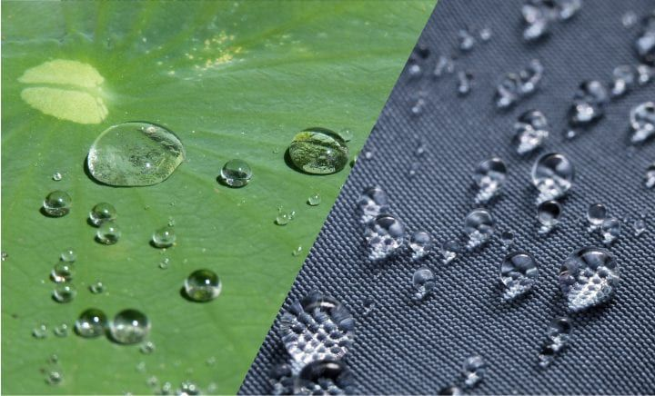
What is Hydrophobicity? — The Lotus Effect
Contact Angle (θ)
The angle formed at the liquid–solid–vapour interface. Measured using sessile drop method.
Surface Type | Contact Angle (θ) | Wetting Behaviour
Superhydrophilic | θ < 10° | Complete wetting
Hydrophilic | 10° < θ < 90° | Partial wetting
Hydrophobic | 90° < θ < 150° | Low wettability
Superhydrophobic | θ > 150° | Lotus effect / self-cleaning
Fig1: lotus effect
Wenzel Model: Liquid fills surface grooves → enhanced wettability. Cassie-Baxter Model: Air trapped in grooves → reduced contact area → superhydrophobicity.

Slide 3
Why Do We Need Hydrophobicity?
🦠 Anti-Bacterial Surfaces
🔬 Anti-Fouling & Self-Cleaning
💧 Microfluidics & Lab-on-Chip
Superhydrophobic surfaces entrap air at the liquid–solid interface, preventing direct bacterial contact. This is vital for medical implants, catheters, and surgical tools.
Water droplets roll off carrying contaminants. Key in marine coatings, solar panels, and optical lenses.
Precise control of droplet movement on Si wafers enables miniaturised diagnostic devices and biosensors.
⚡ Electronics & Semiconductors
🏥 Biomedical Implants
✈️ Aerospace & Automotive
Hydrophobic PVDF surfaces enable moisture-resistant piezoelectric sensors and integrated circuits.
Controlled wettability reduces protein adsorption and platelet activation on implant surfaces, improving biocompatibility.
De-icing, drag reduction, and corrosion resistance are achievable on metal surfaces via superhydrophobic coatings.
Source: Sohrabi et al. (2022); Liu et al. (2014); Dongre et al. (2023); Liu et al. (2010)

Slide 4
Techniques to Generate Hydrophobicity
SURFACE ROUGHNESS METHODS
SURFACE CHEMICAL MODIFICATION
Laser Texturing
UV Laser + Methanol (Si)
ns/fs pulsed lasers create micro/nano structures (ablation threshold creates surface topography)
ArF excimer laser dissociates CH₃OH → –OCH₃ radicals bond to Si surface, reducing surface energy
Chemical Etching
KrF Laser on PVDF
Acid or base solutions roughen metal/polymer surfaces to increase contact angle
Photochemical changes create C–CF₂ and C–F bonds, reducing surface energy
Ion-Beam Lithography
Spray Coating
Focused ion beams pattern nanostructures on Si surfaces
Low surface energy materials (ZnO, fluoropolymers) applied as hydrophobic coating
Photolithography
Self-Assembled Monolayers
UV-patterned photoresist used to create ordered micro-pillars
Organic molecules adsorb onto surfaces to form oriented hydrophobic layers
Solution Immersion
Plasma Treatment + SAMs
One-step process on copper/metal substrates for non-flaking superhydrophobic surfaces
Plasma creates reactive sites; SAMs then lower surface energy selectively

Slide 5
How to Measure Hydrophobicity
💧 Sessile Drop Method
🔭 Ramé-Hart NRL Goniometer (Model 100)
A small water droplet (~3–5 µL) is placed on the surface. The profile of the drop is captured with a CCD camera. The contact angle θ is measured from the drop profile at the solid–liquid–vapour interface.
A precision optical goniometer. The sample is placed on a stage, a drop is dispensed via a microsyringe, and the angle is measured optically. Four independent measurements per site for accuracy.
Used in: All four studies reviewed
Used in: Liu et al. (2014) – Si/methanol study
📐 OCA20 Contact Angle Meter (DataPhysics)
🔬 AFM — Atomic Force Microscopy
Automated video-based system. Measures static, advancing, and receding contact angles. Volume of drop is precisely controlled (3 µL).
Measures surface roughness (R_RMS). Surface topography is mapped in tapping mode over 5×5 µm regions. Roughness determines if hydrophobicity is morphology-driven.
Used in: Liu et al. (2010) – PVDF study
Used in: Liu et al. (2014); Liu et al. (2010)
🖥️ SEM — Scanning Electron Microscopy
⚛️ XPS — X-ray Photoelectron Spectroscopy
High-resolution imaging of laser-induced micro/nano structures. Reveals surface morphology changes such as ablation craters, conical structures, and wall-like formations.
Identifies surface chemical bonds. Confirms formation of Si–OCH₃ (hydrophobic) or C–CF₂/C–F bonds on PVDF after laser irradiation.
Used in: Sohrabi et al. (2022); Dongre et al. (2023); Liu et al. (2010)
Used in: Liu et al. (2014); Liu et al. (2010)

Slide 6
EXPERIMENT 1
Hydrophobicity Generation
on Silicon (Si 001)
Excimer Laser-Assisted Chemical Process for Formation of
Hydrophobic Surface of Si (001)
— Liu, Hassen & Dubowski (2014)

Slide 7
Exp. 1 — Si (001): Experimental Setup
Sample:
P-doped (n-type) Si (001) wafers; 12×6 mm; resistivity 3.1–4.8 Ω·m
Pre-treatment:
Cleaned with Opticlear, acetone, IPA (5 min each); HF etch (1:50, 1 min) to remove native oxides
Key Chemical Mechanism
Irradiation Medium:
Samples immersed in degassed methanol (CH₃OH) in a 0.74 mm microfluidic chamber
1. ArF laser (193 nm) irradiates Si immersed in methanol 2. Photodissociation: CH₃OH → H• + •OCH₃ radicals 3. –OCH₃ radicals bond to Si dangling bonds 4. Si–(OCH₃)ₓ compound forms → lowers surface energy 5. Result: CA increases from 77° → 103° 6. KrF (248 nm) CANNOT photodissociate CH₃OH → no effect
Laser (Primary):
ArF excimer laser — λ = 193 nm; fluences 30, 65, 80 mJ/cm²; up to 1000 pulses
Laser (Control):
KrF excimer laser — λ = 248 nm; up to 250 mJ/cm² (used for comparison)
Post-treatment:
Rinsed with DI water, dried with N₂, stored in sealed N₂ container
Key Principle:
ArF laser (193 nm) photodissociates CH₃OH → –OCH₃ radicals bind to Si dangling bonds → Si–OCH₃ (hydrophobic)

Slide 8
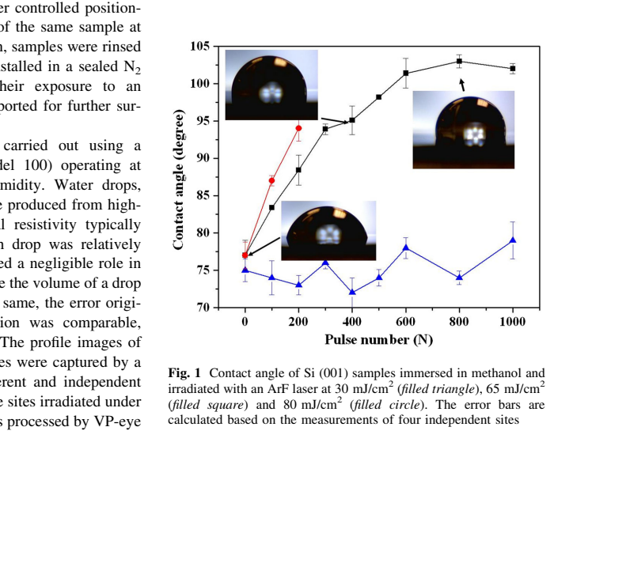
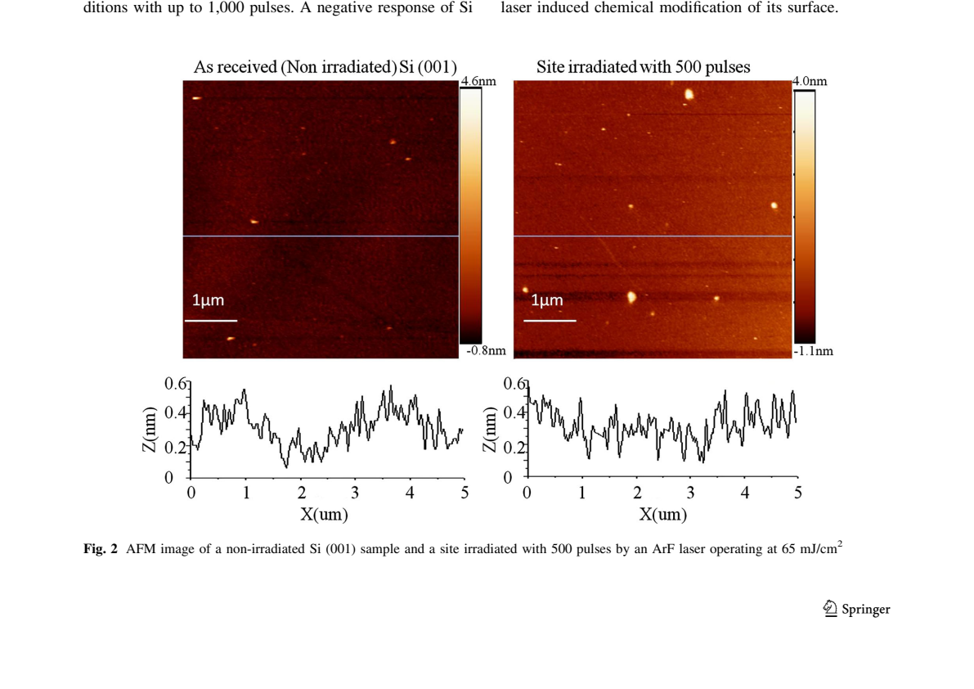
Exp. 1 — Si (001): Results — Contact Angle & AFM Analysis
Fig. 3– AFM images: non-irradiated (left) vs. 500-pulse irradiated (right)
Key Findings — AFM & Contact Angle
Fig. 2 – Contact angle vs. pulse number for ArF laser (Liu et al., 2014)
• CA increased: 77° → 103° at 65 mJ/cm², 800 pulses • AFM roughness: 0.31 nm (ref) vs. 0.37 nm (irradiated) — NO morphology change • Hydrophobicity is purely chemical (Si–OCH₃), not structural • KrF laser showed NO change in CA (cannot break CH₃OH)
Saturation at 103°: Surface energy limited by CH₃ packing. Stability: CA stable for 4 h in N₂; drops to 56° after 20 h in air (SiO₂ oxidation).

Slide 9
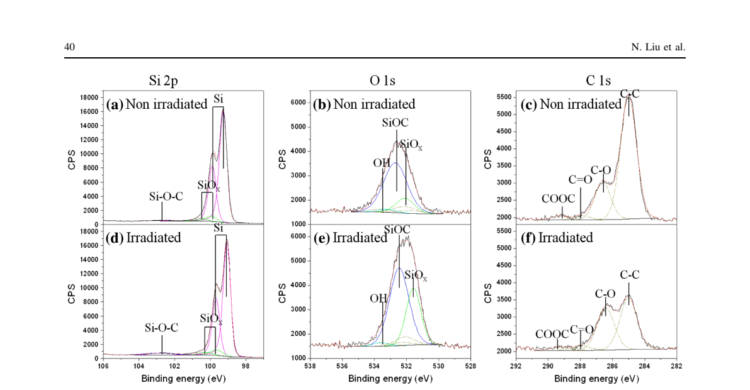
Exp. 1 — Si (001): XPS Characterisation
Fig. 4 – XPS Si 2p, O 1s, C 1s spectra: non-irradiated (a–c) vs. ArF laser irradiated 500 pulses at 65 mJ/cm² (d–f) (Liu et al., 2014)
Si 2p Peak
O 1s Peak
Conclusion
Si–(OCH₃)ₓ concentration: 0.7% (ref) → 3.5% (irradiated). 5-fold increase confirms –OCH₃ bonding.
Si–(OCH₃)ₓ peak at 532.6 eV increases from 1% → 2.5%. Confirms oxygen bonding through methoxy groups.
Hydrophobicity of Si is entirely due to chemical modification (Si–OCH₃), not surface roughness change.

Slide 10
EXPERIMENT 2
Superhydrophobic-Antibacterial
Polycarbonate Fabrication
Using Excimer Laser Treatment
— Sohrabi, Pazokian, Ghafary & Mollabashi (2022)

Slide 11
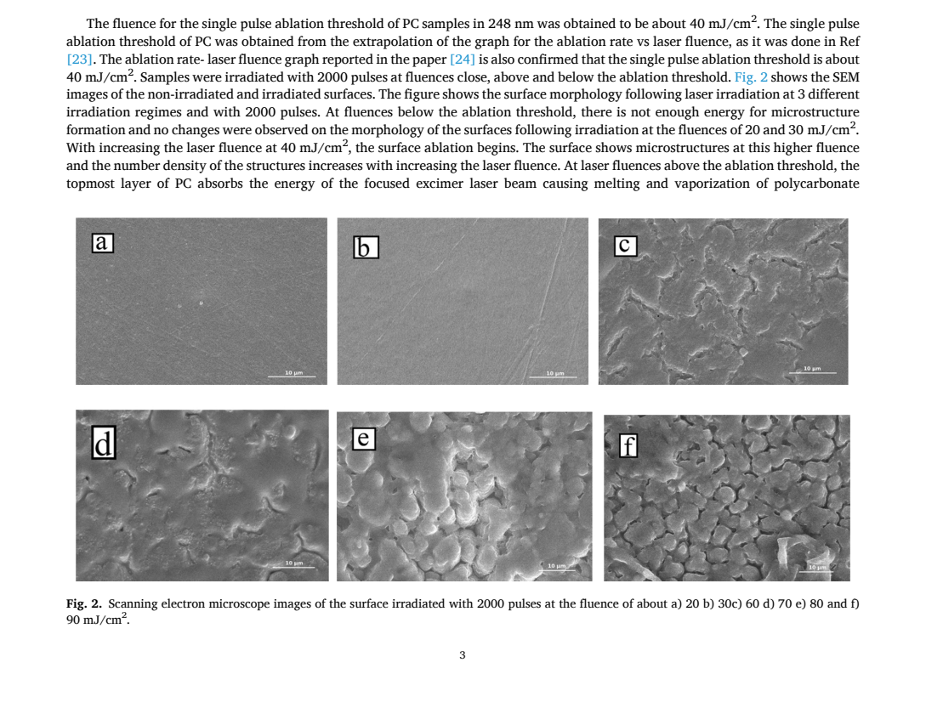
Exp. 2 — Polycarbonate: Setup & SEM Surface Morphology
Experimental Parameters
Sample:
PC (Polycarbonate) 1 mm thick, 1×1 cm, cleaned with water & alcohol
Laser:
KrF pulsed excimer — λ = 248 nm, 25 ns pulse, 2 Hz rep. rate
Fluence range:
Below, near & above ablation threshold (20–100 mJ/cm²)
Ablation threshold:
~40 mJ/cm² (single pulse for PC at 248 nm)
Pulses:
2000 pulses per sample
Wettability:
Sessile drop method; each condition repeated 5 times; ±2° error
Fig. 5 – SEM images at 2000 pulses: (a) 20, (b) 30, (c) 60, (d) 70, (e) 80, (f) 90 mJ/cm² (Sohrabi et al., 2022)
Antibacterial:
E. coli adhesion test with gram staining (OD₆₀₀ ≈ 0.5)
Below ablation threshold (<40 mJ/cm²): no microstructures. Above threshold: melting + rapid re-solidification → micro-scale structures → increased roughness → superhydrophobicity at >80 mJ/cm².

Slide 12
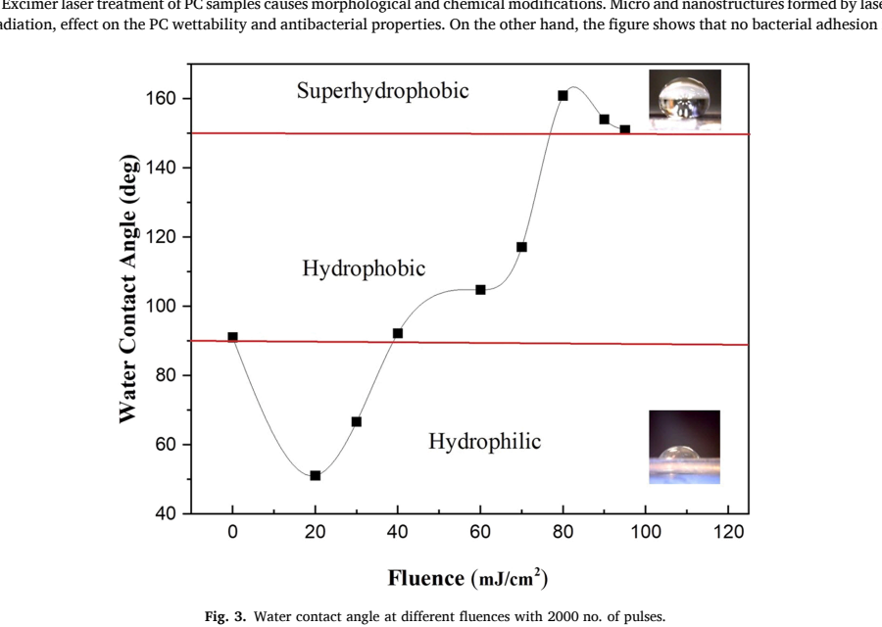
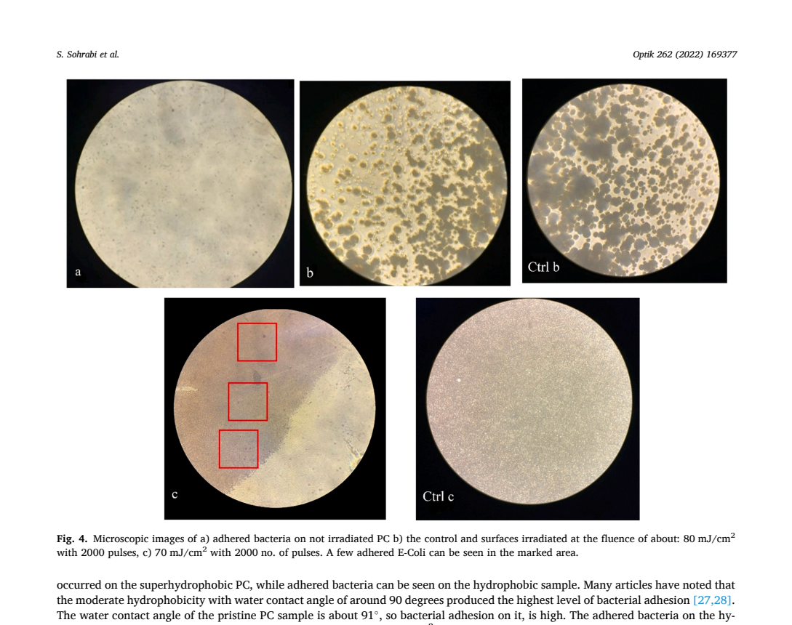
Exp. 2 — Polycarbonate: Wettability & Antibacterial Results
Fig. 6 – Water contact angle vs. laser fluence (2000 pulses) (Sohrabi et al., 2022)
Fig. 7 – Gram-stained E. coli: (a) untreated PC, (b) superhydrophobic 80 mJ/cm², (c) hydrophobic 70 mJ/cm²
Wettability Results
Antibacterial Results
< 38 mJ/cm²: Hydrophilic (θ ↓ to 51°). 60–70 mJ/cm²: Hydrophobic (θ ~90–120°). > 80 mJ/cm²: Superhydrophobic (θ > 150°). Carbonization + double-scale roughness + air pockets = superhydrophobicity.
Superhydrophobic PC (>80 mJ/cm²): NO E. coli adhesion. Hydrophobic (~70 mJ/cm²): some adhesion. Pristine PC (θ ≈ 91°): highest adhesion. Air pockets block direct bacteria–surface contact.

Slide 13
EXPERIMENT 3
Hydrophobicity of
Poly(Vinylidene Fluoride) — PVDF
Increasing the Hydrophobic Property of PVDF by KrF Excimer Laser Irradiation
— Liu, Wei, Jiang & Nie (2010)

Slide 14
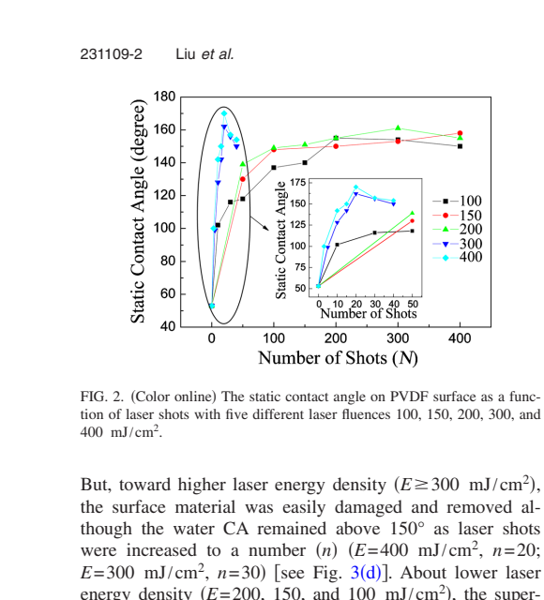
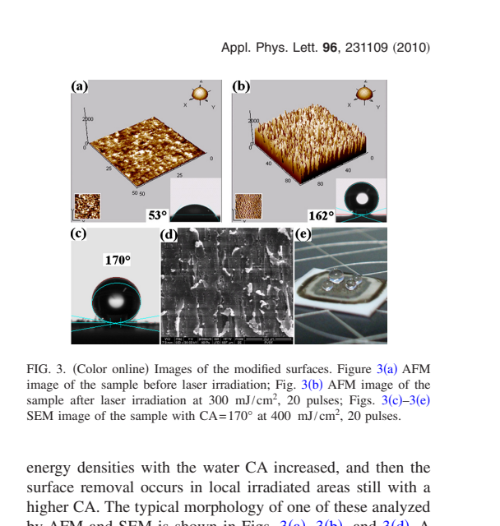
Exp. 3 — PVDF: Setup & Contact Angle Results
Experimental Parameters
Sample:
PVDF film, 0.5 mm thick, irradiated vertically in air
Laser:
Lambda Physik LPX305iF KrF — 248 nm, 30 ns, 50 Hz max, 1 Hz used
Fluence range:
100 – 400 mJ/cm² (E from 50 to 600 mJ/cm²)
Pulses (N):
0 to 500 shots studied
Optics:
9×9 lens array for uniform spot; 2 biconvex lenses
CA Meter:
OCA20 (DataPhysics); 3 µL drops; 5 measurements/site
Fig. 8 – Static CA vs. laser shots at 5 fluences (Liu et al., 2010)
Fig. 9 – AFM (a,b) & SEM (c–e) images of PVDF surfaces
Key Findings:
Characterisation:
AFM (PicoScan 2500), SEM (FEI Quanta 200), XPS (AXIS Ultra)
Maximum CA = 170° at 400 mJ/cm², 20 pulses (from 53°). Superhydrophobicity achieved in seconds (< 1 minute!). At ≥ 300 mJ/cm², surface damage occurs but CA remains > 150°. At lower fluences (100–200 mJ/cm²), ~200 pulses needed — 10× longer process.

Slide 15
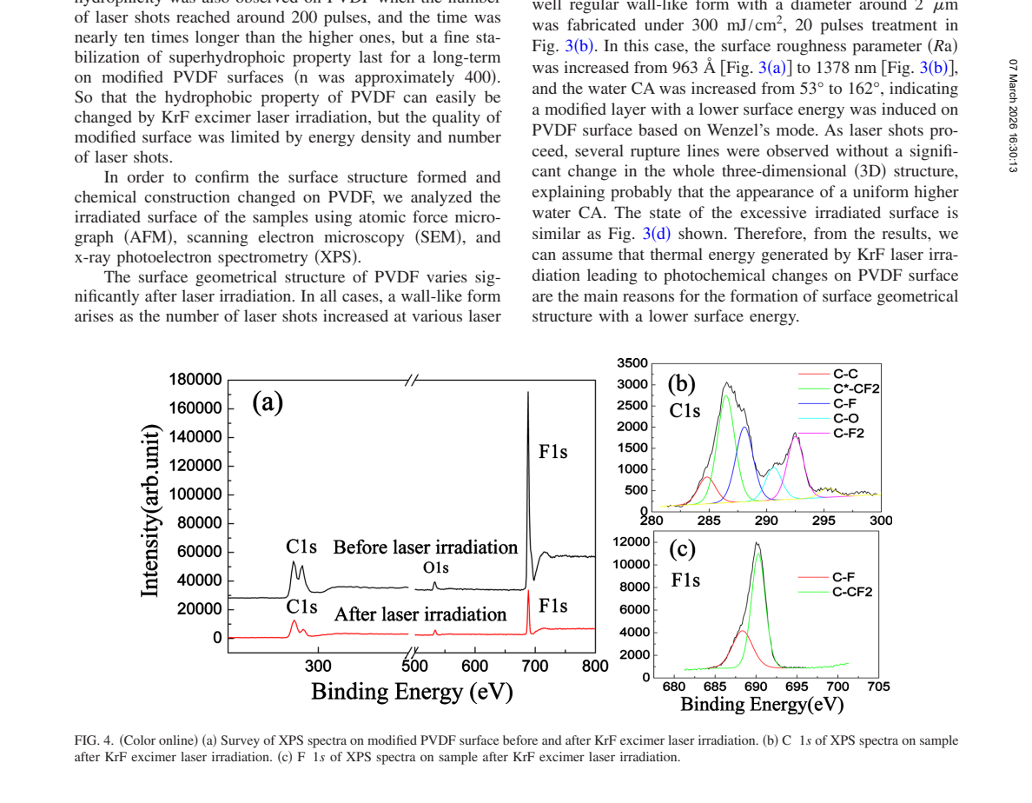
Exp. 3 — PVDF: XPS Analysis & Hydrophobicity Mechanism
Fig. 10 – XPS spectra: (a) survey before/after irradiation, (b) C 1s deconvolution after irradiation, (c) F 1s spectra (Liu et al., 2010)
Before Irradiation
After KrF Irradiation
Mechanism
PVDF dominated by CH₂ (286.42 eV) and CF₂ (290.84 eV) bonds. C 1s: 46%. F 1s: 44%. Contact angle: 53°.
New bonds appear: C–CF₂ (21%), C–F (15%), C–F₂ (12%). F 1s shows C–CF₂ and C–F peaks. These lower surface energy → superhydrophobicity.
KrF laser thermal energy causes photochemical cleavage of C–H and C–F bonds → C–CF₂ and C–F form → regular wall-like 3D structure + reduced surface energy → CA up to 170°.

Slide 16
EXPERIMENT 4
Superhydrophobic Textures on
Stainless Steel 316 (SS316)
Generation of Super-hydrophobic Textures Using a Nanosecond Pulsed Laser Machine
— Dongre, Rane, Raut et al. (AIP Conf. Proc. 2023)

Slide 17
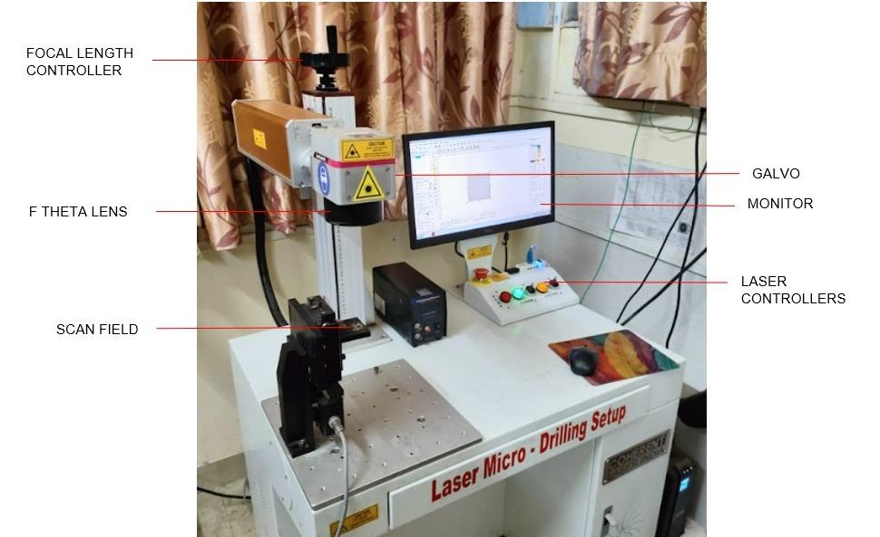
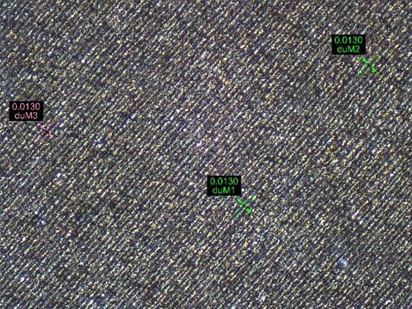
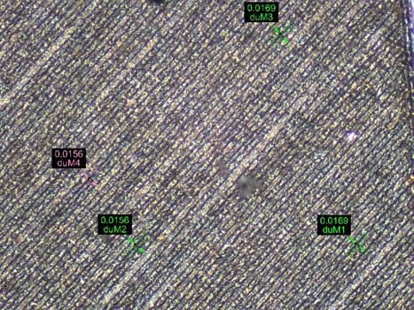
Exp. 4 — SS316: Experimental Setup & Microscopic Results
Experimental Parameters
Material: SS316 plates, 30×30 mm, 1 mm thick
Laser: NUQA-1064-NA-0030-YZ, 30W max, 100±20 ns pulse
Power: 30%, 40%, 50% (= 9W, 12W, 15W)
Scan Speed: 200, 250, 300 mm/s
Frequency: 70, 80, 90 kHz (Taguchi DOE)
Pattern: 10×10 mm square, horizontal hatches, 150 µm spacing, 66 hatches
Microscope: Rapid I-vision for hatch width/depth
Fig. 1 — Nanosecond Pulse LASER machine (NUQA-1064-NA)
Fig. 11 — Rapid I-vision microscopic images of LASER textured SS316 surfaces (Dongre et al., 2023)

Slide 18
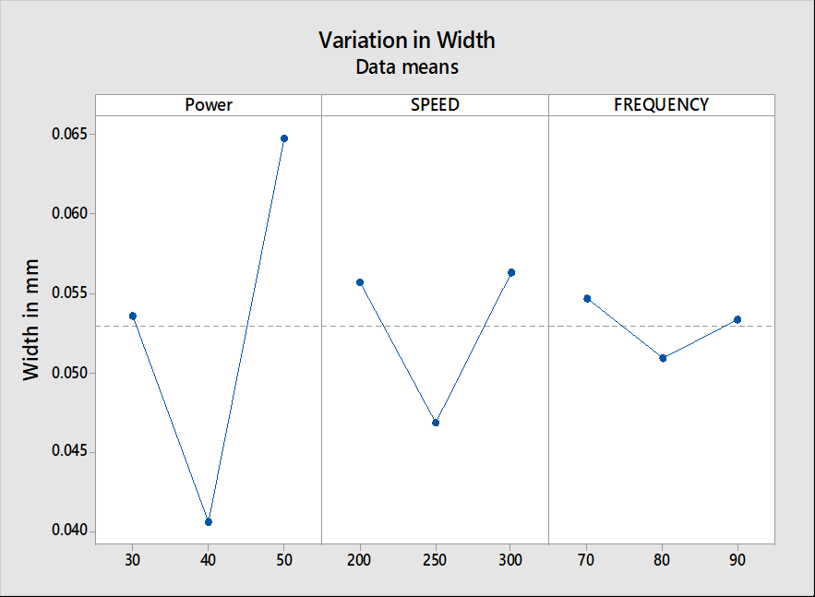
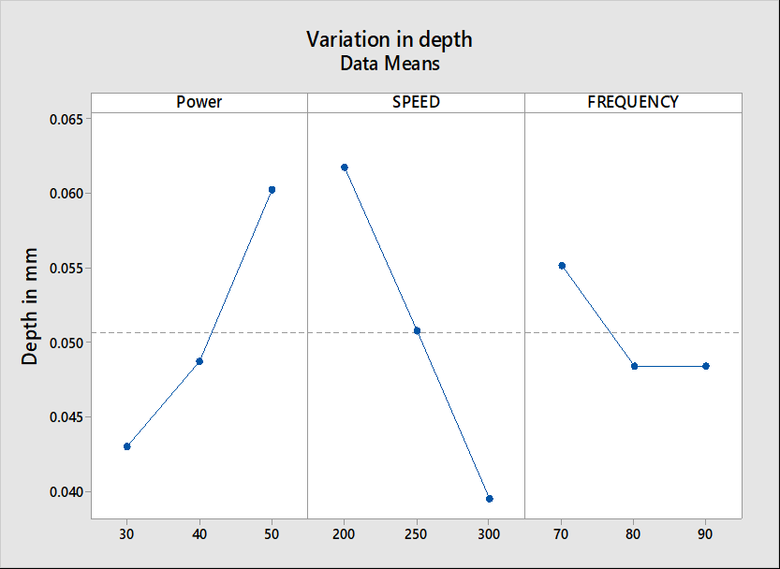
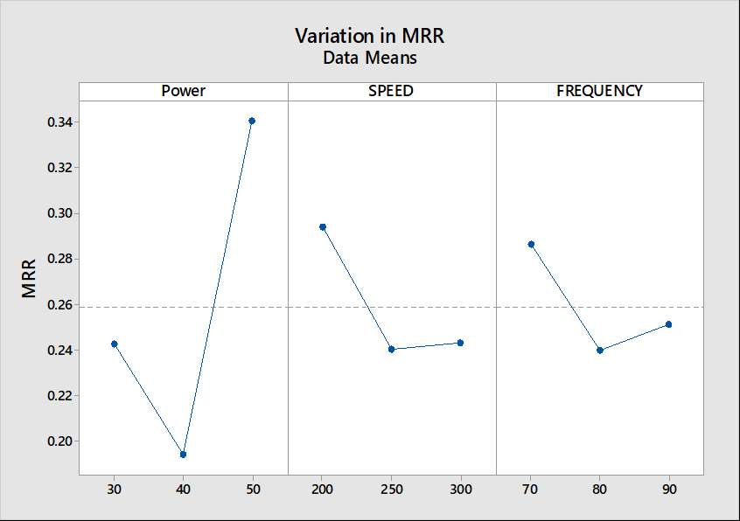
Exp. 4 — SS316: Results — Width, Depth & Material Removal Rate
Fig. 12 — Hatch Width vs. Parameters
Fig. 13 — Hatch Depth vs. Parameters
Fig. 14 — MRR vs. Parameters
Key Findings
Width Trend
Decreases at 40% power then rises at 50%. Power has the sharpest influence on kerf width.
Depth Trend
Increases with power; decreases with scan speed. Frequency stabilizes at 80–90 kHz.
MRR Trend
Dip then rise with all three parameters. Units: mm³/s. Max at 50% power, 200 mm/s.
Optimal Params
9–12W, 70–80 kHz, 250–300 mm/s → CA > 150° (lit. ref.)

Slide 19
Comparative Summary of All Three Experiments
Parameter | Exp. 1 — Si (001) | Exp. 2 — Polycarbonate | Exp. 3 — PVDF
Laser Used | ArF (193 nm) KrF for comparison | KrF (248 nm) 25 ns pulses | KrF (248 nm) 30 ns pulses
Sample Material | Si (001) wafer (n-type, P-doped) | Polycarbonate film 1 mm thick | PVDF film 0.5 mm thick
Irradiation Medium | Methanol solution (CH₃OH) | Ambient air | Ambient air
Fluence / Pulses | 65 mJ/cm², 800 pulses | 20–100 mJ/cm² 2000 pulses | 100–400 mJ/cm² 20–500 pulses
Max CA Achieved | 103° (hydrophobic) | > 150° (superhydrophobic) at > 80 mJ/cm² | 170° (superhydrophobic) at 400 mJ/cm², 20 pulses
Mechanism | Chemical: Si–OCH₃ bond formation | Physical: micro/nano structures + carbonization | Both: C–CF₂/C–F bonds + wall-like structures
Characterisation | AFM, XPS, CA | SEM, CA, E.coli test | AFM, SEM, XPS, CA
Key Application | Microfluidics, lab-on-chip | Medical implants, antibacterial surfaces | Electronics, piezo- electric devices

Slide 20
Conclusions
01
Excimer laser (ArF/KrF) irradiation is a powerful single-step technique to generate hydrophobicity on diverse materials — Si, PC, and PVDF.
04
On Si, hydrophobicity (θ = 103°) is purely chemical with no detectable surface morphology change — confirmed by AFM (R_RMS unchanged at ~0.37 nm).
02
Two distinct mechanisms operate: chemical modification (Si–OCH₃ on Si; C–CF₂/C–F on PVDF) and physical structuring (ablation-induced micro/nano topography on PC).
05
Laser parameters (fluence, pulse number, wavelength) are critical: KrF cannot photodissociate methanol; above-threshold fluence creates micro-structures; below-threshold causes hydrophilicity on PC.
03
Superhydrophobicity (θ > 150°) is achievable on polycarbonate and PVDF via appropriate laser fluence, enabling self-cleaning and antibacterial functionality.
06
These findings have broad applications in biomedical implants, microfluidics, antibacterial surfaces, and semiconductor fabrication.

