Slide 1
PRESENTED BY: Y. PAVAN KUMAR
FILE MANAGEMENT

Slide 2
CONTENTS
What is File Management?
Type of files
Members accessed by the file management
System calls to access files
Example on file management
References

Slide 3
What is a file management ?..
From linux point of view everything it is a file. Every OS will have file system
Linux will support ext2, ext3, ext4, FAT32,…
File : a file is a collection of related information that is recorded on secondary storage
This file system is loaded into RAM during Kernel bootup time.
The file management in OS allows users to create a new file, modify & Delete the old files present at different locations of the computer system
The file system in the OS is capable of managing the individual as well as groups of files present in the computer system.
The file system in the OS tells us about the location, Owner, Time of the Creation and Modification, type, and State of the file present on the Computer System

Slide 4
File types
1. Textual file (.txt/cpp/.c/.py/.java….)
Which are user-understandable formats i.e. ASCII characters, we need editor to read or modify it(textual editor, geditor….etc)
2. Object files(executable files)
These are special types of files, we can’t use textual editors but we have to use special tools like obj dump, read elf…
3. Directories
It is also one type of file, where we can store multiple files and subdirectories(folder)
4.Special files
Device files
Sockets
IPC objects

Slide 5
Members accessed by the file management
The members accessed by the file management is in the PCB is
File descriptor table.
It maintains number of files opened information from a process.
This fd table is a predefined kernel object which can maintain maximum of 1024 entries which means we can open 1024 files from one process.
In these entries it stores open file object base address and there fd values which are index of these fd tables.
As you close the file, the entry is deleted from fd table.
In these fd table first 3 entries are updated by default with
1.Stdin
2.Stdout
3.stderror

Slide 6
System calls for file management
Open(), read(), write(), ioctl(), creat(), close(),fcntl(), dup(), dup2().
These are basic I/O calls and universal calls.
We can open any type of file and can perform operations by using these system calls.
#include<unistd.h> //header file
Open(): To open a file from a process that already exists, we have to use an open system call, even an open() system call is used to create a new file.
Declaration: int open(const char * path, int O_Flags,-----,mode_t mode);
on success, it will return fd value.
on failure, it will return -1.

Slide 7
O_RDONLY, O_RDWR, O_WRONLY,O_APPEND, O_TRUNC, O_CREAT - these macros are used in O_flags.
(00000000) ,(00000002) (00000001), (00002000).
Read(): we want to read the data from an open file, we have to read() system call.
Declaration: size_t read(int fd, void *buff, size_t size);
on success, it will return no of bytes read from the file.
on failure, it will return -1.

Slide 8
Contd…
Write():This call is used to write the content in the file, which is open in the write only mode. For every write operation the cursor position gets updated along with that size of file will also get updated.
Declaration: s size_t write(int fd, const void * buff, int length);
on success, it will return no of bytes written into the file.
on failure, it will return -1.
Close():This call is used to close the open file from a process.
Declaration: int close(int fd);
on success, it will return 0.
on failure, it will return -1.

Slide 9
lseek():
If you want to change the cursor position from current position to either forward or backward or beginning or end of the file. We have to use lseek() system call.
This system call modifies the file object member i.e., f_cursor.
Declaration: off_t lseek(int fd, off_t offset, int whence);
on success, it will return new offset value.
on failure, it will return -1.
Whence:
SEEK_SET;
SEEK_CUR;
SEEK_END;

Slide 10
lseek()
SEEK_SET:
When we use SEEK_SET, the cursor will change beginning to the set offset value
Ex: Lseek(fd,5,SEEK_SET);
SEEK_CUR:
When we use SEEK_CUR , from the current position offset will be added either backward or forward.
Ex: lseek(fd,-5,SEEK_CUR);
lseek(fd,5,SEEK_CUR);
SEEK_END:
When we use SEEK_END, The cursor position value will change from End of the set value either forward or backword.
Ex: lseek(fd,+5,SEEK_END);

Slide 11
Example for system calls
#include<stdio.h>
#include<stdlib.h>
#include<unistd.h>
#include<fcntl.h>
void main(int argc, char *argv[])
{
if(argc<3)
{
printf("cp: missing arguments.",argv[1]);
exit(0);
}
int fd1,fd2,ret1,ret2,a;
char *buf;
fd1=open(argv[1],O_RDONLY);
if(fd1<0)
{
printf("failed to open file\n");
exit(1);
}
fd2=open(argv[2],O_RDWR|O_CREAT|O_TRUNC,0664);
{
if(fd2<0)
{
printf("failed to open or create new file\n");
exit(1);
}
}
a=lseek(fd1,0,SEEK_END);
buf=(char *)malloc(a*sizeof(char));
lseek(fd1,0,SEEK_SET);
ret1=read(fd1,buf,a);
ret2=write(fd2,buf,ret1);
free(buf);
close(fd1);
close(fd2);
}
//This is for creating own copy command

Slide 12
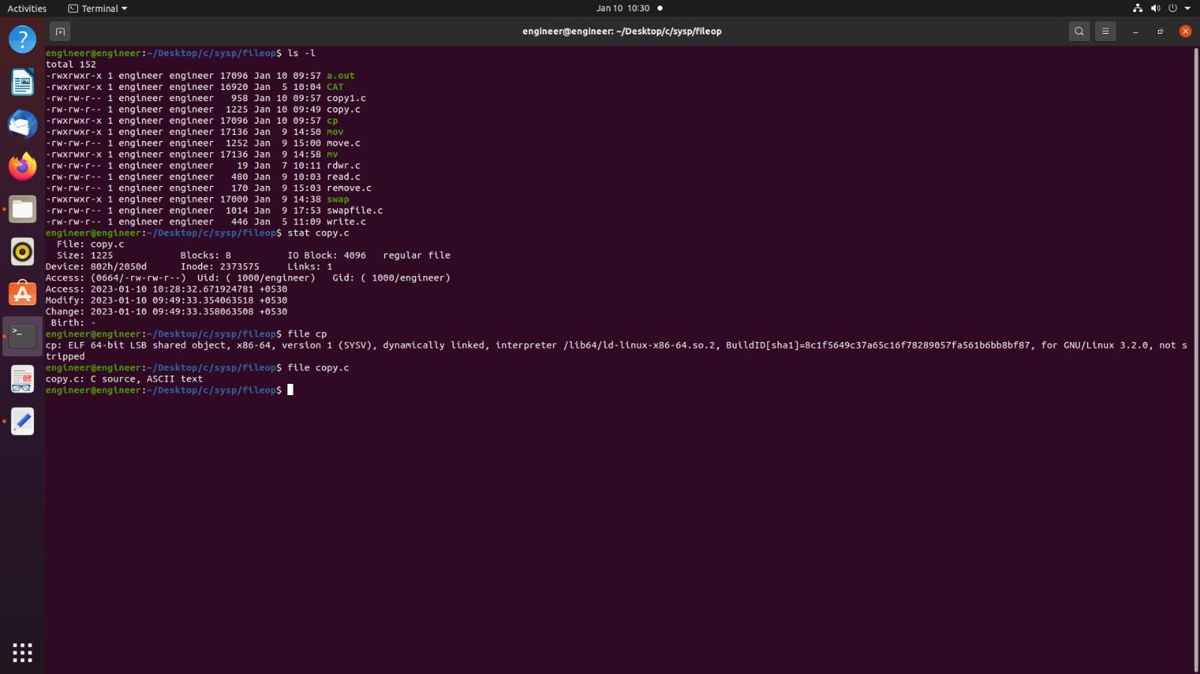
COMMANDS TO DISPLAY FILE DETAILS

Slide 13
REFERENCES
LINUX SYSTEM PROGRAMMING BY MICHEAL KERISK
https://www.tutorialspoint.com/unix/unix-file-permission.htm.

Slide 14
THANK YOU

