Slide 1
IPC MECHANISM

Slide 2
CONTENTS
Introduction to IPC.
What Is Posix IPC.
Functions Overview.
Differences between Posix & System-V IPC mechanism.
Creation Or Opening Of IPC Object.
Closing IPC Object And Permissions.
IPC Object Deletion And Object Persistence.
POSIX Message Queue.
Overview.
Opening, Closing, and Unlinking a Message Queue.
Relationship Between Descriptors and Message Queues.
how to retrieve and modify Message Queue Attributes?
Understanding Exchanging Messages With Example And Functions.
Message Queue Limits.

Slide 3
CONTENTS
Posix Semaphore Overview.
Named Semaphores.
Opening a Named Semaphore.
Closing a Semaphore
Removing a Named Semaphore
Semaphore Operations
Waiting on a Semaphore
Posting a Semaphore
Retrieving TheValue Of A Semaphore
Unnamed Semaphores
Differences Between Named And Unnamed Semaphores

Slide 4
CONTENTS
Initializing an unnamed semaphore
How to Destroy an Unnamed Semaphore
Differences between posix & system-V semaphores
Posix Semaphores vs Pthread Mutexes
Semaphore limits
Posix shared memory overview
Creating Shared Memory Objects
Usage of shred memory object
Removing Shared Memory Objects

Slide 5
Introduction to IPC.
IPC stands for interprocess communication. the term describes different ways of message passing between different processes that are running on some operating system.
We have multiple processes running on a system, with each process having its own address space. .

Slide 6
Process sharing information
Parent
Fd[0] fd[1]
Process
process
process
process
process
Shared
memory
process
Shared
info
kernel
Pipe
Child
filesystem
Fd[0] fd[1]
Add image of pipes

Slide 7
The two processes on the left are sharing some information that resides in a file in the filesystem. To access this data, each process must go through the kernel(e.g., read, write , lseek, and the like).
The two processes in the middle are sharing some information that resides within the kernel. A pipe is an example of this type of sharing, as are System V message queues and System V semaphores.
The two processes on the right have a region of shared memory that each process can reference. Once the shared memory is set up by each process, the processes can access the data in the shared memory without involving the kernel at all.

Slide 8
What Is Posix IPC
There is three types of IPC.
Posix message queues.
Posix semaphores .
Posix shared memory.
Messages allow processes to send formatted data streams to arbitrary processes.
Semaphores allow processes to synchronize execution.
Shared memory allows processes to share parts of their virtual address space.

Slide 9
Functions Overview
 | Message Queue | Semaphores | Shared Memory
Header | <mqueue.h> | <semaphore.h> | include <sys/mman.h>
Function to create ,open or delete. | Mq_open Mq_close Mq_unlink | Sem_open Sem_close Sem_unlink Sem_init Sem_distroy | Shm_open Shm_unlink
Function to control operation. | Mq_getattr Mq_setattr |  | ftruccate fstart
Function for IPC operation. | Mq_send Mq_receive Mq_notify | Sem_wait Sem_trywait Sem_post Sem_getvalue | mmap munmap

Slide 10
Differences between Posix & System-V IPC mechanism.
Posix | System-V
Almost all the basic concepts are the same as System V. It only differs with the interface | SYSTEM V IPC covers all the IPC mechanisms pipes, named pipes, message queues, signals, semaphores, and shared memory.
Shared Memory Interface Calls shm_open(), mmap(), shm_unlink() | Shared Memory Interface Calls shmget(), shmat(), shmdt(), shmctl()
Message Queue Interface Calls mq_open(), mq_send(), mq_receive(), mq_unlink() | Message Queue Interface Calls msgget(), msgsnd(), msgrcv(), msgctl()
Semaphore Interface Calls Named Semaphores sem_open(), sem_close(), sem_unlink(), sem_post(), sem_wait(), sem_trywait(), sem_timedwait(), sem_getvalue() Unnamed semaphores sem_init(), sem_post(), sem_wait(), sem_getvalue(),sem_destroy() | Semaphore Interface Calls semget(), semop(), semctl()
Uses names and file descriptors to identify IPC objects | Uses keys and identifiers to identify the IPC objects.
Shared memory objects can be examined and manipulated using system calls such as fstat(), fchmod() | Requires system calls such as shmctl(), commands (ipcs, ipcrm) to perform status/control operations.
to use any of the API specific to posix, a program must be linked with the lrt library in the /usr/lib directory. This library file contains the client-side stubs for these calls, Add the following to your compile command so that the compiler can find the libraries | No need to add such libraries in system v

Slide 11
Creation Or Opening Of IPC Object.
Each IPC mechanism has an associated open call (mq_open(), sem_open(),
or shm_open()).
Given an IPC object name, the IPC open call either:
creates a new object with the given name, opens that object, and returns a handle for it or
opens an existing object and returns a handle for that object

Slide 12
The type of handle returned by the IPC open call depends on the type of object.
For message queues, it is a message queue descriptor, a value of type mqd_t.
For semaphores, it is a pointer of type sem_t . For shared memory, it is a file descriptor.
All of the IPC open calls permit at least three arguments name, oflag, and mode— given in this block.

Slide 13
Description | mq_open | Sem_open | Shm_open
read only Write only Read-write | O_RDONLY O_WRONLY O_RDWR |  | O_RDONLY O_RDWR
Create if it does not already exist Exclusive create | O_CREAT O_EXCL | O_CREAT O_EXCL | O_CREAT O_EXCL
Nonblocking mode Truncate if it already exist. | O_NONBLOCK |  | O_TRUNC

Slide 14
The Oflag argument is a bit mask that can include at least the following flags.
O_CREAT
Create the message queue, semaphore, or shared memory object if it does not already exist.
When creating a new message queue, semaphore, or shared memory object at least one additional argument is required, called mode.This argument specifies the permission bits and is formed as the bitwise-OR of the constants.

Slide 15
O_EXCL
If this flag and O_CREAT are both specified, then the function creates a new message queue, semaphore, or shared memory object only if it does not already exist.
If it already exists, and if O_CREAT O_EXCL is specified, an error of EEXIST is returned.
O_NONBLOCK
This flag makes a message queue nonblocking with regard to a read on an empty queue or a write to a full queue.
O_TRUNC
If an existing shared memory object is opened read-write, this flag specifies that the object be truncated to 0 length.

Slide 16
Closing IPC Object And Permissions
For POSIX message queues and semaphores, there is an IPC close call that indicate that the calling process has finished.
But a POSIX shared memory object is closed by unmapping it with munmap().
IPC objects are automatically closed if the process terminates or performs an exec().

Slide 17
IPC objects have a permissions mask that is the same as for files.
When an existing message queue, semaphore, or shared memory object is opened by these same three functions permission testing is performed based on...
1. the permission bits assigned to the IPC object when it was created,
2. the type of access being requested and

Slide 18
IPC Object Deletion And Object Persistence.
Each IPC object has a corresponding unlink call whose operation is unlink() system call for files.
The unlink call immediately remove the object’s name, and then destroys the object once all processes cease using it
For message queues and semaphores, the object is destroyed after all processes have closed the object.
for shared memory, we have unmapped the object using munmap().

Slide 19
As with System V IPC, POSIX IPC objects have persistence. Once created, an object continues to exist until it is unlinked or the system is shut down .
Persistence:
We can define the persistence of any type of IPC as how long an object of that type remains in existence so there is three types of persistence.
A process-persistent IPC object remains in existence until the last process that holds the object open closes the object. Examples are pipes and FIFOs.
A kernel-persistent IPC object remains in existence until the kernel reboots or until the object is explicitly deleted.
A filesystem-persistent IPC object remains in existence until the object is explicitly deleted.

Slide 20
POSIX Message Queue
The acronym POSIX stands for Portable Operating System Interface.
POSIX message queues are similar to their System V counterparts, in that data is exchanged in units of whole messages. However, there are also some notable differences:
POSIX message queues are reference counted. A queue that is marked for deletion is removed only after it is closed by all processes that are currently using it.
POSIX messages have an associated priority, and messages are always strictly queued in priority order.
POSIX message queues provide a feature that allows a process to be asynchronously notified when a message is available on a queue.

Slide 21
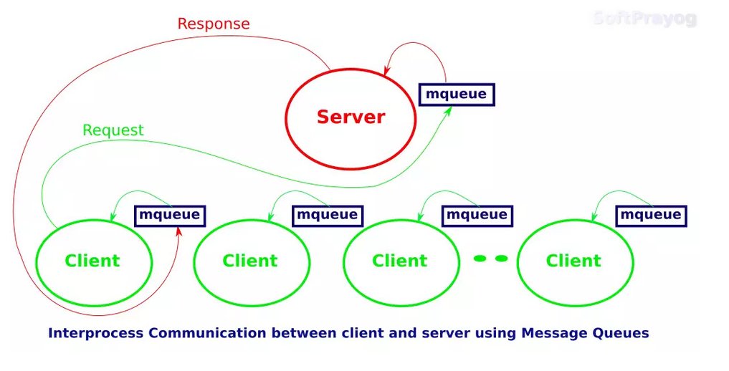
https://www.softprayog.in/programming/interprocess-communication-using-posix-message-queues-in-linux

Slide 22
Overview
The main functions in the POSIX message queue API are the following.
The mq_open() function creates a new message queue or opens an existing queue, returning a message queue descriptor for use in later calls.
The mq_send() function writes a message to a queue.
The mq_receive() function reads a message from a queue.
The mq_close() function closes a message queue that the process previously opened.
The mq_unlink() function removes a message queue name and marks the queue for deletion when all processes have closed it.

Slide 23
Apart from that these are couple of features of POSIX message queue API:
Each message queue has an associated set of attributes.
Some of these attributes can be set when the queue is created or opened using mq_open(). Two functions are provided to retrieve and change queue attributes:
mq_getattr() and mq_setattr().

Slide 24
Opening, Closing, And Unlinking A Message Queue.
Here we will see the function which is used to open, close and remove in message queue.
Opening a message queue.
For opening message queue or opening existing message queue we use this function mq_open().
#include <fcntl.h> /* used to open the files */ #include <sys/stat.h> /* to determine a file based on the path */ #include <mqueue.h> /* to include message queue descriptions */ mqd_t mq_open (const character *name, int oflag); /* to open up and access the queue */ mqd_t mq_open (const character *name, int oflag, mode_t mode, struct mq_attribute *attribute);

Slide 25
The oflag argument specifies flags that control the operation of the call. Exactly one of the following must be specified in oflag:
Flag | Description
O_CREAT O_EXCL | Create queue if it doesn’t already exist With O_CREAT , create queue exclusively
O_RDONLY O_WRONLY O_RDWR | Open for reading only Open for writing only Open for reading and writing
O_NONBLOCK | Open in nonblocking mode

Slide 26
Closing a message queue
The mq_close() function closes the message queue descriptor mqdes.
Syntax
#include <mqueue.h>
int mq_close(mqd_t mqdes);
If the calling process has registered via mqdes for message notification from the queue, then the notification registration is automatically removed, and another process can subsequently register for message notification from the queue.

Slide 27
A message queue descriptor is automatically closed when a process terminates or calls exec(). As with file descriptors, we should explicitly close message queue descriptors.
that are no longer required, in order to prevent the process from running out of message queue descriptors.
As close() for files, closing a message queue doesn’t delete it. For that purpose, we need mq_unlink().

Slide 28
Removing a message queue
The mq_unlink() function removes the message queue identified by name, and marks the queue to be destroyed once all processes cease using it.
Syntax
#include <mqueue.h>
int mq_unlink(const char *name);

Slide 29
Relationship Between Descriptors and Message Queues
The relationship between a message queue descriptor and an open message queue is same as the relationship between a file descriptor and an open file .
POSIX message queues are implemented as i-nodes in a virtual file system, and message queue descriptors and open message queue descriptions are implemented as file descriptors and open file descriptions, respectively.

Slide 30
How to retrieve and modify Message Queue Attributes?
Before retrieve and modify we will see what is Attribution.
Message Queue Attributes.
The mq_open(), mq_getattr(), and mq_setattr() functions all permit an argument that is a pointer to an mq_attr structure. This structure is defined in <mqueue.h> as follows:
struct mq_attr {
long mq_flags; /* Message queue description flags: 0 or
O_NONBLOCK [mq_getattr(), mq_setattr()] */
long mq_maxmsg; /* Maximum number of messages on queue
[mq_open(), mq_getattr()] */
long mq_msgsize; /* Maximum message size (in bytes)
[mq_open(), mq_getattr()] */
long mq_curmsgs; /* Number of messages currently in queue
[mq_getattr()] */
};

Slide 31
Retrieving message queue attributes
The mq_getattr() function returns an mq_attr structure containing information about the message queue description and the message queue associated with the descriptor mqdes.
Syntax
#include <mqueue.h>
int mq_getattr(mqd_t mqdes, struct mq_attr *attr);
Returns 0 on success, or –1 on error.
In addition to the mq_maxmsg and mq_msgsize fields, the following fields are returned in the structure pointed to by attr:

Slide 32
mq_flags
These are flags for the open message queue description associated with the descriptor mqdes. Only one such flag is specified: O_NONBLOCK . This flag is initialized from the oflag argument of mq_open(), and can be changed using mq_setattr().
mq_curmsgs
This is the number of messages that are currently in the queue. This information may already have changed by the time mq_getattr() returns, if other processes are reading messages from the queue or writing messages to it.

Slide 33
The program for Retrieving POSIX message queue attributes
#include <mqueue.h>
#include "tlpi_hdr.h"
Int main(int argc, char *argv[])
{
mqd_t mqd;
struct mq_attr attr;
if (argc != 2 || strcmp(argv[1], "--help") == 0)
usageErr("%s mq-name\n", argv[0]);
mqd = mq_open(argv[1], O_RDONLY);
if (mqd == (mqd_t) -1)
errExit("mq_open");
if (mq_getattr(mqd, &attr) == -1)
errExit("mq_getattr");
printf("Maximum # of messages on queue: %ld\n", attr.mq_maxmsg);
printf("Maximum message size:%ld\n", attr.mq_msgsize);
printf("# of messages currently on queue: %ld\n", attr.mq_curmsgs);
exit(EXIT_SUCCESS);
}

Slide 34
In above program we create a message queue with implementation-defined default attributes and then use the program to display the queue attributes so that we can see the default settings on Linux.
$ ./pmsg_create -cx /mq
$ ./pmsg_getattr /mq
Maximum # of messages on queue: 10
Maximum message size: 8192
# of messages currently on queue: 0
$ ./pmsg_unlink /mq
From the above output, we see that the Linux default values for mq_maxmsg and mq_msgsize are 10 and 8192, respectively.

Slide 35
Modifying message queue attributes
The mq_setattr() function sets attributes of the message queue description associated with the message queue descriptor mqdes, and optionally returns information about the message queue.
Synatx
#include <mqueue.h>
int mq_setattr(mqd_t mqdes, const struct mq_attr *restrict newattr, struct mq_attr *restrict oldattr);
Returns 0 on success, or –1 on error.

Slide 36
The mq_setattr() function performs the following tasks:
It uses the mq_flags field in the mq_attr structure pointed to by newattr to change the flags of the message queue description associated with the descriptor mqdes.
If oldattr is non- NULL , it returns an mq_attr structure containing the previous message queue description flags and message queue attributes .
if (mq_getattr(mqd, &attr) == -1)
errExit("mq_getattr");
attr.mq_flags |= O_NONBLOCK;
if (mq_setattr(mqd, &attr, NULL) == -1)
errExit("mq_getattr");

Slide 37
Understanding Exchanging Messages With Example And Functions
Here we will look at the functions that are used to send messages to and receive messages from a queue.
Sending Messages
The mq_send() function adds the message in the buffer pointed to by msg_ptr to the message queue referred to by the descriptor mqdes.
Syntax
#include <mqueue.h>
int mq_send(mqd_t mqdes, const char *msg_ptr, size_t msg_len, unsigned int msg_prio);

Slide 38
The msg_len argument specifies the length of the message pointed to by msg_ptr. This value must be less than or equal to the mq_msgsize attribute of the queue.
Each message has a nonnegative integer priority, specified by the msg_prio argument.
If the message queue is already full then a further mq_send() either blocks until space becomes available in the queue, or, if the O_NONBLOCK flag is in effect, fails immediately with the error EAGAIN .

Slide 39
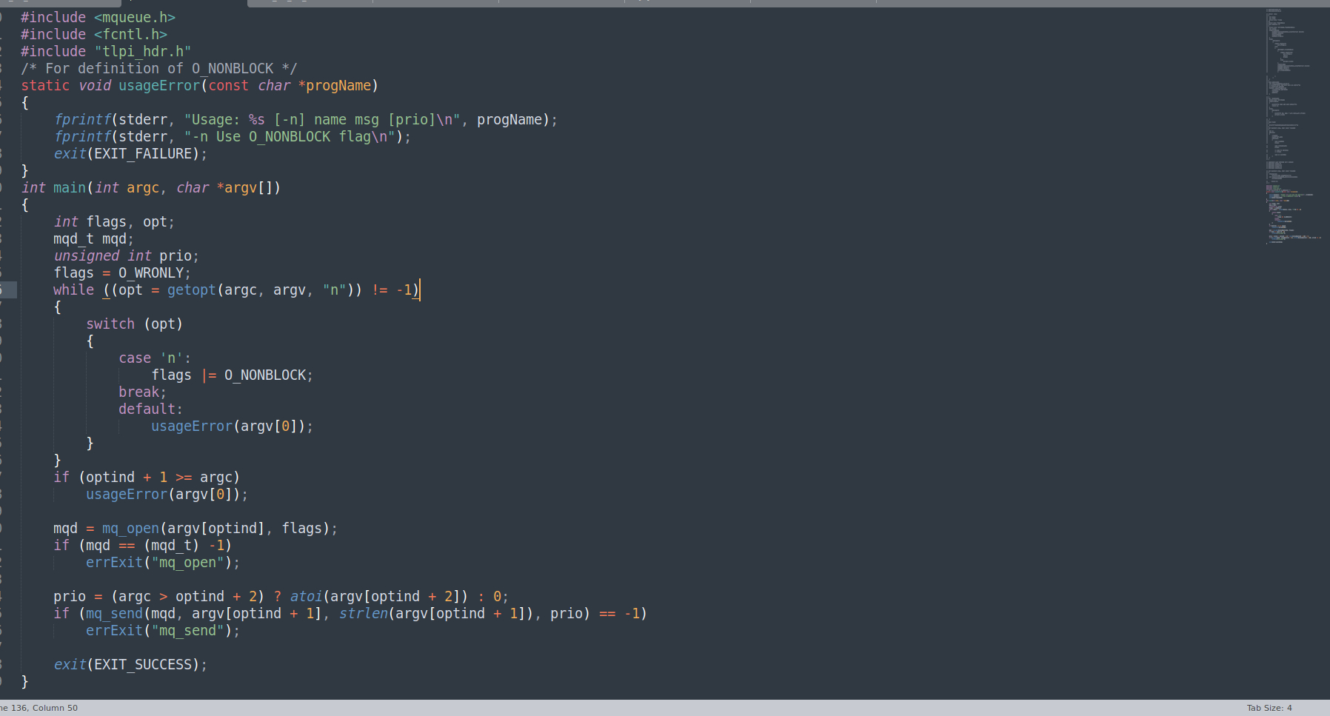
Writing a message to a POSIX message queue

Slide 40
Receiving Messages
The mq_receive() function removes the oldest message with the highest priority from the message queue referred to by mqdes and returns that message in the buffer pointed to by msg_ptr.
Syntax
#include <mqueue.h>
ssize_t mq_receive(mqd_t mqdes, char *msg_ptr, size_t msg_len, unsigned int *msg_prio);

Slide 41
The msg_len argument is used by the caller to specify the number of bytes of space available in the buffer pointed to by msg_ptr.
If msg_prio is not NULL , then the priority of the received message is copied into the location pointed to by msg_prio.
If the message queue is currently empty, then mq_receive() either blocks until a message becomes available, or, if the O_NONBLOCK flag is in effect, fails immediately with the error EAGAIN .

Slide 42
The program listed below provides a command-line interface to the mq_receive() function.
The command format for this program is shown in the usageError() function.
The following shell session demonstrates creating a message queue and sending a few messages with different priorities:
$ . /pmsg_create -cx /mq
$ ./pmsg_send /mq msg-a 5
$ ./pmsg_send /mq msg-b 0
$ ./pmsg_send /mq msg-c 10

Slide 43
We then execute a series of commands to retrieve messages from the queue:
$ ./pmsg_receive /mq
Read 5 bytes; priority = 10
msg-c
$ ./pmsg_receive /mq
Read 5 bytes; priority = 5
msg-a
$ ./pmsg_receive /mq
Read 5 bytes; priority = 0
msg-b
As we can see from the above output, the messages were retrieved in order of priority.
At this point, the queue is now empty. When we perform another blocking receive, the operation blocks:
$ ./pmsg_receive /mq
Blocks; we type Control-C to terminate the program.
On the other hand, if we perform a nonblocking receive, the call returns immediately with a failure status:
$ ./pmsg_receive -n /mq
ERROR [EAGAIN/EWOULDBLOCK Resource temporarily unavailable] mq_receive

Slide 44
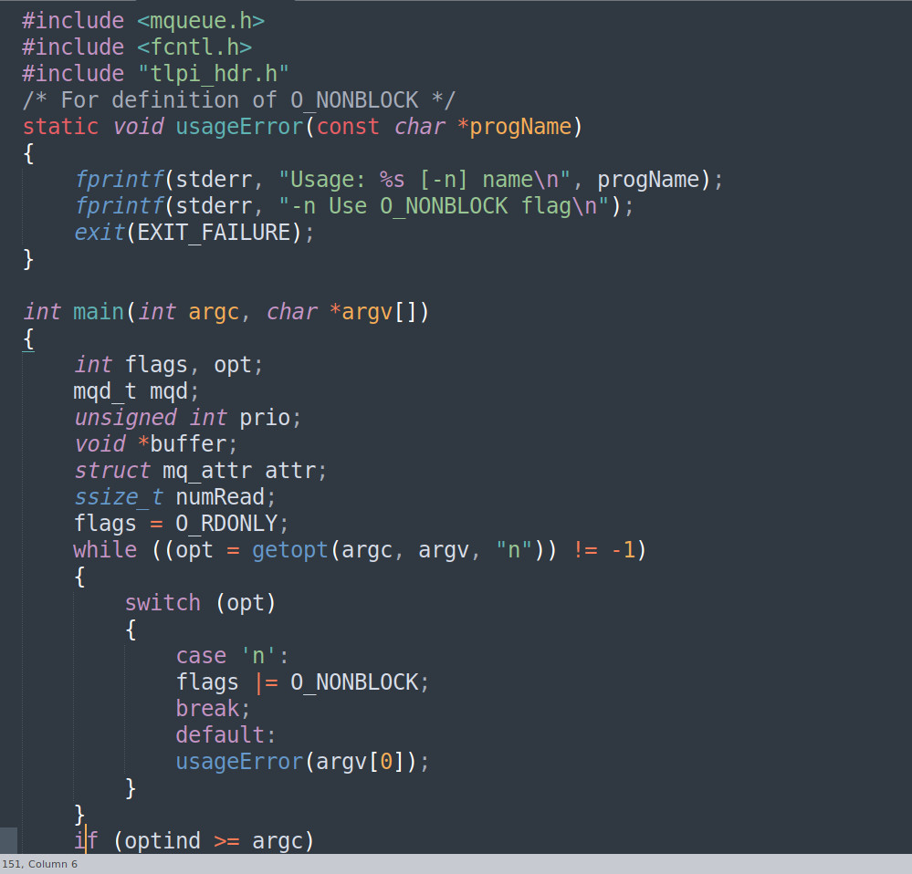
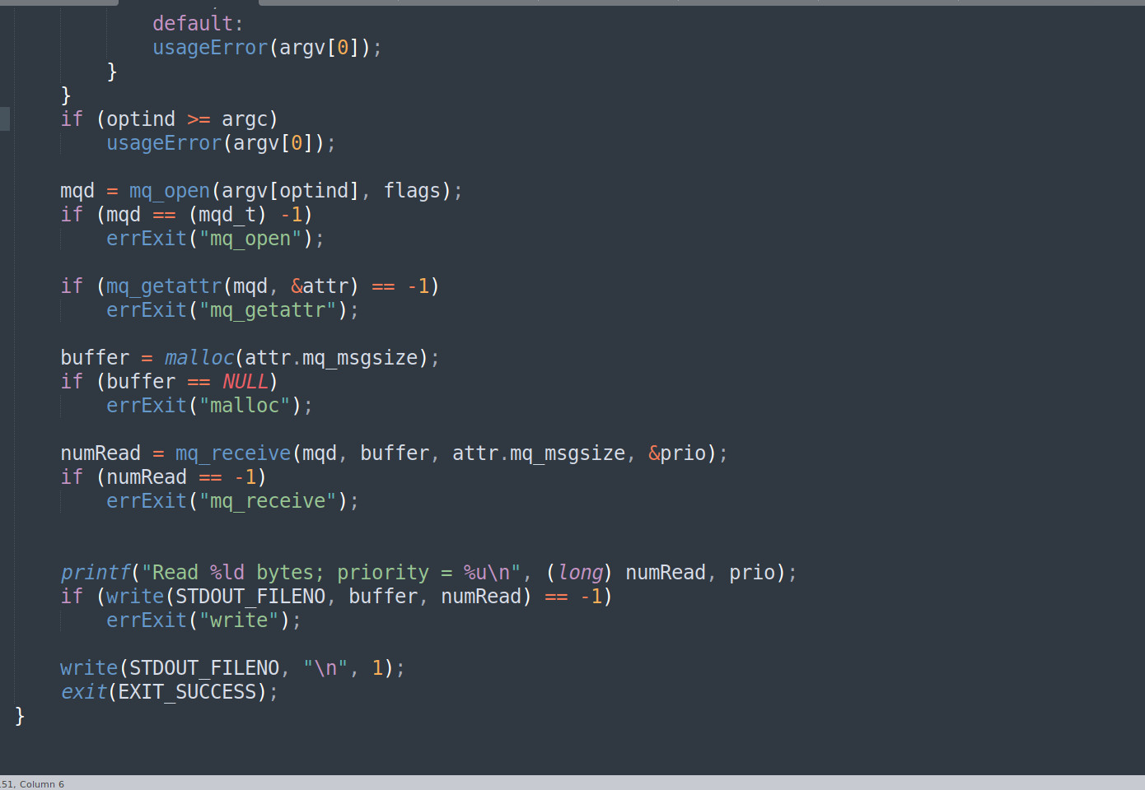
Reading a message from a POSIX message queue

Slide 45
Message Queue Limits
These are the limits for POSIX message queues:
MQ_PRIO_MAX
This defines the maximum priority for a message.
MQ_OPEN_MAX
An implementation can define this limit to indicate the maximum number of message queues that a process can hold open.
msg_max
This limit specifies a ceiling for the mq_maxmsg attribute of new message queues . The default value for this limit is 10. The minimum value is 1. The maximum value is defined by the kernel constant HARD_MSGMAX .
queues_max
This is a system-wide limit on the number of message queues that may be created. Once this limit is reached, only a privileged process can create new queues. The default value for this limit is 256. It can be changed to any value in the range 0 to INT_MAX .

Slide 46
Posix Semaphore
Overview
In posix there is two types of semaphores:
POSIX semaphores, which allow processes and threads to synchronize access to shared resources.
Named semaphores:
This type of semaphore has a name. By calling sem_open() with the same name, unrelated processes can access the same semaphore.
Unnamed semaphores:
This type of semaphore doesn’t have a name.
Unnamed semaphores can be shared between processes or between a group of threads.

Slide 47
Named Semaphores
The sem_open() function opens or creates a semaphore, initializes the semaphore if it is created by the call, and returns a handle for use in later calls.
The sem_post and sem_wait functions respectively increment and decrement a semaphore’s value.
The sem_getvalue() function retrieves a semaphore’s current value.
The sem_close() function removes the calling process’s association with a semaphore that it previously opened.
The sem_unlink() function removes a semaphore name and marks the semaphore for deletion when all processes have closed it

Slide 48
Opening a Named Semaphore
The sem_open() function creates and opens a new named semaphore or opens an existing semaphore.
#include <fcntl.h>
#include <sys/stat.h>
#include <semaphore.h>
sem_t *sem_open(const char * name , int oflag , … /* mode_t mode , unsigned int value */ );
Returns pointer to semaphore on success, or SEM_FAILED on error

Slide 49
Closing a Semaphore
When a process opens a named semaphore, the system records the association between the process and the semaphore. The sem_close() function terminates this association.
#include <semaphore.h>
int sem_close(sem_t * sem );
Open named semaphores are also automatically closed on process termination or if the process performs an exec().

Slide 50
Removing a Named Semaphore
Closing a semaphore does not delete it. For that purpose, we need to use sem_unlink().
The sem_unlink() function removes the semaphore identified by name and marks the semaphore to be destroyed once all processes.
#include <semaphore.h>
int sem_unlink(const char * name );
Returns 0 on success, or –1 on error

Slide 51
Semaphore Operations
Operation used for changing the value of semaphore like sem_post() and sem_wait() are used and they operate on just one semaphore at a time.
The sem_post() and sem_wait() functions increment and decrement a semaphore's value by exactly one.

Slide 52
Waiting on a Semaphore
The sem_wait() function decrements the value of the semaphore referred to by sem.
#include <semaphore.h>
int sem_wait(sem_t * sem );
Returns 0 on success, or –1 on error
If the semaphore currently has a value greater than 0, sem_wait() returns immediately. If the value of the semaphore is currently 0, sem_wait() blocks until the semaphore value rises above 0.

Slide 53
Posting a Semaphore
The sem_post() function increments the value of the semaphore referred to by sem.
#include <semaphore.h>
int sem_post(sem_t * sem );
Returns 0 on success, or –1 on error
If the value of the semaphore was 0 before the sem_post() call, and some other process is blocked waiting to decrement the semaphore, then that process is awoken, and its sem_wait() call proceeds to decrement the semaphore.

Slide 54
Retrieving TheValue Of A Semaphore
The sem_getvalue() function returns the current value of the semaphore referred to by sem in the int pointed to by sval.
#include <semaphore.h>
int sem_getvalue(sem_t * sem , int * sval );
Returns 0 on success, or –1 on error

Slide 55
Unnamed Semaphores
Unnamed semaphores are variables of type sem_t that are allocated in process memory and initialized.
Unnamed semaphore uses same function of named semaphore like (sem_wait(), sem_post(), sem_getvalue().
Here two more functions added sem_init() and sem_destroy.

Slide 56
Differences Between Named And Unnamed Semaphores
Named semaphore | unnamed semaphore
it has an actual name in the file system and can be shared by multiple unrelated process. | It can be used only by threads belonging to the same process.
Named semaphores provide access to a resource between multiple processes. | Unnamed semaphores provide multiple accesses to a resource within a single process
They are referenced with pathname | They are referenced by pshared value

Slide 57
Initializing an unnamed semaphore
The sem_init() function initializes the unnamed semaphore pointed to by sem to the value specified by value.
#include <semaphore.h>
int sem_init(sem_t * sem , int pshared , unsigned int value );
Returns 0 on success, or –1 on error

Slide 58
How to Destroy an Unnamed Semaphore
The sem_destroy() function destroys the semaphore sem, which must be an unnamed semaphore initialized using sem_init().
It is safe to destroy a semaphore only if no processes or threads are waiting on it.
#include <semaphore.h>
int sem_destroy(sem_t * sem );
Returns 0 on success, or –1 on error

Slide 59
Differences between posix & system-V semaphores
POSIX | System-V
Semaphore count is increased and decreased by only 1. | semaphore count can be increased or decreased by any number.
do not allow manipulation of semaphore permissions | allow you to change the permissions of semaphores to a subset of the original permission.
semaphores are straight-forward. | (From a usage perspective) System V semaphores are clumsy.
The scalability of POSIX semaphores (using unnamed semaphores) is much higher than System V semaphores. | The scalability of system V semaphores is lower than System V semaphores.

Slide 60
Posix Semaphores vs Pthread Mutexes
POSIX semaphores and Pthreads mutexes can both be used to synchronization.
Compare to Semaphore Mutex are more preferable for synchronization.
In pthreads mutex thread is lock mutex as well as unlock it.
In Posix semaphore one thread can increment a semaphore that was decrement by another thread.
Mutex can't be used in a multithreading and semaphore may prefreble.

Slide 61
Semaphore limits
Here two limitations for semaphore are described.
SEM_NSEMS_MAX
This is the maximum number of POSIX semaphores that a process may have.
SEM_VALUE_MAX
This is the maximum value that a POSIX semaphore may reach. Semaphores may assume any value from 0 up to this limit.

Slide 62
Posix shared memory overview
POSIX shared memory setting up the shared memory, two or more processes may read from and write to the shared memory region.
Overview
Create or open a shared memory object with shm_open(). A file descriptor will be returned if shm_open() creates a shared memory object successfully.
Set the shared memory object size with ftruncate().
http://logan.tw/posts/2018/01/07/posix-shared-memory/

Slide 63
Map the shared memory object into the current address space with mmap() and MAP_SHARED.
Read/write the shared memory.
Unmap the shared memory with munmap().
Close the shared memory object with close().
Delete the shared memory object with shm_unlink()

Slide 64
Creating Shared Memory Objects
The shm_open() function creates and opens a new shared memory object or opens an existing object. .
#include <fcntl.h>
#include <sys/stat.h>
#include <sys/mman.h>
int shm_open(const char * name , int oflag , mode_t mode );
Returns file descriptor on success, or –1 on error

Slide 65
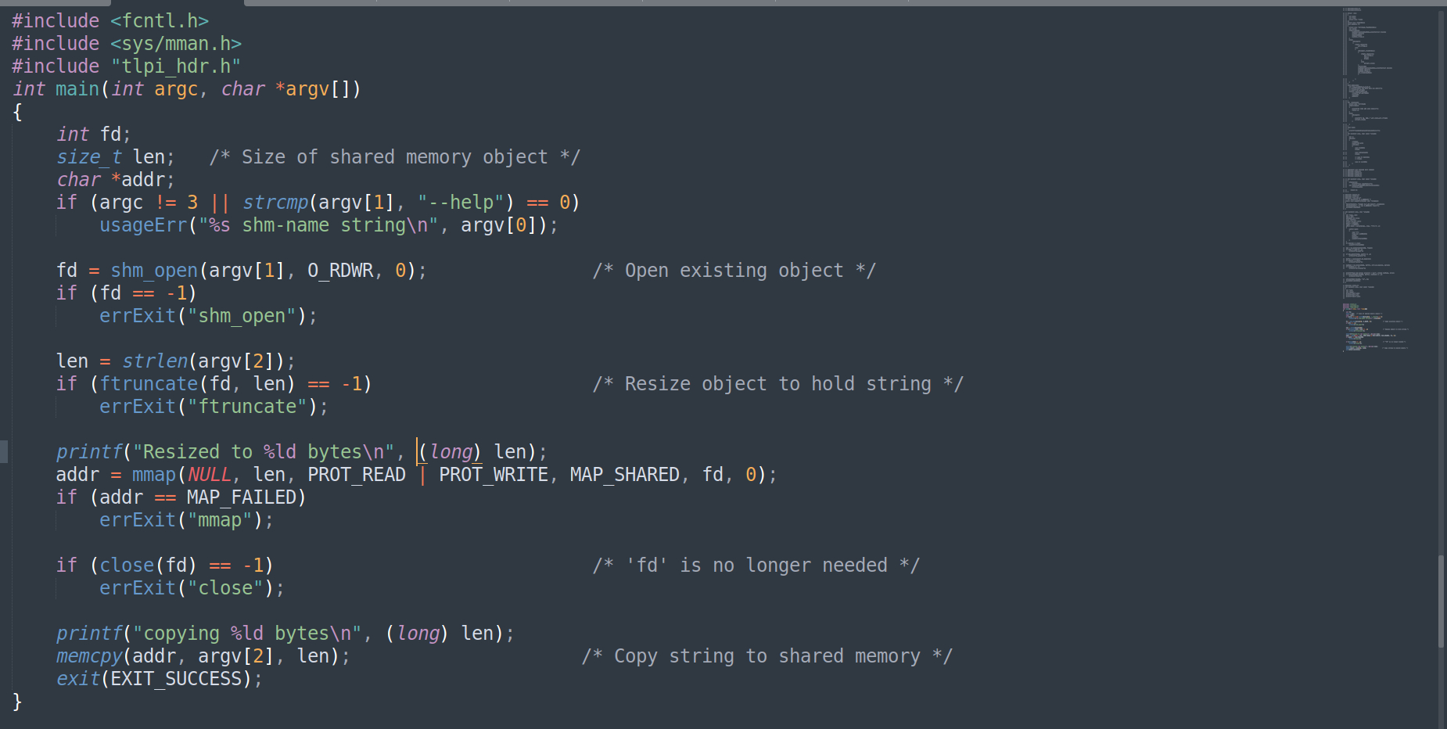
Usage of shred memory object
Copying data into a POSIX shared memory object

Slide 66
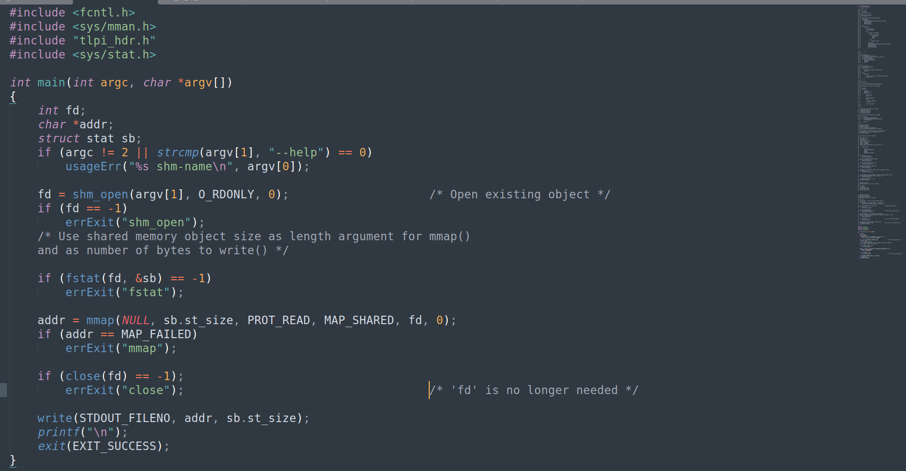
Copying data from a POSIX shared memory object

Slide 67
Removing Shared Memory Objects
When a shared memory object is no longer required, it should be removed using shm_unlink().
#include <sys/mman.h>
int shm_unlink(const char * name );
Returns 0 on success, or –1 on error
The shm_unlink() function removes the shared memory object specified by name.

Slide 68
Comparisons Between Shared Memory APIs
These are the techniques we use for sharing memory between unrelated process.
System V shared memory.
shared file mappings.
POSIX shared memory.
They provides fast IPC for synchronization access to the shared region.
Once the shared memory region has been mapped into the process’s virtual address space, it looks just like any other part of the process’s memory space.
System set shared memory region within the virtual address space.

Slide 69
System V Pipes
What is Pipe.
Pipes allow communication between related processes; pipes are used for communication between a parent and a child process.
Every user of the shell is familiar with the use of pipes (|) in commands such as the following, which counts the number of files in a directory.
$ ls | WC –l.
In order to execute the above command, the shell creates two processes, executing ls and WC, respectively. This is done using fork() and exec(). And the data is transferred from one process to other using pipe mechanism.

Slide 70
Creating and Using Pipe
The pipe() system call creates a new pipe.
#include <unistd.h>
int pipe(int pipefd[2]);
Returns 0 on success, or –1 on error.
A successful call to pipe() returns two open file descriptors in the array pipefd: one for the read end of the pipe ( pipefd[0]) and one for the writ end ( pipefd[1]).

Slide 71
How Pipe is working
To connect two process we use pipe system call with fork.
During fork the child process inherits copies of its parent's file descriptors.
After the fork one process closes its descriptor for the write end of the pipe, and the other closes its descriptor for read end.
For example if parent send data to child ,then it would close its read descriptor for the pipe, pipefd[0], while child will close its write descriptor for the pipe pipefd[1].
As the pipe is unidirectional, it has designated ends the read end and the write end. If this pipe is going to be used by the parent to write data to the child, there is no point for the parent to keep the read end open. Reversely, if the child is going to read the data from the pipe, it does not need to have the write end open.

Slide 72
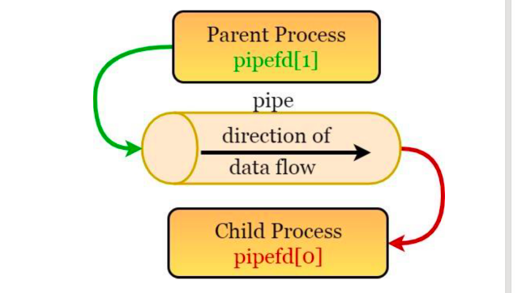

Slide 73
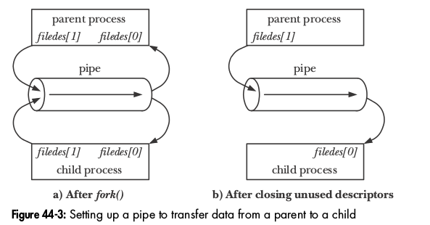


Slide 74
Drawbacks of pipe
Pipes are unidirectional; data can travel only in one direction through a pipe. One end of the pipe is used for writing, and the other end is used for reading.
Pipes have a limited capacity, a pipe is a simply buffer in kernel memory and it have maximum capacity ,once pipe is full further writes to pipe block until the readers removes some data from pipe and the pipe capacity is 65,536 bytes.
A pipe is byte stream, means there is no concept of message boundaries when using pipe, reader can read block of dataof any size.
It is not possible to randomly access the data in pipe using lseek().

Slide 75
What is FIFO (Named Pipe)
A FIFO is similar to a pipe.
The principal difference is that a FIFO has a name within the file system and is opened in the same way as a regular file. Thus, FIFO is also called as named pipe.
This allows a FIFO to be used for communication between unrelated processes. A FIFO has a write end and a read end, and data is read from the pipe in the same order as it is written. This fact gives FIFOs their name: first in, first out.
Once a FIFO has been opened, you use the same I/O system calls as are used with other files (open(), read(), write() and close()). When all descriptors referring to a FIFO have been closed, any outstanding data is discarded.
Another important feature that a FIFO has is that it provides bidirectional communication.

Slide 76
The mkfifo() Function.
The mkfifo() function creates a new FIFO with the given pathname.
#include <sys/types.h>
#include <sys/stat.h>
int mkfifo(const char *pathname, mode_t mode);
Returns 0 on success, or –1 on error.
The mkfifo() makes a FIFO special file with name pathname. The mode specifies the FIFO's permissions. It is modified by the process's umask in the usual way: the permissions of the created file are(mode & ~umask).
A FIFO special file (a named pipe) is similar to a pipe, except that it is accessed as part of the file system.

Slide 77
Steps For FIFO
Step 1 − Create two processes, one is fifoserver and another one is fifoclient.
Step 2 − Server process performs the following −
Creates a named pipe (using system call mknod()) with name “MYFIFO”, if not created.
Opens the named pipe for read only purposes.
Here, created FIFO with permissions of read and write for Owner. Read for Group and no permissions for Others.
Waits infinitely for message from the Client.
If the message received from the client is not “end”, prints the message. If the message is “end”, closes the fifo and ends the process.

Slide 78
Step 3 − Client process performs the following −
Opens the named pipe for write only purposes.
Accepts the string from the user.
Checks, if the user enters “end” or other than “end”. Either way, it sends a message to the server. However, if the string is “end”, this closes the FIFO and also ends the process.
Repeats infinitely until the user enters string “end”.

Slide 79
Difference Between Pipe And Named Pipe(FIFO)
BASIS OF COMPARISON | PIPE | FIFO
Description | They are un-named IPC Object. | They are named IPC Object.
Communication | FIFO is capable of communicating across different computers and network. | PIPE is local to the system and cannot be used for communication across the network.
Existence | PIPE does not exist in the file system. | FIFO exists in the files system.
Processes | In PIPE, data transfer takes place between the child process and parent process. | FIFO have multiple processes communicating through it, like multiple client-server application.
Creation | PIPE is created by pipe () function. | FIFO is created by mkfifo () function.
Read And Write Operation | In PIPE, reader and writer operation is done at same time. | In FIFO, it does not require that both read and write operation to occur at the same time.

Slide 80
Existence | PIPE vanishes as soon as it is closed, or one of the processes (parent or child) completes execution. | FIFO exists even when calling process exit. They remain till system reboots.
Control Over Ownership And Permissions | PIPE has no control over ownership and permissions. | Given that FIFO is a file, you can control ownership and permissions.
Nature | PIPE is unidirectional. | FIFO is bi-directional. The same FIFO can be used for reading and writing.
Mode Of Communication | PIPE provides simplex data flow. | FIFO provides half duplex data flow.
Communication | In PIPE, communication is among the process having a common ancestor (related process). | In FIFO, it is not necessary for the process having a common ancestor for communication (unrelated process).

Slide 81
Genration of IPC key.
ftok() function is used for Generate an interprocess communication (IPC) key.
This function is used by and ipc mechanism comes under system v
#include <sys/ipc.h> key_t ftok(const char *path, int id);
If successful, ftok() returns a key.
If unsuccessful, ftok() returns -1

Slide 82
System V Resource access permissions Structure
For each resource, message queue , semaphore, shared memory, the system uses a common structure of type struct ipc_perm to store information needed in determining permissions to perform an IPC operation. The ipc_perm structure includes the following members:
struct ipc_perm { uid_t cuid; /* creator user ID */ gid_t cgid; /* creator group ID */ uid_t uid; /* owner user ID */ gid_t gid; /* owner group ID */ unsigned short mode; /* r/w permissions */ };

Slide 83
SYSTEM V MESSAGE QUEUES
Ftok ,pips,named pipes,ipcm cmds
Creating or Opening a Message Queue
The msgget() system call creates a new message queue or obtains the identifier of an existing queue.
#include <sys/types.h>
#include <sys/msg.h>
int msgget(key_t key , int msgflg );
Returns message queue identifier on success, or –1 on error

Slide 84
Exchanging Messages
The msgsnd() and msgrcv() system calls perform I/O on message queues.
The first argument to both system calls (msqid) is a message queue identifier.
The second argument, msgp, is a pointer to a programmer-defined structure used to hold the message being sent or received.
struct mymsg {
long mtype;
char mtext[];
}

Slide 85
Sending Messages
The msgsnd() system call writes a message to a message queue.
#include <sys/types.h>
#include <sys/msg.h>
int msgsnd(int msqid , const void * msgp , size_t msgsz , int msgflg );
Returns 0 on success, or –1 on error

Slide 86
msqid_ds structure
#include <sys/msg.h>
struct msqid_ds{ struct ipc_perm msg_perm; struct msg *msg_first; struct msg *msg_last; u_short msg_cbytes; u_short msg_qnum; u_short msg_qbytes; u_short msg_lspid; ushort msg_lrpid; time_t msg_stime; time_t msg_rtime; time_t msg_ctime; };
The msqid_ds structure defines a message queue associated with a message queue ID.

Slide 87
Receiving Messages
The msgrcv() system call reads (and removes) a message from a message queue, and copies its contents into the buffer pointed to by msgp.
#include <sys/types.h>
#include <sys/msg.h>
ssize_t msgrcv(int msqid , void * msgp , size_t maxmsgsz , long msgtyp , int msgflg );
Returns number of bytes copied into mtext field, or –1 on error

Slide 88
Message Queue Control Operations
The msgctl() system call performs control operations on the message queue identified by msqid.
#include <sys/types.h>
#include <sys/msg.h>
int msgctl(int msqid , int cmd , struct msqid_ds * buf );
Returns 0 on success, or –1 on error

Slide 89
The cmd argument specifies the operation to be performed on the queue.
IPC_RMID
Immediately remove the message queue object and its associated msqid_ds data structure.
IPC_STAT
Place a copy of the msqid_ds data structure associated with this message queue in the buffer pointed to by buf.
IPC_SET
Update selected fields of the msqid_ds data structure associated with this

Slide 90
IPCRM command for ipc.
ipcrm command in Linux is used to remove some ipc resources. It eliminates the IPC objects and their associated data structure form the system.
Syntax:
ipcrm [options]
Options
-a, –all [shm] [msg] [sem] : Remove all resources. When an option argument is provided, the removal is performed only for the specified resource types.
-M, –shmem-key shmkey : Remove the shared memory segment created with shmkey after the last detach is performed.
-m, –shmem-id shmid : Remove the shared memory segment identified by shmid after the last detach is performed.
-Q, –queue-key msgkey : Remove the message queue created with msgkey.
-q, –queue-id msgid : Remove the message queue identified by msgid.
-S, –semaphore-key semkey : Remove the semaphore created with semkey.
-s, –semaphore-id semid : Remove the semaphore identified by semid.
-V, –version : Display version information and exit.

Slide 91
SYSTEM V SEMAPHORES
The main use of a semaphore is to synchronize access to a block of shared memory.
A semaphore, includs the following steps:
setting the semaphore to an absolute value.
adding a number to the current value of the semaphore.
subtracting a number from the current value of the semaphore.
waiting for the semaphore value to be equal to 0.

Slide 92
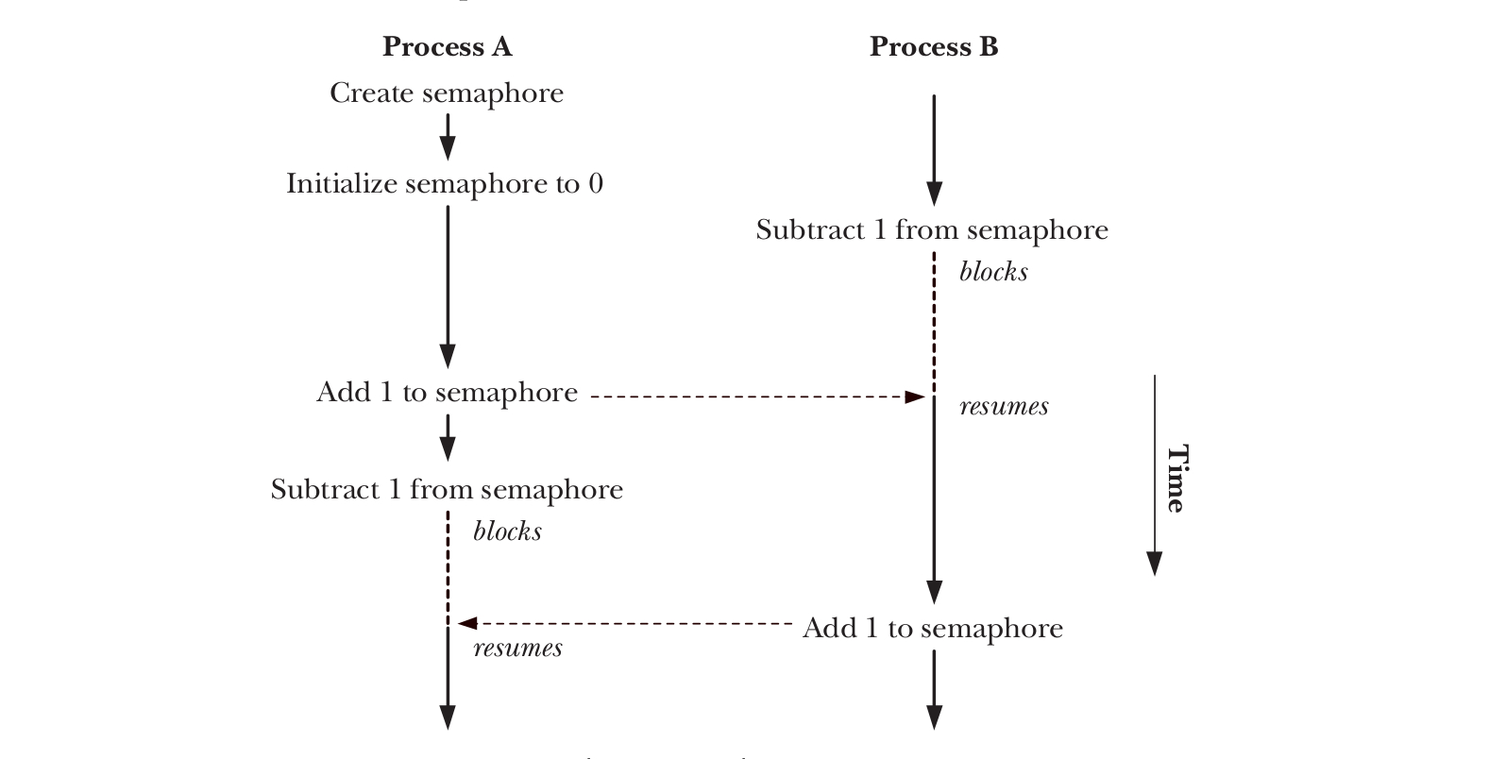

Slide 93
Overview
The general steps for using a System V semaphore are the following:
Create or open a semaphore set using semget().
Initialize the semaphores in the set using the semctl() SETVAL or SETALL operation.
Perform operations on semaphore values using semop(). T
When all processes have finished using the semaphore set, remove the set using the semctl() IPC_RMID operation.

Slide 94
Creating or Opening a Semaphore Set
The semget() system call creates a new semaphore set or obtains the identifier of an existing set.
#include <sys/types.h>
#include <sys/sem.h>
int semget(key_t key , int nsems , int semflg );
Returns semaphore set identifier on success, or –1 on error

Slide 95
Semaphore Control Operations
The semctl() system call performs a variety of control operations on a semaphore set or on an individual semaphore within a set.
#include <sys/types.h>
#include <sys/sem.h>
int semctl(int semid , int semnum , int cmd , ... /* union semun arg */);
Returns nonnegative integer on success (see text); returns –1 on error

Slide 96
Semaphore Associated Data Structure
Each semaphore set has an associated semid_ds data structure of the following form:
struct semid_ds { struct ipc_perm sem_perm; /* Ownership and permissions */ time_t sem_otime; /* Last semop time */ time_t sem_ctime; /* Creation time/time of last modification via semctl() */ unsigned long sem_nsems; /* No. of semaphores in set */ };

Slide 97
Semaphore Operations
The semop() system call performs one or more operations on the semaphores in the semaphore set identified by semid.
#include <sys/types.h>
#include <sys/sem.h>
int semop(int semid , struct sembuf * sops , unsigned int nsops );
Returns 0 on success, or –1 on error

Slide 98
SYSTEM V SHARED MEMORY
Overview
Call shmget() to create a new shared memory segment or obtain the identifier of an existing segment.
Use shmat() to attach the shared memory segment; that is, make the segment part of the virtual memory of the calling process.
Call shmdt() to detach the shared memory segment. After this call, the process can no longer refer to the shared memory.
Call shmctl() to delete the shared memory segment.

Slide 99
Creating or Opening a Shared Memory Segment
The shmget() system call creates a new shared memory segment or obtains the identifier of an existing segment.
#include <sys/types.h>
#include <sys/shm.h>
int shmget(key_t key , size_t size , int shmflg );
Returns shared memory segment identifier on success, or –1 on error

Slide 100
Using Shared Memory
The shmat() system call attaches the shared memory segment identified by shmid to the calling process’s virtual address space.
#include <sys/types.h>
#include <sys/shm.h>
void *shmat(int shmid , const void * shmaddr , int shmflg );
Returns address at which shared memory is attached on success,
or (void *) –1 on error

Slide 101
The shmdt() function detaches from the calling process's address space the shared memory segment located at the address specified by the argument shmaddr.
#include <sys/types.h>
#include <sys/shm.h>
int shmdt(const void * shmaddr );
Returns 0 on success, or –1 on error

Slide 102
Shared Memory Control Operations
The shmctl() system call performs a range of control operations on the shared memory segment identified by shmid.
#include <sys/types.h>
#include <sys/shm.h>
int shmctl(int shmid , int cmd , struct shmid_ds * buf );
Returns 0 on success, or –1 on error

Slide 103
Shared Memory Associated Data Structure
Each shared memory segment has an associated shmid_ds data structure.
struct shmid_ds {
struct ipc_perm shm_perm; /*Ownership and permissions */
size_t shm_segsz; /* Size of segment in bytes */
time_t shm_atime; /*Time of last shmat() */
time_t shm_dtime; /*Time of last shmdt() */
time_t shm_ctime; /*Time of last change */
pid_t shm_cpid; /*PID of creator */
pid_t shm_lpid; /*PID of last shmat() / shmdt() */
shmatt_t shm_nattch; /*Number of currently attached processes */
};

Slide 104
Refrences
https://docs.oracle.com/cd/E23824_01/html/821-1602/svipc-posixipc.html
https://stackoverflow.com/questions/4582968/system-v-ipc-vs-posix-ipc
https://www.opensourceforu.com/2021/05/the-usefulness-of-posix-message-queues/
https://linuxhint.com/posix-message-queues-c-programming/
https://man7.org/linux/man-pages/man2/mq_open.2.html
https://www.softprayog.in/programming/interprocess-communication-using-posix-message-queues-in-linux
https://www.tkvco.com/?product_id=94244701_28
https://vivadifferences.com/difference-between-pipe-and-fifo-inter-process-communication/
Referred the Linux programming interface book

