Slide 1
MUTEX AND CONDITION VARIABLES
PRESENTED BY
ANUSHA GAJJELLI

Slide 2
CONTENTS
What is mutex ?
Working of mutex
Execution of mutex with threads
Mutex in pthreads
Locking and Unlocking the mutex
Example of mutex
Mutex deadlocks
Advantages and Disadvantages of mutex
Condition Variables
Signaling and Waiting on condition variables
Example of Condition variable
References

Slide 3
WHAT IS MUTEX ?
MUTEX is nothing but MUTual EXclusion (MUTEX).
A MUTEX is a lock that is used to protect shared resources.
The code or c-statements that is accessing the global resources is known as “critical-section”.
Before accessing the critical section,we have to lock the mutex object.
After executing the critical section,we have to unlock the mutex object.
Whenever the lock is set, no other thread can access the locked region of code i.e, critical section.
Lock and Unlock also known as “Acquire” and “Release”.

Slide 4
WORKING OF MUTEX
Suppose one thread has locked a region of code using mutex and is executing that piece of code.
The thread which locks the mutex will become the owner of that mutex,only that particular thread can unlock the mutex.
By default when we initialize a mutex, it is in “Unlock state”.
When one thread locks the mutex, if other thread trying to release the mutex, then that thread moves to “blocking state ”, until the owner release the lock.
Now if schedular decides to do a context switch, then all the other threads which are ready to execute the same region are unlocked.
So this ensures that once a thread as a locked a piece of code then no other thread can execute the same region until it is unlocked by the thread who locked it.

Slide 5
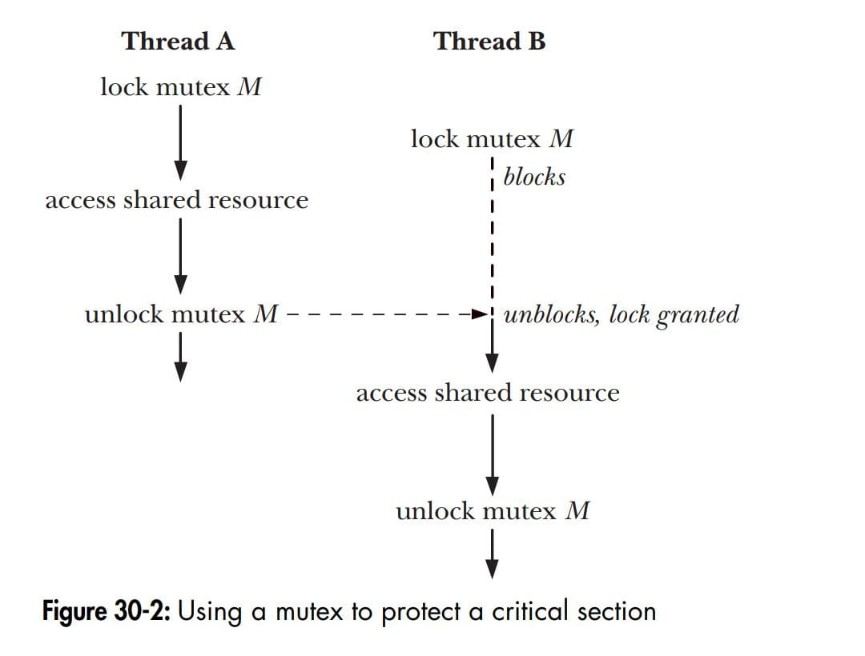
EXECUTION EXAMPLE WITH 2 THREADS

Slide 6
MUTEX IN PTHREADS
Headerfile:#include<pthread.h>
A SPECIAL TYPE FOR MUTEX: pthread_mutex_t.
int pthread_mutex_init(pthread_mutex_t *mutex, const pthread_mutex attr_t *attr);
TO GAIN ACCESS TO A CRITICAL SECTION:
int pthread_mutex_lock(pthread_mutex_t *mutex);
TO RELEASE:
int pthread_mutex_unlock(pthread_mutex_t *mutex);
WHEN FINISHING USE OF A MUTEX CALL:
int pthread_mutex_destroy(pthread_mutex_t *mutex);
ON SUCCESS IT RETURNS 0 .
ON FAILURE IT RETURNS ERROR.

Slide 7
LOCKING A MUTEX
To lock a mutex, we specify the mutex in a call to pthread_mutex_lock( ).
If the mutex is currently unlocked, this call locks the mutex and returns immediately.
If the mutex is locked by another thread then pthread_mutex_lock( ) this function will blocks until the mutex is unlocked.
The thread that has locked by mutex becomes its current owner and remains the owner until the same thread has unlocked it.
ON SUCCESS IT RETURNS 0.
ON FAILURE IT RETURNS ERROR

Slide 8
UNLOCKING A MUTEX
The pthread_mutex_unlock( ) function unlocks a mutex previously locked by the calling thread.
It is an error to unlocks a mutex that is not currently locked or to unlock a mutex that is locked by another thread.
I f more than one other thread is waiting for mutex unlocked call, it is indeterminate which thread to unlock.
ON SUCCESS IT RETURNS 0.
ON FAILURE IT RETURNS ERROR.

Slide 9
EXAMPLE
#include<pthread.h>
#include<stdio.h>
#include<stdlib.h>
#include<unistd.h>
int global=0;
pthread_mutex_t count_mutex = PTHREAD_MUTEX_INITIALIZER;
void* thread_fun1(void* arg);
void* thread_fun2(void* arg);
void main( )
{
pthread_t t1,t2;
int res,loop=1000;
void* ret;
pthread_create(&t1,0,thread_fun1,&loop);
pthread_create(&t2 ,0 ,thread_fun2,&loop);
pthread_join(t1,&ret);
pthread_join(t2,&ret);
printf(“Final value of global variable-%d\n”,global);
}

Slide 10
void* thread_fun1(void* arg) { int local, i, loop; loop=*(int*)arg; for(i=0;i<loop;i++) { pthread_mutex_lock(&count_mutex); local=global; local++; global=local; pthread_mutex_unlock(&count_mutex); } } void* thread_fun2(void* arg) { int local, i, loop; loop=*(int*)arg; for(i=0;i<loop;i++) { pthread_mutex_lock(&count_mutex); local=global; OUTPUT: 2000 local++; global=local; pthread_mutex_unlock(&count_mutex); } }

Slide 11
MUTEX DEADLOCKS
When more than one thread is locking the same set of mutexes, then deadlock situations can arises.
For example:
Thread A Thread B
1.pthread_mutex_lock(mutex1); 1.pthread_mutex_lock(mutex2);
2.pthread_mutex_lock(mutex2); 2.pthread_mutex_lock(mutex1);
blocks blocks
From above example of deadlock in which each thread successfully locks one mutex and then tries to lock the mutex that the other thread has already locked.
Both threads will remains blocked.

Slide 12
The simplest way to avoid such deadlocks is to define a mutex hierarchy.
The deadlock could be avoided if the two threads always lock the mutexes in the order mutex 1 followed by mutex 2.
An alternative way is “try and then back off” .
In this strategy, a thread locks the first mutex using pthread_mutex_lock( ), and then locks the remaining mutexes using pthread_mutex_trylock( ).
If any of the pthread_mutex_trylock( ) call fails, then the thread releases all mutexes and tries again after a delay interval.
This approach is less efficient then lock hierarchy.

Slide 13
DISADVANTAGES OF MUTEX
ADVANTAGES OF MUTEX
To overcome the thread updation issues or mutual exclusion issues.
Use of mutex can lead to starvation(A process gets blocked for indefinite time).
Locking or unlocking cannot be done from a different thread.
The standard implementation may cause more waiting state, which results in wastage of CPU time.

Slide 14
CONDITION VARIABLES
A condition variable is a variable of type pthread_cond_t and is used with appropriate functions for waiting and later,process execution.
The condition variable mechanism allows thread to suspend execution and continue the processor until some condition is true.
A condition variable must always be associated with a mutex to avoid the thread updation issues.

Slide 15
Creating/Destroying:
pthread_cond_init
pthread_cond_t cond=PTHREAD_COND_INTIALIZER;
pthread_cond_destroy
Waiting on condition:
pthread_cond_wait:unlocks the mutex and waits for the condition variable cond to be signaled.
Waking thread based on condition:
pthread_cond_signal: restarts one of the threads that are waiting on condition variable cond.
pthread_cond_broadcast: wakeup all threads blocked by the specific condition variable.

Slide 16
SIGNALING AND WAITING ON CONDITIONAL VARIABLES
The principal condition variable operations are signal and wait.
The signal operation is a notification to waiting threads that a shared variable’s state has changed.
The wait operation is the means of blocking until such a notification is received.
The pthread_cond_signal( ) and pthread_cond_broadcast( ) functions both signal the condition variable specified by cond.
The pthread_cond_wait( ) function blocks a thread until the condition variable cond is signaled.

Slide 17
Headerfile: #include<pthread.h>
int pthread_cond_signal(pthread_cond_t *cond);
int pthread_cond_broadcast(pthread_cond_t *cond);
int pthread_cond_wait(pthread_cond_t *cond , pthread_mutex_t *mutex);
int pthread_cond_init(pthread_cond_t *cond,const pthread_condattr_t *attr);
int pthread_cond_destroy(pthread_cond_t *cond);
All will return 0 on success.
On failure, it will return the error number which indicates as error.

Slide 18
EXAMPLE
#include <pthread.h>
#include <stdio.h>
#include <stdlib.h>
int count = 0,n=50;
pthread_mutex_t mutex;
pthread_cond_t cond;
void *printEvenNum(void *arg)
{
while(count < n)
{
pthread_mutex_lock(&mutex);
while(count % 2 != 0)
{
pthread_cond_wait(&cond, &mutex);
}
printf("even:-%d\n", count++);
sleep(1);
pthread_mutex_unlock(&mutex);
pthread_cond_signal(&cond);
}
}
void *printOddNum(void *arg)
{
while(count < n)
{
pthread_mutex_lock(&mutex);
while(count % 2 != 1)
{
pthread_cond_wait(&cond, &mutex);
}
printf("odd:-%d\n", count++);
sleep(1);
pthread_mutex_unlock(&mutex);
pthread_cond_signal(&cond);
}
}

Slide 19
int main()
{
pthread_t thread1;
pthread_t thread2;
pthread_mutex_init(&mutex, 0);
pthread_cond_init(&cond, 0);
pthread_create(&thread1, 0, &printEvenNum, NULL);
pthread_create(&thread2, 0, &printOddNum, NULL);
pthread_join(thread1, 0);
pthread_join(thread2, 0);
pthread_mutex_destroy(&mutex);
pthread_cond_destroy(&cond);
return 0;
}

Slide 20
OUTPUT :
even:-0 odd:-1 even:-2 odd:-3 even:-4 odd:-5 even:-6 odd:-7 even:-8 odd:-9 even:-10 odd:-11 even:-12 odd:-13 even:-14 odd:-15 even:-16 odd:-17 even:-18 odd:-19 even:-20 odd:-21 even:-22
odd:-23 even:-24 odd:-25 even:-26 odd:-27 even:-28 odd:-29 even:-30 odd:-31 even:-32 odd:-33 even:-34 odd:-35 even:-36 odd:-37 even:-38 odd:-39 even:-40 odd:-41 even:-42 odd:-43 even:-44 odd:-45
even:-46 odd:-47 even:-48 odd:-49 even:-50

Slide 21
REFERENCES:
BOOK:
The linux programming interface by Micheal kerrisk.
Websites:
Geeks for geeks
Yolinux threads.

Slide 22
…THANK YOU…

Slide 23
ANY QUERIES…?

