Slide 1
SOCKET TCP AND UDP
PRESENTED BY:
G.YAMINI NISHA

Slide 2
CONTENTS
What is socket?
Where we use this socket?
Types of sockets
TCP and UDP
Brief intro about IPV4
IPV4 VS IPV6
Byte order format
TCP VS UDPs
references

Slide 3
A BREIF INTRO ABOUT SOCKET
Mostly the communication is based on server and client
In OSI we have 7 layers
This TCP and UDP protocol are present in transport layer
IP(INTERNET PROTOCOL):The packets are handled and delivered independently and each packet must contain an IP address of its destination.

Slide 4
WHAT IS SOCKET ?
A network that is connected with two devices as a link to execute two-way communication on the network.
It receives and sends data to the devices.
The socket address is a combination of IP address and port
The transport layer in the socket is the core mechanism for managing and establishing communication between the devices.
Sockets are used as a communication device or interaction between the client and server.

Slide 5
WHERE WE USE THIS SOCKET ?
A unix socket is used in a client-server application framework.
A server is a process that performs some functions on request from a client.
We have only one server and we can have multiple clients.
Most of the application-level protocols like ftp, smtp, and pop3 make use of sockets to establish connection between client and server and then for exchanging data.

Slide 6
TYPES OF SOCKETS
1. Datagram sockets: datagram sockets allow processes to use the user datagram protocol (UDP). It is a two-way flow of communication or messages. It can receive messages in a different order from the sending way and also can receive duplicate messages. These sockets are preserved with their boundaries .The socket type of datagram socket is SOCK_DGRAM.
2. Stream sockets: stream socket allows processes to use the transfer control protocol (TCP) for communication. A stream socket provides a sequenced, constant or reliable, and two-way (bidirectional) flow of data. After the establishment of connection, data can be read and written to these sockets in a byte stream. The socket type of stream socket is SOCK_STREAM.

Slide 7
TRANSMISSION CONTROL PROTOCOL(TCP):
TCP is a connection oriented protocol that provides a reliable full duplex byte streams to its users.
TCP sockets are an example of stream sockets.
TCP takes care of details such as acknowledgements timeouts and retransmission etc.
Most of internet application program use TCP
This TCP can either IPV4 or IPV6.

Slide 8
USER DATAGRAM PROTOCOL(UDP)
UDP is a connection less protocol
In UDP we don'ts have any acknowledgements, retransmission etc
UDP is a simple transport layer protocol. The application writes a msg to UDP socket, which is then encapsulated in a UDP datagram, which is further encapsulated in an ip datagram, which is sent to the destination.
There is no guarantee that a UDP will reach the destination, that the order of the datagrams will be preserved across the network
The problem of UDP is its lack of reliability, if a datagram is dropped in the network, it is not automatically retransmitted.
Each UDP datagram is characterized by a length . the length of a datagram is passed to the receiving application along with the data.
No connection is established between the client and the server and for this reason, we can say that UDP provides a connection-less service.

Slide 9
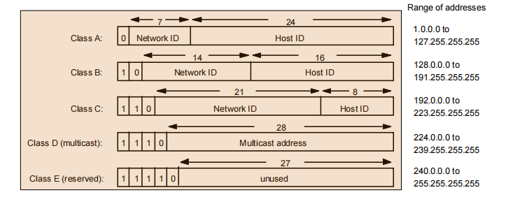
IPV4
The 32 bits of an IPv4 address are broken into 4 octets, or 8 bit fields (0-255 value in decimal notation) For networks of different size,  the first one (for large networks) to three (for small networks) octets can be used to identify the network, while the rest of the octets can be used to identify the node on the network

Slide 10
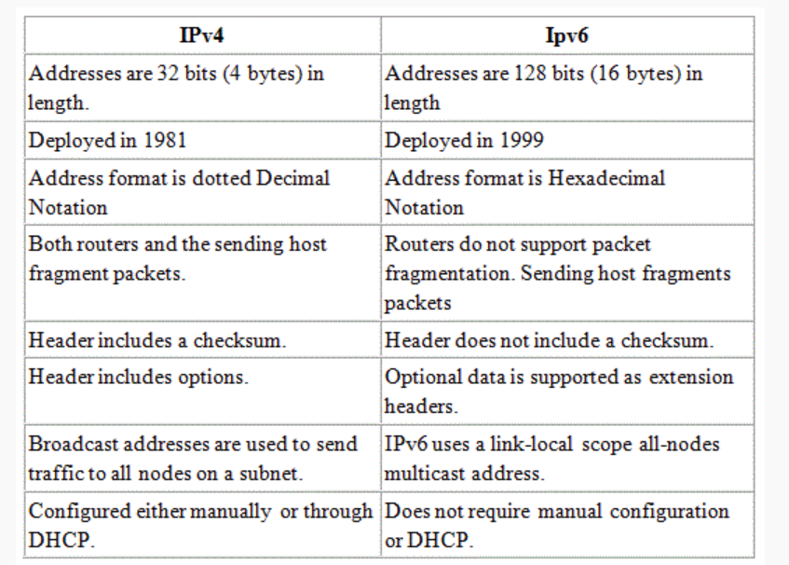

Slide 11
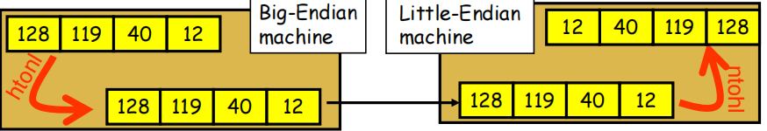
Byte-Ordering
Host Byte-Ordering: the byte ordering used by a host (big or little)
Network Byte-Ordering: the byte ordering used by the network –
always big-endian
u_long htonl(u_long x);
u_short htons(u_short x);
u_long ntohl(u_long x);
u_short ntohs(u_short x);
On big-endian machines, these routines do nothing
On little-endian machines, they reverse the byte order

Slide 12
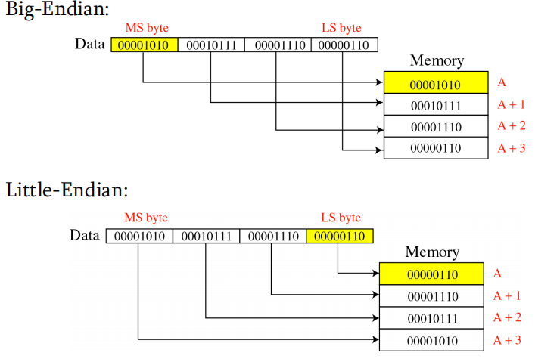

Slide 13
Socket Functions
1. Socket creation:
int sockfd = socket(domain, type, protocol)
2. Setsockopt:
int setsockopt(int sockfd, int level, int optname, const void *optval, socklen_t optlen);
3. Bind:
int bind(int sockfd, const struct sockaddr *addr, socklen_t addrlen);
4. Listen:
int listen(int sockfd, int backlog);

Slide 14
Contd..
5. ACCEPT:
int new_socket= accept(int sockfd, struct sockaddr *addr, socklen_t *addrlen);
6. CONNECT
int connect(int sockfd, const struct sockaddr *addr, socklen_t addrlen);

Slide 15
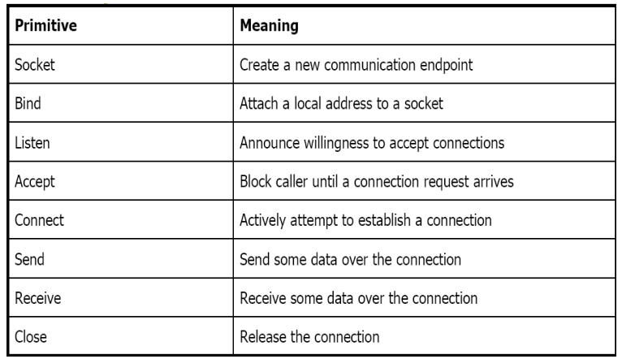

Slide 16
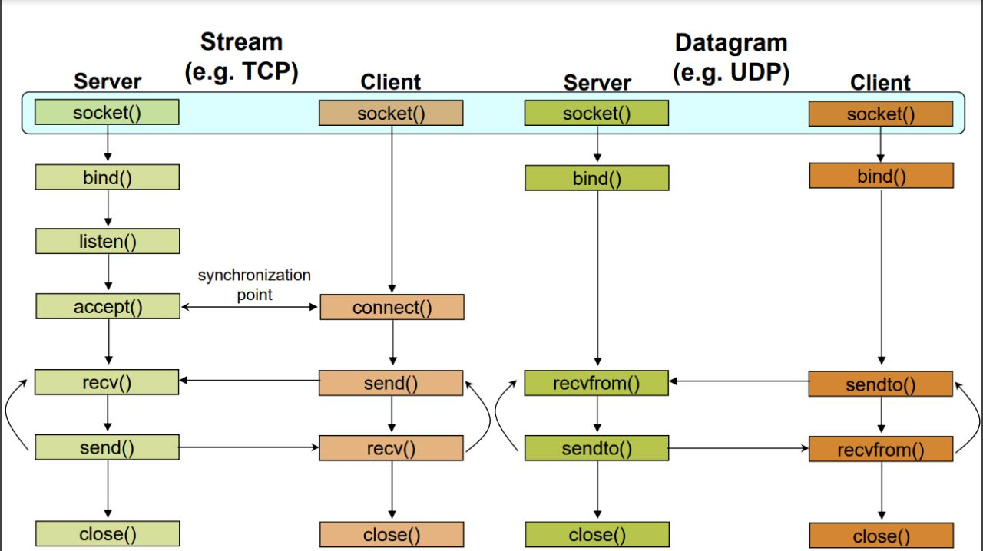
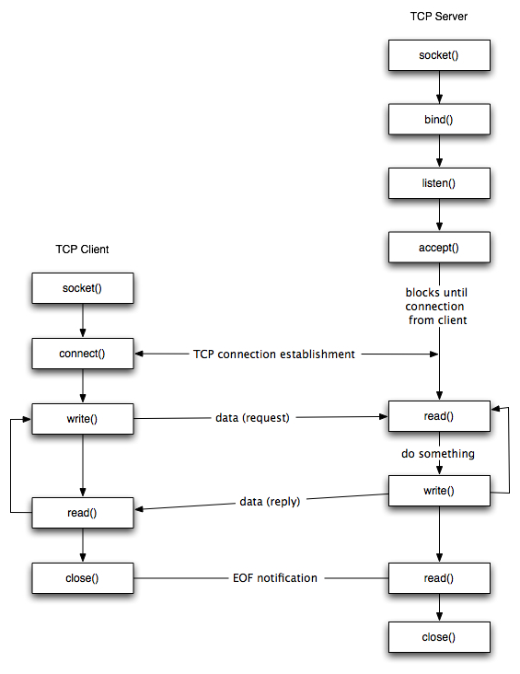
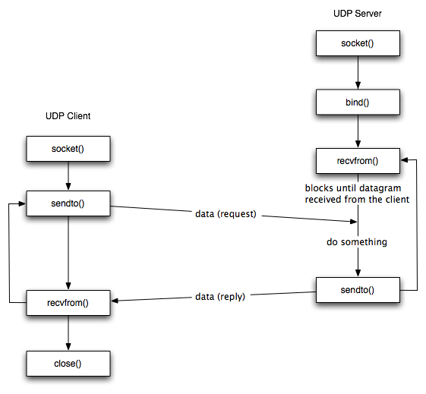

Slide 17
Steps to Create TCP Server & Client
The entire process can be broken down into following steps:
TCP Server –
using create(), Create TCP socket.
using bind(), Bind the socket to server address.
using listen(), put the server socket in a passive mode, where it waits for the client to approach the server to make a connection
using accept(), At this point, connection is established between client and server, and they are ready to transfer data.
Go back to Step 3.
TCP Client –
Create TCP socket.
connect newly created client socket to server.

Slide 18
Server
Void main()
{
Int sockfd,newsockfd,client_size;
Char buf[256];
Int ret;
Struct sockaddr_in serv,client;
Sockfd=socket(AF_INET,SOCK_STREAM,IPPROTO_TCP);
Bzero(&serv,sizeof(struct sockaddr_in));
Serv.sin_family=AF_INET;
Serv.sin_port=htons(5000);
Serv.sin_addr.s_addr=INADDR_ANY;
Bind(sockd,(struct sockaddr*)&serv,sizeof((serv));
Listen(sockfd,5);
Client_size=sizeof(client);
Newsockfd=accept(sockfd,(struct sock addr*)&client,&client_size);
Ret=read(newsockfd,buf,256);
Write(1,buf,ret);
Ret=write(newsockfd,”hello”,strlen
(“hello”));
Close(newsockfd);
}

Slide 19
Client
void main()
{
Int sockfd,ret;
Struct sockaddr_in serv;
Char buf[256]=“hi”;
Sockfd=socket(AF_INET,SOCKSTREAM,IPPROTO_TCP);
Bzero(&serv,sizeof(serv));
Serv.sin_addr.s_addr=inet_addr(“127.0.0.1”);
serv.sin_port=htons(5000);
Serv.in_family=AF_INET;
Connect(sockfd,(struct sock addr*)&serv,sizeof(serv));
Ret=send(sockfd,”hi”,strlen(“hi”),0);
Ret=recv(sockfd,buf,256,0);
}

Slide 20
Steps to Create UDP Server & Client
Implementation of UDP Client Server Program
UDP server
UDP socket creation.
Connect the socket to the server's address.
Await the arrival of the client's datagram packet.
The datagram packet is processed, and a response is sent to the client.
Returning to Step 3.
UDP Client
Construct a UDP socket.
To the server, send a message.
Hold off until you get a response from the server.
Respond to the message and, if necessary, return to step 2.
Terminate the socket descriptor.

Slide 21
Server
{perror("bind failed");
exit(EXIT_FAILURE);}
int len, n;
len = sizeof(cliaddr); //len is value/result
n = recvfrom(sockfd, (char *)buffer, MAXLINE,
buffer[n] = '\0';
printf("Client : %s\n", buffer);
sendto(sockfd, (const char *)hello, strlen(hello);
printf("Hello message sent.\n");
return 0;}
int main() {
int sockfd;
char buffer[MAXLINE];
char *hello = "Hello from server";
struct sockaddr_in servaddr, cliaddr;
if ( (sockfd = socket(AF_INET, SOCK_DGRAM, 0)) < 0 ) {perror("socket creation failed");
exit(EXIT_FAILURE);}
memset(&servaddr, 0, sizeof(servaddr));
memset(&cliaddr, 0, sizeof(cliaddr));
servaddr.sin_family = AF_INET; // IPv4
servaddr.sin_addr.s_addr = INADDR_ANY;
servaddr.sin_port = htons(PORT);
if ( bind(sockfd, (const struct sockaddr *)&servaddr,
sizeof(servaddr)) < 0 )

Slide 22
Client
int main() {
int sockfd;
char buffer[MAXLINE];
char *hello = "Hello from client";
struct sockaddr_in servaddr;
if ( (sockfd = socket(AF_INET, SOCK_DGRAM, 0)) < 0 ) {
perror("socket creation failed");
exit(EXIT_FAILURE);}
memset(&servaddr, 0, sizeof(servaddr));
servaddr.sin_family = AF_INET;
servaddr.sin_port = htons(PORT);
servaddr.sin_addr.s_addr = INADDR_ANY;
int n, len;
sendto(sockfd, (const char *)hello, strlen(hello),
printf("Hello message sent.\n");
n = recvfrom(sockfd, (char *)buffer, MAXLINE);
buffer[n] = '\0';
printf("Server : %s\n", buffer);
close(sockfd);
return 0;
}

Slide 23
TCP VS UDP
It stands for Transmission Control Protocol.
It is a connection-oriented protocol, which means that the connection needs to be established before the data is transmitted over the network.
TCP is a reliable protocol as it provides assurance for the delivery of data packets.
It stands for User Datagram Protocol.
It is a connectionless protocol, which means that it sends the data without checking whether the system is ready to receive or not.
UDP is an unreliable protocol as it does not take the guarantee for the delivery of packets.

Slide 24
Contd…
TCP is slower than UDP as it performs error checking, flow control, and provides assurance for the delivery of
The size of TCP is 20 bytes.
This protocol is mainly used where a secure and reliable communication process is required, like military services, web browsing, and e-mail.
UDP is faster than TCP as it does not guarantee the delivery of data packets.
The size of the UDP is 8 bytes.
This protocol is used where fast communication is required and does not care about the reliability like VoIP, game streaming, video and music streaming, etc.

Slide 25
References
Google

Slide 26
Thank you

