Slide 1

GDB SERVER

Slide 2

CONTENTS
What is GDB..?
WhaT IS DEBUGGING..?
Types of debugging..?
-REmote debugging / tcp debugging.
Serial debugging.
Building kernel image adding gdb tool chain via busy box..
Building a kernel image for target board.
-via build root.
-via crosstool compilation.

Slide 3
What is GDB?
gdbserver is a control program for Unix-like systems, which allows you to connect your program with a remote GDB via target remote.
gdbserver is not a complete replacement for the debugging, because it requires essentially the same operating-system facilities that GDB itself does. In fact, a system that can run gdbserver to connect to a remote GDB could also run GDB locally!
gdbserver is sometimes useful nevertheless, because it is a much smaller program than GDB itself. It is also easier to port than all of GDB, so you may be able to get started more quickly on a new system by using gdbserver.
Finally, if you develop code for real-time systems, you may find that the tradeoffs involved in real-time operation make it more convenient to do as much development work as possible on another system, for example by cross-compiling. You can use gdbserver to make a similar choice for debugging.

Slide 4
WhaT IS Debugging..?
Debugging is the process of locating and removing coding mistakes in computer programs. In information technology and engineering, the word 'bug' is a synonym for the word 'error.' The goal of debugging is to identify and correct an error's root cause.
Debugging plays an important role in the software development process and ironically, testing to determine and eliminating the presence of bugs can take just as much time as writing code. The debugging process itself consists of identify the cause of an error and fixing it. During the debugging process, which can be carried out manually or automated through software debugging tools, engineers will look for:
> Syntax errors
> Errors in logic
> Implementation errors
For Linux and Unix operating systems, GDB is used as a standard debugger.
For Windows OS, the visual studio is a powerful editor and debugger.
For Mac OS, LLDB is a high-level debugger.

Slide 5
Difference between GDB and GDBSERVER
GDB (GNU Debugger) is a powerful debugging tool used for debugging programs written in various programming languages, including C, C++, and Assembly. GDB runs on a host machine and allows developers to debug programs running on a target machine.
GDB server, on the other hand, is a program that runs on the target machine and acts as an intermediary between the debugger (GDB) running on the host machine and the program being debugged on the target machine. GDB server provides a debugging interface on the target machine and handles communication between the host and target machines.
The main difference between GDB and GDB server is that GDB is a debugging tool that runs on the host machine, while GDB server is a program that runs on the target machine and provides a debugging interface for GDB to communicate with the program being debugged.

Slide 6
Types of debugging..?
Print debugging: This involves inserting print statements in the code to display variable values or other information at specific points in the program's execution. It is a simple and effective debugging technique, but it can also be time-consuming and may require modifying the code.
Interactive debugging: Interactive debugging involves using a debugger tool like GDB (GNU Debugger) to interactively debug a program. Developers can set breakpoints, step through the code, inspect variables, and execute commands while the program is running. This technique is more efficient and flexible than print debugging and allows developers to debug complex issues.
Core dump analysis: When a program crashes, it generates a core dump file, which contains information about the program's state at the time of the crash. Developers can use tools like GDB to analyze the core dump file and identify the cause of the crash.
System call tracing: This technique involves tracing system calls made by a program to understand its behavior. Tools like strace and ltrace can be used to trace system calls and library calls made by a program and identify issues like resource leaks or incorrect system call usage.
5.Profiling: Profiling involves collecting data on a program's execution, including how much time is spent in each function or code block. Tools like gprof can be used to generate a profile report and identify performance bottlenecks or areas for optimization.

Slide 7
Debugging Strategies:
Debugging is the process of identifying and fixing errors or defects in a program. There are several strategies that developers can use to debug their code effectively, including:
1.Reproduce the problem: Reproducing the problem is the first step in debugging. Developers should try to reproduce the problem in a controlled environment, which will help them identify the cause of the issue more.
2.Divide and conquer: This strategy involves breaking down the problem into smaller parts and testing each part individually. This helps to isolate the problem and identify the exact point where the error occurs.
3.Use debugging tools: Debugging tools like GDB, Valgrind, or strace can be used to identify the cause of the issue. These tools provide detailed information about the program's execution, memory usage, and system calls, which can help developers identify the root cause of the issue.
4.Read the code: Developers should carefully read the code and try to understand how it works. This will help them identify errors or issues that may not be obvious from the output or behavior of the program.
5.Simplify the problem: Sometimes, complex problems can be simplified by removing unnecessary code or data. This can help to isolate the problem and make it easier to debug.
6.Seek help: If all else fails, developers can seek help from their peers or online communities. Many developers share their experiences and solutions to common problems on forums, mailing lists, or social media platforms.

Slide 8
Importance of Debugging
Debugging is a critical part of the software development process, and its importance cannot be overstated. Here are some of the reasons why debugging is so important:
Finding and fixing errors: Debugging is the process of identifying and fixing errors or defects in a program. Errors can cause a program to crash, behave unexpectedly, or produce incorrect results. By debugging the code, developers can find and fix these errors, ensuring that the program works as intended.
Improving software quality: Debugging can help to improve the quality of software by identifying and fixing errors before the program is released to users. This can reduce the number of bugs that users encounter, making the program more reliable and easier to use.
3.Saving time and money: Debugging can save time and money by identifying and fixing errors early in the development process. The cost of fixing errors increases as the project progresses, so identifying and fixing errors early can save time and money in the long run.
4.Enhancing performance: Debugging can help to identify performance bottlenecks in a program, allowing developers to optimize the code and improve its performance.
5.Increasing developer productivity: Debugging can increase developer productivity by helping them to understand how the code works and how to improve it. By debugging the code, developers can learn more about the program's behavior and improve their programming skills.

Slide 9
Debugging Tools
There are many tools available to developers for debugging their code. Here are some of the most popular debugging tools:
GDB: GDB (GNU Debugger) is a powerful command-line debugger that can be used to debug programs written in C, C++, and other languages. It allows developers to set breakpoints, step through code, examine variables, and more.
Valgrind: Valgrind is a suite of debugging and profiling tools that can help developers find memory leaks, race conditions, and other errors in their code. It includes tools like Memcheck, which can detect memory errors, and Helgrind, which can detect threading errors.
strace: strace is a command-line tool that can be used to trace system calls and signals made by a program. It can help developers identify system-related issues and performance bottlenecks.
Wireshark: Wireshark is a network protocol analyzer that can be used to debug network-related issues. It allows developers to capture and analyze network traffic, which can help them identify and fix issues related to network connectivity and performance.

Slide 10
Contd..
5.Visual Studio Debugger: Visual Studio Debugger is a debugging tool that is included with Microsoft's Visual Studio IDE. It provides a graphical user interface that allows developers to set breakpoints, step through code, examine variables, and more.
6.Eclipse Debugger: Eclipse Debugger is a debugging tool that is integrated into the Eclipse IDE. It provides similar functionality to the Visual Studio Debugger, including the ability to set breakpoints, step through code, and examine variables.

Slide 11
Remote debugging :
Remote debugging is the process of debugging a program running on a remote machine, typically over a network connection. It allows developers to debug code on a remote machine without having to physically access that machine.
Remote debugging typically involves two components: a debugging client and a debugging server. The client is the tool used by the developer to connect to the remote machine and debug the code. The server is the program running on the remote machine that allows the client to connect to it and debug the code.
To perform remote debugging, the developer typically sets up the server program on the remote machine and then connects to it using the client tool. Once connected, the developer can set breakpoints, step through code, examine variables, and perform other debugging tasks.
Remote debugging can be useful in a variety of situations, such as when the developer does not have physical access to the machine running the code, or when the code is running on a server in a remote data center. It can also be useful for debugging distributed systems, where multiple machines are involved in the processing of a task.
However, remote debugging can also be more complex than local debugging, as it requires a network connection and often involves additional security considerations. It is important for developers to carefully configure and secure the remote debugging environment to ensure the security and stability of the system.

Slide 12
Standard Remote Debugging
Standard remote debugging refers to the use of a standardized protocol for remote debugging. The protocol defines the communication between the debugger and the debugging agent and ensures that they can work together seamlessly, regardless of the language or platform being used.
There are several standardized remote debugging protocols, each designed for specific languages or platforms.
Here are some examples:
GDB Remote Serial Protocol: This protocol is used for remote debugging of applications written in C, C++, and other languages that use the GNU Debugger (GDB).
Java Debug Wire Protocol (JDWP): This protocol is used for remote debugging of Java applications.

Slide 13
Extended Remote Debugging
Extended remote debugging refers to the process of debugging a software application that is running on a remote machine, usually over a network or the internet. It allows developers to access and analyze the code, variables, and other important information about the application without physically being on the same machine as the software.
This type of debugging is particularly useful when dealing with distributed systems, where different components of the application are running on different machines, or when the software is deployed to production environments where access is limited. Extended remote debugging is typically done using specialized debugging tools that provide features such as
Remote code execution.
Live code editing.
Real-time debugging information.

Slide 14
GDB Server
GDBserver is a component of the GNU Debugger (GDB) that enables remote debugging of target systems. It allows developers to debug programs running on a remote machine or embedded system without having to physically access that machine. Instead, GDBserver runs on the target system and communicates with GDB running on the development host.
To use GDBserver, the developer first starts the GDBserver program on the target system, specifying the port number and any other necessary configuration options. Then, on the development host, they start GDB and connect to the remote target by specifying the IP address and port number of the machine running.
GDBserver. GDB can then communicate with the target system and debug the program running on it as if it were running locally.
GDBserver supports a variety of communication protocols, including TCP/IP, serial port, and USB, making it flexible enough to be used in a variety of situations. It can also be used in conjunction with cross-compilers to debug programs built for different architectures than the development host.
Overall, GDBserver is a powerful tool for remote debugging that enables developers to debug programs running on embedded systems and other remote targets with ease.

Slide 15
Features of GDB Server
Remote Debugging: gdbserver allows developers to debug applications that are running on remote machines or devices, even if the local machine doesn't have the same architecture or operating system.
Multi-Thread Support: gdbserver has multi-thread support, which allows developers to debug multi-threaded applications remotely.
Symbol Table Support: gdbserver can read symbol tables generated by compilers, which allows it to display function names and other debugging information.
Breakpoints: gdbserver allows setting and removing breakpoints, which is useful when trying to pinpoint the exact location of a bug in the code.
Signal Handling: gdbserver can handle signals such as SIGINT and SIGTERM, which are sent to the application being debugged.
Core Dump Analysis: gdbserver can analyze core dumps generated by a remote process, which can help identify the root cause of a crash.
Reverse Debugging: gdbserver can be used for reverse debugging, which means stepping backwards through code execution to identify the cause of a problem.

Slide 16
Rules for GDB server-client communication
GDB (GNU Debugger) is a powerful tool used for debugging and analyzing software applications. gdbserver is a component of GDB that allows remote debugging of applications running on a target system. When using gdbserver for remote debugging, there are several rules that should be followed to ensure effective communication between the gdbserver and client components.
Compatibility: The gdbserver and client versions should be compatible with each other. If they are not compatible, it may result in errors during communication or unexpected behavior. Protocol: gdbserver and the client should use the same protocol for communication. The protocol can be selected using the "-x" command line option with gdbserver.
Network connectivity: gdbserver and the client should be connected to the same network or reachable through a secure channel. If there is a firewall or other network security measures, they should be configured to allow communication between the gdbserver and client.
Permissions: The user running gdbserver should have sufficient permissions to execute and debug the application being debugged. Additionally, any necessary permissions should be granted to the client machine to connect and communicate with the gdbserver.
Debugging Symbols: The application being debugged should be compiled with debugging symbols (-g option), so that gdbserver can provide the necessary information to the client to perform

Slide 17
Special commands used with GDBserver
GDBserver is a program that allows remote debugging of applications using GDB (GNU Debugger). When debugging a program remotely using GDBserver, you can use several TCP commands to control the debugger and the debugged program. Some of the commonly used TCP commands with GDBserver are:
target remote <host>:<port>: This command connects GDB to the remote GDBserver running on the specified host and port.
set remotebaud <baudrate>: This command sets the baud rate for serial connections. //Serial communication
monitor reset: This command resets the target system.
monitor reset: This command resets the target system.
monitor exit: This command exits GDBserver.
monitor help: This command displays a list of available monitor commands.
monitor resume: This command resumes the execution of the target system.

Slide 18
Common set of commands
step: This command executes the current line of code in the debugged program and then stops at the next line.
next: This command executes the current line of code in the debugged program and stops at the next line, but does not step into any function calls.
finish: This command continues the execution of the debugged program until it returns from the current function.
break <location>: This command sets a breakpoint at the specified location.
info breakpoints: This command displays information about all currently set breakpoints.
continue: This command continues the execution of the debugged program.
delete breakpoints: This command deletes all currently set breakpoints.

Slide 19
Copy the file
Using file get command in gdb: You can use the file get command in gdb to copy the executable file from the remote machine where gdbserver is running to the local machine where gdbclient is running.
Using SCP: SCP (Secure Copy) is a command-line utility that allows you to securely copy files between remote and local machines. You can use SCP to copy the executable file from the remote machine to the local machine. Here's an example command to copy the file:
scp user@remote:/path/to/remote/executable /path/to/local/destination
where user is the username on the remote machine, remote is the IP address or hostname of the remote machine, /path/to/remote/executable is the path to the executable file on the remote machine, and /path/to/local/destination is the path where you want to save the file on the local machine.

Slide 20
File transfer protocol
File Transfer Protocol (FTP) is a standard network protocol used to transfer files between clients and servers on a computer network. The following are some of the commonly used FTP commands:
USER: This command is used to send the username to the FTP server.
PASS: This command is used to send the password to the FTP server.
LIST: This command is used to list the files and directories on the remote server.
RETR: This command is used to retrieve a file from the remote server.
STOR: This command is used to store a file on the remote server.
DELE: This command is used to delete a file on the remote server.
CWD: This command is used to change the current working directory on the remote server.
PWD: This command is used to display the current working directory on the remote server.
SIZE: This command is used to get the size of a file on the remote server.
ABOR: This command is used to abort the current file transfer operation.
QUIT: This command is used to terminate the FTP session.

Slide 21
Implementation FTP
Using FTP: FTP (File Transfer Protocol) is a standard protocol used for transferring files over a network.
You can use an FTP client to transfer the executable file from the remote machine to the local machine.
You'll need to have an FTP server running on the remote machine and an FTP client installed on the local machine. Here's an example command to copy the file using the ftp command:​
ftp remote​
ftp> get /path/to/remote/executable /path/to/local/destination​ ​
where remote is the IP address or hostname of the remote machine, /path/to/remote/executable is the path to the executable file on the remote machine, and /path/to/local/destination is the path where you want to save the file on the local machine.​

Slide 22
SFTP
Using SFTP: SFTP (Secure File Transfer Protocol) is a secure version of FTP that encrypts data during transfer.
You can use an SFTP client to transfer the executable file from the remote machine to the local machine. You'll need to have an SFTP server running on the remote machine and an SFTP client installed on the local machine.
Here's an example command to copy the file using the sftp command:
​sql​sftp user@remote​
sftp> get /path/to/remote/executable /path/to/local/destination​​
where user is the username on the remote machine, remote is the IP address or hostname of the remote machine,
/path/to/remote/executable is the path to the executable file on the remote machine.
/path/to/local/destination is the path where you want to save the file on the local machine.​

Slide 23
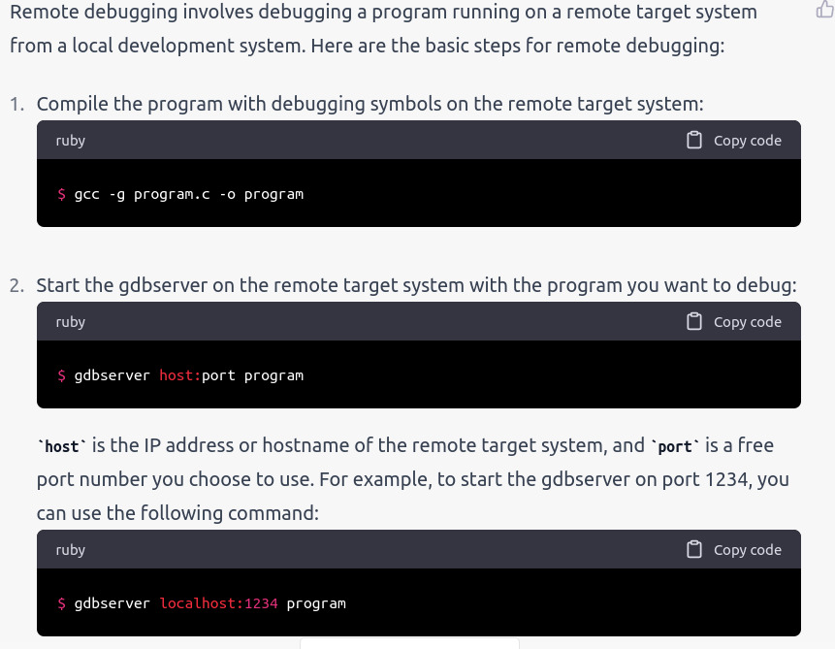
Steps

Slide 24
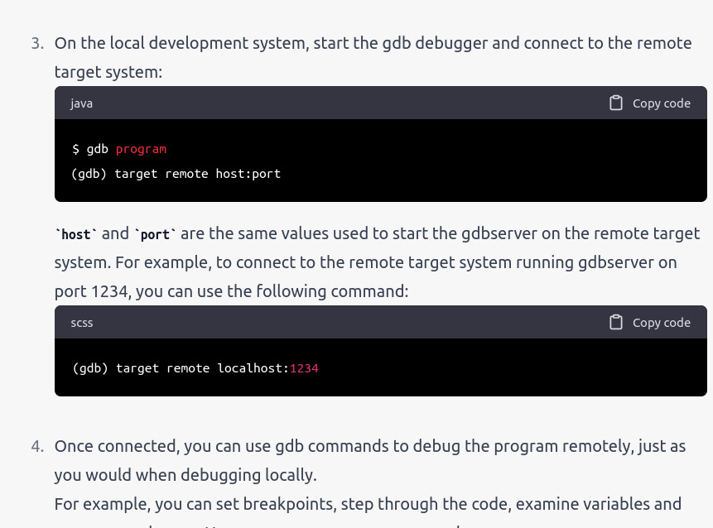

Slide 25
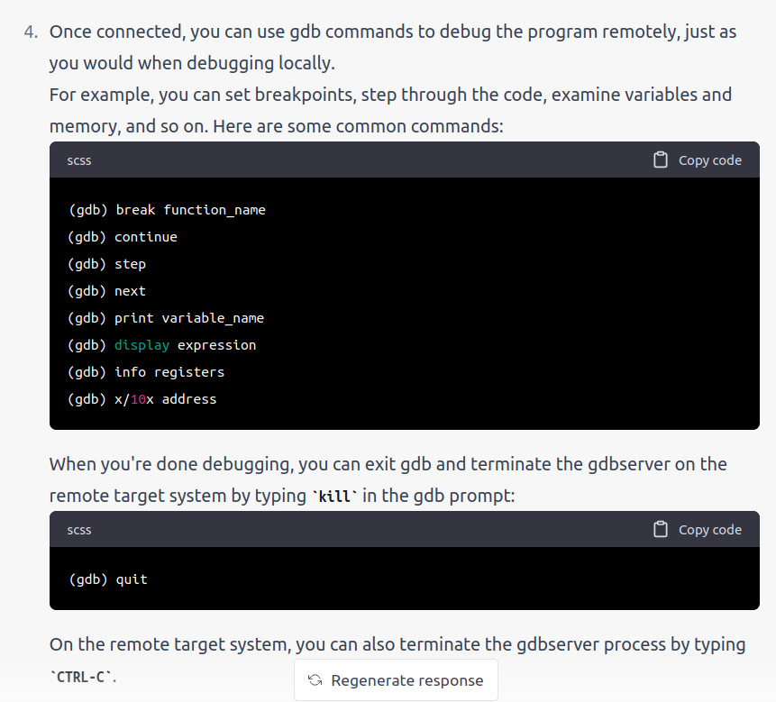

Slide 26
| Remote machine | | Local machine |
+----------------+ +----------------+
| |
| Start gdbserver on remote machine |
| with <hostname>:<port> |
| and <program> |
| |
|---------------------------------------------------------->|
| |
| |
| Start gdb on local machine |
| with <program> |
| |
|<-----------------------------------------------------------|
| |
| |
| Set target remote with <hostname>:<port>|
| |
|----------------------------------------------------------->|
| |
| |
| Load program symbols with file |
| <program> |

Slide 27
|------------------------------------------------------------>|​
| |​
| |​
| Set breakpoints or watchpoints |​
​
| Continue running the program with |​
| the command continue |​
| |​
|<------------------------------------------------------------|
| |​
| |​
| Use gdb commands to debug the program |​
| |​
| Terminate the debugging session |​
| with the command kill in gdb | ​
| |​
|<-------------------------------------------------------------|
| |​
| |​
| Quit gdb with the command quit |​

Slide 28
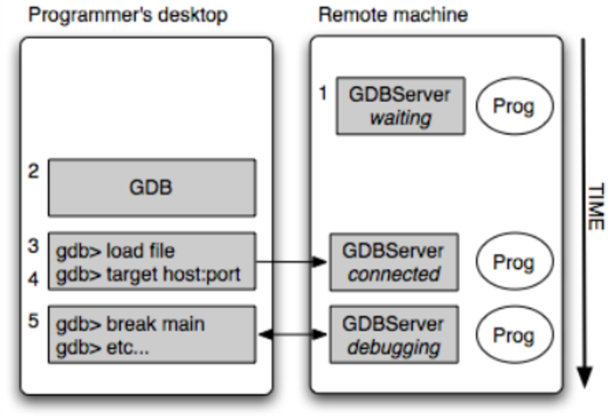

Slide 29
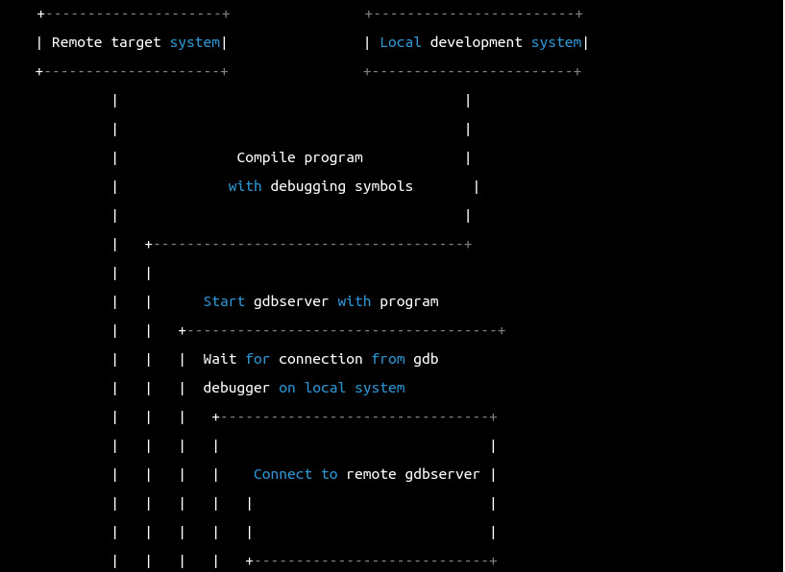

Slide 30
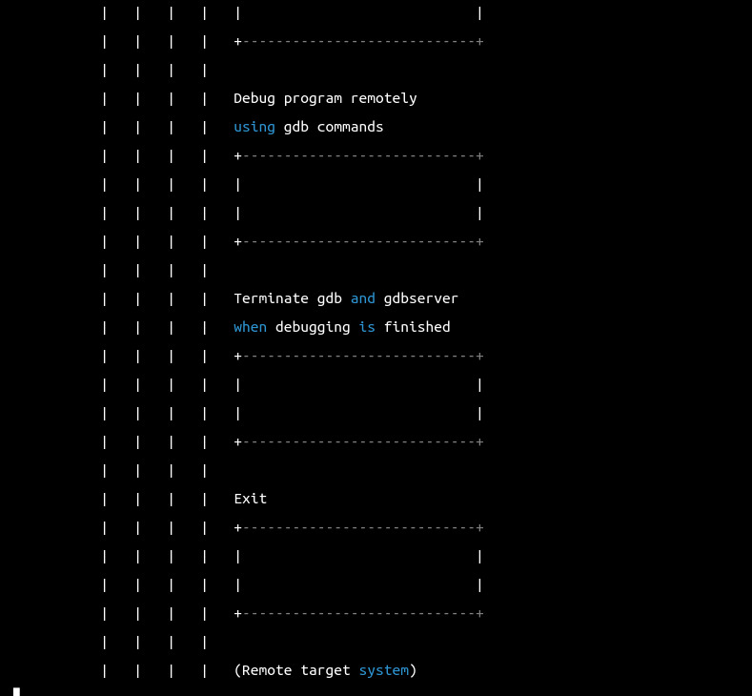

Slide 31
Successful connection server and client

Slide 32
srihari

Slide 33
Cross-Compiling the Kernel:
Install Required Dependencies and Toolchain:
To build the sources for cross-compilation, make sure you have the dependencies needed on your machine by executing:
sudo apt install git bc bison flex libssl-dev make libc6-dev libncurses5-dev
Install the 32-bit Toolchain for a 32-bit Kernel:
sudo apt install crossbuild-essential-armhf
Install the 64-bit Toolchain for a 64-bit Kernel:
sudo apt install crossbuild-essential-arm64
Get the Kernel Sources:
To download the minimal source tree for the current branch, run:
git clone --depth=1 https://github.com/raspberrypi/linux
Build sources:
32-bit Configs:
For Raspberry Pi 1, Zero and Zero W, and Raspberry Pi Compute Module 1:
cd linux KERNEL=kernel make ARCH=arm CROSS_COMPILE=arm-linux-gnueabihf- bcmrpi_defconfig

Slide 34
For Raspberry Pi 2, 3, 3+ and Zero 2 W, and Raspberry Pi Compute Modules 3 and 3+:
cd linux KERNEL=kernel7 make ARCH=arm CROSS_COMPILE=arm-linux-gnueabihf- bcm2709_defconfig
For Raspberry Pi 4 and 400, and Raspberry Pi Compute Module 4:
cd linux KERNEL=kernel7l make ARCH=arm CROSS_COMPILE=arm-linux-gnueabihf- bcm2711_defconfig
64-bit Configs
For Raspberry Pi 3, 3+, 4, 400 and Zero 2 W, and Raspberry Pi Compute Modules 3, 3+ and 4:
cd linux KERNEL=kernel8 make ARCH=arm64 CROSS_COMPILE=aarch64-linux-gnu- bcm2711_defconfig
Build with Configs
For all 32-bit Builds
make ARCH=arm CROSS_COMPILE=arm-linux-gnueabihf- zImage modules dtbs
For all 64-bit Builds
make ARCH=arm64 CROSS_COMPILE=aarch64-linux-gnu- Image modules dtbs

Slide 35
Install in sdcard
First, use lsblk before and after plugging in your SD card to identify it. You should end up with something a lot like this:
sdb sdb1 sdb2
with sdb1 being the FAT filesystem (boot) partition, and sdb2 being the ext4 filesystem (root) partition.
Mount these first, adjusting the partition letter as necessary:
mkdir mnt mkdir mnt/fat32 mkdir mnt/ext4 sudo mount /dev/sdb1 mnt/fat32 sudo mount /dev/sdb2 mnt/ext4
Note:
You should adjust the drive letter appropriately for your setup, e.g. if your SD card appears as /dev/sdc instead of /dev/sdb.
Next, install the kernel modules onto the SD card:
For 32-bit
sudo env PATH=$PATH make ARCH=arm CROSS_COMPILE=arm-linux-gnueabihf- INSTALL_MOD_PATH=mnt/ext4 modules_install
For 64-bit
sudo env PATH=$PATH make ARCH=arm64 CROSS_COMPILE=aarch64-linux-gnu- INSTALL_MOD_PATH=mnt/ext4 modules_install

Slide 36
Finally, copy the kernel and Device Tree blobs onto the SD card.
Another option is to copy the kernel into the same place, but with a different filename - for instance, kernel-myconfig.img - rather than overwriting the kernel.img file. You can then edit the config.txt file to select the kernel that the Raspberry Pi will boot:
kernel=kernel-myconfig.img
Finally, plug the card into the Raspberry Pi and boot it!
Configuring the Kernel:
Configuration is most commonly done through the make menuconfig interface. Alternatively, you can modify your .config file manually, but this can be more difficult for new users.
Preparing to Configure:
The menuconfig tool requires the ncurses development headers to compile properly. These can be installed with the following command:
sudo apt install libncurses5-dev
Using menuconfig
Once you’ve got everything set up and ready to go, you can compile and run the menuconfig utility as follows:
make menuconfig
If you’re cross-compiling a 32-bit kernel:
make ARCH=arm CROSS_COMPILE=arm-linux-gnueabihf- menuconfig

Slide 37
if you are cross-compiling a 64-bit kernel:
make ARCH=arm64 CROSS_COMPILE=aarch64-linux-gnu- menuconfig
Kernel Headers:
> If you are compiling a kernel module or similar, you will need the Linux Kernel headers. These provide the various function and structure definitions required when compiling code that interfaces with the kernel.
>If you have cloned the entire kernel from github, the headers are already included in the source tree. If you don’t need all the extra files, it is possible to install only the kernel headers from the Raspberry Pi OS repo.
sudo apt install raspberrypi-kernel-headers

Slide 38
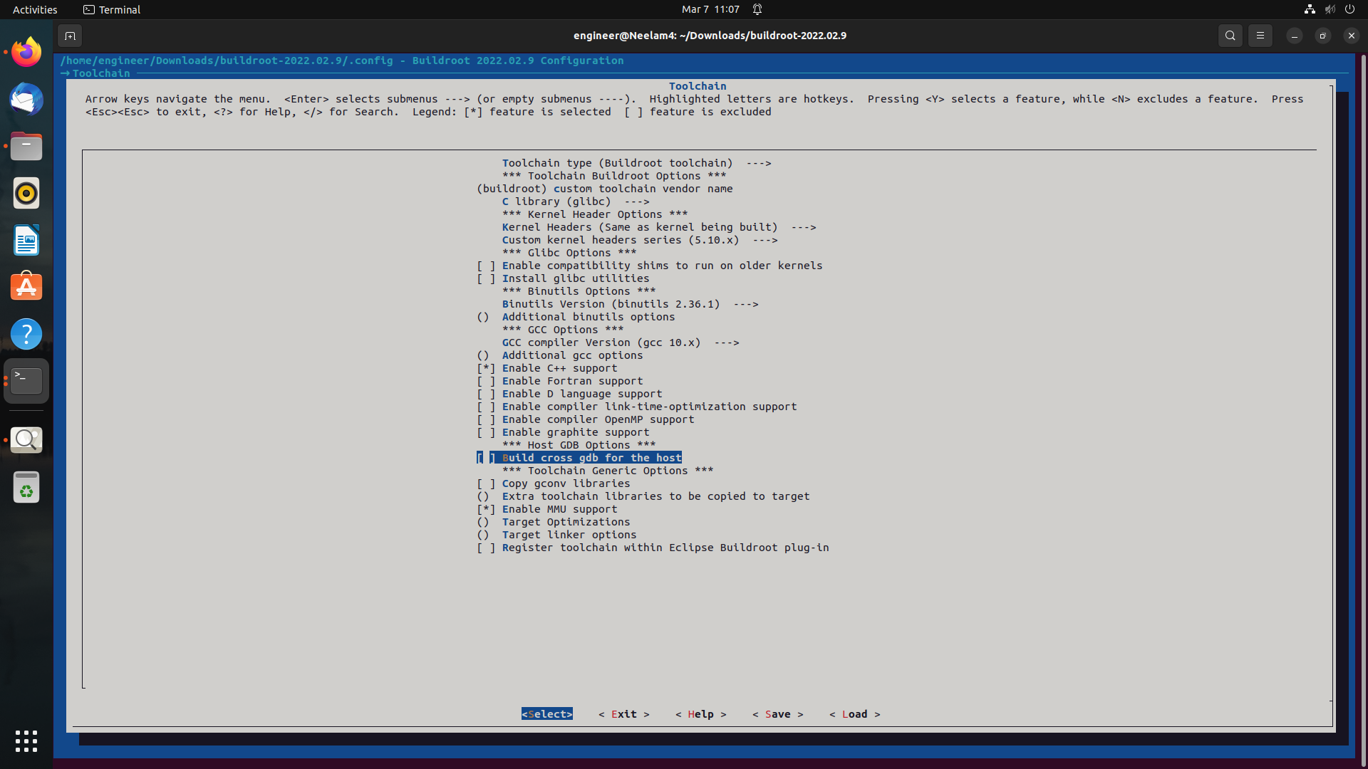

Slide 39
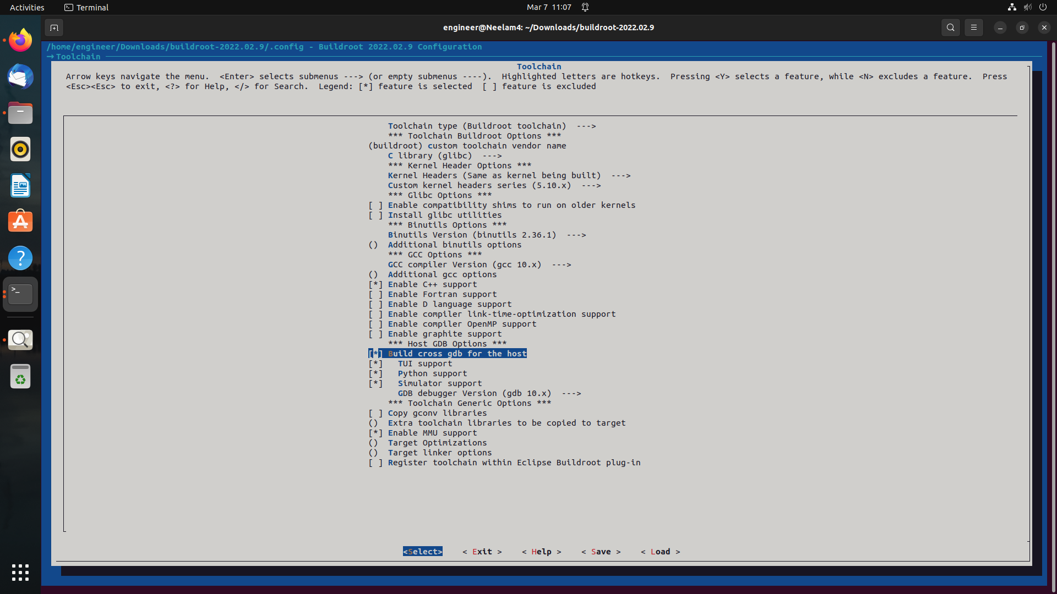

Slide 40
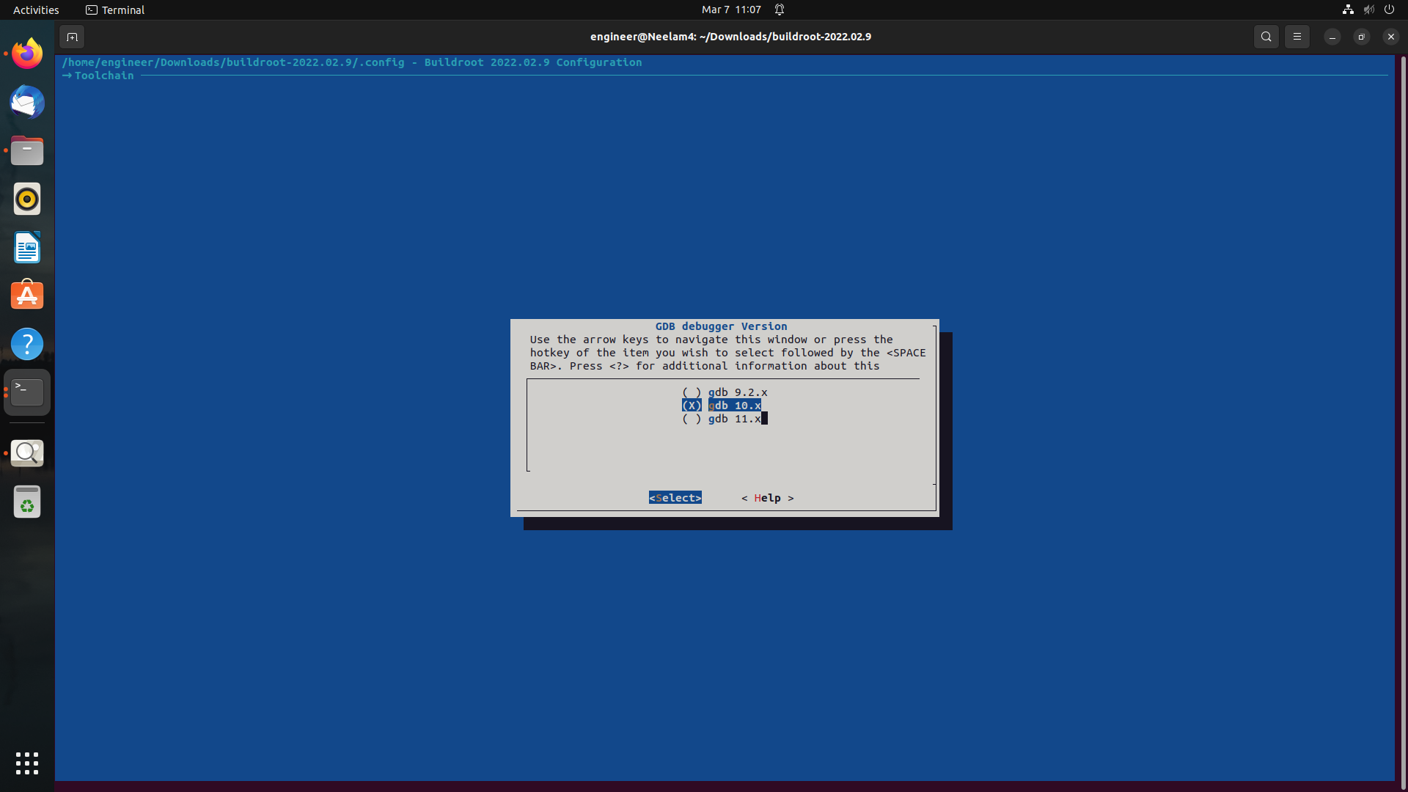

Slide 41
What is BusyBox in Linux?
BusyBox is a software suite that provides several Unix utilities in a single executable file. It is commonly used in embedded systems and in systems with limited resources, such as routers, IoT devices, and small Linux distributions.
BusyBox combines several commonly used Unix utilities, such as shell, grep, ls, cp, and many others, into a single binary file that can be used as a drop-in replacement for the original utilities.
BusyBox includes utilities such as ls, cp, mv, grep, and many others, and provides a lightweight alternative to larger and more complex packages such as GNU Coreutils. The utilities in BusyBox are designed to be small and efficient, and many of them can perform multiple functions, which helps to keep the size of the executable file small.
BusyBox can be used as the default command shell for a system, or it can be used as a standalone executable for running specific commands. It is often included in embedded Linux systems and can also be used on desktop systems.
Overall, BusyBox provides a convenient way to have a minimal set of Unix utilities in a single executable file, which can be useful in various contexts where size and efficiency are important considerations.

Slide 42
Busybox ABI’s
ABI (Application Binary Interface) refers to the interface between a program and the operating system or runtime environment it is running on.
BusyBox supports multiple ABIs, which are determined by the target architecture and compiler used to build the BusyBox binary.
Some of the ABIs supported by BusyBox include:
ARM EABI (ARM Embedded Application Binary Interface): This is the default ABI used for ARM-based systems.
x86 (32-bit and 64-bit): BusyBox supports x86 processors, including 32-bit and 64-bit versions of the ABI.
MIPS: BusyBox can be built for MIPS processors, which are commonly used in embedded systems.
PowerPC: BusyBox supports PowerPC processors, which are often used in embedded systems, gaming consoles, and other specialized devices.
SPARC: BusyBox can be built for SPARC processors, which are often used in servers and other high-performance computing systems.

Slide 43
Buildroot
Buildroot is a tool that allows you to create a custom Linux system image for embedded systems. Here are the basic steps to create a Buildroot image:
Install Buildroot: First, you need to download and install Buildroot on your system.
Configure Buildroot: Next, you need to configure Buildroot to create the image according to your requirements. You can do this by running the command make menuconfig.
Choose the target system: Select the target architecture and system that you want to build the image for. This includes selecting the processor type, board, and kernel version.
Select packages: Choose the packages you want to include in the image. This includes the libraries, utilities, and applications that you need for your system.
5.Build the image: Once you have configured Buildroot, you can build the image by running the command make.
6.Flash the image: After building the image, you need to flash it onto your target device. This involves copying the image file onto a bootable device, such as an SD card or USBdrive, and then inserting it into the device.
7.Test the image: Finally, you can test the image to ensure that everything is working correctly. This involves booting up the device and verifying that the software and hardware are working as expected.

Slide 44
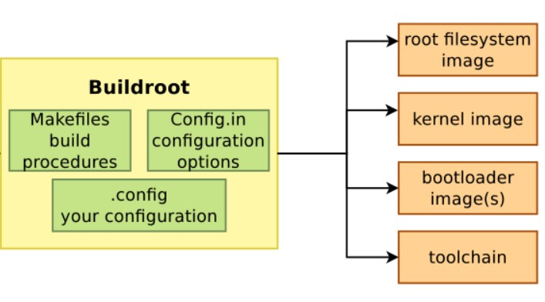
Buildroot

Slide 45
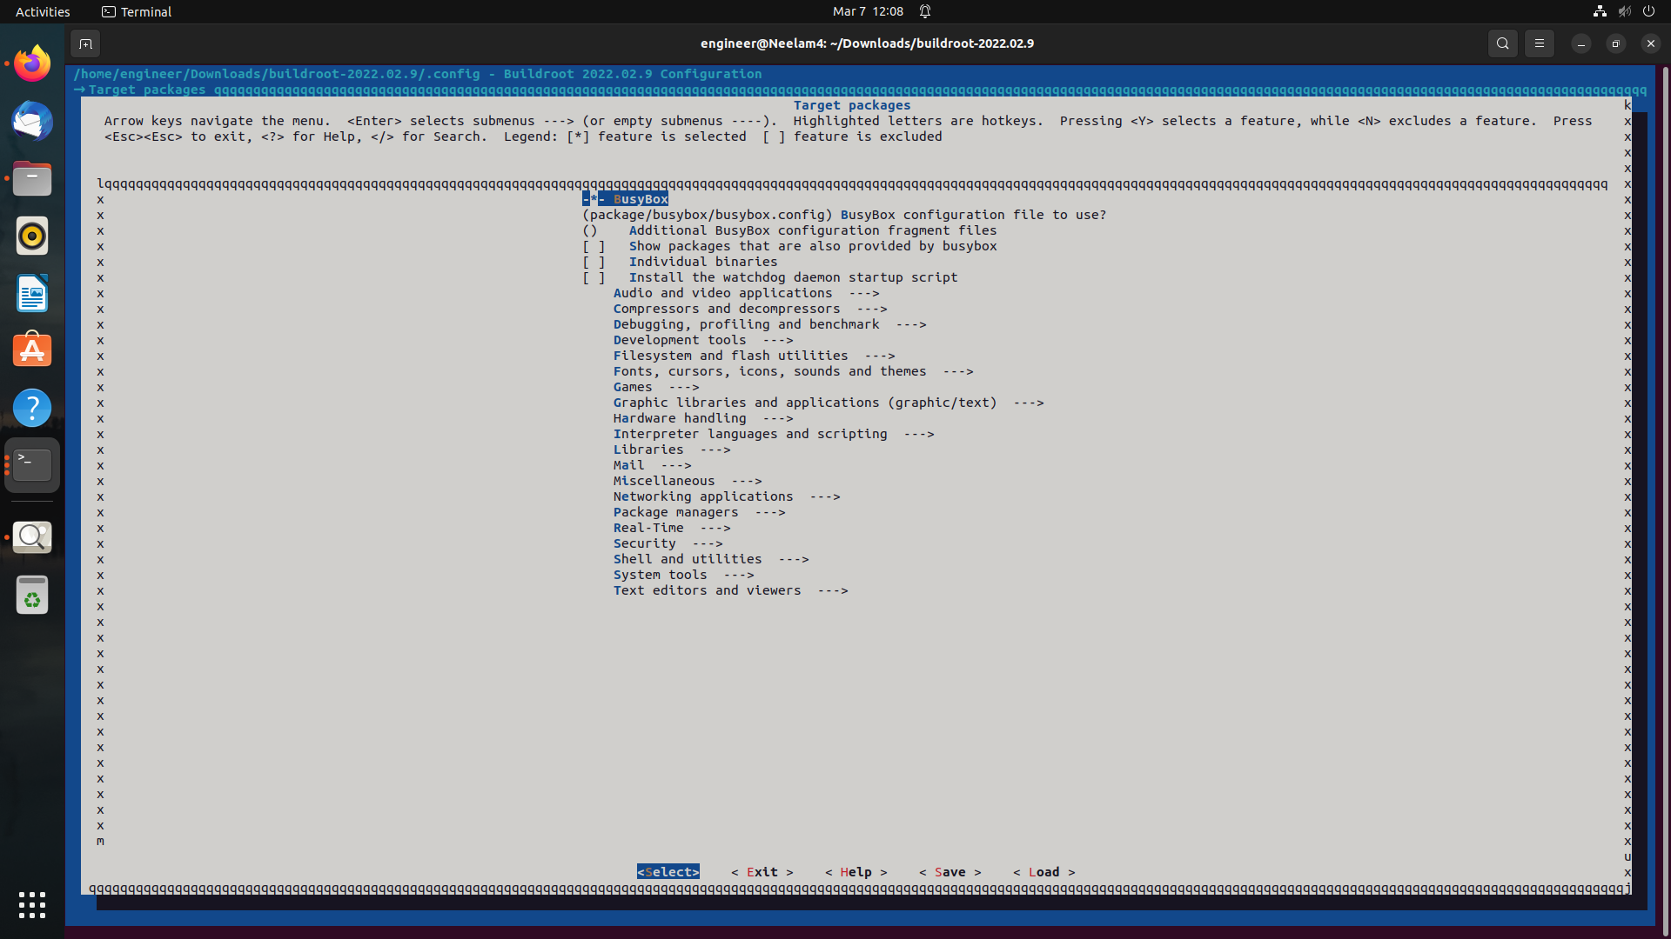

Slide 46
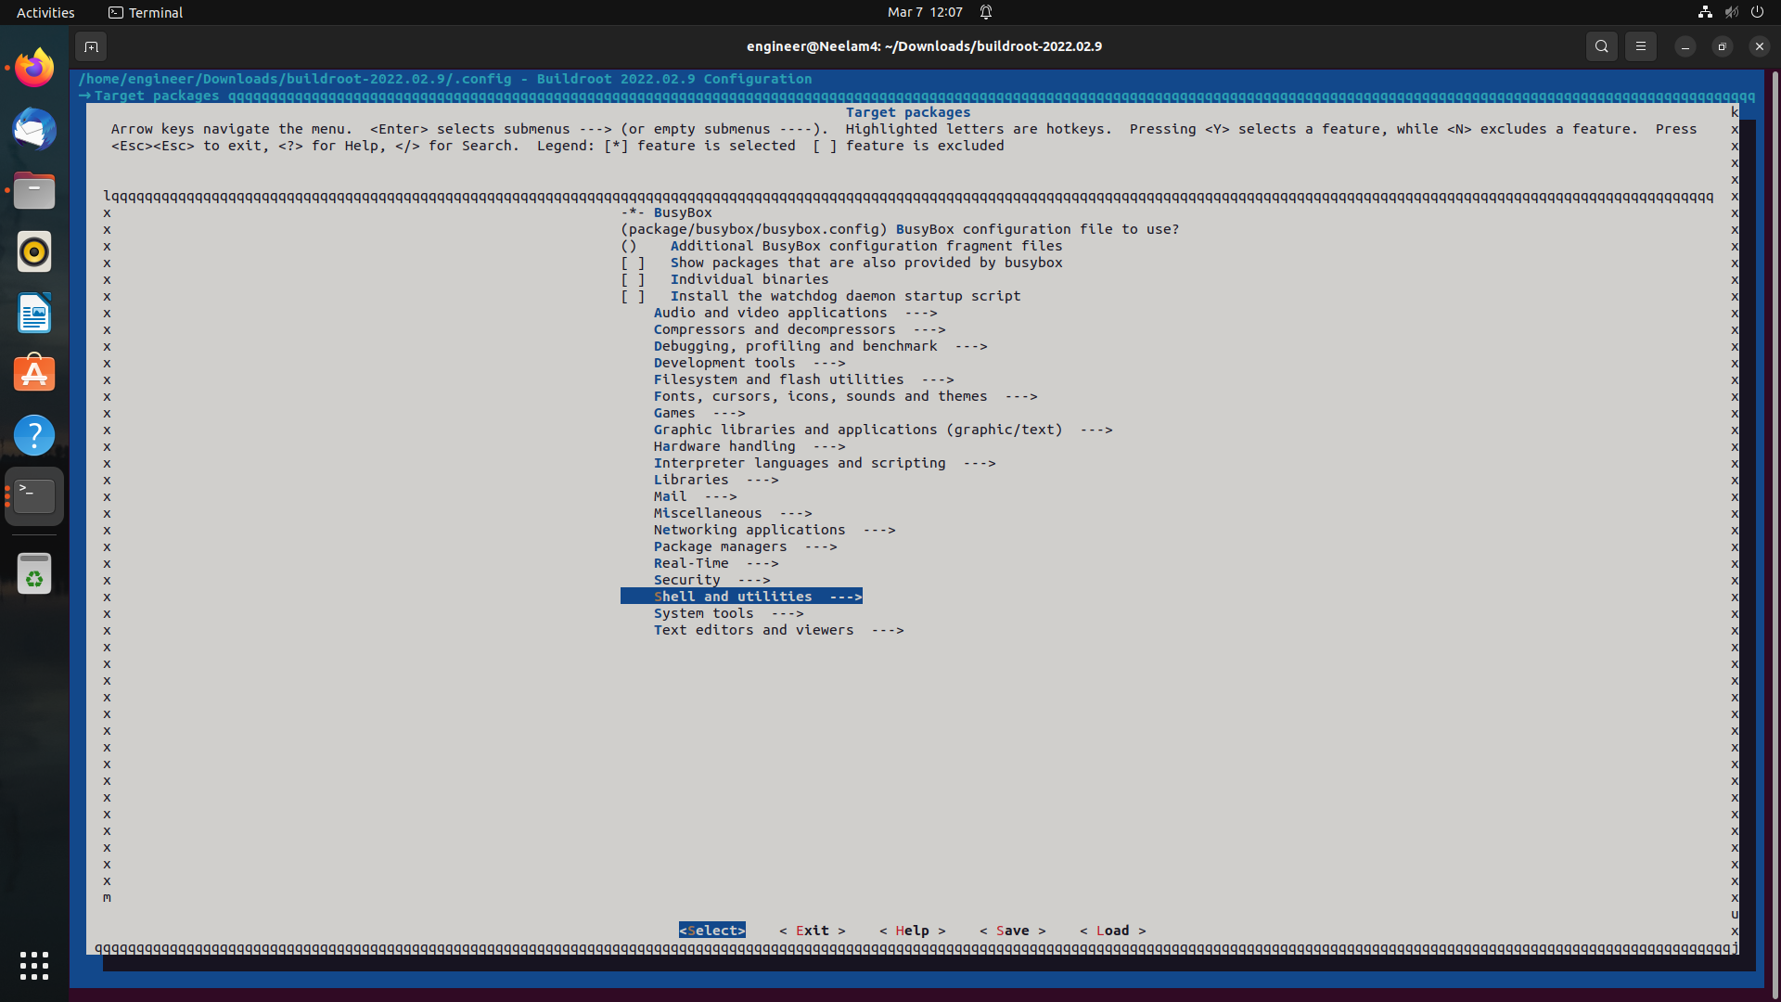

Slide 47
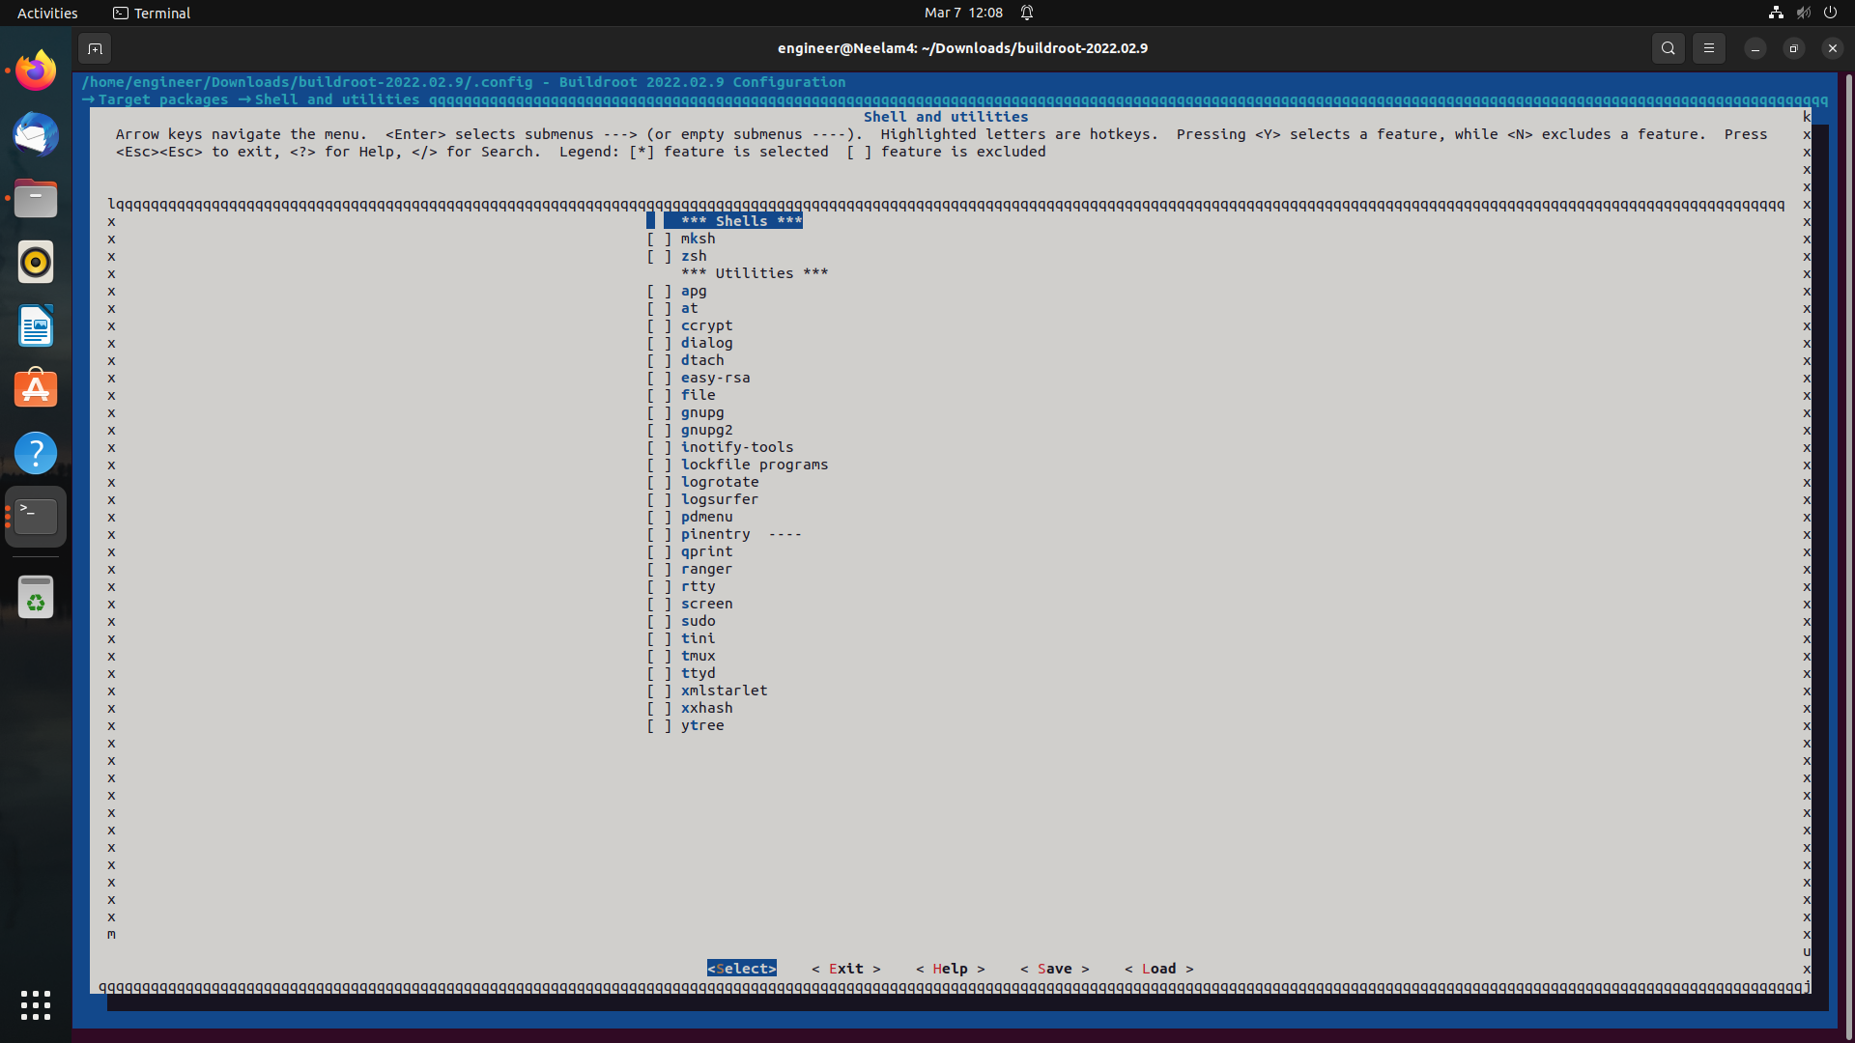

Slide 48
Advantages
Remote debugging: GDBserver allows remote debugging of a program running on a target system. This is particularly useful when the target system is a different architecture than the development system, or when the target system is a separate embedded device that cannot be directly connected to the development system.
Flexibility: GDBserver is a flexible tool that can be used with a wide variety of programming languages and development environments. It can be used to debug C and C++ programs, as well as programs written in other languages that can be compiled to run on the target system.
Real-time debugging: GDBserver allows for real-time debugging of programs running on a target system. This means that developers can debug programs while they are running, making it easier to identify and fix bugs in complex or time-critical applications.
Improved productivity: Using GDBserver can improve productivity by reducing the time required to identify and fix bugs in software. It can also reduce the need for developers to physically access target systems, which can be time-consuming and costly.

Slide 49
Disadvantages
Security Risks: GDBserver creates a network connection between the target system and the GDB client, which can potentially create security risks. If the connection is not properly secured, it could be vulnerable to unauthorized access or exploitation.
Performance Overhead: The use of GDBserver can introduce some performance overhead, particularly when debugging remote systems. The additional network latency and processing overhead required for remote debugging can affect the performance of the target system.
Debugging Limitations: GDBserver provides a limited set of debugging features compared to running GDB locally on the target system. This is because some features, such as debugging kernel code, are not supported by GDBserver.
Compatibility Issues: GDBserver may not be compatible with all target systems or architectures, which can limit its usefulness in certain situations.

Slide 50
Applications
Embedded system development.
Cross-platform development.
Real-time debugging.
Kernel debugging.
Remote debugging.

