Slide 1
Audio Compression
Usha Sree
CMSC 691M
10/12/04

Slide 2
Motivation
Efficient Storage
Streaming
Interactive Multimedia Applications

Slide 3
Compression Goals
Reduced bandwidth
Make decoded signal sound as close as possible to original signal
Lowest Implementation Complexity
Robust
Scalable

Slide 4
Compression Techniques
Voc File Compression
Linear Predictive Coding
Mu-law compression
Differential Pulse Code Modulation
MPEG

Slide 5
MPEG
Moving Picture Experts Group
Part of a multiple standard for
  Video compression
  Audio compression
  Audio, Video and Data synchronization
  to an aggregate bit rate of1.5 Mbit/sec

Slide 6
MPEG Audio Compression
Physically Lossy compression algorithm
Perceptually lossless, transparent algorithm
Exploits perceptual properties of human ear
Psychoacoustic modeling
MPEG Audio Standard ensures inter-operability, defines coded bit stream syntax, defines decoding process and guarantees decoder’s accuracy.

Slide 7
MPEG Audio Features
No assumptions about the nature of the audio source
Exploitation of human auditory system perceptual limitations
Removal of perceptually irrelevant parts of audio signal
It offers a sampling rate of 32, 44.1 and 48 kHz.
Offers a choice of three independent layers

Slide 8
MPEG Audio Feautures cont.
All three layers allow single chip real-time decoder implementation
Optional Cyclic Redundancy Check (CRC) error detection
Ancillary data may be included in the bit stream
Also features such as random access, audio fast forwarding and audio reverse are possible.

Slide 9
Overview
Quantization, the key to MPEG audio compression
Transparent, perceptually lossless compression
No distinction between original and 6-to-1 compressed audio clips

Slide 10
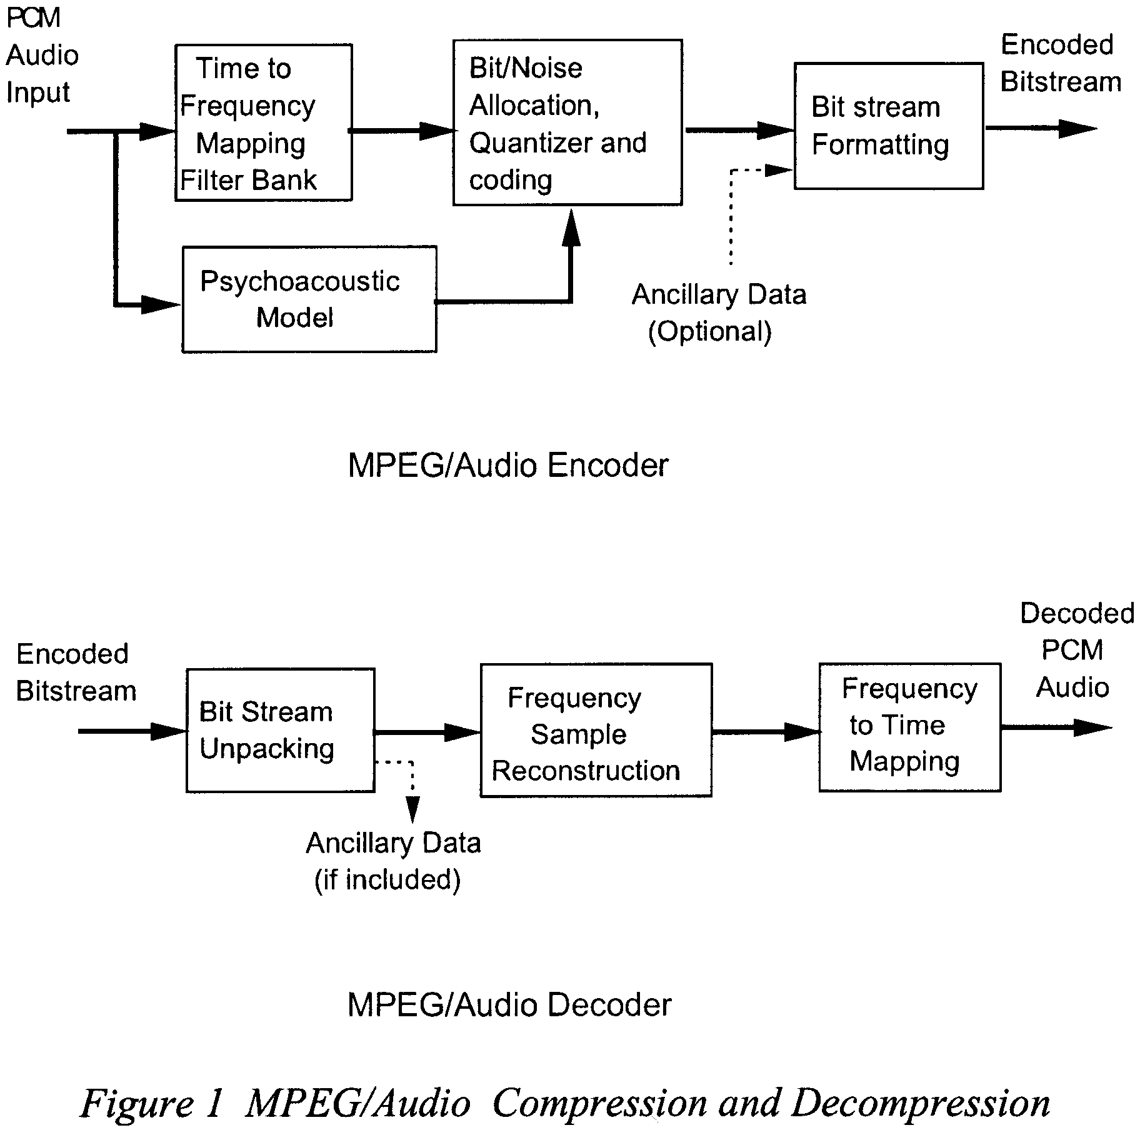

Slide 11
The Polyphase Filter Bank
Key component common to all layers
Divides the audio signal into 32 equal-width frequency subbands
The filters provide good time and reasonable frequency resolution
Critical bands associated with psychoacoustic models

Slide 12
Psychoacoustics
The aim is to remove irrelevant parts of the audio signal
The human auditory system is unable to hear quantization noise under conditions of auditory masking
Masking occurs whenever a strong signal makes a neighborhood of weaker audio signals imperceptible

Slide 13
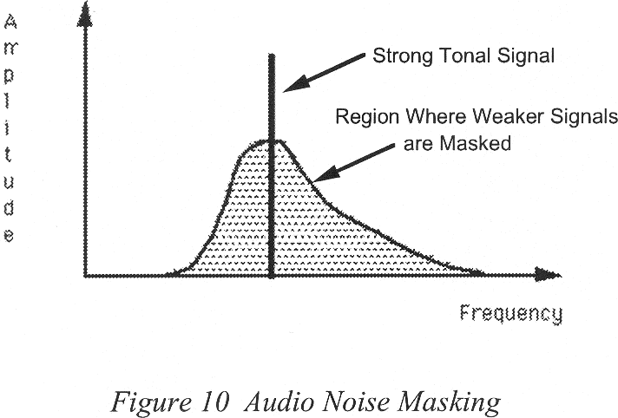
Noise masking threshold
Human ear resolving power is frequency dependent
Noise masking threshold, at any frequency, depends only on the signal energy within a limited bandwidth neighborhood that frequency

Slide 14
The Psychoacoustic Model
Analyzes the audio signal and computes the amount of noise masking as a function of frequency
The encoder decides how best to represent the input signal with a minimum number of bits

Slide 15
Basic Steps
Time align audio data
Convert audio to frequency domain representation
Process spectral values into tonal and non-tonal components
Apply a spreading function
Set a lower bound for threshold values
Find the threshold values for each subband
Calculate the signal to mask ratio

Slide 16
MPEG Audio Layer I
Simplest coding
Suitable for bit rates above 128 kbits/sec per channel
Each frame contains header, an optional CRC error check word and possibly ancillary data.
Eg. Philips Digital Compact Cassette

Slide 17
MPEG Audio Layer II
Intermediate complexity
Bit rates around 128 kbits/sec per channel
Digital Audio Broadcasting (DAB)
Synchronized Video and Audio on CD-ROM
Forms frames of 1152 samples per audio channel.

Slide 18
MPEG Audio Layer III
Based on Layer I&II filter banks
Most complex coding
Best audio quality
Bit rates around 64 kbits/sec per channel
Suitable for audio transmission over ISDN
Compensates filter deficiencies by processing outputs with a two different MDCT blocks.

Slide 19
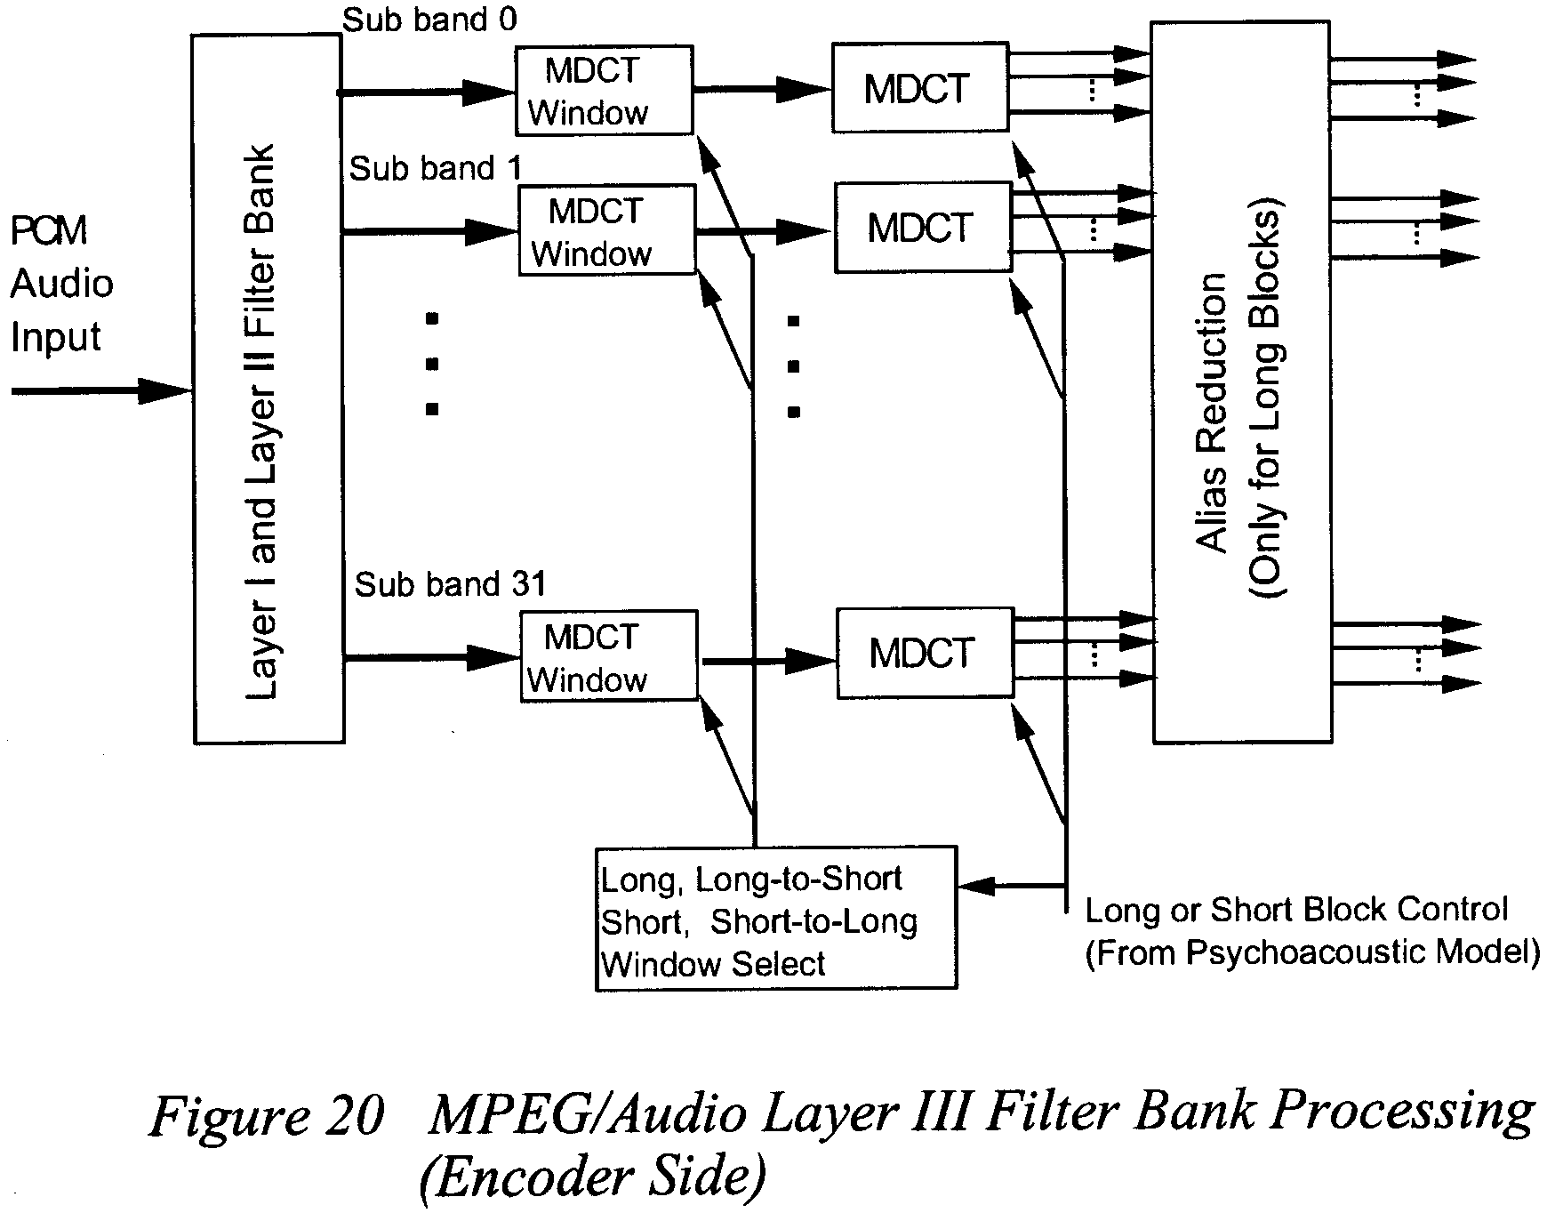

Slide 20
Layer III enhancements
Alias reduction
Non uniform quantization
Scalefactor bands
Entropy coding of data values
Use of a “bit reservoir”

Slide 21
MPEG and the Future?
MPEG-1: Video CD and MP3.
MPEG-2: Digital Television set top boxes and DVD
MPEG-4: Fixed and mobile web
MPEG-7: description and search of audio and visual content
MPEG-21: Multimedia Framework

Slide 22
References
Digital Audio Compression -http://das.iocon.com/res/docs/pdf/Digital_Audio_Compression_01oct1993DTJA03P8.pdf
MPEG Audio Standard-www.cs.columbia.edu/~coms6181/slides/6R/mpegaud.pdf

Slide 23
Thank You

