Slide 1
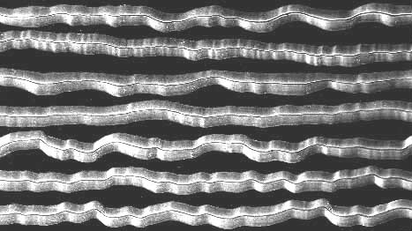
Analog Representations of Sound
Magnified phonograph grooves, viewed from above:
The shape of the grooves encodes the continuously varying audio signal.

Slide 2
Analog to Digital Recording Chain
ADC
Microphone converts acoustic to electrical energy. It’s a transducer.
Continuously varying electrical energy is an analog of the sound pressure wave.
ADC (Analog to Digital Converter) converts analog to digital electrical signal.
Digital signal transmits binary numbers.
DAC (Digital to Analog Converter) converts digital signal in computer to analog for your headphones.

Slide 3
Analog versus Digital
Analog
Continuous signal that mimics shape of acoustic sound pressure wave
Digital
Stream of discrete numbers that represent instantaneous amplitudes of analog signal, measured at equally spaced points in time.

Slide 4
Analog to Digital Conversion
Instantaneous amplitudes of continuous analog signal, measured at equally spaced points in time.
A series of “snapshots”

Slide 5
Analog to Digital Overview
Sampling Rate
How often analog signal is measured
[samples per second, Hz]
Example: 44,100 Hz
Sampling Resolution
[a.k.a. “sample word length,” “bit depth”] Precision of numbers used for measurement: the more bits, the higher the resolution.
Example: 16 bit

Slide 6
Sampling Rate
Determines the highest frequency that you can represent with a digital signal.
Nyquist Theorem:
Sampling rate must be at least twice as high as the highest frequency you want to represent.
Capturing just the crest and trough of a sine wave will represent the wave exactly.

Slide 7
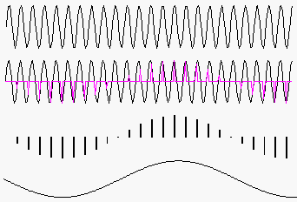
Aliasing
What happens if sampling rate not high enough?
A high frequency signal
sampled at too low a rate
looks like …
… a lower frequency signal.
That’s called aliasing or foldover. An ADC has a low-pass anti-aliasing filter to prevent this.
Synthesis software can cause aliasing.

Slide 8
Common Sampling Rates
Which rates can represent the range of frequencies audible by (fresh) ears?
Sampling Rate | Uses
44.1 kHz (44100) | CD, DAT
48 kHz (48000) | DAT, DV, DVD-Video
96 kHz (96000) | DVD-Audio
22.05 kHz (22050) | Old samplers
Most software can handle all these rates.

Slide 9
3-bit Quantization
A 3-bit binary (base 2) number has 2³ = 8 values.
7
6
5
4
Amplitude
3
2
1
0
Time — measure amp. at each tick of sample clock
A rough approximation

Slide 10
4-bit Quantization
A 4-bit binary number has 2⁴ = 16 values.
14
12
10
8
Amplitude
6
4
2
0
Time — measure amp. at each tick of sample clock
A better approximation

Slide 11
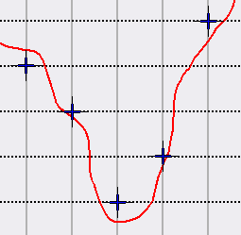
Quantization Noise
Round-off error: difference between actual signal and quantization to integer values…
Random errors: sounds like low-amplitude noise

Slide 12
The Digital Audio Stream
It’s just a series of sample numbers, to be interpreted as instantaneous amplitudes: one for every tick of the sample clock.
Previous example:
11 13 15 13 10 9 6 1 4 9 15 11 13 9
This is what appears in a sound file, along with a header that indicates the sampling rate, bit depth and other things.

Slide 13
Common Sampling Resolutions
Word length | Uses
8-bit integer | Low-res web audio
16-bit integer | CD, DAT, DV, sound files
24-bit integer | DVD-Video, DVD-Audio
32-bit floating point | Software (usually only for internal representation)

Slide 14
16-bit Sample Word Length
A 16-bit integer can represent 2¹⁶, or 65,536, values (amplitude points).
We typically use signed 16-bit integers, and center the 65,536 values around 0.
32,767
0
-32,768

Slide 15
Audio File Size
CD characteristics…
- Sampling rate:
44,100 samples per second (44.1 kHz)
- Sample word length:
16 bits (i.e., 2 bytes) per sample
- Number of channels:
2 (stereo)
How big is a 5-minute CD-quality sound file?

Slide 16
Audio File Size
How big is a 5-minute CD-quality sound file?
44,100 samples * 2 bytes per sample * 2 channels
= 176,400 bytes per second
5 minutes * 60 seconds per minute
= 300 seconds
300 seconds * 176,400 bytes per second
= 52,920,000 bytes = c. 50.5 megabytes (MB)

Slide 17
DAC: Sample and Hold
To reconstruct analog signal, hold each sample value for one clock tick; convert it to steady voltage.
7
6
5
4
Amplitude
3
2
1
0
Time

Slide 18
DAC: Smoothing Filter
Apply an analog low-pass filter to the output of the sample-and-hold unit: averages “stair steps” into a smooth curve.
7
6
5
4
Amplitude
3
2
1
0
Time

