Slide 1
Video Basics
Ron Birkett Technical Training Instructor

Slide 2
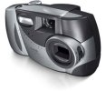
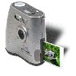
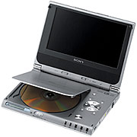

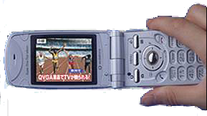
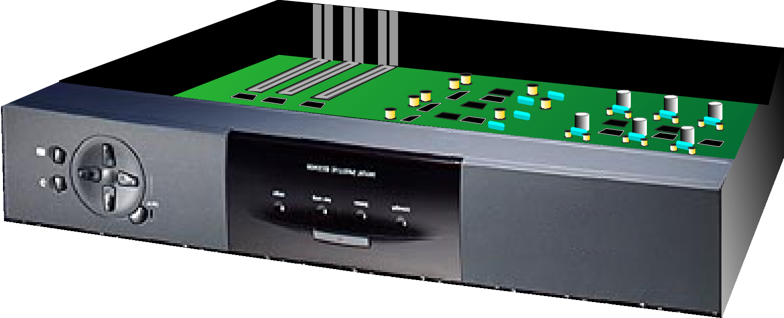
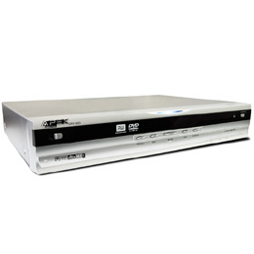
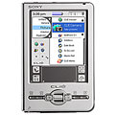
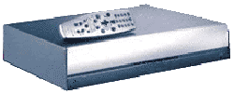
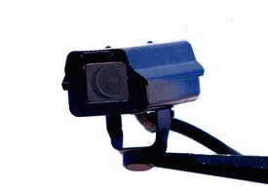

Digital Still Cameras
Digital Video Cameras
Portable DVD
Do you want to build something like this…
Broadband Set Top Box
TV Cell Phone
PDA
DVD-R
PVR
Media Encoders/Decoders
Security Camera
Notes:
Each of these carry of TI's Video Decoder Chips.
TVP5150A - PDA, Portable DVD, TV Cell Phone, Security Camera
TVP5146 - LCD TV, DVD Player, DLP, PVR

Slide 3


Which works best for your needs?
358 x 238 pixels
23 KB
1491 x 991 pixels
303 KB
12 times the size … Is it twelve times the quality?
What resolution should you use?
Printers or displays with fixed dot (or pixel) densities might lead you to a specific resolution
Conforming to a specific standard (NTSC, PAL, etc.) might dictate your choice
Data rate, processing rate, storage capacity may direct your decision
Notes:
Would it be ideal to have Infinite Resolution?
Eye can see about 1800 DPI (very subjective figure)
Storage and transmission costs ↑ with higher resolution
Often, it pays to capture at higher resolution so that after editing and cropping, image is not overly degraded

Slide 4
How about between these?
How about now
358 x 238 pixels
23 KB
? x ? pixels
? KB

Slide 5
Which works best for your needs?
358 x 238 pixels
23 KB
1491 x 991 pixels
303 KB
12 times the size … Is it twelve times the quality?
What resolution should you use?
For printers or displays with fixed dot (or pixel) densities, this might lead you to a particular resolution
Notes:
Would it be ideal to have Infinite Resolution?
Eye can see about 1800 DPI (very subjective figure)
Storage and transmission costs ↑ with higher resolution
Often, it pays to capture at higher resolution so that after editing and cropping, image is not overly degraded

Slide 6
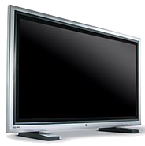
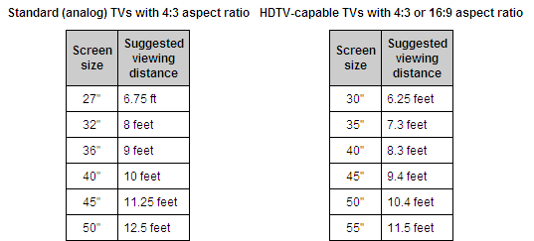
Resolution
Perceived resolution is a function of:
Actual resolution
Distance
Size of diplay (i.e. size of pixels)

Slide 7
Various Standard Resolutions
Format | Application(s) | NTSC | PAL
D1 | Full Analog Television Resolution | 720 x 480 | 720 x 576
SIF | Resolution VHS VCR is capable of | 352 x 240 | 352 x 288
ATSC | Digital Television | 18 different resolutions/rates (three most common are shown)
 | Standard Definition (SDTV) | 720 x 480
 | High Definition (HDTV) | 1280 x 720 1920 x 1080
4CIF | Often used in Video Conferencing or for small screen applications (specified for various codecs, e.g. H.261) | 704 x 576 352 x 288 176 x 144
CIF
QCIF

Slide 8
Various Standard Resolutions
Format | Application(s) | NTSC | PAL
D1 | Full Analog Television Resolution | 720 x 480 | 720 x 576
SIF | Resolution VHS VCR is capable of | 352 x 240 | 352 x 288
ATSC | Digital Television | 18 different resolutions/rates (three most common are shown)
 | Standard Definition (SDTV) | 720 x 480
 | High Definition (HDTV) | 1280 x 720 1920 x 1080
4CIF | Often used in Video Conferencing or for small screen applications (specified for various codecs, e.g. H.261) | 704 x 576 352 x 288 176 x 144
CIF
QCIF
NTSC National Television Standards Committee TV format in North America, Japan and much of the world
PAL Phase Alternation Line TV format for Europe (and more of the world)
SECAM Sequentiel Couleur Avec Memoire TV format for France (and a couple others)
ATSC Advanced Television Systems Committee Digital TV standards (including HDTV)
D1 Standard Digital Videotape Format Often used to denote full standard TV resolution
CIF Common Interface Format or Common Interchange Format

Slide 9
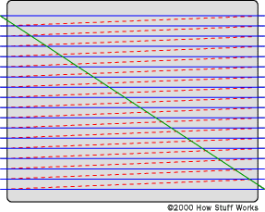
How is NTSC "D1" Resolution Defined?

Slide 10
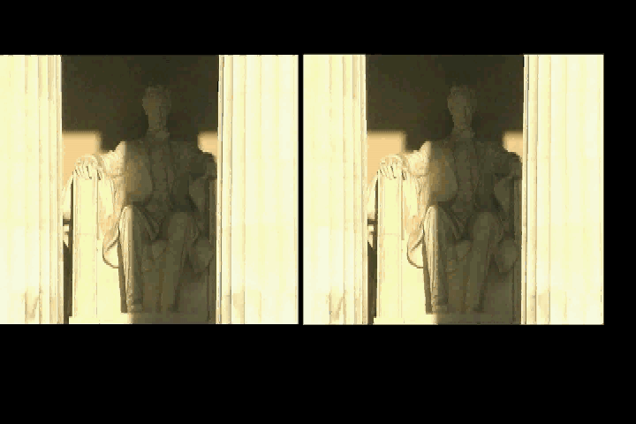
Which Video Clip Looks Better?
5 frames/sec
15 frames/sec

Slide 11

Which Video Clip Looks Better?
15 frames/sec
30 fields/sec
progressive
interlaced
Same data rate between these two

Slide 12
Progressive and Interlaced
Interlaced formats decrease the data rate by eliminating every other line
Each set of odd or even lines are called a field:
Field 1: Odd lines are "painted" every 1/60th of a second
Field 2: Even lines are painted the next 1/60th of a second
In the end, the two fields end up "painting" the entire screen 30 times/second
Conversely, progressive formats scan (i.e. paint) the entire screen in one pass
Each full screen scan is called a frame
Frames are commonly updated at 25, 29.97, 30, or 60 frames per second (fps)
Notes:
Interlacing is visible in movies which have a height > 288 (NTSC: > 240). So when you capture a movie, say, 384x288 or smaller you won't see interlaced frames. It's practically blending. Some capture cards don't blend but drop every second field with sizes smaller or equal to 288.

Slide 13
Interlacing Side Effects
While interlacing can reduce the data rate without reducing the image resolution, it does produce some side effects
Tomato is moving right in this example
See how the image is distorted due to movement between the two fields …
This is called "combing" (or "feathering)
Similarly the skier seems to flicker (called "line twitter")
Worse yet, very thin image elements (such as the ski pole) that are only one line wide seem to disappear and reappear (exacerbated by vertical movement)
As long as nothing in the picture changes (such as when showing a still image), the alternating fields will actually complement each other and form a complete picture. The display will flicker and scan lines will be visible (both a inherent of an interlaced system), but that's life in an interlaced world. We don't spend the evening looking at a still picture on the TV though. The moment something moves, we get interlacing artifacts! ¹

Slide 14
NTSC, PAL, and CIF Formats
NTSC | Resolution | Frame Rate | I/P | Data Rate
D1 | 720 x 480 | 59.94 fields/sec | I | 10M pix/sec
SIF | 352 x 240 |  |  | 5M pix/sec
PAL | Resolution | Frame Rate | I/P | Data Rate
D1 | 720 x 576 | 50 fields/sec | I | 10M pix/sec
SIF | 352 x 288 |  |  | 5M pix/sec
4CIF | 704 x 576 | 30 frames/sec | P | 12M pix/sec
CIF | 352 x 288 | 30 frames/sec | P | 3M pix/sec
QCIF | 176 x 144 | 30 frames/sec | P | 760K pix/sec
Scan Method in Table Above
I = Interlaced
P = Progressive
Notice how the data rate is the same between NTSC and PAL, even though the resolution and frame rates are different
Notes:
Data Rate
10,357,632 p/sec
5,178,816 p/sec
Data Rate
10,368,000 p/sec
5184000 p/sec

Slide 15
ATSC Formats
ATSC | Name | Resolution | Frame Rate (per second) | I/P | Data Rate (pixels/sec)
SDTV | 480i | 720 x 480 | 60 fields | I | 10 M
 | 480p | 720 x 480 | 60 frames | P | 20 M
HDTV | 720p | 1280 x 720 | 60 frames | P | 55 M
 | 1080i | 1920 x 1080 | 60 fields | I | 62 M
 | 1080p | 1920 x 1080 | 60 frames | P | 124 M
Key
SDTV = Standard Definition Television
HDTV = High Definition Television
I = Interlaced
P = Progressive
Standard supports both NTSC rates and integer rates: i.e. 60.00, 59.94, 30.00, 29.97, 24.00, and 23.98
Notice the similarity between 720p and 1080i data rates
Debate solved between competing HD formats by including both
In USA, of four major broadcast networks, two chose 720p while the other two chose 1080i
ATSC compatible HDTV's provide one native format (720p, 1080i), but they must convert the other so they can display both
Notes:
Data Rate
10,357,632 p/sec
5,178,816 p/sec
Data Rate
10,368,000 p/sec
5184000 p/sec

Slide 16





Color Depth
1-bit/pixel = black/white
4-bits/pixel = 16 colors
24-bits/pixel = 16 million colors
8-bits Red
8-bits Green
8-bits Blue
8-bits/pixel = 256 greys
8-bits/pixel = 256 colors

Slide 17
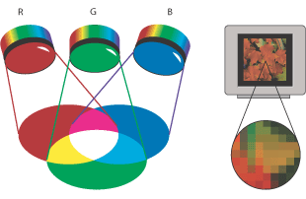
RGB Color
8-bits Red
8-bits Green
8-bits Blue
All color can be composed by adding specific amounts of R, G, & B
8-bits (2⁸) specifies the amount of each color
This is the scheme used by most electronic displays to generate color; e.g. we often call our computer monitors, "RGB displays"
0 255

Slide 18
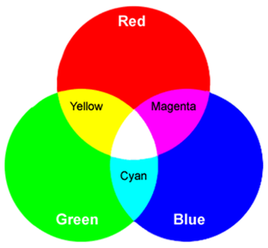
Color Reduction
Human eye is not as sensitive to color as it is to Luminance
dark
vs
light
To this end, to save costs the various standards decided to:
Maintain luminance information in our images, but
Reduce color information
Using RBG, though, how do we easily reduce color information without removing luminance?
For this, and other technical reasons, a separate color space was chosen by most video standards …

Slide 19
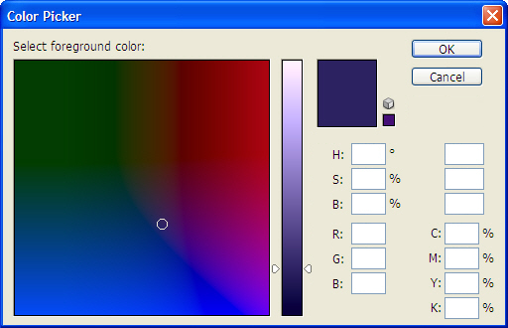
Color Spaces
248
Y:
18
70
Cb:
-37
32
Cr:
20
32
98
24
100
81
31
23
Color Spaces:
Along with RGB, there are many different ways to represent color
This "picker" example demonstrates 4 different common color spaces

Slide 20
Color Spaces
248
Y:
18
70
Cb:
-37
32
Cr:
20
32
98
24
100
81
31
23
Color Spaces:
Along with RGB, there are many different ways to represent color
This "picker" example demonstrates 4 different common color spaces
YCbCr is the color space most often used in video, where:
Y = Luminance (Black/White/Gray)
Cb = Blue difference value (Y – Blue)
Cr = Red difference value (Y – Red)
Notes:
*The human eye is able to see millions of colors, but it may be difficult to see the difference in colors that are very similar. Usually holding one shade up to another is the only way to really see the difference.

Slide 21
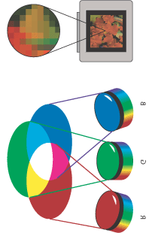
What is YCbCr?
Video
Source
Y
Y
R
Cb
Cb
G
Cr
Cr
B
Even though most displays actually use RGB create the image, YCbCr is used most often in consumer electronics for transmission of the image
Historically, B/W televisions transmitted only luminance (Y)
The color signals were added later

Slide 22
YCbCr → YPbPr
Video DAC
(e.g. Encoder)
Y
Y
Cb
Cr
Pb
Pr
When YCbCr values are converted to analog signals, they are called YPbPr

Slide 23
YCbCr → YPbPr
Memory
Video DAC
(e.g. Encoder)
Y
Y
Cb
Cr
Y
Cb
Cr
Y
Cb
Cr
Y
Cb
Cr
…
Pb
Pr
When YCbCr values are converted to analog signals, they are called YPbPr
Digital displays sample the signals to regain the discrete values

Slide 24
Packed Pixel (Interleaved)
Memory
Video DAC
(e.g. Encoder)
Y
Y
Cb
Cr
Y
Cb
Cr
Y
Cb
Cr
Y
Cb
Cr
…
Pb
Pr
When YCbCr values are converted to analog signals, they are called YPbPr
Digital displays sample the signals to regain the discrete values
In memory, pixel values can be:
Packed (i.e. interleaved)
Sorted (shown on next slide)

Slide 25
Packed Pixel (Sorted)
Memory
Y
Y
Y
Y
Video DAC
(e.g. Encoder)
Y
Cb
Cb
Cb
Cb
Pb
Cr
Cr
Cr
Cr
Pr
In memory, pixel values can be:
Packed (i.e. interleaved)
Sorted Pixels are grouped in memory by type
We still haven't reduced the color info, yet ...

Slide 26
Color (Chroma) Subsampling
Memory
Y
Y
Y
Y
Y
Cb
Cb
Pb
Cr
Cr
Pr
Y
Cb
Cr
Y
Y
Cb
Cr
Y
Y
Cb
Cr
Y
Y
Cb
Cr
Y
One way to reduce data would be to sample the color signals every other time
Variations of this scheme are used in many video systems

Slide 27
Color (Chroma) Subsampling
Memory
Y
Y
Y
Y
Y
Cb
Cb
Pb
Cr
Cr
Pr
Y
Cb
Cr
Y
Y
Cb
Cr
Y
Y
Cb
Cr
Y
Y
Cb
Cr
Y
One way to reduce data would be to sample the color signals every other time
Variations of this scheme are used in many video systems
This scheme is often referred to as 4:2:2 and is often represented as:
Y | Y
Y | Y
Cb | Cb
Cr | Cr

Slide 28
Digital Video Formats (4:4:4, 4:2:2, 4:2:0, 4:1:1)
Y
Pb
Pr
4:2:2
Y | Y
Y | Y
Cb | Cb
Y
Cb
Cr
Y
Y
Cb
Cr
Y
Y
Cb
Cr
Y
Y
Cb
Cr
Y
Y
Cb
Cr
Y
Y
Cb
Cr
Y
Cr | Cr
4:4:4 would be the original stream, with no chroma subsampling

Slide 29
Digital Video Formats (4:4:4, 4:2:2, 4:2:0, 4:1:1)
Y
Pb
Pr
4:2:2
Y | Y
Y | Y
Cb | Cb
Y
Cb
Cr
Y
Y
Cb
Cr
Y
Y
Cb
Cr
Y
Y
Cb
Cr
Y
Y
Cb
Cr
Y
Y
Cb
Cr
Y
Cr | Cr
4:2:0
Y
Cb
Cr
Y
Y
Y
Y
Cb
Cr
Y
Y
Y
Y
Cb
Cr
Y
Y
Y
Y
Cb
Cr
Y
Y
Y
Y
Cb
Cr
Y
Y
Y
Y
Cb
Cr
Y
Y
Y
Y | Y
Y | Y
Cb
Cr
4:4:4 would be the original stream, with no chroma subsampling

Slide 30
Digital Video Formats (4:4:4, 4:2:2, 4:2:0, 4:1:1)
Y
Pb
Pr
4:2:2
Y | Y
Y | Y
Cb | Cb
Y
Cb
Cr
Y
Y
Cb
Cr
Y
Y
Cb
Cr
Y
Y
Cb
Cr
Y
Y
Cb
Cr
Y
Y
Cb
Cr
Y
Cr | Cr
4:2:0
Y
Cb
Cr
Y
Y
Y
Y
Cb
Cr
Y
Y
Y
Y
Cb
Cr
Y
Y
Y
Y
Cb
Cr
Y
Y
Y
Y
Cb
Cr
Y
Y
Y
Y
Cb
Cr
Y
Y
Y
Y | Y
Y | Y
Cb
Cr
4:1:1
Y | Y
Y | Y
Cb | Cr
Y
Cb
Cr
Y
Y
Y
Y
Cb
Cr
Y
Y
Y
Y
Cb
Cr
Y
Y
Y
4:4:4 would be the original stream, with no chroma subsampling

Slide 31
Packed vs Sorted Pixels
Table 2-4. Pixel Interleaving Examples
Packing Format | Interleaved | Sequential | Separate
ABGR | ABGRABGR ABGRABGR ABGRABGR | AAABBBGGGRRR AAABBBGGGRRR | AAAAAAAA BBBBBBBBB GGGGGGGGG RRRRRRRRR
444 YCrCb, with CbYCr packing | CbYCrCbYCr CbYCr | CbCbCbYYYCrCrCr CbCbCbYYYCrCrCr | CbCbCbCbCbCb YYYYYY CrCrCrCrCrCr
420 YCrCb, with CbYCrY packing | CbYCrYYYCb YCrYYYCbY CrYYY | CbCbCbYYYYYYYYYYYYYCrCrCr CbCbCbYYYYYYYYYYYYCrCrCr | CbCbCbCbCbCb YYYYYYYYYYYY YYYYYYYYYYYY CrCrCrCrCrCr

Slide 32
Summary: Pixel's in 4D
width
Dimensions:
Heigth
Width
h
Frame rate determines how long the pixel exists, i.e. how it moves
Color Depth of the pixel
How many bits are used to represent the color of each pixel?
1 bit
8 bits
Red: 8 bits
Green: 8 bits or YCbCr
Blue: 8 bits 4:2:2

Slide 33
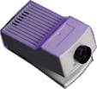
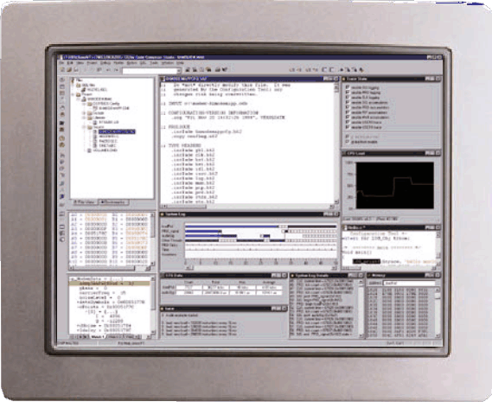

Typical Video System Chain
Capture
Process
Display
Formatting Compression Encryption
Decryption Decompression
Video Input
Video Output
NTSC/PAL
Decoder
NTSC/PAL Encoder

Slide 34
Typical Video System Chain
Capture
Process
Display
Formatting Compression Encryption
Decryption Decompression
Video Input
Video Output
NTSC/PAL
Decoder
NTSC/PAL Encoder
Input
Process
Process
Output
Store Transmit
Decoder
Encoder

Slide 35
Video H/W Interfaces
Processing
Video Input
Video Output
NTSC/PAL
Decoder
NTSC/PAL Encoder
Digital Data Format
Digital Hardware I/F
Encoder (Video DAC)
Analog Data Format
Analog Hardware I/F
Display / Monitor

Slide 36
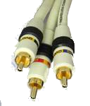

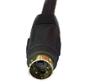
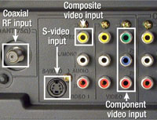
Video H/W Interfaces
Video Input
Processing
Video Output
Component
S-Video
CVBS
Digital Data Format
Digital Hardware I/F
Encoder (Video DAC)
Analog Data Format
Analog Hardware I/F
Display / Monitor
Analog Data Format
Analog Hardware I/F
RF
CVBS
S-Video
Component

Slide 37

Video Connections - RF
Antenna (RF)
Off-the-Air (OTA) antenna
Radio Frequency (RF)
Coaxial Cable (RG58, RG59, RG6)
Analog TV
Audio/Video signals transmitted on RF carrier signal
Signals follow NTSC format in North America; PAL in Europe
Signals usually transmitted from attenna to TV via 75Ω coaxial cable
Using RG58, RG59, or RG6 cable and F-connector
Luminance and color signals transmitted independently
Historically, luminance information (Black/White/Gray) was introduced in the 1930's
Color was added as a sideband signal later in the 1950's

Slide 38
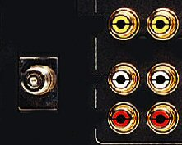
Video Connections – Composite (CVBS)
COMP Video
Left
VCR
RF
Right
RF
or
CH 8
12:00
Composite Video
Analog TV
VCR's provide two means of connecting to TV:
RF – Tape playback "broadcast" on open channel (usually channel 3 or 4)
Composite Video is one of three cables used to carry A/V line-level signals
Composite video, also known as Composite Video with Blanking and Sync (CVBS), is a 75 ohm video cable using a Yellow RCA plug
Right and Left audio channels using Red/White RCA plugs (respectively)
VCR recordings do not utilize the full NTSC resolution, rather they only achieve approximately SIF quality (~340x240)
CVBS improves performance by eliminating the RF carrier, and separating A & V

Slide 39
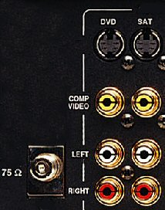

Video Connections: S-Video
S Video
Digital Satellite
RG6
CH 8
S-Video
Analog TV
While most satellite receivers still have RF and CVBS cables, if an analog TV has an S-Video connection, it provides a noticable picture improvement
S-Video differs from composite (CVBS) by breaking out the video into two signals:
Y – Luminance (black/white/gray)
C – Chrominance (colors)
S-Video is provided by a circular jack with two differential signals (4 pins in jack)
Stereo audio is still provided by Left/Right RCA jacks

Slide 40
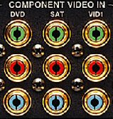
Video Connections: Component Video
DVD
T2 CH3 10:53
Component Video




Y
Y
Pr
Pb
Pr
Pb
Digital TV
New video sources (like DVD players) now incorporate Component Video outputs
Component differs from S-Video (Y/C) by further breaking out the chromo signal:
Y – Luminance (black/white/gray)
Pb – Chroma information (Luma – Blue)
Pr – Chroma information (Luma – Red)
Y'Pb'Pr' specifies how data is physically sent to TV, not the data format. It can be sent in any format discussed earlier (480i, 480p, 720p, 1080i, etc.)
While some high-end products use BNC connectors, most Component outputs use three RCA plugs
Audio is (still) provided separately (will discuss later)

Slide 41
Video H/W Interfaces
Processing
Video
DAC
(Encoder)
Video Input
Digital Data Format
Digital Hardware I/F
Encoder (Video DAC)
Analog Data Format
Analog Hardware I/F
Display / Monitor

Slide 42
Video H/W Interfaces
Processing
YCbCr 4:2:2
BT.656 (shown later)
Video
DAC
(Encoder)
Video Input
Digital Data Format
Digital Hardware I/F
Encoder (Video DAC)
Analog Data Format
Analog Hardware I/F
Display / Monitor

Slide 43
Output Summary
Video Input
Processing
Video Output
Decoder
Encoder
 | Video Processing
Analog Data Format |  | Digital Data Format
Digital Hardware I/F |  | Digital Hardware I/F
Decoder (Video ADC) |  | Encoder (Video DAC)
Analog Data Format |  | Analog Data Format
Analog Hardware I/F |  | Analog Hardware I/F
Analog Camera |  | Display / Monitor

Slide 44
Input and Output
Input
Process
Output
Decoder
Encoder
 | Video Processing
Digital Data Format |  | Digital Data Format
Digital Hardware I/F |  | Digital Hardware I/F
Decoder (Video ADC) |  | Encoder (Video DAC)
Analog Data Format |  | Analog Data Format
Analog Hardware I/F |  | Analog Hardware I/F
Analog Camera |  | Display / Monitor

Slide 45
What if it's a Digital Display?

Slide 46
Digital Display (e.g. DTV, Computer)
Input
Process
Output
Decoder
 | Video Processing
Digital Data Format |  | Digital Data Format
Digital Hardware I/F |  | Digital Hardware I/F
Decoder (Video ADC)
Analog Data Format
Analog Hardware I/F
Analog Camera |  | Digital Display

Slide 47
Digital Display (e.g. DTV, Computer)
Input
Process
Output
Decoder
 | Video Processing
Digital Data Format |  | Digital Data Format
Digital Hardware I/F
Decoder (Video ADC)
Analog Data Format
Analog Hardware I/F
Analog Camera |  | Digital Display
BT.656
DVI
IEEE 1394
BT.656 is a
very popular
chip-level interconnect

Slide 48

Video Connections: DVI
HDTV Receiver
CH 38.1
Digital TV
The latest consumer video interface is the DVI (Digital Video Interface) connector.
While it is the first digital video I/F for the consumer market, many digital computer monitors use it as well. (It transfers 24-bit RGB or 24-bit YCbCr.)
DVI can be found in three variations:
DVI-D – Digital signals (24 signals)
DVI-A – Analog signals (5 analog signals similar to VGA: RGBHV)
DVI-A/D – Analog and digital signals (24+5 = 29 signals)
Supports High-Bandwidth Digital Content Protection (HDCP) to ensure unauthorized copying of material is prevented
Audio is (still) provided separately (will discuss later)

Slide 49
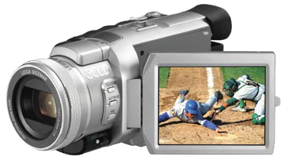
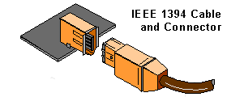

Digital Video Connections: IEEE 1394
DVD-Recorder
CH 8
2:43am
Digital TV
High-speed, digital serial interconnect
No need to convert digital data into analog and tolerate a loss of data integrity
Physically small: Thin serial cable can replace larger and more expensive ones
Easy to use: No need for terminators, device IDs, or elaborate setup
6-pin connector provides power, 4-pin is very small
Inexpensive: Priced for consumer products
Scalable architecture:
Supports 63 devices by daisy chaining and branching for true peer-to-peer comm.
Hot pluggable: Add or remove 1394 devices with the bus active
Cross platform: Apple (FireWire™), Microsoft, HDTV, Sony (iLink™), ect.
Fast: Speeds of 100, 200, 400, and 800 Mbps
Isochronous: Even real-time, multimedia data can be guaranteed its bandwidth for just-in-time delivery
Notes:
isochronous
Time-dependent. Pronounced eye-sock-ra-nuss, it refers to processes where data must be delivered within certain time constraints. For example, multimedia streams require an isochronous transport mechanism to ensure that data is delivered as fast as it is displayed and to ensure that the audio is synchronized with the video.
Isochronous can be contrasted with asynchronous, which refers to processes in which data streams can be broken by random intervals, and synchronous processes, in which data streams can be delivered only at specific intervals. Isochronous service is not as rigid as synchronous service, but not as lenient as asynchronous service.
Certain types of networks, such as ATM, are said to be isochronous because they can guarantee a specified throughput. Likewise, new bus architectures, such as IEEE 1394, support isochronous delivery.

Slide 50
Video H/W Interfaces
Input
Process
Output
Decoder
 | Video Processing
Digital Data Format |  | Digital Data Format
Digital Hardware I/F |  | Digital Hardware I/F
Decoder (Video ADC) |  | Encoder (Video DAC)
Analog Data Format |  | Analog Data Format
Analog Hardware I/F |  | Analog Hardware I/F
Analog Camera |  | Display / Monitor

Slide 51
Elements of a Video System
Formatting Compression Encryption
Decryption Decompression
Video Input
Video Output
NTSC/PAL
Decoder
NTSC/PAL Encoder
Software Codecs
Digital Formats
Hardware Codecs
Analog Formats

Slide 52
You are entering…The Software Zone
Input
Process
Process
Output
Store Transmit
Decoder
Encoder
Hardware
Software
Processing: Formatting
Compression
Encryption
Etc.
Processing: Decryption
Decompression
Formatting
Etc.
Video Capture Device Driver
Video Display Device Driver
Store Transmit
Since Compression/Decompression is so important, let’s take a closer look at it.

Slide 53
Why compression?
Video Capture Device Driver
Compression
Decompression
Video Display Device Driver
Store Transmit
Without it…
Format 30 frames/s, 4:2:0 | Storage (90 min.) | Transmission
D1 (720x480) | 83.7 GBytes | ~15.5 Mbytes/s (124.4 Mbits/s)
CIF (352x288) | 23.3 GBytes | ~4.5 Mbytes/s (36.5 Mbits/s)
A movie won’t fit on a CD (800 MBytes) or a DVD (4.7 GBytes)
…and it can’t be streamed over ADSL (384 Kbits/s – 1.5Mbits/s) or common ethernet (10-100 Mbits/s)

Slide 54
Compression
Still Picture
MJPEG and MPEG
H.26x
H.264 (L) / MPEG 4-10
Windows Media Video9 (WMV9)
Others

