Slide 1
Tizen Multimedia Framework

Slide 2
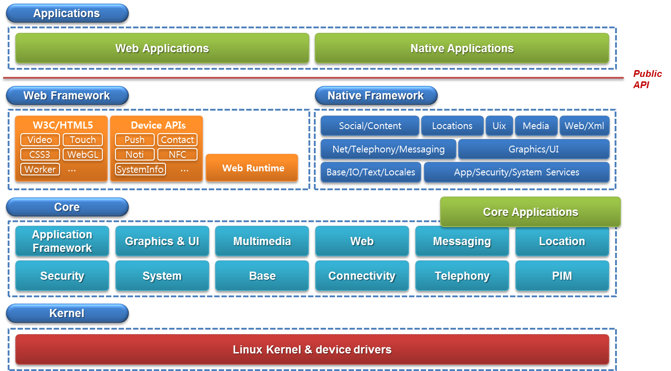
Tizen Architecture Overview
Manufacturer
Adaptation
Interface

Slide 3
Tizen Multimedia Framework (1/3)
Provides
  Playback of audio and video contents(local and streaming)
  Capturing images and recording audio and video
  3D Audio Sound (OpenAL) specially for games
  Scanning & Playback of radio
  Determining audio policy
  Extracting and displaying media content information

Slide 4
Tizen Multimedia Framework (2/3)
Features
  High Quality Video Playback
    Full HD(1080P) Playback (with HW codec & Render Optimization)
    Support for various kind of Multimedia Streaming (HTTP, RTP/RTSP)
    Support for HTML5 Video and embedded playback in Web Browser
  High Quality & High Speed Camera/Recorder
    High Quality Image Capture & Video Recording
    Support for various kind of shooting mode (single, continuous, panorama, etc)

Slide 5
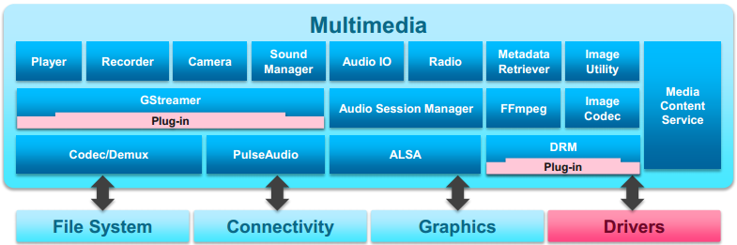
Multimedia Framework (3/3)
Key Components:
  Gstreamer: Audio, Video, Recording, Streaming, Editing, Etc
  Audio Session Manager: Sound Policy Management
  PulseAudio: Software mixing multiple audio streams
  Multiple-Format Codec: Various supports of codec
  Media Content Service: Content management for media files
  Audio I/O: Accessing raw audio buffer to manipulate
(V4L2)

Slide 6
What is GStreamer?
Framework for creating/streaming media applications
Fundamental Design
  Video pipeline at Oregon Graduate Institute
Provides
  an API for multimedia applications
  a plugin architecture ; over 150 plug-ins
  a pipeline architecture
  a mechanism for media type handling/negotiation
  a set of tools
    gst-inspect
    gst-launch

Slide 7
More Information about GStreamer
Initial Release: 2001/1/11
Developed in C
  Dependencies on
    Glib
    libxml2
    libintl
    libiconv
  Cross Platform
  License: GNU Lesser GPL
  Add Language Bindings
    Python, Perl, .NET, C++, Qt, Android, Guile, Java, Ruby, Vala
Tizen multimedia application is implemented by GStreamer

Slide 8
GStreamer Design Principles
Clean & Powerful interface (API)
Object oriented – adheres to Gobject, the Glib 2.0
  Uses the mechanism of signals and object properties
Extensible
  Using the Gobject inheritance methods
  All plugins are loaded dynamically, can be extended & upgraded
Allow binary-only plugins
  Just loaded at runtimes
High Performance
Clean core/plugins separation
Provide a framework for codec experimentation
Notes:
App 개발자는 쉽게 media pipeline을 구성할 수 있는 tool이 제공되고 plugin 개발자에게도 API가 제공되어 쉽게 plugin을 제작할 수 있다. (디버깅 또는 tracing에 용이)
Glib 2.0과 GTK+에 익숙한 프로그래머가 쉽게 접근할 수 있다.
Gstreamer는 Gobject의 상속 구조를 그대로 따르기 때문에 기능을 확장하기 쉽다.
plugin의 경우 필요할 때 runtime 중에 load되는 형태, 기능별로 plugin 형태의 모듈화가 잘 되어있기 때문에 확장성이 좋다
모두 Gobject를 사용하여 plugin이 구현되었기 때문에 Plugin을 위한 별도의 header 파일이 없이 binary만으로 load해서 사용하는 것이 가능하다.
plugin간에 light-weight linking으로 연결되어 있고, 디바이스 할당 메모리 공간에 직접 접근이 가능하기 때문에 overhead가 적다. (예시: sound card 내의 hw buffer에 직접 접근), 특별한 Plugin의 경우 hw 가속을 사용할 수 있도록 되어 있다.
Gstreamer의 core부분은 미디어와 관계없이 구조체 및 기본 구성요소에 대한 구현이 포함되어 있고, 기능적인 부분은 전부 plugin으로 분리되어 있다.
코덱 개발 때 쉽게 사용할 수 있는 프레임 워크가 제공되어 개발이 쉽다.

Slide 9
GStreamer “Element"
Basic building block for a media pipeline
  GstElement
Categories
  sources: for audio and video
  formats: parsers, formaters, muxers, demuxers, metadata, subtitles
  codecs: coders and decoders
  filters: converters, mixers, effects, …
  sinks: for audio and video (involves protocol plugins)
source_element
Decoder
sink_element
src
sink
src
sink
Disk data source
Decoder
Audio data sound card
Notes:
Element 하나가 하나의 기능을 담당하게 된다.
(파일로부터 data를 읽는다, data를 decoding한다, decoding된 data를 sound card로 넘겨준다 등)
이러한 element들을 하나로 linking하는 경우 전체 조합이 하나의 파이프라인으로 존재 ➔ 전체적인 하나의 기능을 제공(위의 경우, 미디어 재생)
기본적으로 Element의 종류를 여러 가지로 제공하고 있다.

Slide 10
GStreamer “Bin”
Element container
  Set of elements
  Minimize complexity to manage multiple elements
    Change bin’s attribute to change included elements’ attribute
    Manage bus messages related to the element
Pipeline
  Top-level bin
  Provide communication bus about application
  Implement specific functions using threads for each pipeline
Notes:
Element 여러 개를 함께 제어하고 싶을 때 대상 element가 포함되어 있는 Bin의 속성을 변경할 경우 포함된 element의 속성이 변경된다.

Slide 11
GStreamer “Pad” (1)
Interface to connect between element and external layer
  Input and output of element
Definition
  Direction: source / sink
  Availability: always / sometimes / on-request
Notes:
Pad는 element의 input과 output을 담당하고 있어서 다른 element와의 연결 고리 역할을 한다.

Slide 12
GStreamer “Pad” (2)
Capabilities
  Characteristics to define element which includes pads
  Caps negotiation
    Action to identify capability with two connected pads
    GstCaps
      Constructed with more than one GstStructure which describes media type
  Utilize
    Autoplugging: Detect suitable elements with capability to connect
    Compatibility detection: Checking compatibility
    Metadata: Provide media type information to pass
    Filtering: Setup limitations of passed media(ex. size)
Notes:
source pad만 갖고 있다 ➔ source element
source pad와 sink pad를 모두 갖고 있다 ➔ decoder, mixer 등의 element
pad는 특정 data를 handling하는 capability가 지정되어 있기 때문에 다른 type의 data의 flow를 제한한다. 따라서 두 개의 연결된 pad의 속성이 같아야지만 data flow가 발생하게 된다. (caps negotiation, data type은 GstCaps로 정의)

Slide 13
GStreamer “Bus”
Passing message from streaming thread to application
  Every pipeline contains a bus by default
  Only message handler is needed
  Add ‘message watch’ to the bus
    Detect messages in the main loop of Glib/Gtk+ periodically
    Asynchronous communication between pipeline and application
      Not suitable for real time application
    gst_bus_add_watch(), gst_bus_add_signal_watch()
  Checking messages by polling
    gst_bus_peek(), gst_bus_poll()

Slide 14
GStreamer Communication (1)
Messages
  Objects posted by elements on the pipeline’s message bus
  Usually handled asynchronously by the application from the application’s main thread
  Transmit information from elements to the application in a thread-safe way
    errors, tags, state changes, buffering state, redirects etc.
Notes:
Message는 element에서 application으로 작업 수행과 관련된 정보를 전달하는 역할로 bus를 통해 전달하는 object이다.

Slide 15
GStreamer Communication (2)
Buffers
  Objects for passing streaming data between elements in the pipeline
  Downstream: source ➔ sink
Events
  Objects sent between elements or from the application to elements
  Upstream and Downstream
    Downstream events can be synchronized to the data flow.
Notes:
Buffer ➔ 데이터 전달 역할
Event ➔ element 사이 또는 application에서 element로 전달할 수 있는 object, upstream과 downstream 모두 가능하나 downstream의 경우 data flow와 sync된다. 재생, 일시정지 등의 action을 전달하는 역할

Slide 16
GStreamer Communication (3)
Queries
  Request from application or elements
  Example
    By application: duration or current playback position from the pipeline etc.
    By elements: file size or duration (peer-to-peer communication)
  Upstream and downstream (Upstream is common)
Notes:
Query의 경우 application에서 element에게 또는 element들 간의 Request 역할
Application에서 미디어 동작에 대한 제어를 요구할 때 이용
Element 간에는 미디어 flow에 대해서 크기 조절 및 duration 정보를 전달할 때

Slide 17


Gstreamer pipeline with different communication flows
Application
Bus
messages
Pipeline
events
queries
file-source
ogg-demuxer
vorbis-decoder
audio-sink
src_01
sink
src
sink
src
sink
buffer
src_02
theora-decoder
video-sink
gst_element_set()
GST_STATE_NULL
GST_STATE_READY
GST_STATE_PAUSED
GST_STATE_PLAYING
sink
src
sink
Notes:
전체적인 구조

Slide 18
Example: Tizen libmm player
Tizen 2.2 version default multimedia player
  Define callbacks(play, stop, volume up/down, zoom)
    Implement functions in callback using GStreamer library
0. Play Callback
libmm player
5. Register watch to detect multiple action’s message according to the play state
bus
Bus watch
3. Create decoding element if source is not streaming
1. Create pipeline
pipeline
mainbin
Source
Decoder
2. Create element with checking the location of media source
4. Add source/decode elements in mainbin

Slide 19



Source code of Tizen libmm player
Player 생성
Allocate memory and player object
Initialization of player
Initialization of GStreamer

Slide 20
Source code of Tizen libmm player
Player 주요 Callback 정리
Callback | 기능
 | Play
 | Stop
 | Pause
 | Resume
 | Set position of media
 | Set message callback from GStreamer
 | Mute
 | Set position of caption
 | Control volume

Slide 21


Source code of Tizen libmm player
Source code of media playing
Application Play Callback
Create pipeline for media playing
Create mainbin(element container)

Slide 22





Source code of Tizen libmm player
Allocate element according to the media source
Factory name
(in player’s ini file)
Element name

Slide 23

Source code of Tizen libmm player
Add source element to the mainbin
Create decode element according to the pad capability of source element
  using autoplugging
Add mainbin(including elements) in pipeline

Slide 24
Source code of Tizen libmm player
Connect bus between player and GStreamer
…
Define callbacks to process bus messages
Pass messages from Gstreamer to the Bus ➔ designated application API processes messages

Slide 25
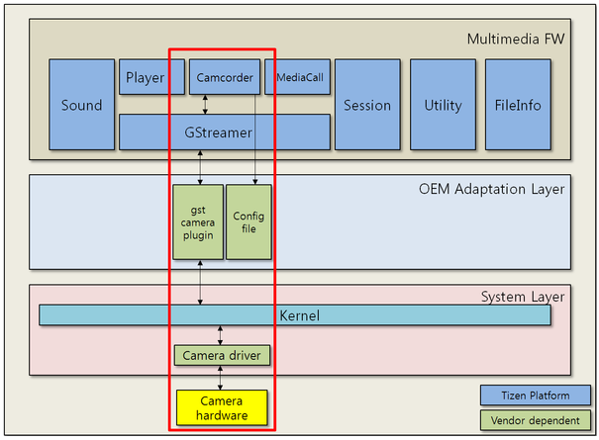
Example: Camcorder
Gets camera data(preview or captured image) from the camera device
Specifically for each chipset
V4L2

Slide 26
Source code of test suite camcorder
Embedded in NX2000 model source code
  Video capture
    Capture
      Multiple shot(burst shot)
      Shot
    Recording
  Audio capture
    Recording
Similar with libmm player
  Create camcorder and initialize states

Slide 27

Source code of test suite camcorder
Source code of media capturing
Define states of camcorder
Change states to the ‘RECORD’ for recording
Change states to the ‘CAPTURE’ for capturing

Slide 28

Source code of test suite camcorder
Create GstElement(pipeline, pad) to video capturing/recording
(Example)
Clear previous video data in buffer
Change pipeline state

Slide 29
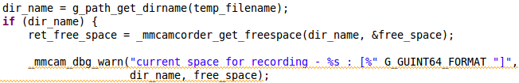
Source code of test suite camcorder
Checking storage’s location and free space
Add camcorder object to the pipeline
--- Linking with VideoSrc, AudioSrc, Codec elements in pipeline
Change pipeline state
--- Data flow(downstream) starts if element state is changed by PLAYING

Slide 30
Video4Linux
Linux standard interface to access various video capture devices
  Like Unix character device
Features
  Video capture interface(/dev/video)
  Video output interface(/dev/video)
  Video overlay interface(/dev/video)
  VBI interfaces(/dev/vbi)
  Radio interface(/dev/radio)

Slide 31
Video4Linux
Initialize GStreamer element/buffer per device for recording
Source element of GStreamer
gst_v4l2src_capture_start(struct GstV4l2Src);
use mmap
don’t use mmap
gst_v4l2_buffer_pool_dqbuf(struct GstV4l2BufferPool)
gst_v4l2src_get_read
v4l2_ioctl(video_fd, VIDIOC_DQBUF, &buffer)
v4l2_read(video_fd, &buffer)
return buffer;
return buffer;

Slide 32
Video4Linux
Support scatter-gather IO using IOMMU
  Allocate contiguous memory using DMA in device driver
  Allocate memory through ‘vb2_dma_contig_alloc() on device registration
    if scatter-gather,
      Allocate non-contiguous memory through ‘vb2_dma_sg_alloc()’
  Example: mx3_camera, sh_mobile_ceu_camera

Slide 33
GStreamer Core Elements
Includes compulsory elements, documents, test code and core library which should be included by other modules in GStreamer
Elements | Description
capsfilter | Pass data without modification, limiting formats
fakesrc | Push empty (no data) buffers around
fakesink | Black hole for data
fdsink | Write data to a file descriptor
fdsrc | Read from a file descriptor
filesrc | Read from arbitrary point in a file
filesink | Write stream to a file
identity | Pass data without modification
queue | Data queue
tee | 1-N pipe fitting
typefind | Finds the media type of a stream
valve | Drops buffers and events or lets them through

Slide 34
GStreamer Base Elements(gst-plugins-base)
Include qualified elements and plugins
Set of steadily used plugins
Elements | Description
adder | Add N audio channels together
appsrc | Allow the application to feed buffers to a pipeline
appsink | Allow the application go get access to raw buffer
audioconvert | Convert audio to different formats
audioresample | Resamples Audio
decodebin | Autoplug and decode to raw media
encodebin | Convenience encoding/muxing element
tcpclientsrc | Receive data as client over the network via TCP
tcpclientsink | Send data as a server over the network via TCP
videoscale | Resizes Video
volume | Set volume on audio/raw streams
uridecodebin | Autoplug and decode an URI to raw media

Slide 35
GStreamer Good Elements(gst-plugins-good)
Include good quality plugins
Available to refer when users make user-specific plugins
Elements | Description
aasink | An ASCII art videosink
agingtv | adds age to video input using scratches and dust
aspectratiocrop | Crops video into a user-defined aspect-ratio
audioamplify | Amplifies an audio stream by a given factor
audiokaraoke | Removes voice from sound
audioecho | Adds an echo or reverb effect to audio stream
cacasink | A colored ASCII art videosink
dicetv | ‘Dices’ the screen up into many small squares
webmmux | Muxes video and audio streams into a WebM stream
videobalance | Adjusts brightness, contrast, hue, saturation on a video stream
speexenc/speexdec | speex!
relimiter | Apply signal compression to raw audio data

Slide 36
GStreamer Ugly Elements(gst-plugins-ugly)
Provide good quality and functions
Problem with licence ➔ Use carefully!
Elements | Description
lamemp3enc | High-quality free MP3 encoder
mad | Uses mad code to decode mp3 streams
mp3parse | parses and frames mpeg1 audio streams(levels 1-3, provides seek)
rademux | Demultiplex a Real Audio file
rmdemux | Demux a RealMedia file into audio and video streams
synaesthesia | Creates video visualizations of audio input using stereo and pitch information
x264enc | H264 Encoder

Slide 37
GStreamer Bad Elements(gst-plugins-bad)
Set of plugins with low quality
There are problems with code, documentation, test or updates
Elements | Description
aacparse/ac3parse
aiffparse/aiffmux
diffuse | Diffuses the image by moving its pixels in random directions
dialate | Copies the brightest pixel around
faceblur | Blurs faces in images and videos
facedetect | Performs face detection on videos and images, providing detected positions via bus messages
festival | Synthesizes plain text into audio
mirror | Split the image into two halves and reflect one over each other
vp8dec/vp8enc

Slide 38
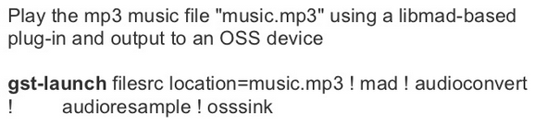
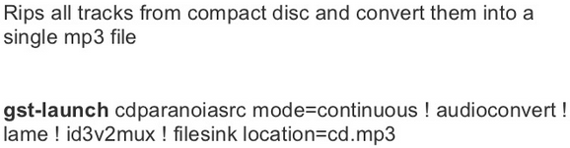
Tools
gst-inspect
  print info about a Gstreamer plugin or element
gst-launch
  build and run a Gstreamer pipeline
  Examples

Slide 39
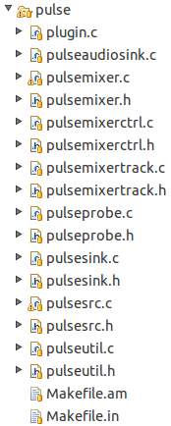
Miscellaneous - PulseAudio
Modified plugin in GStreamer
Provide mixer about audio source
Location: /gst-plugins-good0.10/ext/pulse
audio source mixing
multiple audio sinking
audio source management

Slide 40
Miscellaneous
Multiple-Format Codec
  FFmpeg
  Various codec libraries
  3rd party codec packs
    flac, jpeg, png etc.
Media content service
  Location: /framework/multimedia/libmedia-service
  Manage multimedia contents
    Contents table, folder table, playlist table, album table, tag table, bookmark table
    Using sqlite3(DB) to manage file type, name, media type, album, artist, genre etc.

Slide 41
References
https://events.linuxfoundation.org/images/stories/pdf/lceu2012_haitzler.pdf
http://elinux.org/images/7/71/Elc2013_Matsubara.pdf
http://www.slideshare.net/jeffsigmon/g-streamer
https://wiki.tizen.org/wiki/Porting_Guide/Multimedia#Codec
http://elinux.org/images/7/71/Elc2013_Matsubara.pdf
http://www.slideshare.net/calvaris/webkit-and-gstreamer
http://gstreamer.freedesktop.org/data/doc/gstreamer/head/manual/html/chapter-motivation.html
V4L2: http://lwn.net/Articles/203924/

