Slide 1
GStreamer Multimedia Framework
Part 3

Slide 2
Contents
 |  | Description
Part 1 |  | Introduction to GStreamer
Part 2 |  | GStreamer Plugin Internals
Part 3 |  | Advanced GStreamer Concepts
Part 4 |  | Concepts of GStreamer Application
Part 5 |  | An Example Application Code

Slide 3
Buffers in GStreamer

Slide 4
GstBuffer
GstBuffer is a data type defined by GStreamer which represents a fundamental unit/block of media that is transferred between GStreamer elements
GstBuffer is actually a header structure which internally contains a pointer to raw memory area. Apart from the data pointer, the GstBuffer contains some meta data information which aids in interpreting the raw data.
Buffer Header: GstBuffer Structure
Raw memory buffer

Slide 5
Contents of the GstBuffer buffer header structure
Field Name | Data type | Description
data | guint8 * | Pointer to the raw memory buffer
size | guint | Size (in bytes) of the raw memory buffer
timestamp | GstClockTime (64 bit) | Media timestamp of the buffer in nanoseconds
duration | GstClockTime (64 bit) | Duration of media buffer, in nanoseconds
caps | GstCaps * | Pointer to a caps structure which describes the media contained in the raw memory buffer
malloc_data | guint8 * | Pointer to raw memory buffer which needs to be freed when reference count of this buffer becomes zero. In most cases, this would be same as the field “data”
free_func | GFreeFunc (function pointer) | Pointer to function that will be used to free malloc_data when the reference count becomes zero. By default, this would point to g_free() function.

Slide 6
Methods of buffer allocation and free’ing
Allocating buffer header structure and internal raw data separately.
GstBuffer *buf = NULL;
buf = gst_buffer_new ();
GST_BUFFER_DATA (buf) = g_malloc (10 * 1024);
GST_BUFER_SIZE (buf) = 10 * 1024;
GST_BUFFER_MALLOC_DATA (buf) = GST_BUFFER_DATA (buf);
Allocating buffer header structure along with internal raw data allocation in one shot.
GstBuffer *buf = NULL;
buf = gst_buffer_new_and_alloc (10 * 1204);
This method implicitly initialises size and malloc data fields.

Slide 7
Methods of buffer allocation and free’ing
Freeing a buffer is achieved in the following manner.
gst_buffer_unref (buf);
When gst_buffer_unref is called,
  The reference count for the buffer is decremented
  If the reference count becomes zero,
    If malloc_data field is NOT NULL, it is assumed that it is pointing to data that needs to be free’d. The free_func (function pointer) is invoked to free the data pointed to by malloc_data.
    If malloc_data is NULL, the raw memory buffer pointed to by “data” field will be left untouched.
    Finally, the memory used for the buffer header structure itself is freed.

Slide 8
Buffer Allocation Schemes used by Elements in Pipeline
Buffer Allocation Methods
Plugin Allocates from System
Plugin requests peer
Peer allocates from system (default operation)
Peer requests it’s peer (chain)
Peer allocates from special memory (e.g. hardware buffers, mmap’ed buffers)

Slide 9
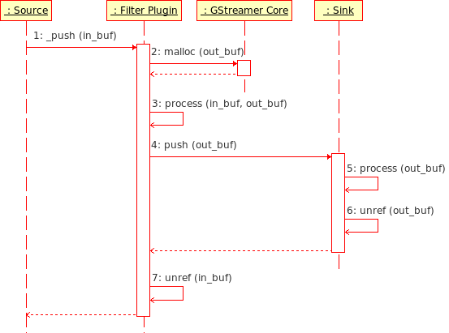
1. Plugin allocating output buffer from system
GLib
Allocation
Free if last unref

Slide 10
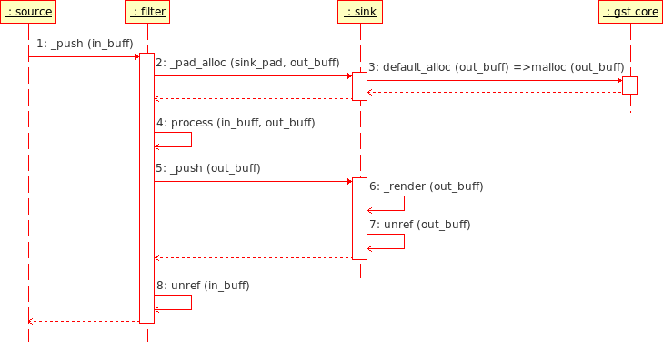
2. Plugin Requests from Peer; Peer allocates from system
If the peer plugin doesn’t over-ride the _pad_alloc() function on it’s sink pad, then then default _pad_alloc () function is invoked, which allocates memory from system.
GLib
Allocation
Free if last unref

Slide 11
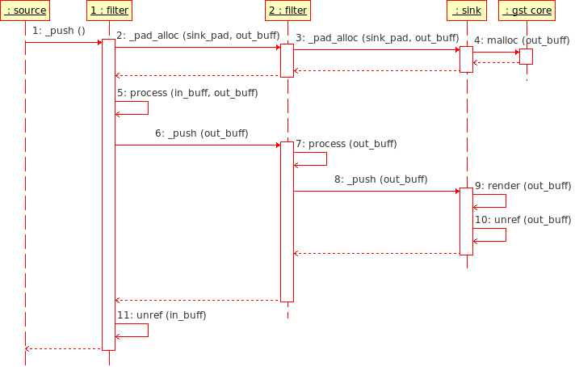
3. Plugin requests peer; peer forwards to it’s peer
This mode is used if the first peer can work on data “in-place” and does not change the buffer size.
Over-rides pad_alloc to invoke peer
GLib
Allocation
Free if last unref

Slide 12
4. Plugin requests peer; peer allocates from special mem
This mode is used typically in cases where hardware display/render buffers or memory mapped buffers need to be re-used.
Typically filters would request the sink for hardware buffers, and directly write the output on to these buffers
In case of hardware buffers, the default action of freeing to system on losing the last reference of the buffer is not suitable. Hence, freeing of buffers has to be handled separately.
This is achieved by setting a custom free function to the free_func pointer in the buffers header structure.
When the reference count becomes zero, the custom free function gets invoked, in the context of which the buffer can be returned back to internal pool.

Slide 13
The New Segment event

Slide 14
Purpose of New Segment Event
A new segment event “sets the context” for flow of data buffers.
It is a downstream event which is sent through the pipeline at two instances
  First instance: At the very beginning of playback before the first data buffer is pushed
  Second instance: Whenever there is a change / discontinuity in the sequence of dataflow. Example, when application performs a seek to different time position in stream.
New segment describes the flow of data buffers that is going to flow after it. It gives information on:
  Start time of segment: same as timestamp of first buffer that is going to follow after this event
  Stop time of segment: same as timestamp of last buffer in the segment. If the stop time is not known, the value can be set to –1
  Rate of playback
    1.0 implies normal rate
    > 1.0 implies fast motion playback
    0.0 < 1.0 implies slow motion playback

Slide 15
Behaviour of Plugins on receiving New Segment Event
New Segment Event is generally initiated by the “driving” element of the pipeline. E.g, demuxer, parser, camera source, etc. Demuxers will send the same event on all its src pads.
Non-sink elements, i.e. decoders, encoders and filters generally do not take any action on receiving new segment event. They just forward the event to the next downstream plugin.
Sink elements will store the start and stop timestamps of the segment being defined. Post that, any buffer received by sink which is out of range of the defined segment, will be simply dropped.
Some questions
  If a video stream is played from beginning to end without any seek operation in between, how many new segment events will be initiated by the demuxer?
    Answer: Only One
  Can data buffers be sent without any preceding new segment event?
    Answer: Yes. However, in this case sink elements would assume that the start timestamp would be zero by default

Slide 16
Behaviour of Plugins on receiving New Segment Event
Questions continued
  Is there any other way to indicate sink elements that there is a change in segment configuration?
    Answer: No. A segment can be reconfigured only by sending another new segment event.
  If the beginning of data is indicated by new segment, how is end of data flow indicated?
    Answer: By using a end of stream event, which too would be initiated by demuxer plugin
New segment event and end of stream event are said to be “in-band” events as they are sent interspersed with data buffers.

Slide 17
Typical contents of a stream transmission through the pipeline
Apart from the beginning of stream, can be introduced in b/w buffer stream to achieve fast forward/slow motion or during seek
Event
Data
Event
New Segment
Buffer₀
Buffer₁
Buffer₂
Buffer_{i}
Buffer_{N-1}
EOS
Properties:
Buffer timestamp (b:ts)
Properties:
Start (ns:start)
Stop (ns:stop)
Rate (ns:rate)
Already applied rate (ns:app_rate)
Time (ns:time)
Accumulated Time (ns:acc_time)

Slide 18
Queue plugin revisited
Queue plugin provides a generic data queue implementation.
Queue works in FIFO model and has properties to control the thresholds. In its default configuration:
  Queue has a limit in terms of “amount of data” that it can queue up. Once this limit is reached, any function calls to queue more data will just block till space becomes available
  Queue can be configured to allow data to be taken out only after a certain threshold for amount of data is queued up. By default this threshold value will be zero.
More importantly queue element acts as a thread boundary. Presence of a queue plugin instance in the pipeline will create a new thread from that point onwards.
Queues do not copy buffers or data. They just hold references to incoming data till they are pushed out.

Slide 19
Clocks and Synchronization

Slide 20
Clock Sources
Any element in a pipeline can provide a counter that can act as a clock source. Examples:
  Audio sink device (clock based on number of audio samples played)
  Media source
Clock source need not be from an element always. Example:
  System Clock
In a pipeline, more than one element can provide a clock.
Pipeline selects and uses one clock from among all the clock providers (including the system clock)
Pipeline distributes the selected clock to all the elements in the pipeline
Clocks can be….
  Continuous (e.g. system clock)
  Discontinuous (e.g., audio device based, which does not run when audio is paused)
Clocks may or may not start at zero

Slide 21
Interface provided by pipeline regarding clocks
Auto clock | This is the default mode of a pipeline. Pipeline selects the clock to use from among all the clock providers. System clock would also be one of the providers.
Set clock | Application can request the pipeline to use the application specified clock. Pipeline may change to a different clock when a new element which provides a clock is added to it.
Use Clock | Application can force the pipeline to use the application specified clock. Pipeline will use this clock even if new clock provider elements are added to the pipeline. Application can call the “auto clock” interface to make the pipeline revert back to its default clock selection policy Application can give a NULL clock, which makes the pipeline run as fast as possible
Get Clock | Application can get a reference to the clock currently in use by the pipeline (GstClock *)

Slide 22
Counters derived from the clock source by the pipeline
Pipeline derives the following three time counters from the selected clock source
Counter | Notation | Description
Absolute Time | c:at | Running value of the clock source in use by the pipeline
Running Time | c:rt | State Dependent: In null/ready state: not defined In playing state: c:rt = (c:at – c:bt) In paused state: frozen to its value at the instance of going in to paused state. Will resume again with the same value when moving to playing state again. Running time gives the time spent in playing state only
Base Time | c:bt | Fixed value that is set at the beginning of every transition to playing state. Once set, the base time remains same for the entire duration of that playing state. Formula for setting base time (at the instance of transitioning to playing state): c:bt = (c:at – c:rt) When the pipeline goes to playing state for the first time, c:rt would be zero, which means c:bt would be same as c:at For the subsequent transitions to playing state, c:rt would be a non zero value

Slide 23
Example of time counters based on clock: source clock is continuous
Δ₁
Δ₂
Δ₃
Δ₄
NULL/READY
PAUSED
PLAYING
PAUSED
PLAYING
Absolute time (c:at)
T₀
T₀ + Δ₁
T₀+Δ₁+ Δ₂
T₀+Δ₁+ Δ₂ + Δ₃
T₀+Δ₁+ Δ₂ + Δ₃ + Δ₄
T₀
T₀
T₀
T₀ + Δ₃
T₀ + Δ₃
Base time (c:bt)
0
Δ₁
Δ₁ + Δ₂
Δ₁ + Δ₂
Δ₁ + Δ₂ + Δ₄
Running time (c:rt)

Slide 24
Example of time counters based on clock: source clock is discontinuous
Δ₁
Δ₂
Δ₃
Δ₄
NULL/READY
PAUSED
PLAYING
PAUSED
PLAYING
Absolute time (c:at)
T₀
T₀ + Δ₁
T₀+Δ₁+ Δ₂
T₀+Δ₁+ Δ₂
T₀+Δ₁+ Δ₂ + Δ₄
T₀
T₀
T₀
T₀
T₀
Base time (c:bt)
0
Δ₁
Δ₁ + Δ₂
Δ₁ + Δ₂
Δ₁ + Δ₂ + Δ₄
Running time (c:rt)

Slide 25
Typical contents of a stream transmission through the pipeline
Apart from the beginning of stream, can be introduced in b/w buffer stream to achieve fast forward/slow motion
Event
Data
Event
New Segment
Buffer₀
Buffer₁
Buffer₂
Buffer_{i}
Buffer_{N-1}
EOS
Properties:
Buffer timestamp (b:ts)
Properties:
Start (ns:start)
Stop (ns:stop)
Rate (ns:rate)
Already applied rate (ns:app_rate)
Time (ns:time)
Accumulated Time (ns:acc_time)

Slide 26
Segment, buffer timestamps
Segment start time, ns:start_time = b:ts(0)
Segment stop time, ns:stop_time = b:ts(N-1)
New Segment
Buffer₀
Buffer₁
Buffer₂
Buffer_{i}
Buffer_{N-1}
EOS
ns:rate | Used for playback speed control
 | ns:rate > +1.0 | Fast forwarding, in forward direction
 | ns:rate == +1.0 | Normal speed, forward direction
 | 0.0 < ns:rate < +1.0 | Slow motion, forward direction
 | ns:rate == 0.0 | Unused, undetermined state
 | -1.0 < ns:rate < 0.0 | Slow motion, reverse direction (from ns:stop to ns:start)
 | -1.0 == ns:rate | Normal speed, reverse direction (from ns:stop to ns:start)
 | ns:rate < -1.0 | Fast backward, reverse direction (from ns:stop to ns:start)

Slide 27
Segment timestamp: “already applied rate”
The requested ns:rate is honored by rendering buffers faster or slower. In this mode, all buffers of the streams would be decoded. Rate adaptation is only through faster or slower rendering.
However, a plug-in might decide to perform rate adaptation on its own. For e.g., by
  Re-time-stamping, re-sampling
  Dropping frames, skipping B-frames, etc
  More efficient rate conversion techniques
If a plug-in uses it’s own rate adaptation, it would set
  ns:rate to 1.0 and
  ns:app_rate to a value not equal to 1.0. This field would inform the other plug-ins that rate adaptation has already been applied.

Slide 28
Segment timestamp: “time” and “accumulated time”
“ns:time” and “ns:acc_time” are zero based time stamps
“ns:time” of a new segment is the stream time (zero based) to which ns:start timestamp corresponds to.
“ns:acc_time” is the total accumulated time of all the previous new segments

Slide 29
Synchronization
For each buffer, a running time (b:rt) is computed based on the information in the preceding “new segment” event and the buffer timestamp
If ns:rate > 0.0
  b:rt = (( b:ts – ns:start ) / abs(ns:rate)) + ns:acc_time
else
  b:rt = (( ns:stop – b:ts) / abs(ns:rate)) + ns:acc_time

Slide 30
Synchronisation
Synchronisation is achieved by playing the buffer with a running time b:rt at the instance where the clock’s running time reaches the same value. In other words, the following should hold
b:rt = c:rt
Expanding,
b:rt = c:at – c:bt
Or,
c:at = b:rt + c:bt
The absolute time at which a buffer with running time b:rt is played is identified as the sync time
b:sync_time = b:running_time + c:base_time
Pipelines would wait till b:sync_time is reached before rendering a buffer with running time b:running_time

Slide 31
Synchronisation b/w multiple streams
Demuxers should ensure that, the buffers from different streams that need to be rendered simultaneously need to have the same running times (b:rt)
This is achieved by demuxers sending the same new-segment event on all source pads and making sure that the synchronised buffers have the same timestamps

Slide 32
Stream Time
Stream time is typically the value reported to user to indicate the position of playback, value used while seeking, etc. It is NOT used for synchronisation.
Stream time = (b:ts – ns:start) * ns:app_rate + ns:time

Slide 33
Summary
Synchronisation algorithm is independent of the clock source
  Works for a clock source which is continuous
  Works for a clock source which is discontinuous
Is capable of handling
  Playback rate adaptation (fast, normal and slow)
  Playback direction (forward, rewind)
Supports seeking to a different position
Supports querying for the stream position

Slide 34
Threading Architecture in GStreamer

Slide 35
Threading Architecture
Internal threading details of GStreamer are hidden from the application
A pipeline would always run in a background thread of its own
In simple applications, there would be just one pipeline used and all the components within the pipeline would be executed in the pipeline thread context
Application
Thread 1
API
Bus
Pipeline
Thread 2
Element
Bin
Element

Slide 36
Case for multiple threads
Applications can “influence” in some way, if multiple threads need to be used. Scenarios for this include:
  Data buffering: encountered while dealing with network streams or recording sources
  Synchronizing output devices: e.g., playback of audio and video tracks simultaneously
Threads can be forced by introducing a queue element between a group of elements
Data Source
Parser
Decoder
Queue
Thread

Slide 37
Gstreamer’s way of handling scheduling
GStreamer uses one thread for each group of elements
Group is defined as a set of linked elements separated by queue elements
Within a group, scheduling is either push-based or pull-based depending on the nature of elements (mode supported by elements)

Slide 38
Threading Scheme in Video Player Prototype
Thread 1: Application
GTK based Video Player Application
GStreamer Framework
Thread 2: File read, parsing (driven by parser)
Thread 3: Video path, driven by buffer queue
Buffer Que
Video (MPEG4) Dec
V4L2 Video Sink
File Source
3GP Parser
Thread 4: Audio path, driven by buffer queue
Buffer Que
Audio (AMRNB) Dec
OSS Audio Sink

Slide 39
GstElement functions – execution thread context
Thread 1: Application thread context
State change handler function calls
Element
sink pad
src pad
Thread 2: Queue loop context
Data buffer flow (chain function call)
Event handler function call (for New segment and end of stream events)
Thread 3: Parser loop context / Application thread context
Event handler function call (for flush request events)

Slide 40
Pipeline operations
Normal playback
Pause / resume
Query (duration / position) seeking
Seek operation

Slide 41
Normal playback
Parser loop runs continuously
  Does not wait for any thing (e.g. does not wait for rendering at peripheral)
  It will keep on running and will block only when the upstream queue element is full
Queue loop runs continuously
  The rate of consumption of buffers at the output of queue, depends only on sink consumption rate.
  If playback is happening with media time synchronisation at sink elements, consumption rate at output of queue would be in synch with media rendering rate.

Slide 42
Sink Elements
Architecture

Slide 43
Sink Elements: Introduction
Sink elements are by far the most complex elements in a GStreamer pipeline.
Apart from preserving the temporal sense of the underlying media stream, the sink elements directly influence all the operations of the pipeline. For example,
  Pause is achieved by the sink element blocking the streaming thread
  Position / duration query is generally satisfied by the sink plugin itself
  In case of seek operation, apart from Demuxer plugins, it is the sink elements which contribute mainly in achieving the operation (by honoring flush requests and new segment events)
Thankfully, GStreamer provides a base class for sink elements which encapsulates most of this functionality.

Slide 44
The GstBaseSink base class
GstBaseSink is the base class provided in GStreamer for implementing sink elements
It incorporates pre-implemented logic for handling:
  Preroll
  Clock synchronisation
  State changes
  Activation in push or pull mode
  Supporting queries
GstBaseSink caters to sink elements with just one sink pad.
It also defines certain virtual methods, which derived data types of this object need to implement. Example list of base sink virtual methods include:
  Start
  Stop
  Event
  Render
  Buffer Alloc

Slide 45
Prerolling in Sink Elements
Core
Upstream Peer Plugin
Sink Element
1. Request state change to GST_STATE_PAUSED
2. Return ASYNC
3. Push Data
4. Push Data
Check Preroll
5. Notify GST_STATE_PAUSED committed
Block!

Slide 46
Sink Elements: Object Hierarchy
Base Classes
GstElement
Final Sink
Derivation
GstBaseSink
GstBaseAudioSink
GstVideoSink
GstAudioSink
GstRingBuffer
alsasink
osssink
xvimagesink
ximagesink

Slide 47
Thank You

