Slide 1
Docker

Slide 2
What is Docker ?
Docker is a software tool that lets you put different software applications and their dependencies (like libraries and settings) inside a "container," which can be easily moved between different computers or servers. This makes it easier to deploy and manage software, without worrying about compatibility issues or other problems that can arise when running software on different machines.
Docker is like a magic box that allows you to put different things inside it, such as your favorite toys or books, and keep them safe and organized.

Slide 3
What is Docker Image ?
A way to package application with all the necessary dependencies and configuration.
Like Class concept in JavaScript

Slide 4
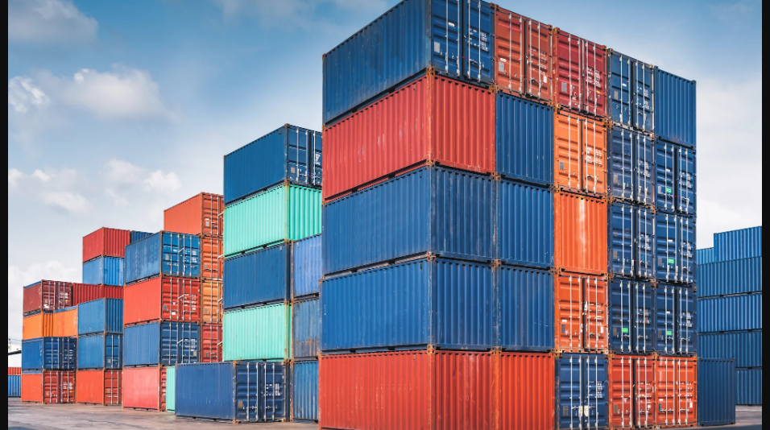
What is Docker Container ?
Instance of Image like JavaScript Object.
Portable artefact easily shared and movable.
Makes deployment and development more efficient.

Slide 5
Before Containers
Each developer needs to install the application specific version.
Installation process is different on each OS environment.
Many step could go wrong.
Textual guide of installation.
Configuration on the server needed.

Slide 6
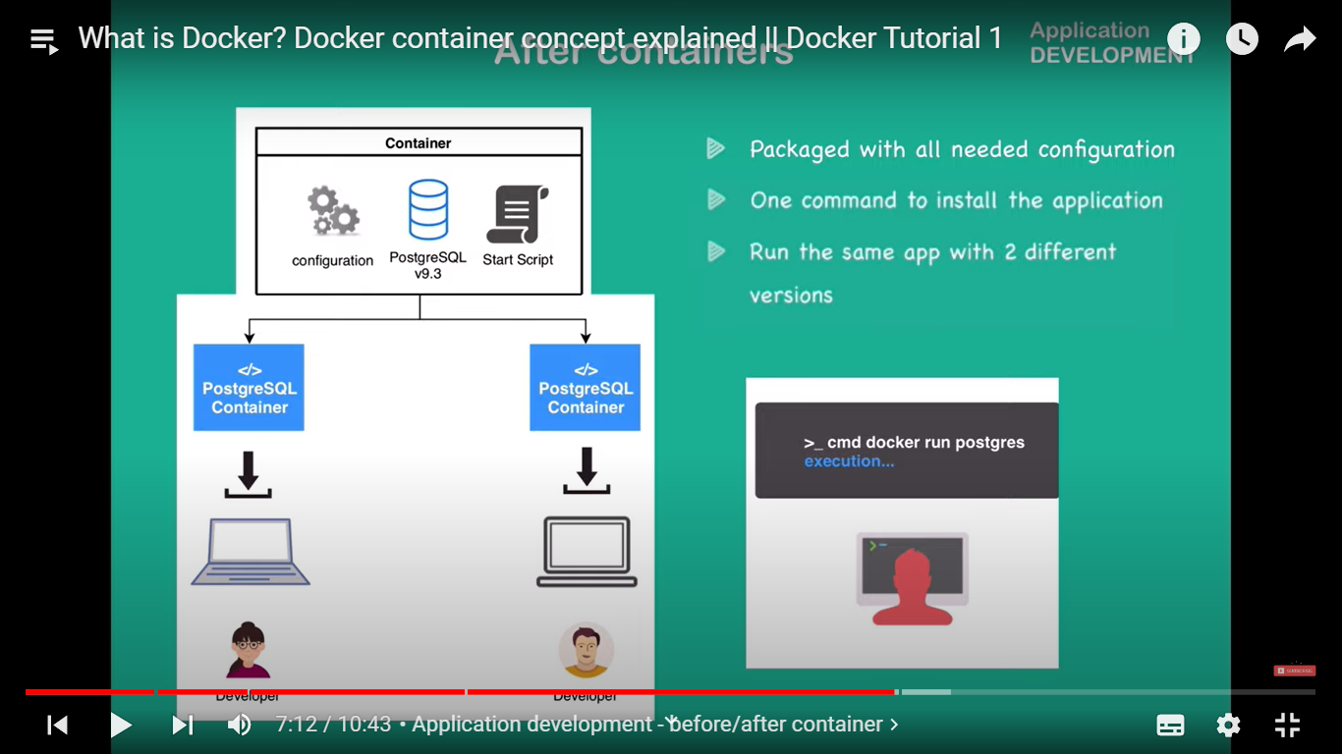
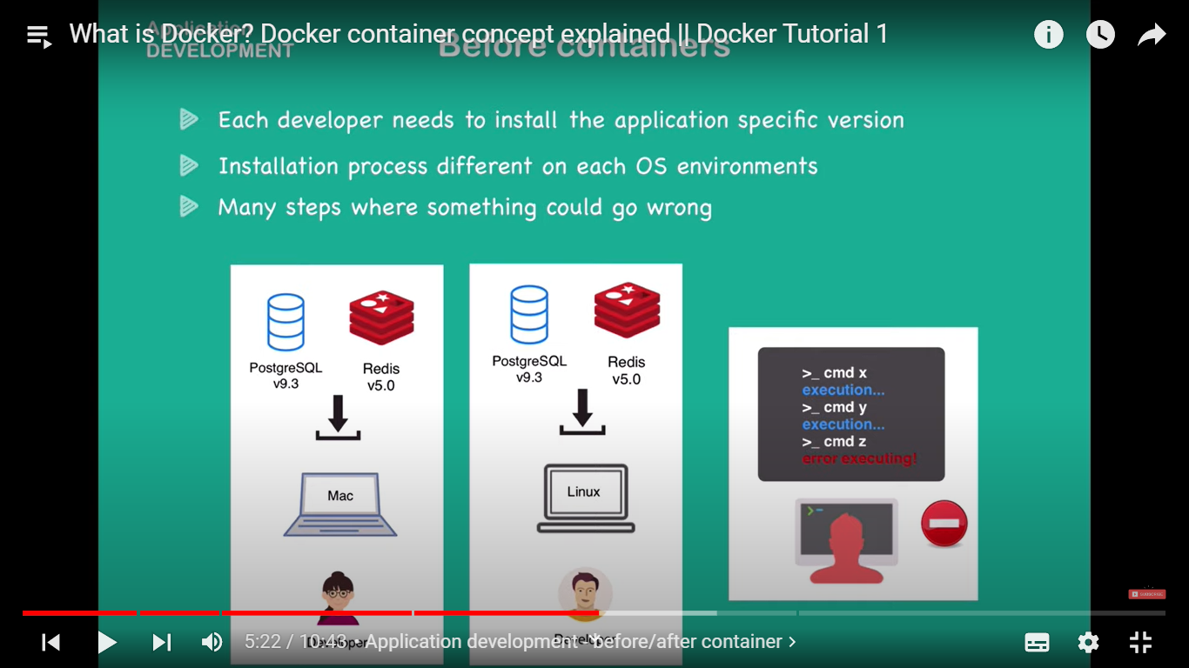

Slide 7
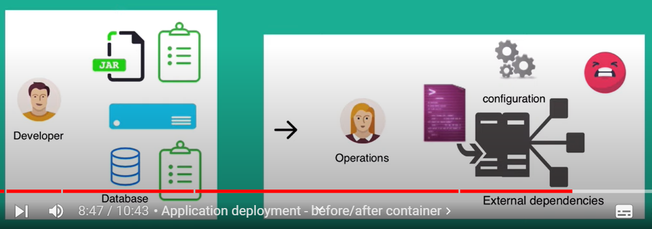
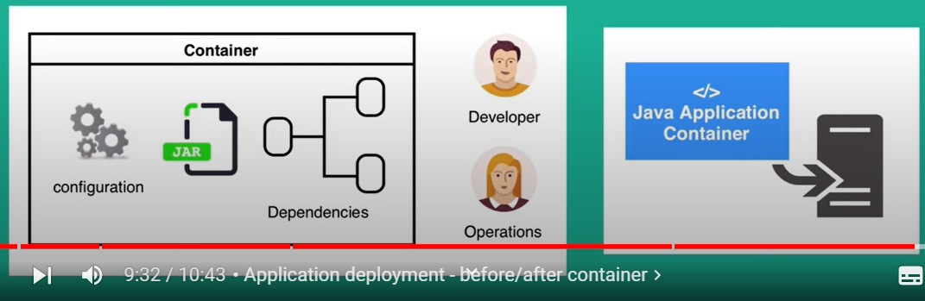

Slide 8
Pros
Portability : Docker allows you to package an application along with all of its dependencies into a single container that can be run on any system that supports Docker.
Consistency: Docker ensures that your software will run in the same environment every time, regardless of where it's being run. This helps to avoid issues that can arise from differences in operating systems.
Isolation: Docker containers are isolated from the host system and other containers, which provides an added layer of security and helps prevent conflicts between different applications running on the same machine.

Slide 9
Flexibility: Docker allows you to easily switch between different versions of software and libraries

Slide 10
Cons
Complexity: Docker can be complex to set up and use, especially if you're not familiar with containerization concepts and technologies. This can be a significant barrier for users who are not familiar with Docker.
Resource consumption: Docker can consume significant system resources, especially if you're running multiple containers.
Learning curve: Docker has a steep learning curve, and it may take some time to become familiar with the various commands, tools, and concepts involved in containerization.

Slide 11
Docker Commands
Command | Description | Example
pull | Download an image from docker hub | $ docker pull hello-world
run | Run a container ( create and start a container ) | $ docker run hello-world
ps | List containers ( process status ) | $ docker ps
images | List images | $ docker images
logs | Show container logs | $ docker logs -f myapp
exec | Execute a command in a running container | $ docker exec myapp ls
cp | Copy files between a container and local file system | $ docker cp [OPTIONS] CONTAINER:SRC_PATH DEST_PATH
build | Build a new image | $ docker build -t myapp:latest .
start | Start a Docker container | $ docker start myapp
stop | Stop a docker container | $ docker stop myapp
version | Display Docker Client and Docker Server version | $ docker version
info | Display number of containers running, paused, stopped, number of images etc. | $ docker info
build | Build docker image | $ docker build . -t myapp:1.0.0
dockerd | To launch Docker daemon | $ dockerd
create | To create a new container. | $ docker create hello-world
kill | To kill a container | $ docker kill myapp
commit | To create a new image from container changes. | $ docker container commit mycontainer myimage
login | To login into hub.docker.com | $ docker login
push <username/image name> | push it to docker hub | $ docker push myapp
rm <container id> | delete a stopped container | $ docker rm myapp
rmi <image-id> | delete an image from the local system | $ docker rmi myapp
system prune | to remove all the stopped containers, all the networks that are not used, all dangling images and all build caches. | $ docker system prune --all

