Slide 1

TRAIN TICKET RESERVATION SYSTEM
ANKIT RAWAT ( Database )
DURGA PHUKAN (Designer )
BHARGAV MANDADI ( Developer )
VASU JAIN ( Designer )
AMIT YADAV ( Tester )

Slide 2
ABOUT :
THE AIM OF THIS PROJECT IS TO GENERATE A TRAIN TICKET AND PRINT THE TICKET TO A FILE.
IT TAKES TRAIN NUMBER AND PASSENGER DETAILS AS INPUT.
THE APPLICATION GENERATES A TRAIN TICKET WHICH CONTAINS THE TRAIN DETAILS AND PASSENGER DETAILS.
THE GENERATED TICKET CONTAINS PNR NUMBER, TRAVEL DATE, TRAIN NUMBER, TRAIN NAME, SOURCE STATION AND ESTINATION STATION.
AS FOR THE PASSENGER DETAILS IT CONTAINS THE PASSENGER’S NAME, AGE, GENDER AND THE TICKET FARE.

Slide 3



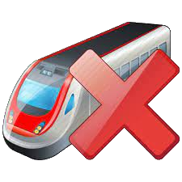

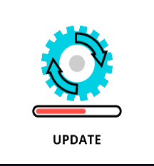




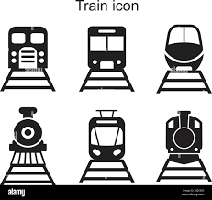



Design Flow:
Add train
Delete train
Update train
WebSite
Logout
Existed
First Time
Updated In
User
Stored In
Logged In
Show All Trains
Ticket Downloaded
Clik on Book Ticket
Logout

Slide 4
SOFTWARE USED
IDE | ECLIPSE
FRONT END | HTML, CSS, JAVASCRIPT, BOOTSTRAP
DATABASE | MYSQL WORK BENCH
TEXT EDITOR | VISUAL STUDIO
BACKEND | JAVA, SPRING BOOT AND REST API
TESTING | SOAPUI
BROWSER | GOOGLE CHROME

Slide 5
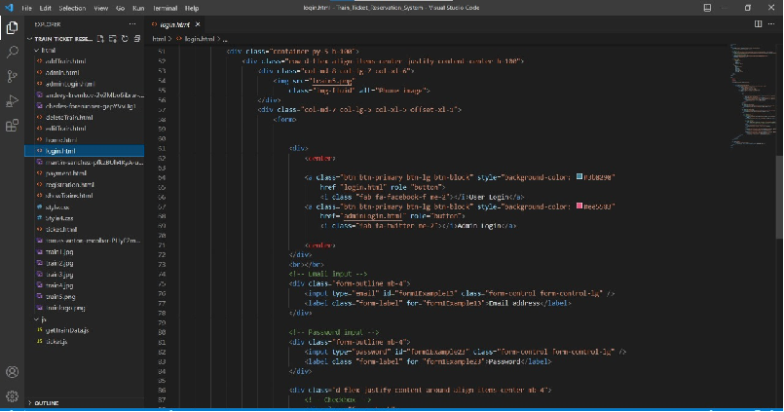
HTML CODE :

Slide 6
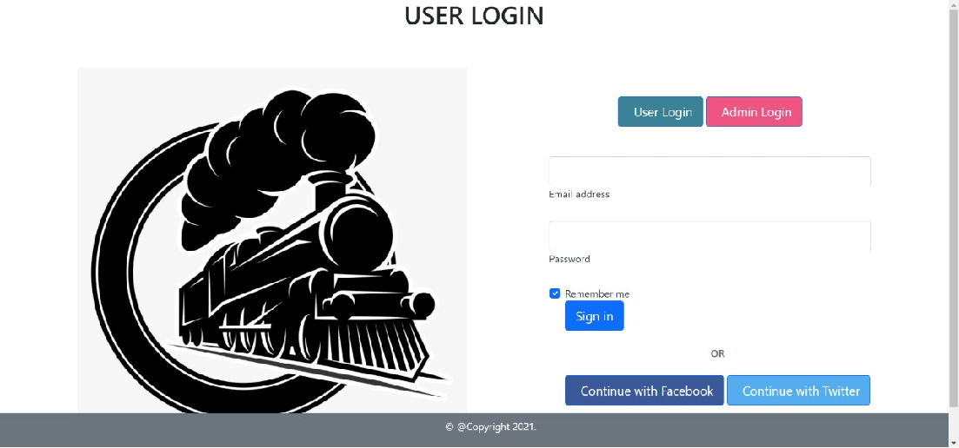
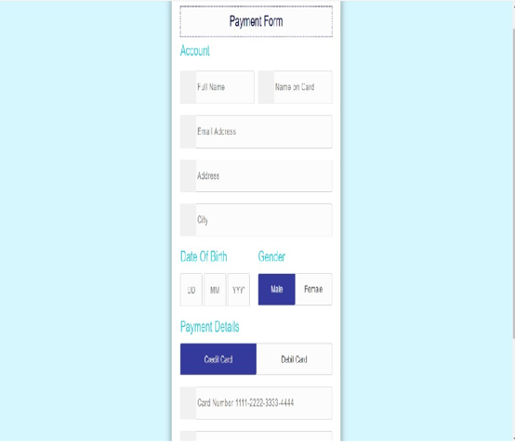
USER LOGIN :

Slide 7
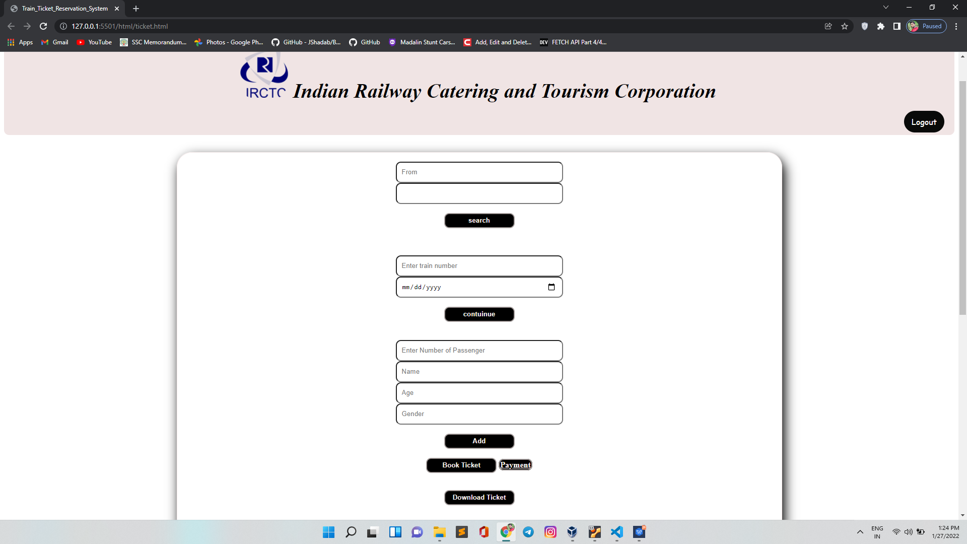
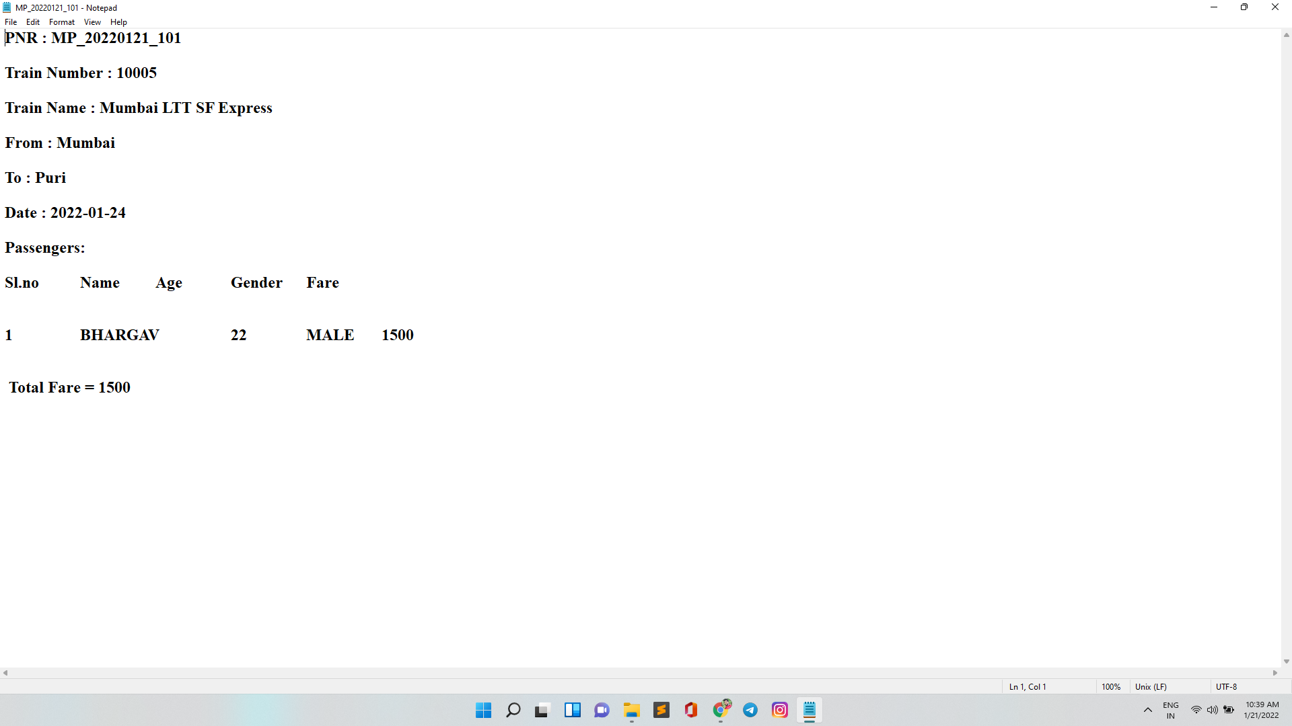
BOOK TICKET :

Slide 8
THANK YOU

