Slide 1
Project-2
Image Captioning using CNN and LSTM
Presenter: Bhargav Sai Bhuvanagiri(B191228EC)
mailto:bhuvanagiri_b191228ec@nitc.ac.in

Slide 2
Problem Statement:
Automatically describing the content of an image is a fundamental problem in artificial intelligence that connects computer vision and natural language processing.
In this project we address the aforementioned issue.

Slide 3
Model Motivation:
This model that addresses this problem was inspired by machine translation model(encoder decoder model), where both encoder and decoder are RNNs.
But in this problem as input is an image rather than sequence of words we use CNN as our encoder to extract features from the image and then decode the sentence using LSTM(RNN) which is image captioning.

Slide 4
Theory:
Tokenization.
CNN model(encoder) has been discussed in the last project there no new things to explain.
LSTM.

Slide 5
Tokenization:
In tokenization we convert raw text into structured format that can be analysed and understood by ML Algorithm.
Tokenization can be done in different ways such as one hot encoded vector, word embedding(dimension reduction of vector).

Slide 6
Vanilla RNN:
RNN is mainly used for sequence inputs(input lengths that changes).
Since we want the same function to be executed at each timestep we should share the same network (i.e., same parameters at each timestep) .
This parameter sharing also ensures that the network becomes independent to the length (size) of the input.

Slide 7
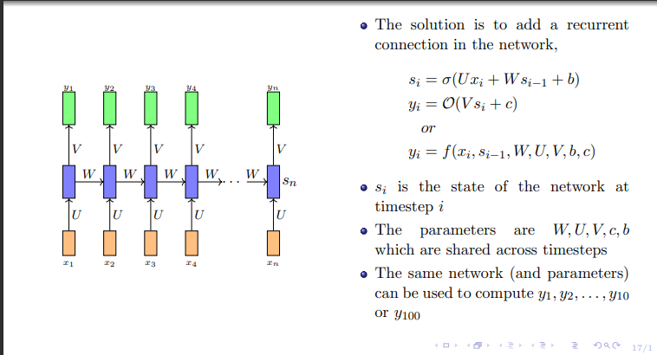

Slide 8
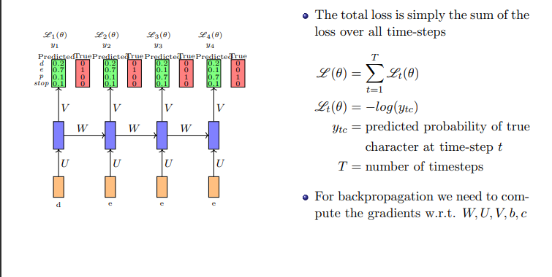
Ref: NPTEL IIT ropar Deep Learning Course

Slide 9
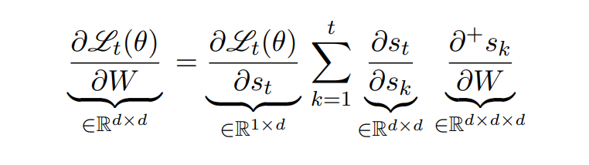
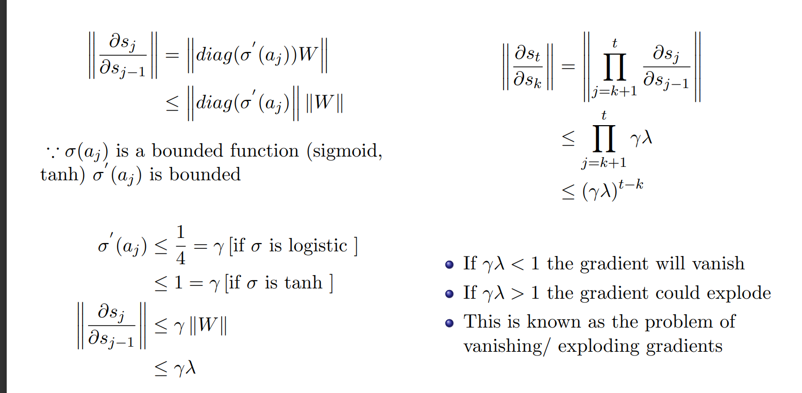

Slide 10
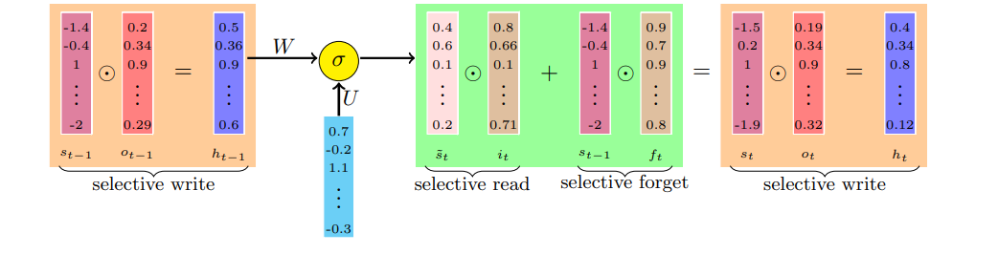
LSTM:
One of LSTM models.

Slide 11
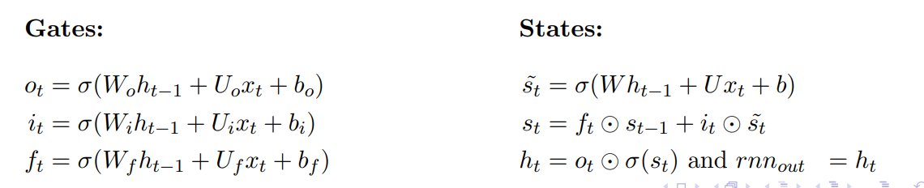
Equations:

Slide 12
How LSTM avoids vanishing gradients:
During forward propagation the gates control the flow of information.They prevent any irrelevant information from being written to the state
Similarly during backward propagation they control the flow of gradients.It is easy to see that during backward pass the gradients will get multiplied by the gate.
If the state at time t − 1 did not contribute much to the state at time t (i.e., if ∥ft∥ → 0 and ∥ot−1∥ → 0) then during backpropagation the gradients flowing into st−1 will vanish.
But this kind of a vanishing gradient is fine (since st−1 did not contribute to st we don’t want to hold it responsible for the crimes of st).

Slide 13
How LSTM avoids vanishing gradients:
The key difference from vanilla RNNs is that the flow of information and gradients is controlled by the gates which ensure that the gradients vanish only when they should (i.e., when st−1 didn’t contribute much to st).
Model compilation and testing will be discussed in the code section

Slide 14
Thank you

