Slide 1
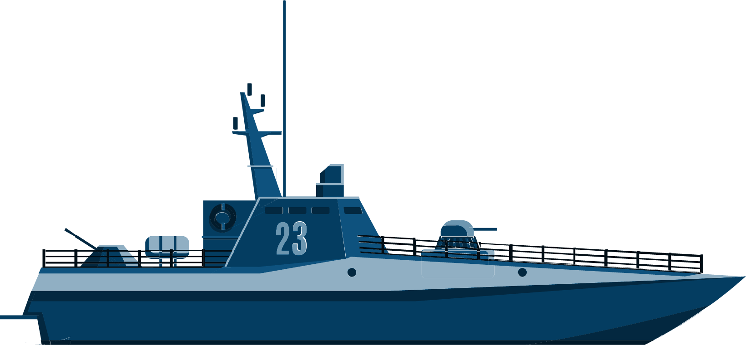
Cruise App
Kajal Patel –
Khanjan Dave –
Bhargav Borse - 301278352

Slide 2
Introduction
The "Cruise App" project aims to enhance the cruise booking experience through a user-friendly mobile application.
Emphasis on streamlining cruise research and booking for an efficient and enjoyable user experience.
Develop a user-friendly mobile app to simplify cruise research, selection, and booking.
Provide comprehensive cruise information, customizable booking options, secure payment processing, and transparent booking summaries.

Slide 3
Specifications / Requirements
01
02
03
Cruise Selection
Customer Info
Secure Payment
04
Checkout Details

Slide 4

Roles and Responsibilities
Kajal Patel
Khanjan Dave
Bhargav Borse
Backend handling
UI/UX enhancements
Backend handling
Testing the functionality and fixing issues
Backend handling
UI/UX designing

Slide 5
Implementation Progress
Milestone 1
Milestone 2
Milestone 3
Milestone 4
Final Submission
Requirement analysis
Learn from existing cruise app
Mockups and prototype
Finished all designing all screens
Iphone and ipad with portrait and landscape orientation
Connected with database and created tables.
Passed data from one screen to another
Finished creating all tables
Implemented dynamic data for cruise screens
Tested the app and fixed bugs
Frontend development
Iphone and ipad with portrait and landscape orientation

Slide 6
Challenges
User interface consistency
Backend data synchronization
Device compatibility
Timeline pressures

Slide 7
Thank you

