Slide 1
Radio Propagation Characteristics

Slide 2
Models for path loss, shadowing and multipath fading (delay spread, coherence band width, coherence time, Doppler spread), jakes channel model, digital modulation for mobile radio, analysis under fading channels, radio wave propagation

Slide 3
Introduction
Exponential growth of mobile communications has increased interest in many topics in radio propagation.
Much effort is now devoted to refine radio propagation path-loss models for urban, suburban, and other environments together with substantiation by field data.
Radio propagation in urban areas is quite complex because it often consists of reflected and diffracted waves produced by multipath propagation.
For closed areas such as indoors, tunnels, and underground passages, no established models have been developed as yet, since the environment has a complicated structure.

Slide 4
In general, radio wave propagation consists of three main attributes: reflection, diffraction and scattering.
Reflection occurs when radio wave propagating in one medium impinges upon another medium with different electromagnetic properties.
The amplitude and phase of the reflected wave are strongly related to the medium’s intrinsic impedance, incident angle, and electric field polarization.
Diffraction is a phenomenon by which propagating radio waves bend or deviate in the neighborhood of obstacles.
Diffraction results from the propagation of wavelets into a shadowy region caused by obstructions such as walls, buildings, mountains, and so on.

Slide 5
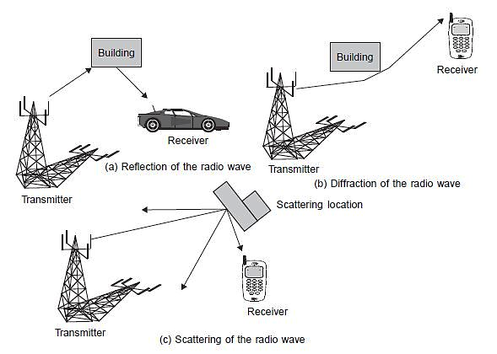
Scattering occurs when a radio signal hits a rough surface or an object having a size much smaller than or on the order of the signal wavelength.
This causes the signal energy to spread out in all directions. Scattering can be viewed at the receiver as another radio wave source.
Typical scattering objects are furniture, lamp posts, street signs, and foliage.

Slide 6
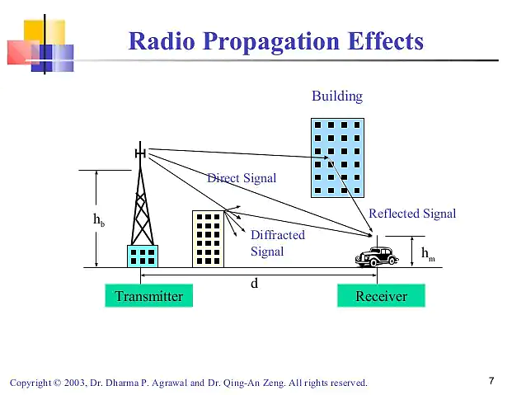

Slide 7
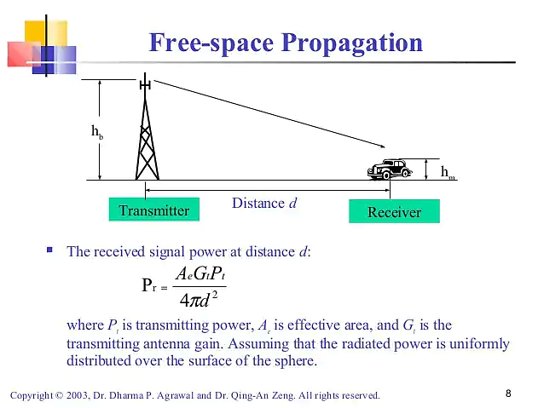

Slide 8
Propagation Path-Loss Models
Propagation path-loss models play an important role in the design of cellular systems to specify key system parameters such as transmission power, frequency, antenna heights, and so on.
Several models have been proposed for cellular systems operating in different environments (indoor, outdoor, urban, suburban, rural).
Some of these models were derived in a statistical manner based on field measurements and others were developed analytically based on diffraction effects.
Each model uses specific parameters to achieve reasonable prediction accuracy.

Slide 9
The long distance prediction models intended for macrocell systems use base station and mobile station antenna heights and frequency.
On the other hand, the prediction models for short distance path-loss estimation use building heights, street width, street orientation, and so on. These models are used for microcell systems.
When the cell size is quite small (in the range of 10 to 100 m), deterministic models based on ray tracing methods are used.
Thus, it is essential to select a proper path-loss model for design of the mobile system in the given environment.

Slide 10
Propagation models are used to determine the number of cell sites required to provide coverage for the network. Initial network design typically is based on coverage.
Later growth is engineered for capacity. Some systems may need to start with wide area coverage and high capacity and therefore may start at a later stage of growth.
The propagation model is also used in other system performance aspects including handoff optimization, power level adjustments, and antenna placements.
Although no propagation model can account for all variations experienced in real life, it is essential that one should use several models for determining the path losses in the network.

Slide 11
Okumura/Hata Model
Okumura analyzed path-loss characteristics based on a large amount of experimental data collected around Tokyo, Japan.
He selected propagation path conditions and obtained the average path-loss curves under flat urban areas.
Then he applied several correction factors for other propagation conditions, such as:
Antenna height and carrier frequency
Suburban, quasi-open space, open space, or hilly terrain areas
Diffraction loss due to mountains
Sea or lake areas
Road slope
Hata derived empirical formulas for the median path loss (L50) to fit Okumura curves.

Slide 12
IMT-2000 Models
The operating environments are identified by appropriate subsets consisting of indoor office environments, outdoor to indoor and pedestrian environments, and vehicular (moving vehicle) environments.
For narrowband technologies (such as FDMA and TDMA), delay spread is characterized by its rms value alone.
However, for wide band technologies (such as CDMA), the strength and relative time delay of the many signal components become important.

Slide 13
The key parameters of the IMT-2000 propagation models are:
Delay spread, its structure, and its statistical variation
Geometrical path loss rule (e.g., d, 2 5)
Shadow fading margin
Multipath fading characteristics (e.g., Doppler spectrum, Rician vs. Rayleigh
for envelope of channels)
Operating radio frequency

Slide 14
Characteristics of a Wireless Channel
The wireless channel is different and much more unpredictable than the wire line channel because of factors such as multipath and shadow fading, Doppler shift, and time dispersion or delay spread.
These factors are all related to variability introduced by mobility of the user and the wide range of environmental conditions that are encountered as a result.
Multipath delays occur as a transmitted signal is reflected by objects in the environment between a transmitter and a receiver.
These objects can be buildings, trees, hills, or even trucks and cars (see Figure).

Slide 15
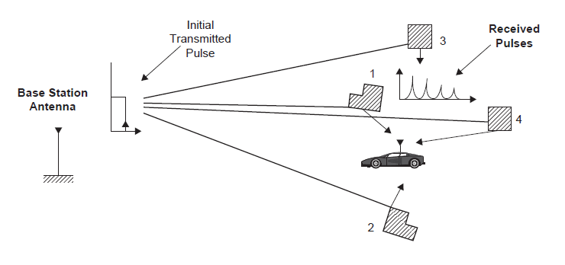

Slide 16
The reflected signals arrive at the receiver with a random phase offset, since each reflected signal generally follows a different path to reach the user’s receiver, resulting in a random signal that fades as the reflections destructively or constructively superimpose on one another.
This effectively cancels or adds part of signal energy for brief periods of time.
The degree of fading will depend on the delay spread of the reflected signals as embodied by their relative phases, and their relative power.

Slide 17
A mobile radio channel exhibits both time dispersion and frequency dispersion.
Time dispersion is the distortion to the signal and is manifested by the spreading in time of the modulation symbols. This is caused by frequency-selective fading.
A channel, which is said to be frequency selective, has many frequency components that take different times to arrive at the receiver and undergo different attenuation levels.
Time dispersion occurs when the channel is band-limited or when the coherence bandwidth of the channel is smaller than the modulation bandwidth.
The time dispersion leads to inter-symbol-interference (ISI), where the energy from one symbol spills over into another symbol, thereby increasing the bit-error-rate (BER).

Slide 18
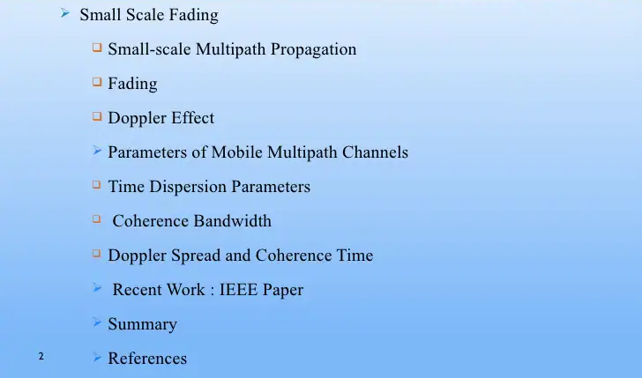

Slide 19
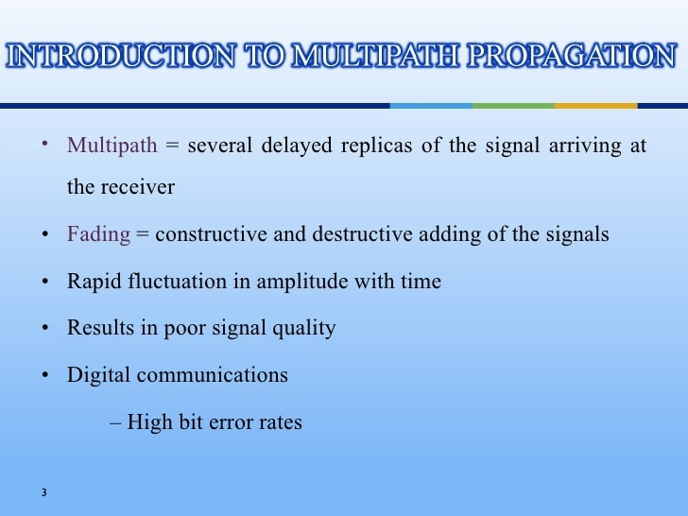

Slide 20
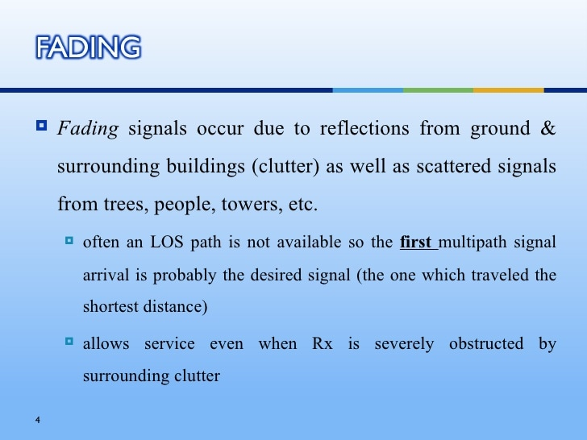

Slide 21
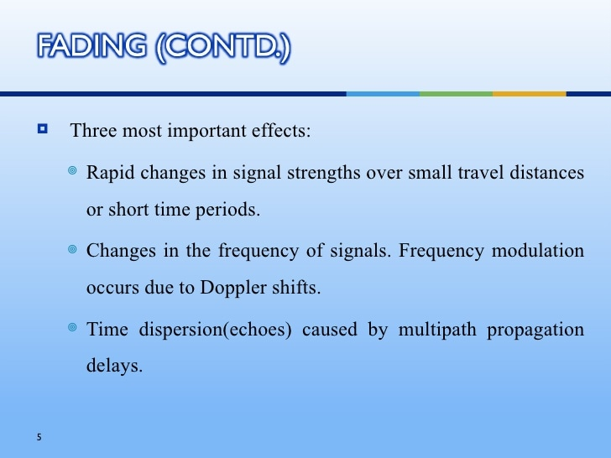

Slide 22
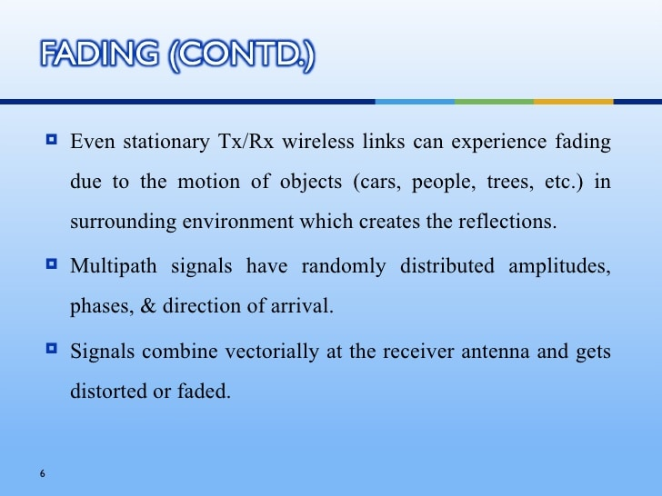

Slide 23
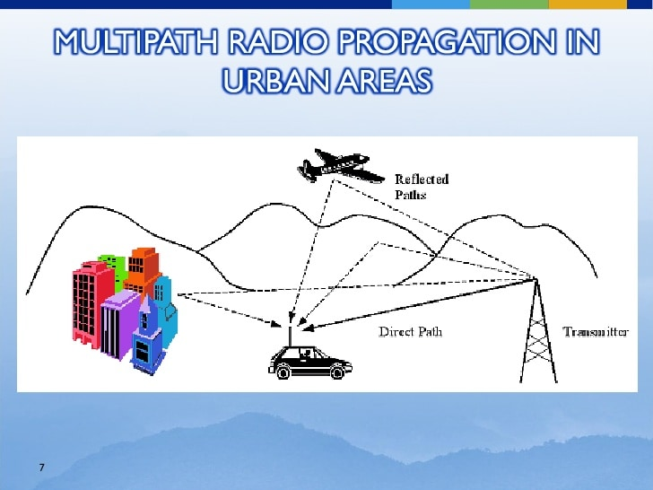

Slide 24
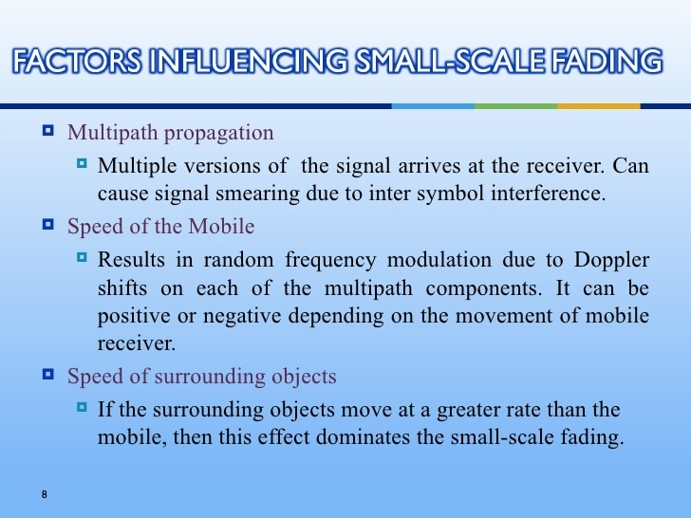

Slide 25
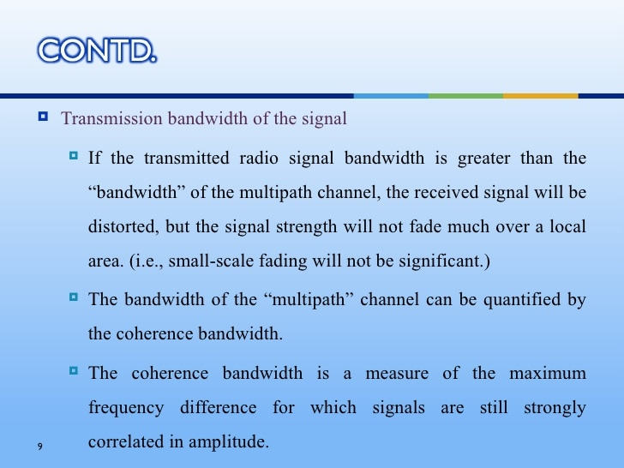

Slide 26
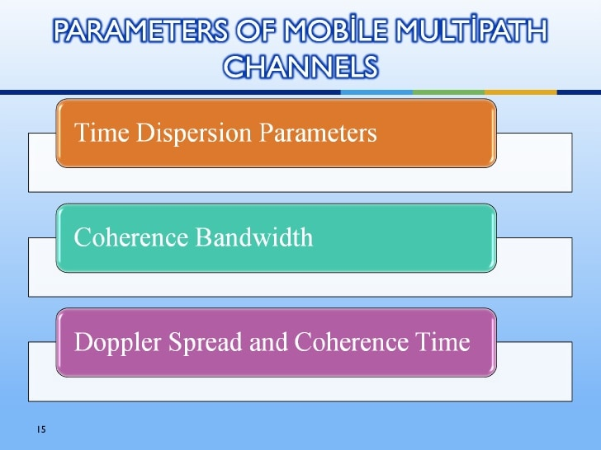

Slide 27
Time Dispersion Parameters
When a signal is transmitted, this signal can suffer a distortion caused by reflections and scattered propagation paths in the radio channel, and these phenomenon's cause that an identical signal arrives at different times at its destination.
These different times are due that to the signal arrives via multiple paths and in different incident angles. The time difference between the arrival moment of the first multipath component and the last one is called delay spread/Time Dispersion.

Slide 28
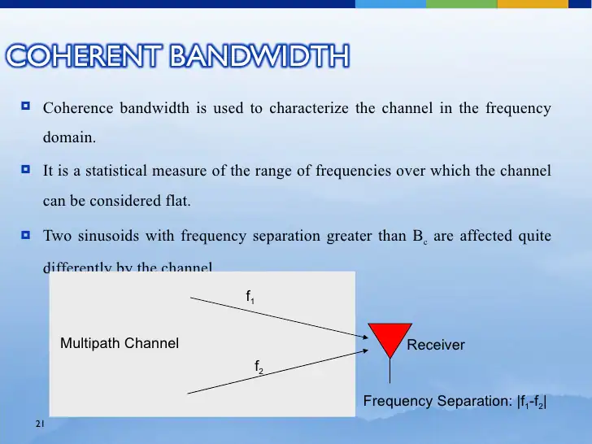

Slide 29
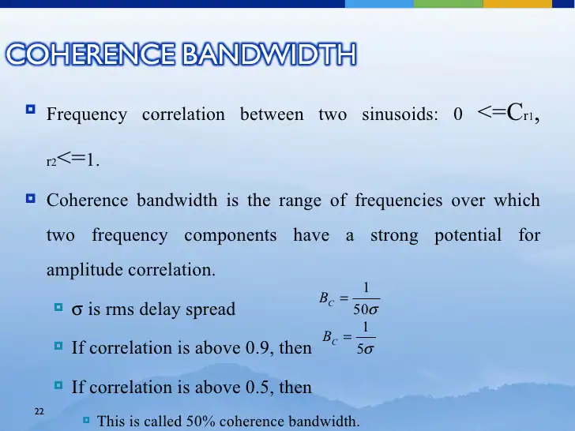

Slide 30
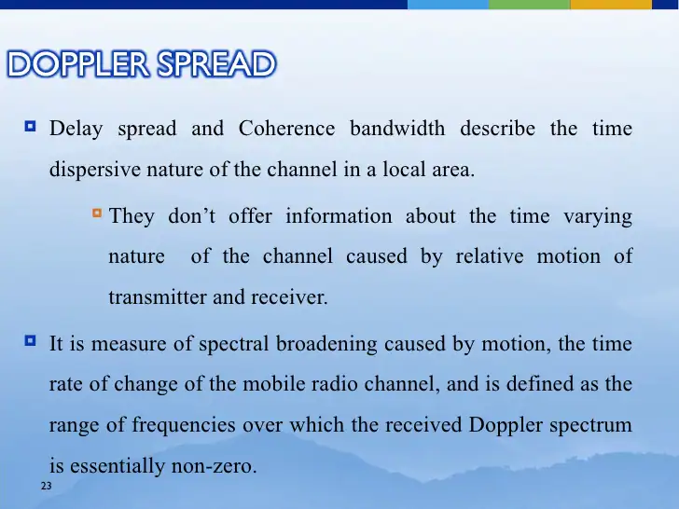

Slide 31
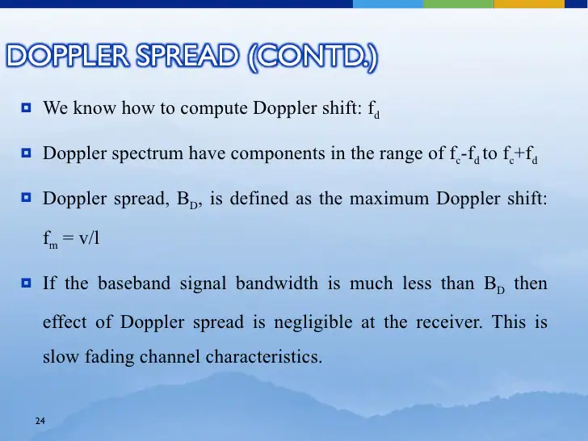

Slide 32
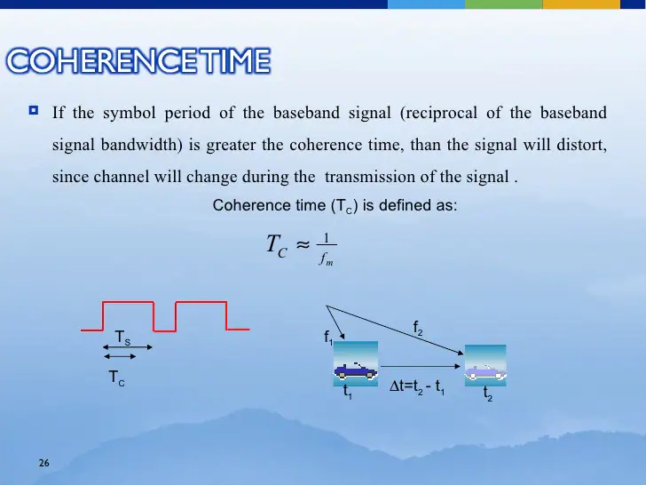

Slide 33
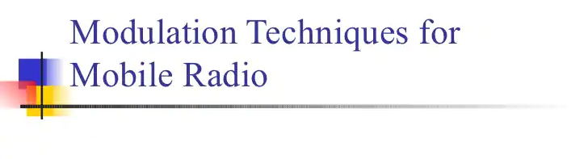

Slide 34
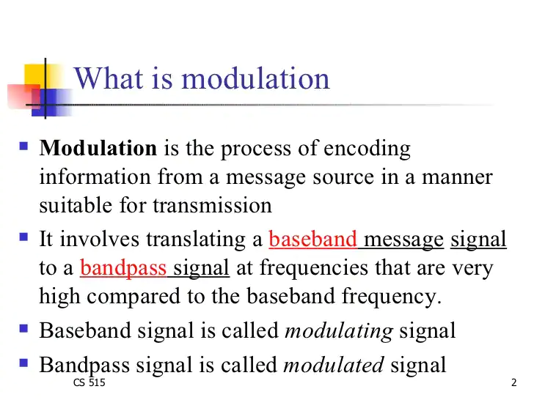

Slide 35
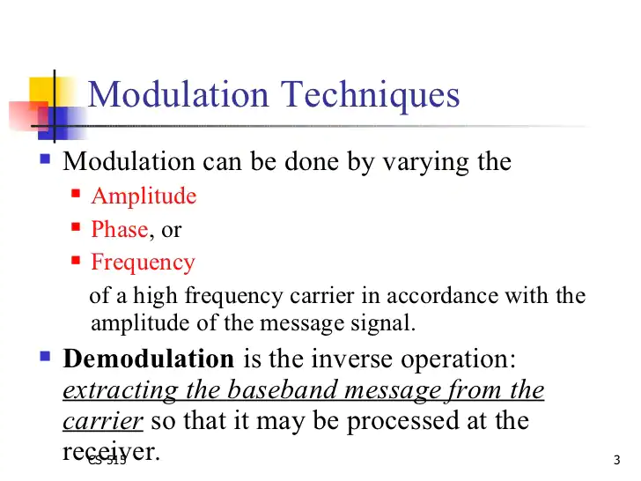

Slide 36
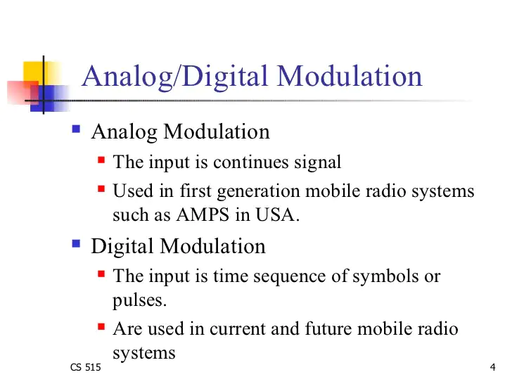

Slide 37
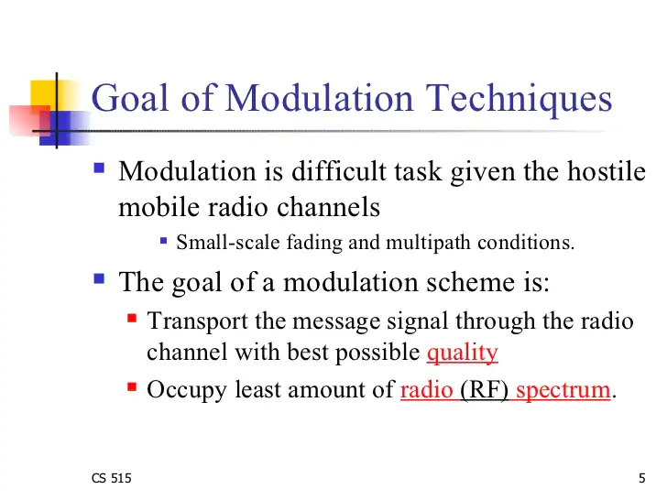

Slide 38
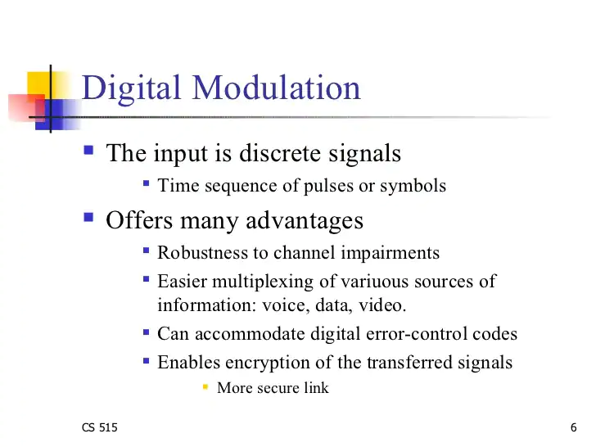

Slide 39
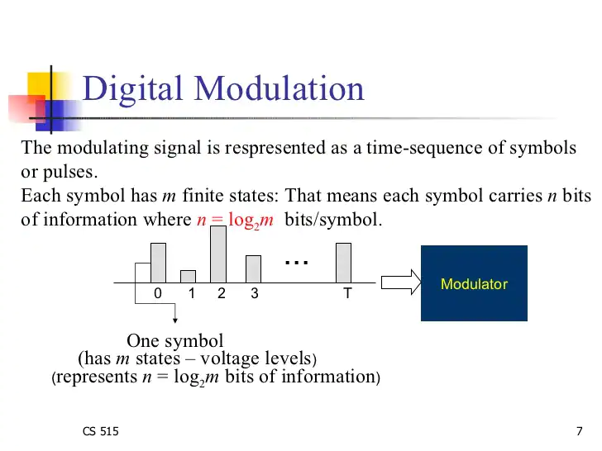

Slide 40
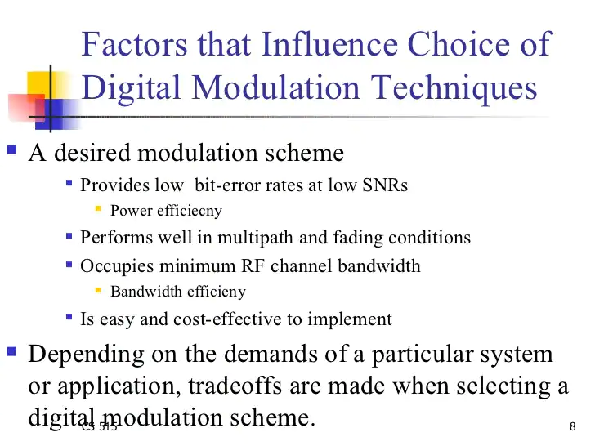

Slide 41
Radio Wave Propagation
Radio waves propagate through space as travelling electromagnetic waves.
The energy of signals exists in the form of electrical and magnetic fields. Both electrical and magnetic fields vary sinusoidally with time. The two fields always exist together because a change in electrical field generates a magnetic field and a change in magnetic field develops an electrical field. Thus there is continuous flow of energy from one field to the other.
Radio waves arrive at a mobile receiver from different directions with different time delays.
They combine via vector addition at the receiver antenna to give a resultant signal with a large or small amplitude depending upon whether the incoming waves combine to strengthen each other or cancel each other.

Slide 42
As a result, a receiver at one location may experience a signal strength several tens of decibels (dB) different from a similar receiver located only a short distance away.
As a mobile receiver moves from one location to another, the phase relationship between the various incoming waves also changes. Thus, there are substantial amplitude and phase fluctuations, and the signal is subjected to fading.
A steady decrease in the received signal power at a separation distance, d, of several kilometers (or miles) occurs.
This is the signal attenuation. Attenuation is proportional to the second power of distance in the free space, but can vary to the fourth or fifth power in built-up areas because of reflections and obstacles.

Slide 43
When we focus on a distance of a couple of kilometers, we observe that signal power fluctuates around a mean value and the fluctuations have a somewhat longer period. This is referred to as long-term or slow fading.
When we concentrate and examine the signal power over a few hundred meters, we find that signal power fluctuates more rapidly. These rapid fluctuations are caused by a local multipath. The phenomenon giving rise to these rapid fluctuations is referred to as short-term or fast fading.

