Slide 1
Propagation Characteristics of Mobile Channel

Slide 2
Free-space attenuation, attenuation over reflecting surface, effect of earth’s curvature, radio wave propagation, characteristics of wireless channel, multipath delay spread, coherence bandwidth, and coherence time, signal fading statistics, level crossing rate and average fade duration, propagation path-loss models, indoor loss models, fade margin, link margin

Slide 3
Free-Space Attenuation
The most simple wave propagation case is that of a direct wave propagation in free space.
In this special case of line-of-sight (LOS) propagation there are no obstructions due to the earth’s surface or other obstacles.
We consider radiation from an isotropic antenna. This type of antenna is completely omni-directional, radiating uniformly in all directions.
While there is no such thing as a purely isotopic antenna in practice, it is a useful theoretical concept.

Slide 4
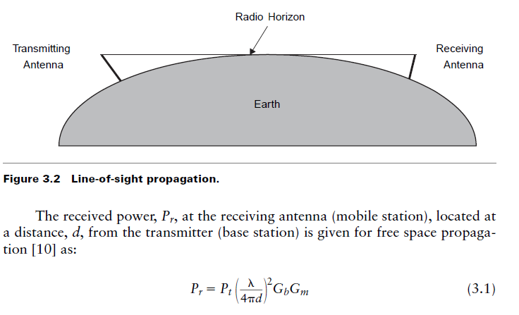
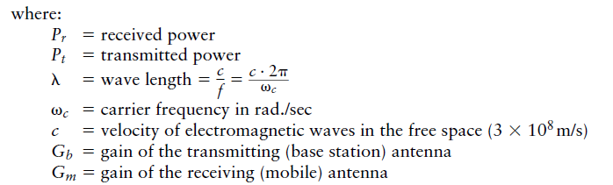

Slide 5
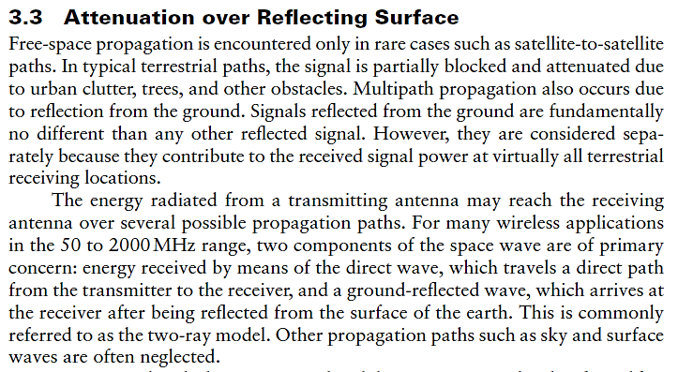

Slide 6
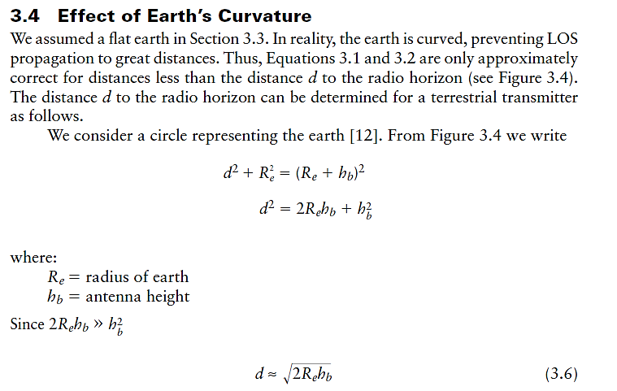

Slide 7
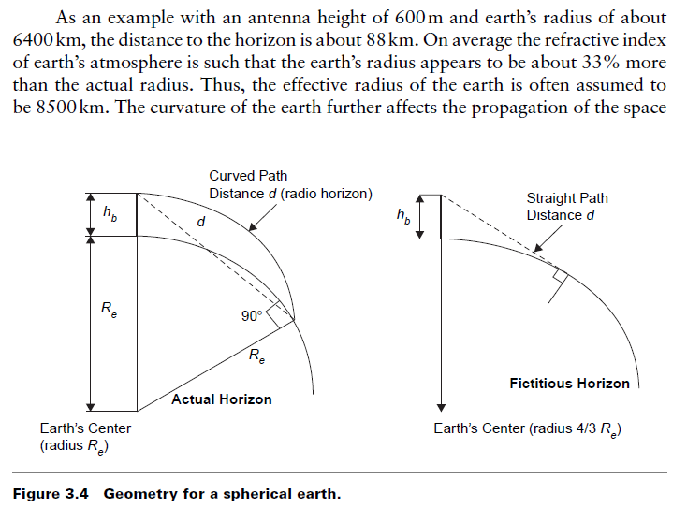


Slide 8
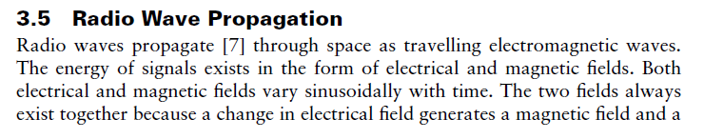
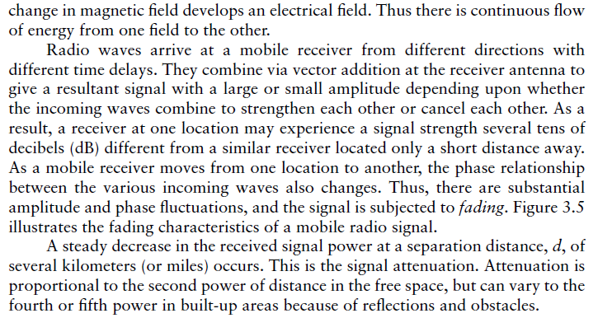

Slide 9
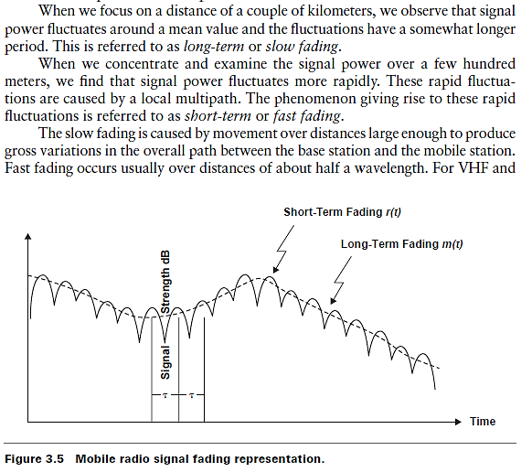

Slide 10
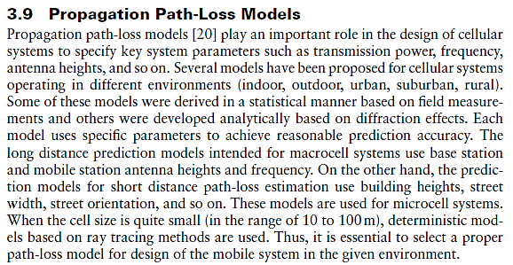

Slide 11
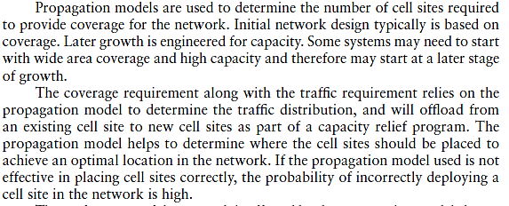

Slide 12
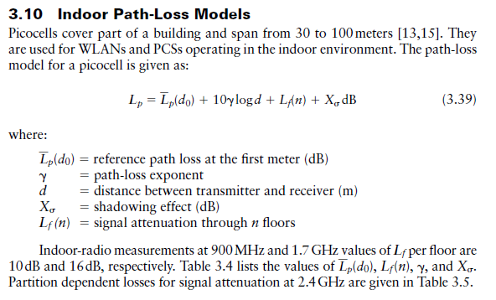

Slide 13
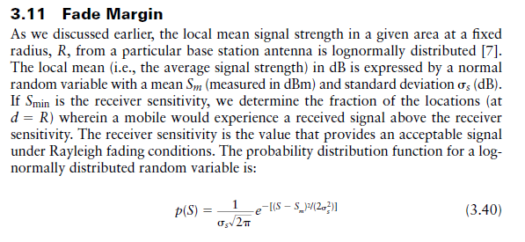

Slide 14
