Slide 1
Wireless Networks

Slide 2
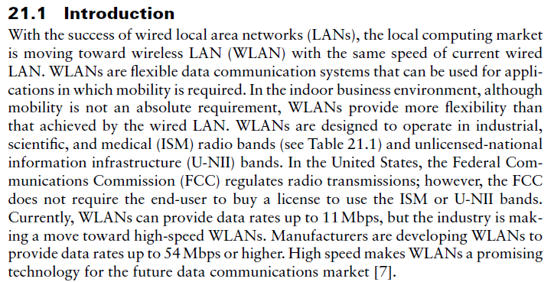

Slide 3
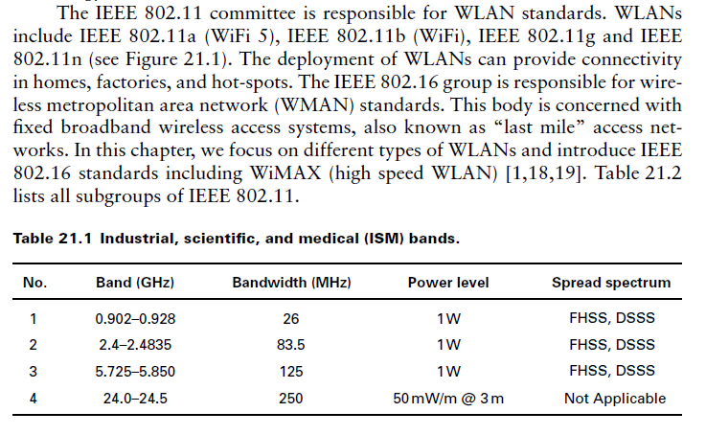

Slide 4
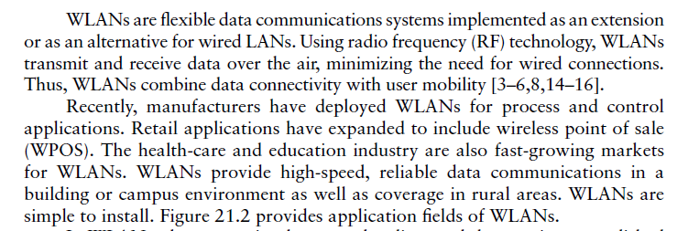

Slide 5
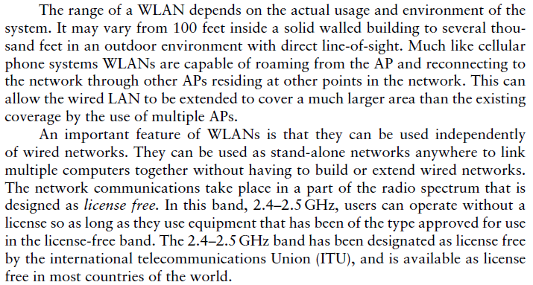

Slide 6
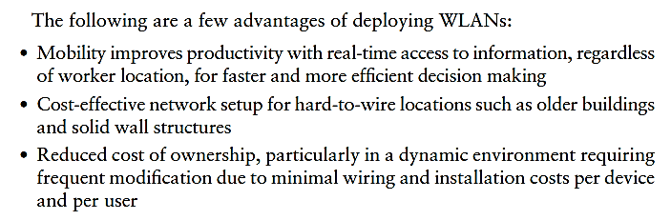
Advantages and Disadvantages

Slide 7
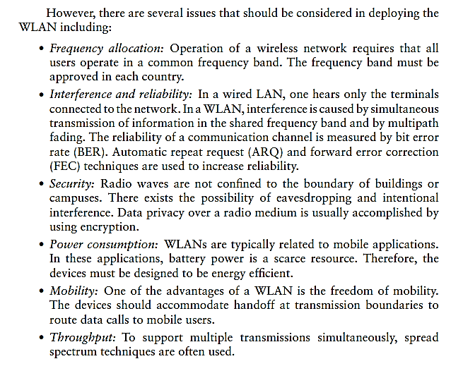

Slide 8
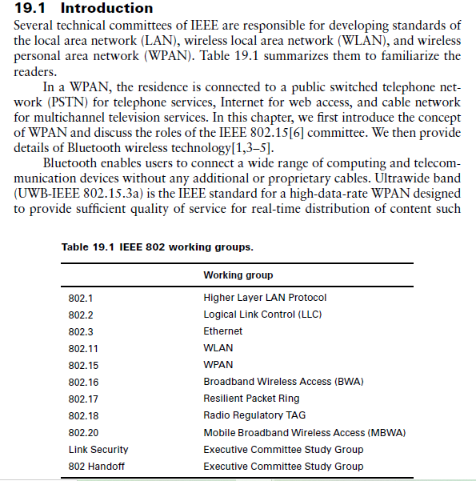

Slide 9
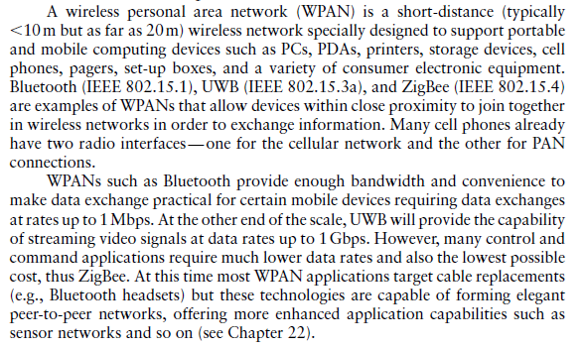
The Wireless Personal Area Network

Slide 10
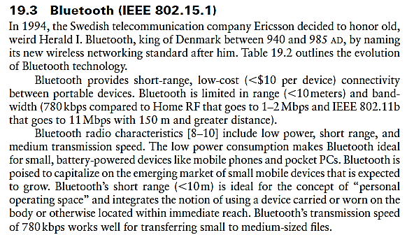

Slide 11
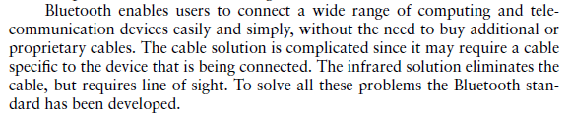

Slide 12
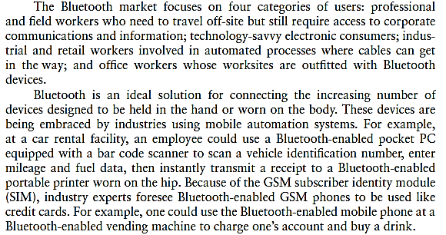

Slide 13
Orthogonal Frequency Division Multiplexing (OFDM)
In this section we briefly introduce OFDM. OFDM uses three transmission principles, multirate, multisymbol, and multicarrier. OFDM is similar to frequency division multiplexing (FDM).
OFDM distributes the data over a large number of carriers that are spaced apart at precise frequencies. The spacing provides the orthogonality in this technique, which prevents the demodulator from seeing frequencies other than their own.
Multiple Input, Multiple Output-OFDM (MIMO-OFDM) uses multiple antennas to transmit and receive radio signals. MIMO-OFDM allows service providers to deploy a broadband wireless access system that has non-line-of-sight (NLOS) functionality.
MIMO-OFDM takes advantage of the multipath properties of the environment using base station antennas that do not have LOS.
The MIMO-OFDM system uses multiple antennas to simultaneously transmit data in small pieces to the receiver, which can process the data flow and put it back together.
This process, called spatial multiplexing, proportionally boosts the data transmission speed by a factor equal to the number of transmitting antennas. In addition, since all data is transmitted both in the same frequency band and with separate spatial signatures, this technique utilizes spectrum efficiently. VOFDM (vector OFDM) uses the concept of MIMO technology.

Slide 14
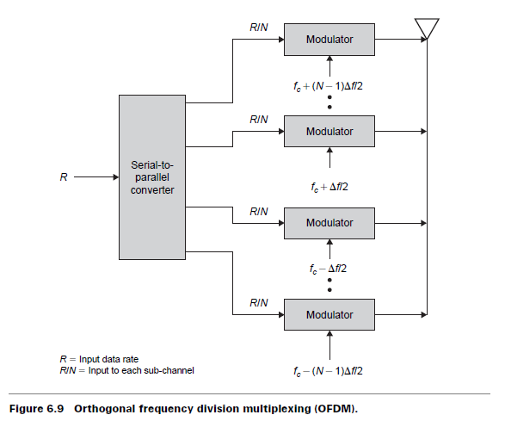
We consider a data stream operating at R bps and an available bandwidth of N∆f centered at fc. The entire bandwidth could be used to transmit a data stream, in which case the bit duration would be 1/R.
By splitting the data stream into N substreams using a serial-to-parallel converter, each substream has a data rate of R/N and is transmitted on a separate subcarrier, with spacing between adjacent subcarriers of f (see Figure 6.9). The bit duration is N/R.
The advantage of OFDM is that on a multiple channel the multipath is reduced relative to the symbol interval by a ratio of 1/N and thus imposes less distortion in each modulated symbol. OFDM overcomes inter-symbol interference (ISI) in a multipath environment.
ISI has a greater impact at higher data rates because the distance between bits or symbols is smaller. With OFDM, the data rate is reduced by a factor of N, which increases the symbol duration by a factor of N. Thus, if the symbol duration is Ts for the source stream, the duration of OFDM signals is NTs
The most important feature of OFDM is the orthogonal relationship between the subcarrier signals. Orthogonality allows the OFDM subcarriers to overlap each other without interference. OFDM uses FH to create a spread spectrum system. FH has several advantages over DSSS, for example, no near-far problem, easier synchronization, less complex receivers, and so on.

