Slide 1
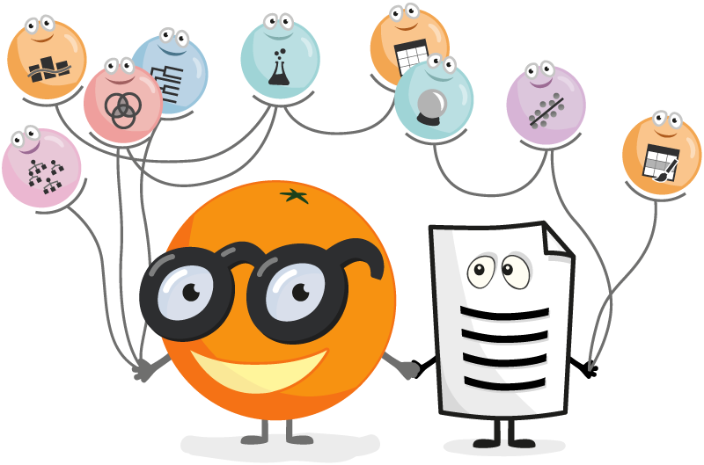
Data Mining with Orange
Group Members :
Bhargav Teja Jakku – G01334185
Naresh Kukkapalli – G01340317

Slide 2
Why Orange?
Orange is component based visual programing software for data mining.
Useful for Data Exploration, Data visualization and Machine learning.
Supports communication between Datascientists and domain experts.
It’s a Open Source- Component based" No programming- Data visualization- Platform independent software.
Allows clustering and classification- Data mining through visual programming.
The application is based on python scripting.
Data Mining with Orange

Slide 3
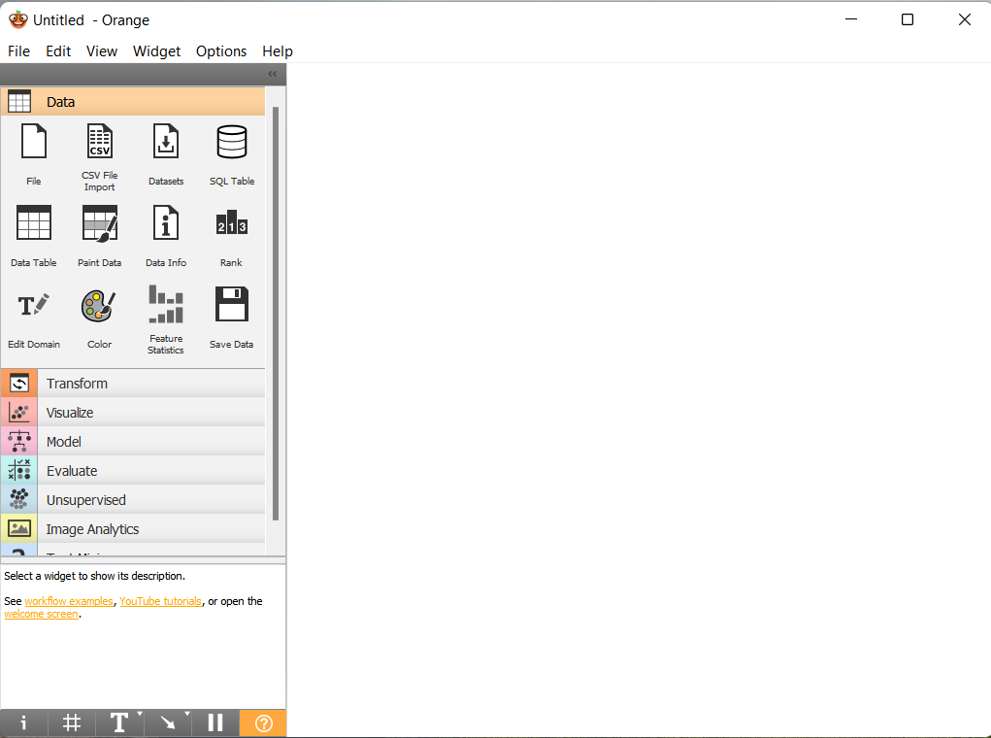
Getting Started with Orange
Data Mining with Orange
The Canvas is divided into two sections.
The left most part has the components for Datamining.
Each Component has multiple icons called “Widgets”.
The Right most part is where we design our workflow.

Slide 4
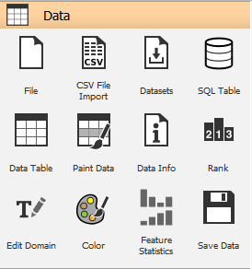
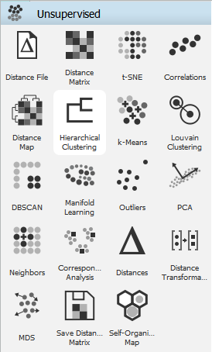
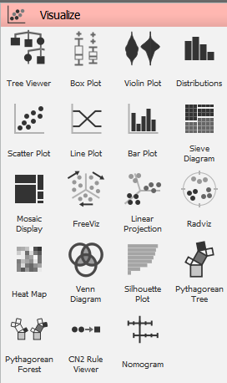
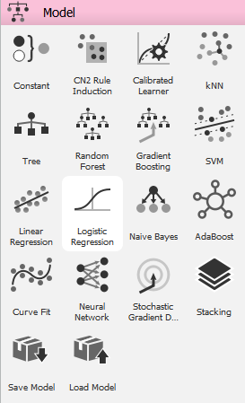
Components
Data Mining with Orange

Slide 5
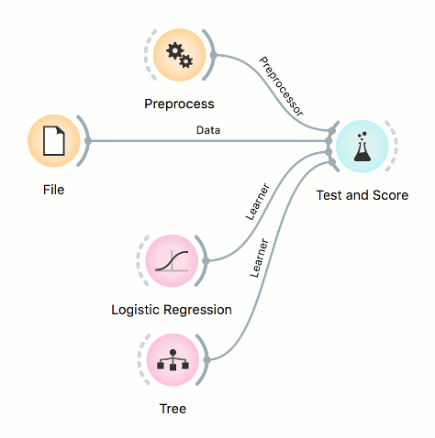
Example of Workflow
Data Mining with Orange
Budling Workflow is super simple
Data is easily structured to the desired pattern in orange to move the widgets where necessary. .
By connecting all the widgets a workflow is designed.
A large number of widgets(more than 100) appear to be provided.
Fun Fact : The connected widgets can communicate with each other.

Slide 6
Limitations
It is suitable for small to medium size dataset.
We can not do advanced analysis.
Tracing error is difficult as we need to see it manully.
It is not possible to export the visualization charts.
We cant set the seed in the software which causes results and analysis to not reproducible.
Data Mining with Orange

Slide 7
Conclusion
Data Mining with Orange
Orange is a powerful platform to perform data analysis and visualization, see data flow and become more productive.
It provides a clean, open source platform and the possibility to add further functionality for all fields of science.
A perfect suit for business statistics, prediction analysis, machine learning and data visualization.
Uses low resources, fast and convenient.
Orange has been fruitful as it picked up machine learning concepts without allowing any basic coding knowledge.

Slide 8
Data Mining with Orange
Thank you

