Slide 1
Big Data Implementing on Educational system in USA

Slide 2
Why BigData on Education Sector?
Education field has vast data about the schools, grading and many more.
Big data in the education sector, first and foremost, helps with analyzing students’ achievements.
Using BigData will help the user to understand about how the schools function and student’s performance and overall ranking of them.
Big data makes them feel much more confident in personalizing education, developing blended learning, transforming assessment systems and promoting life-long learning.
Big data analytics in education have all the power to define students’ skills, match them to the professional direction.

Slide 3
Research Questions
To compare which District has the overall scoring in terms of best school in state.
To distinguish which type of school has best rating.
which school has the best score(A) and worst score(F).
To find out which district has the best grades.
To find out the correlation in the variables.
Sql queries on dataset.

Slide 4

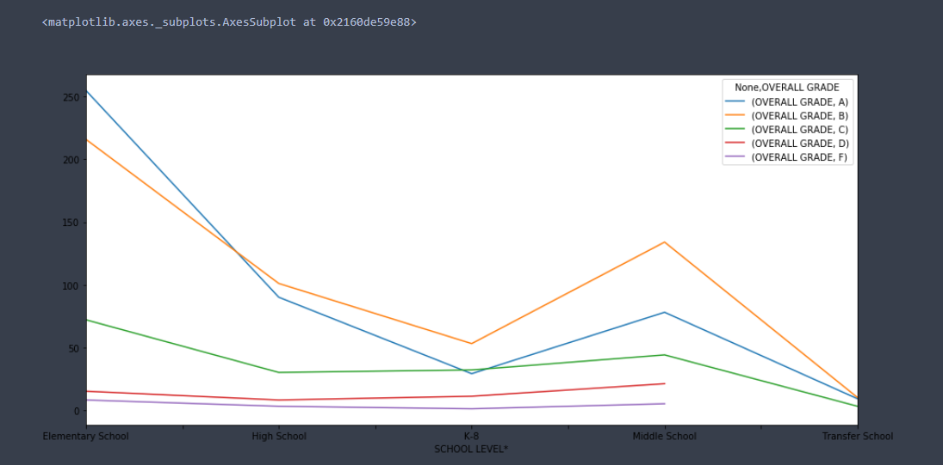
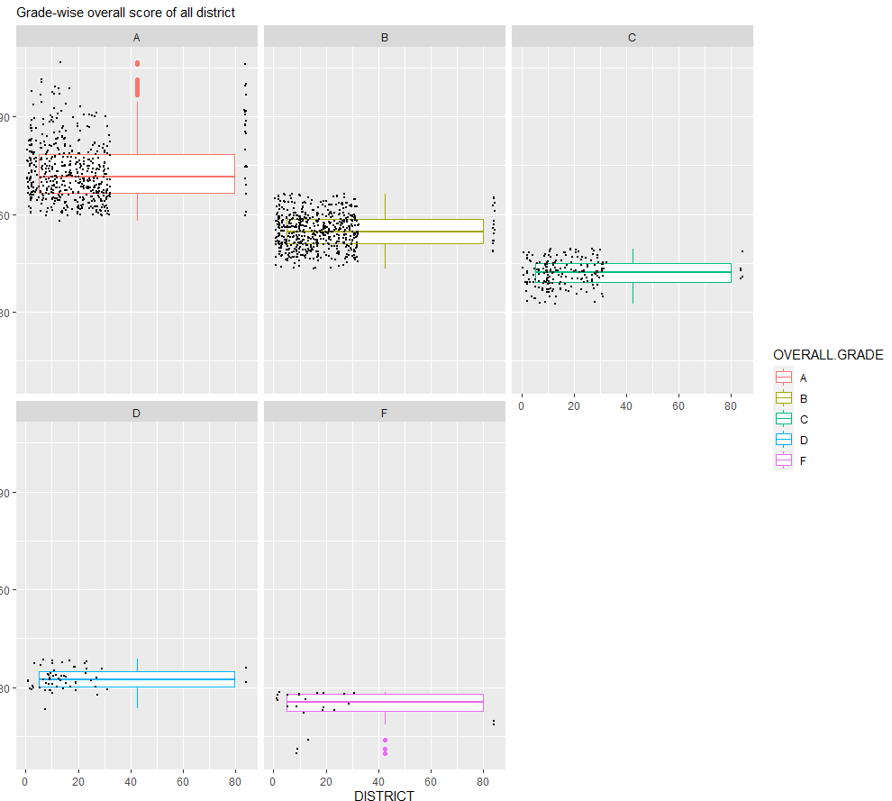
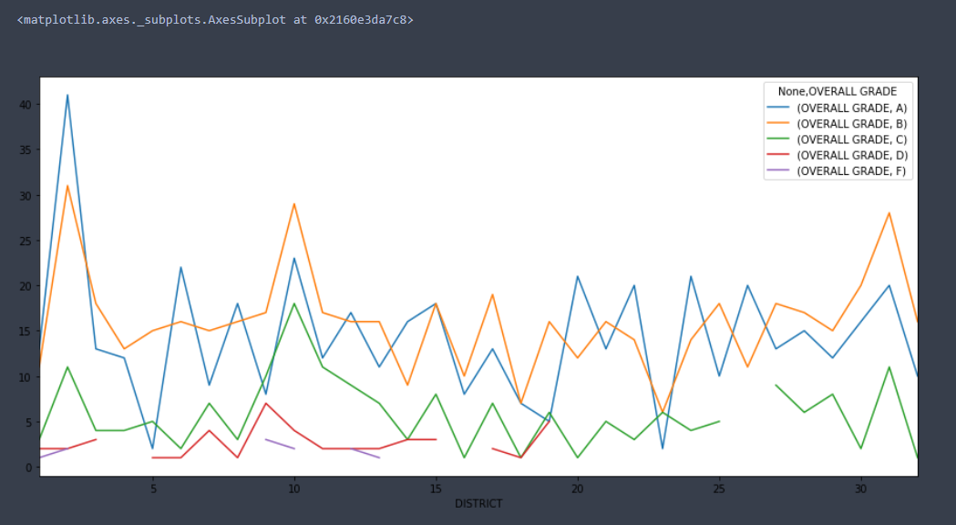
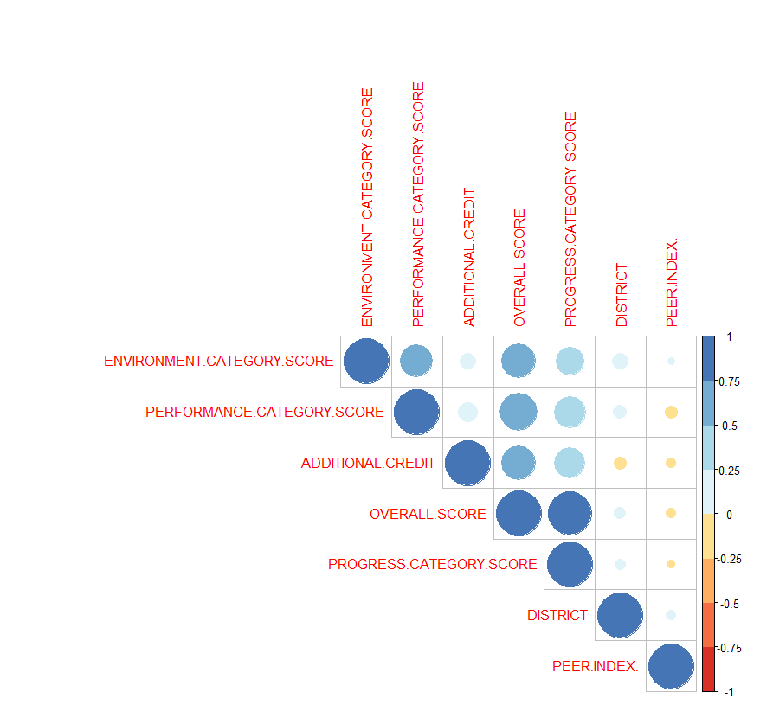

Slide 5
Conculsion
Big Data offers extraordinary skills to provide educational institutions with benefits not only in terms of decision-making, preventative, and preemptive capacities, but also in terms of increasing teaching and learning and driving a specific educational establishment towards academic greatness
Educational intelligence is emerging as the next generation of analytical solutions for education and research.
By using BigData Technology, it has a significant impact in education sector and helps to monitor the students and improves the quality of education.

