Slide 1
MINI PROJECT ON
GST CALCULATOR
By
Bhargav Ram (1601-16-737-036)
Spandana (1601-16-737-026)
H1 , IT-2/4

Slide 2
I.INTRODUCTION
AIM
To provide a GST calculator
To provide a webpage which gives information
about GST

Slide 3
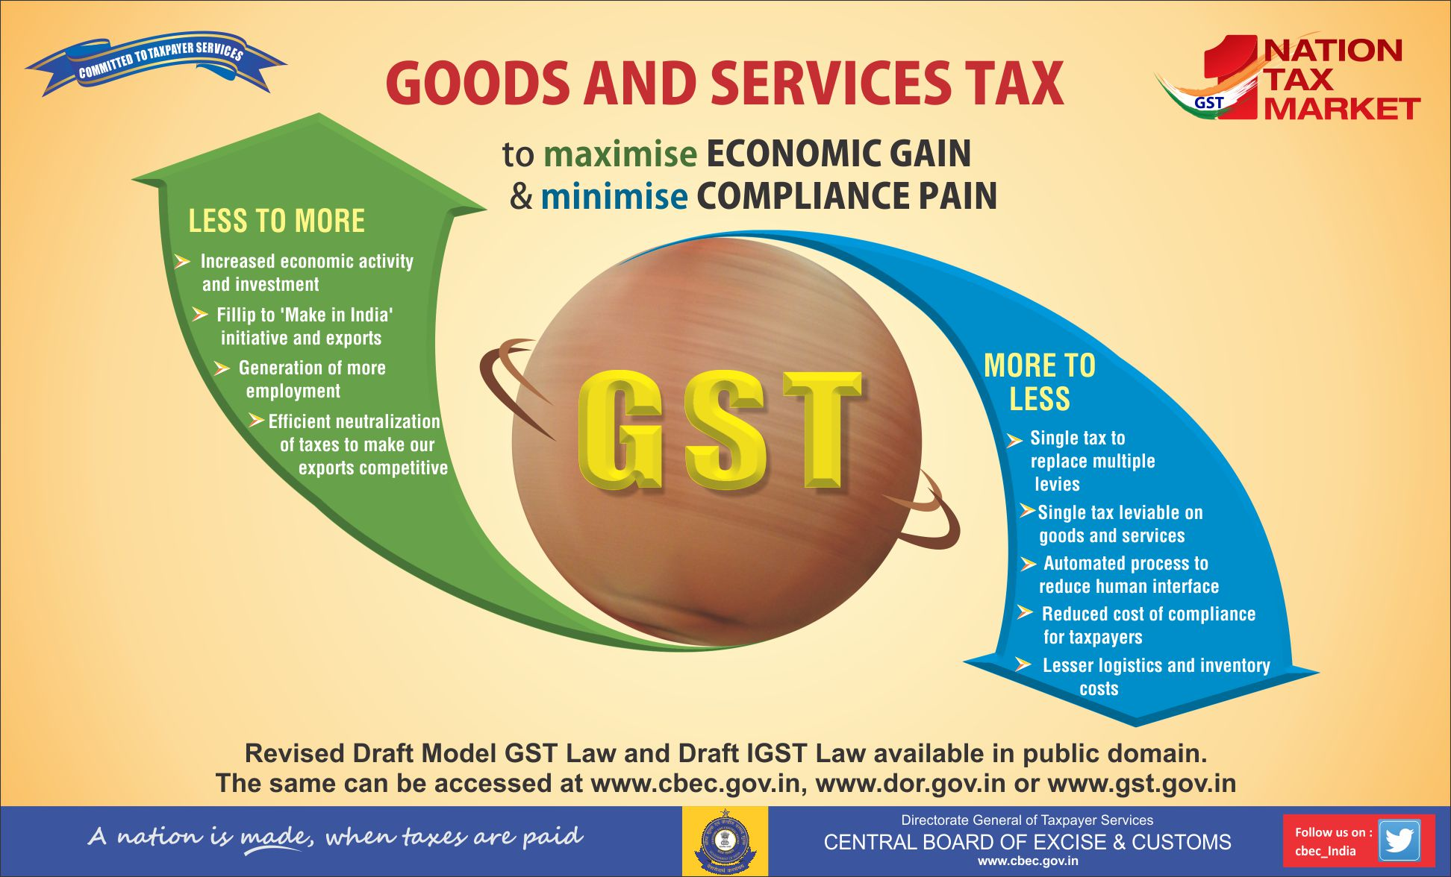
DIFFERENCES BETWEEN OLD AND NEW TAXATION SYSTEM

Slide 4
II.Technologies
HTML
HTML stands for Hyper Text Markup Language.
It is used to display the contents in the webpage like headings,paragraphs,lists,etc.
HTML basically consists of tags. Tags like <div>, <p>, <input>, <img>, <h1> ,<h2>, etc., are extensively used while writing in HTML.

Slide 5
CSS
CSS stands for Cascading Style Sheets.
It is used for describing the presentation of a document written in markup language (i.e., HTML).
JavaScript
JavaScript is used to define the behaviour of the webpage in response to the interaction with the user.It provides dynamic interactivity and provides services to the client side of the browser.

Slide 6
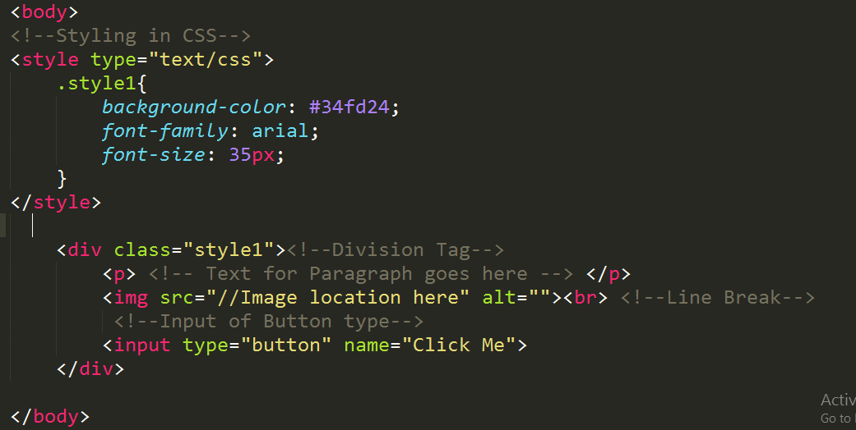
HTML & CSS snippet

Slide 7
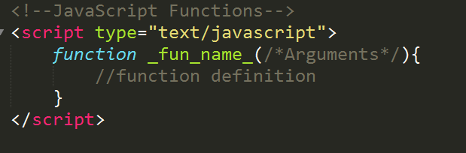
JavaScript Snippet

Slide 8
III. Software & Hardware Requirements
Operating System : Windows 2000 & higher or Mac OS 9 or 10 & higher.
Internet :Working high speed internet connection.
Internet Browser like IE,Chrome,Safari,etc.
RAM : 1GB or higher
Min Disk Space : 500MB

Slide 9
IV. Implementation
HTML was used to display the basic structure of the website.
CSS was used to make the layout and design. The header and footer, home page layout was done using this language.
JavaScript was used to describe dynamic interactivity and back-end mathematical functions of the website.

Slide 10
Hosting the website
The GST Calculator website was hosted using the functionality of GitHub.
GitHub is a web-based Git or version control repository and Internet hosting service. It is mostly used for code.
Small websites can be hosted from public repositories on GitHub. The URL format is https://username.github.io.

Slide 11
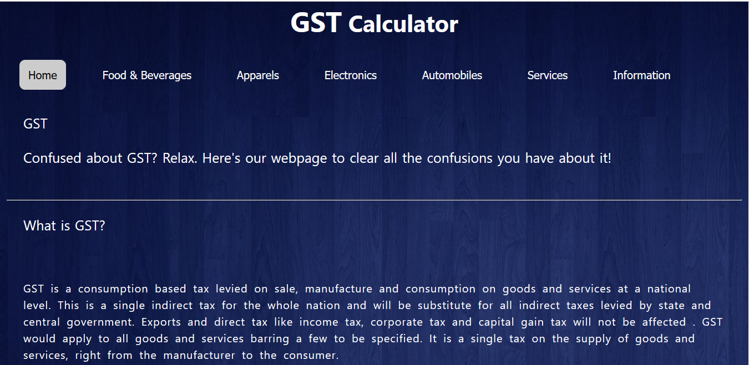
V. TESTING AND RESULTS
OUTPUT SCREENS
HOME PAGE

Slide 12
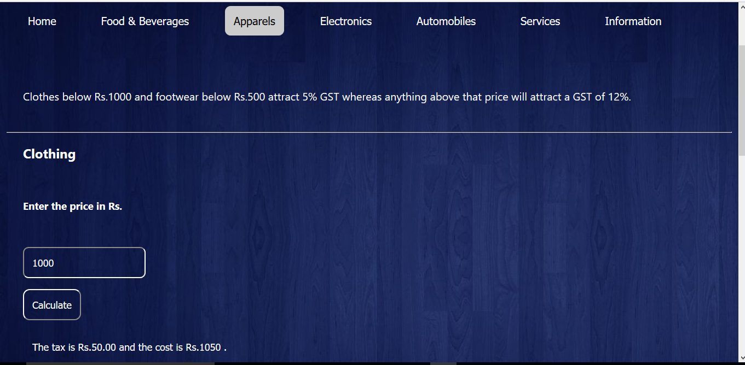
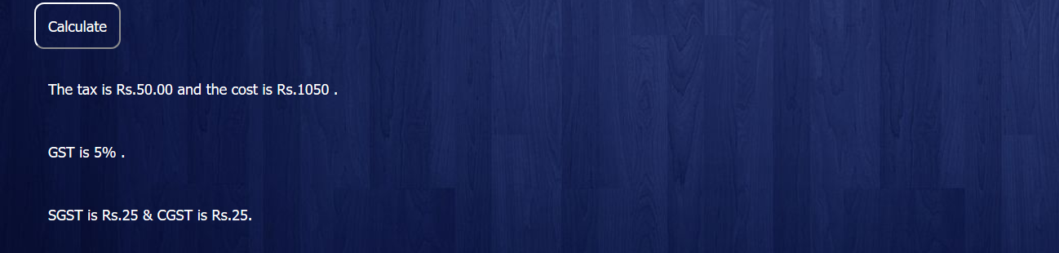
APPARELS
Output screen which shows tax, tax percent ,cost of the product after GST is levied on it , SGST and CGST

Slide 13
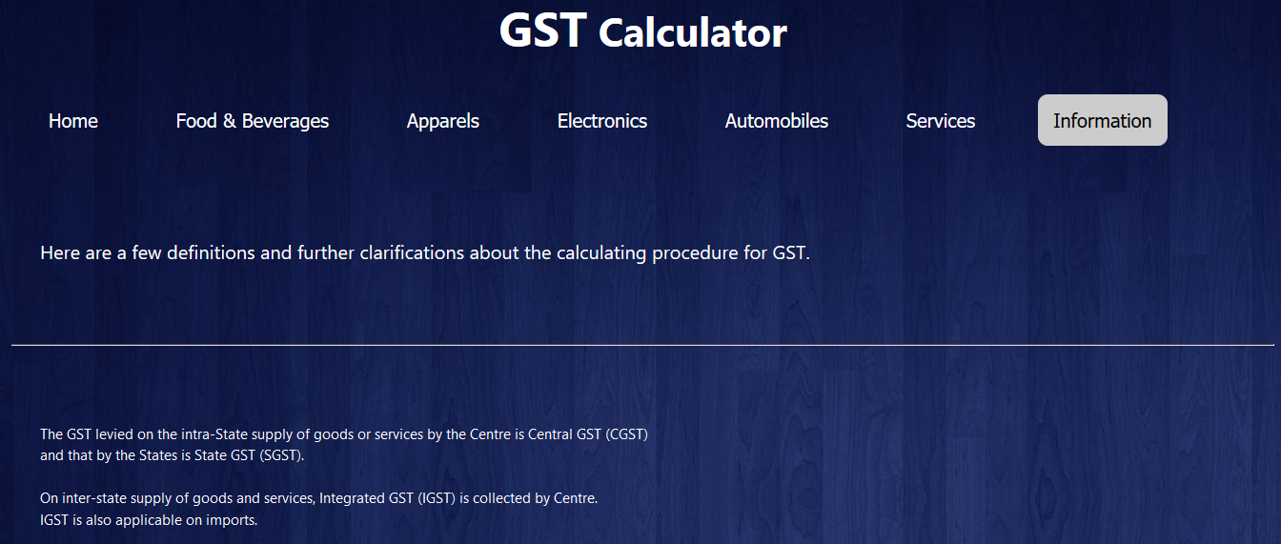
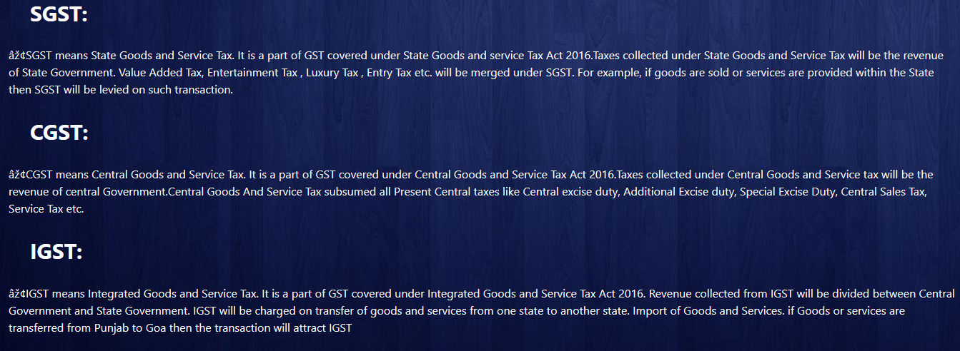
INFORMATION PAGE

Slide 14
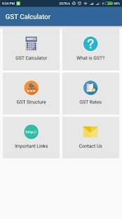
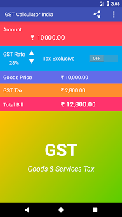
VI. FUTURE SCOPE
To create an android application which includes the following features
GST Calculator
Calculate users monthly expenditure and savings
Give warnings when account balance is low

