Slide 2
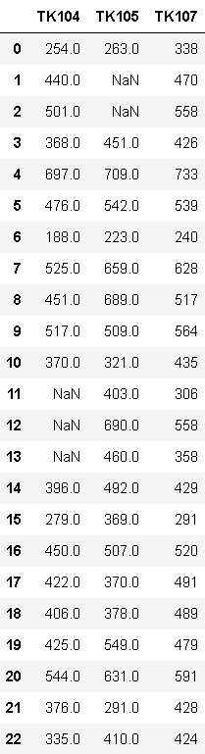
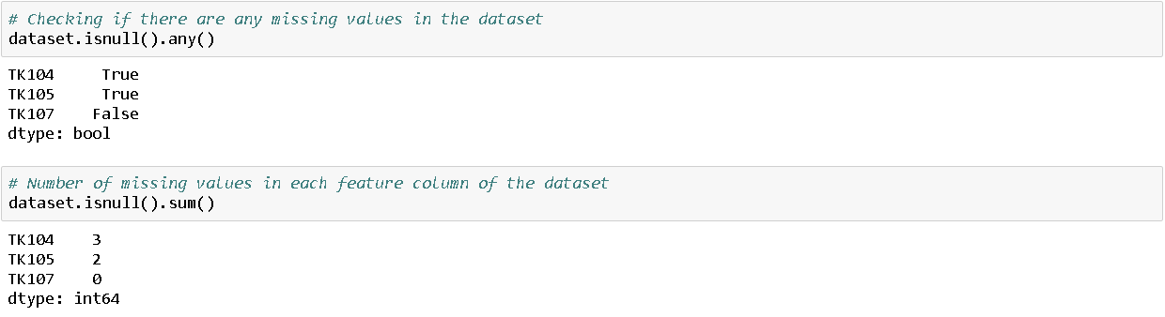
Data Deletion:
Importing dataset
Summarizing missing value

Slide 3
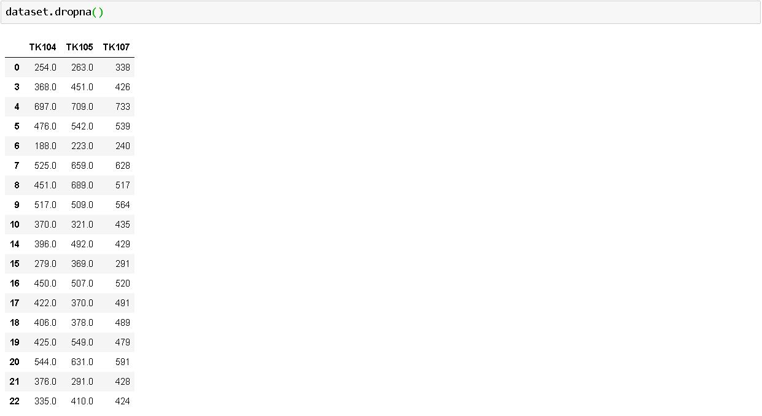
Data Deletion:
Drop the rows where at least one element is missing.

Slide 4
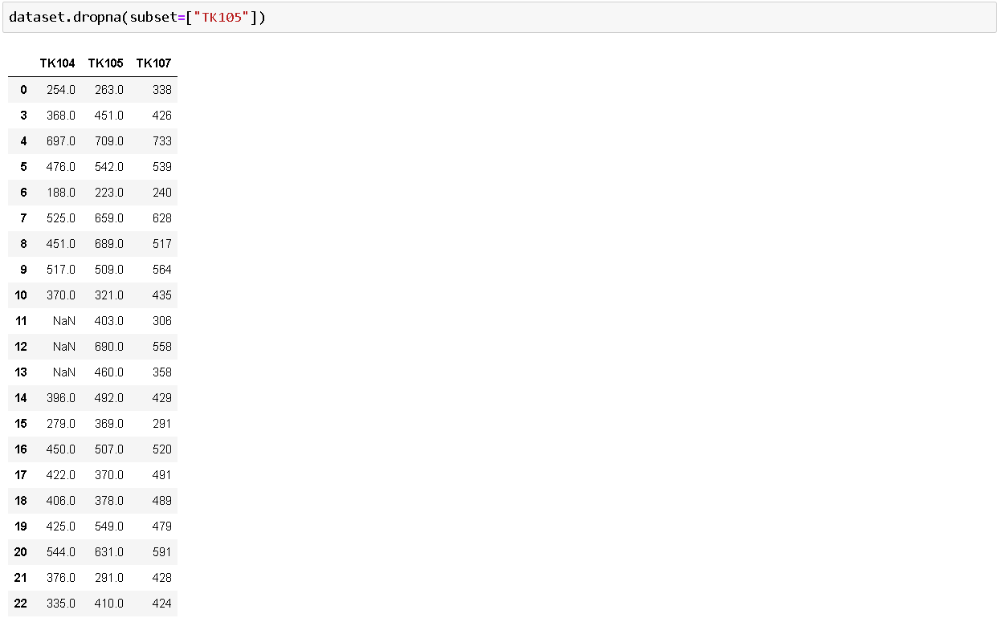
Data Deletion:
Define in which columns to look for missing values.

Slide 5
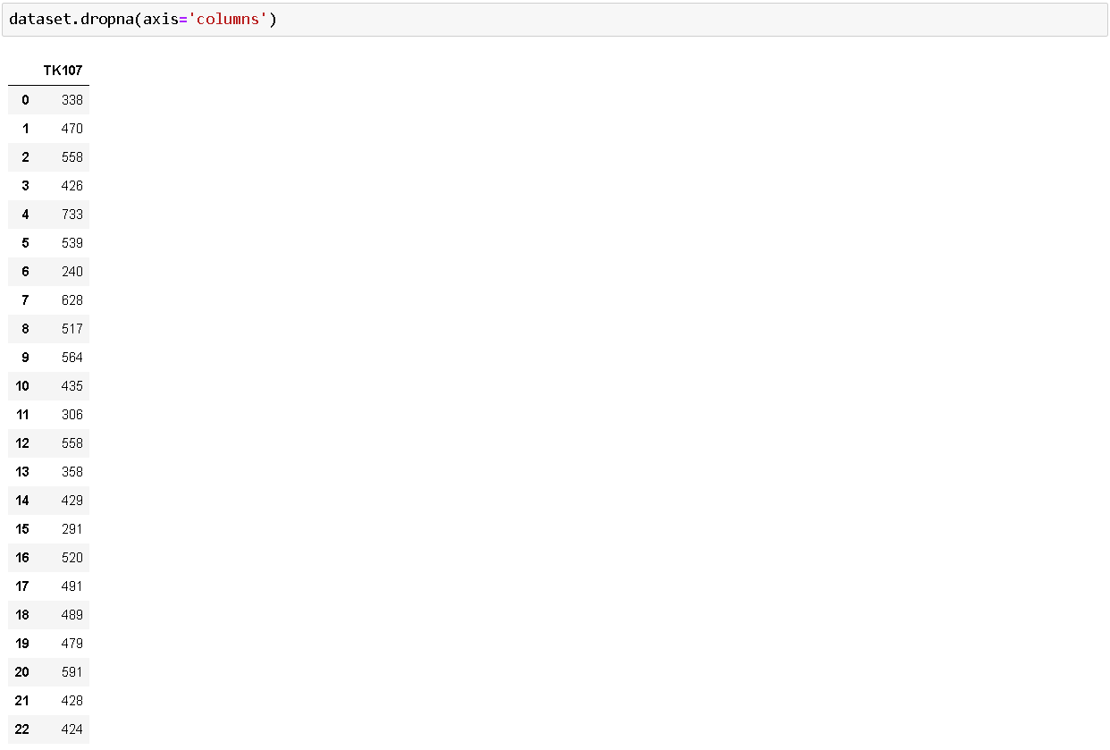
Data Deletion:
Drop the columns where at least one element is missing.

Slide 6
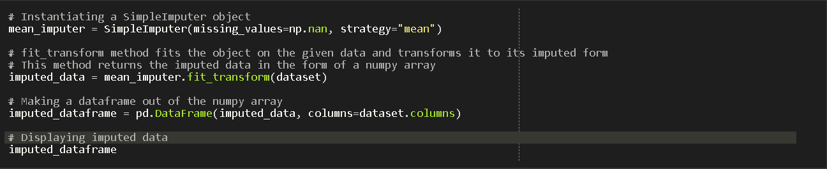
Data Imputation:
# UNIVARIATE IMPUTATION
Importing dependencies
1. Mean Imputation

Slide 7
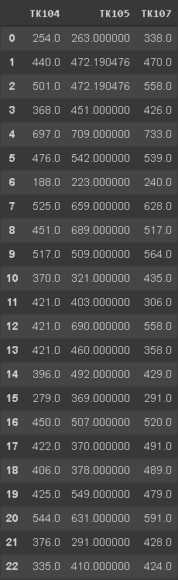
Data Imputation:
# UNIVARIATE IMPUTATION
Mean imputed data

Slide 8
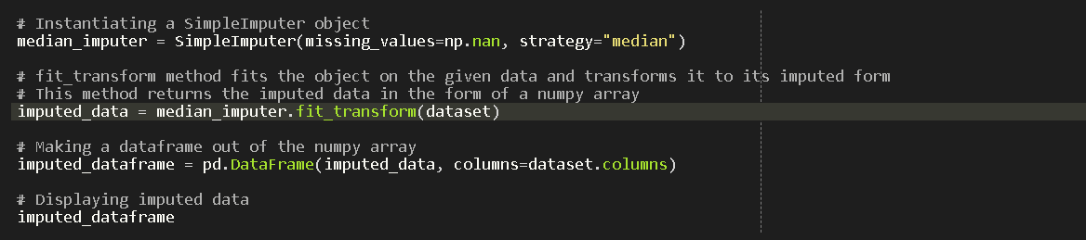
Data Imputation:
# UNIVARIATE IMPUTATION
Importing dependencies
2. Median Imputation

Slide 9
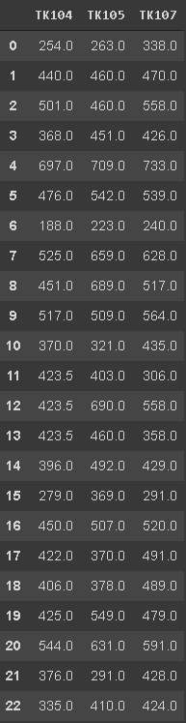
Data Imputation:
# UNIVARIATE IMPUTATION
Median imputed data

Slide 10
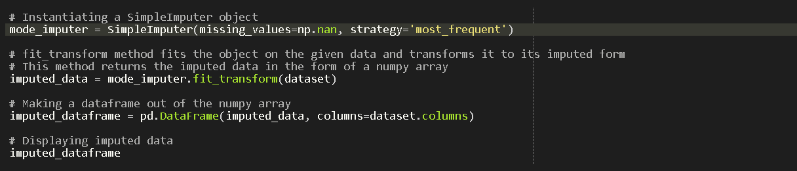
Data Imputation:
# UNIVARIATE IMPUTATION
Importing dependencies
3. Mode Imputation

Slide 11
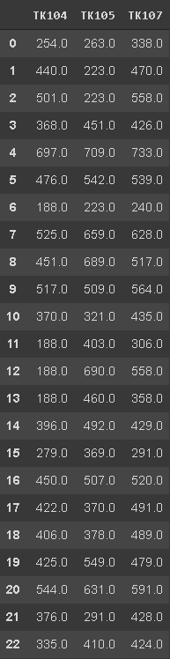
Data Imputation:
# UNIVARIATE IMPUTATION
Mode Imputed data

Slide 12
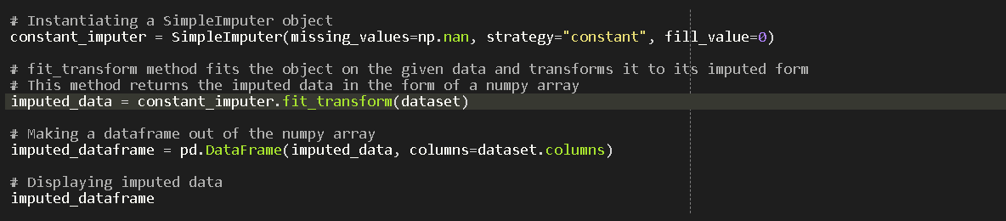
Data Imputation:
# UNIVARIATE IMPUTATION
Importing dependencies
4. Constant Imputation

Slide 13
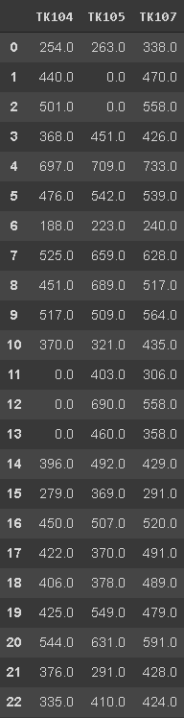
Data Imputation:
# UNIVARIATE IMPUTATION
Data imputation
with a constant

Slide 14
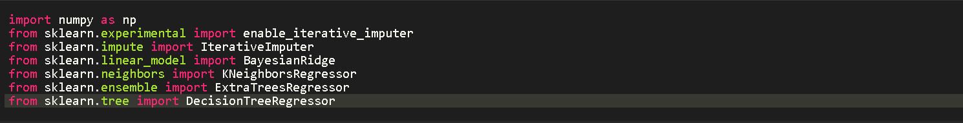
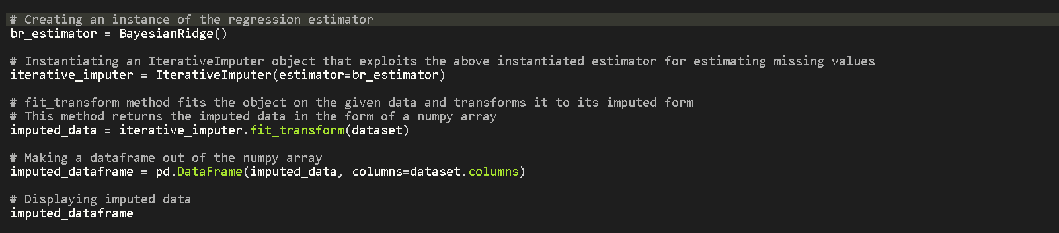
Data Imputation:
# MULTIVARIATE IMPUTATION (Iterative Regression Imputation)
Importing dependencies
1. Bayesian Ridge Regressor imputation

Slide 15
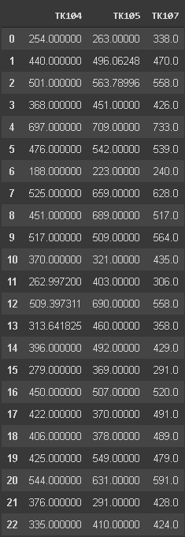
Data Imputation:
# MULTIVARIATE IMPUTATION
Bayesian Ridge
Imputed data

Slide 16
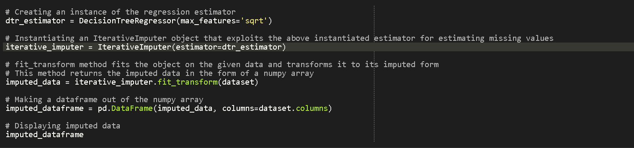
Data Imputation:
# MULTIVARIATE IMPUTATION (Iterative Regression Imputation)
Importing dependencies
2. Decision tree Regressor imputation

Slide 17
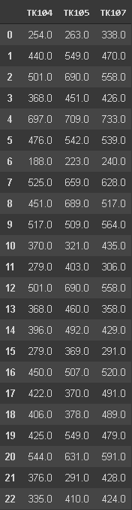
Data Imputation:
# MULTIVARIATE IMPUTATION
Decision tree
Imputed data

Slide 18
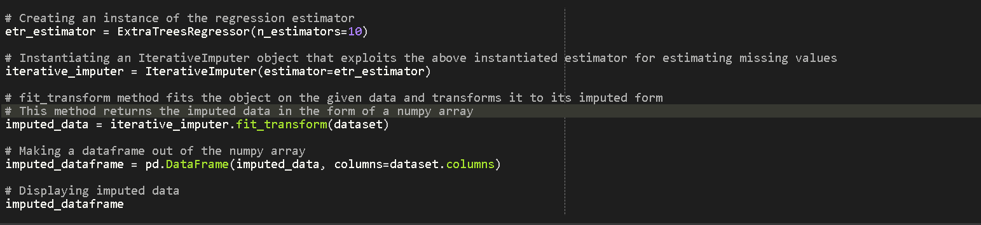
Data Imputation:
# MULTIVARIATE IMPUTATION (Iterative Regression Imputation)
Importing dependencies
3. Extra Trees Regressor imputation

Slide 19
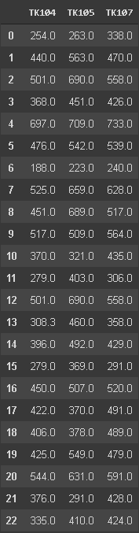
Data Imputation:
# MULTIVARIATE IMPUTATION
Extra trees
Imputed data

Slide 20
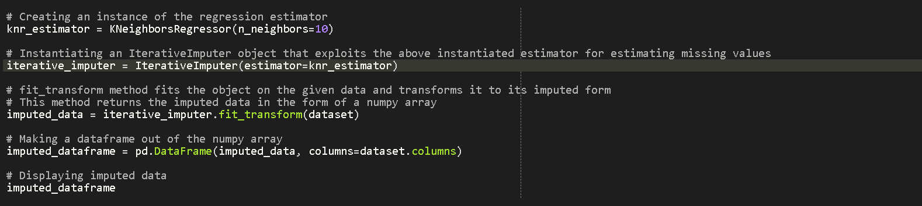
Data Imputation:
# MULTIVARIATE IMPUTATION (Iterative Regression Imputation)
Importing dependencies
4. K-Neighbors Regressor imputation

Slide 21
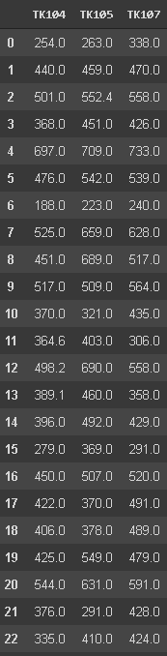
Data Imputation:
# MULTIVARIATE IMPUTATION
K-neighbors
Imputed data

