Slide 1
Handling missing data

Slide 2
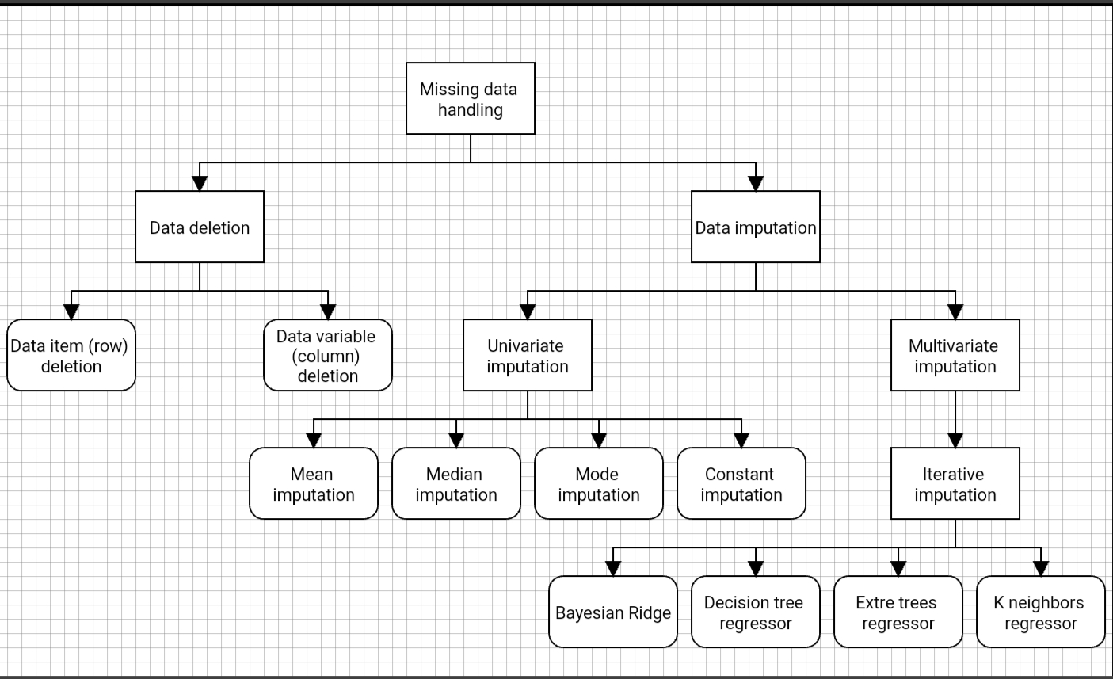

Slide 3
Table of contents:
Data deletion
1.1 Drop rows
1.1.1 Drop rows with at least one element missing
1.1.2 Define which columns to look for missing values
1.2 Drop columns
1.2.1 Drop columns with at least one element missing
Data Imputation
2.1 Univariate Imputation
2.1.1 Mean imputation
2.1.2 Median imputation
2.1.3 Mode imputation
2.1.4 Constant imputation
2.2 Multivariate Imputation
2.2.1 Iterative Imputation
2.2.1.1 Bayesian Ridge
2.2.1.2 Decision tree regressor
2.2.1.3 Extra trees regressor
2.2.1.4 K neighbors regressor

Slide 4
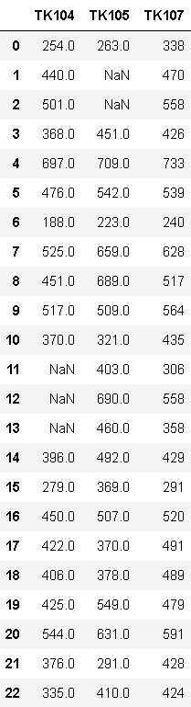
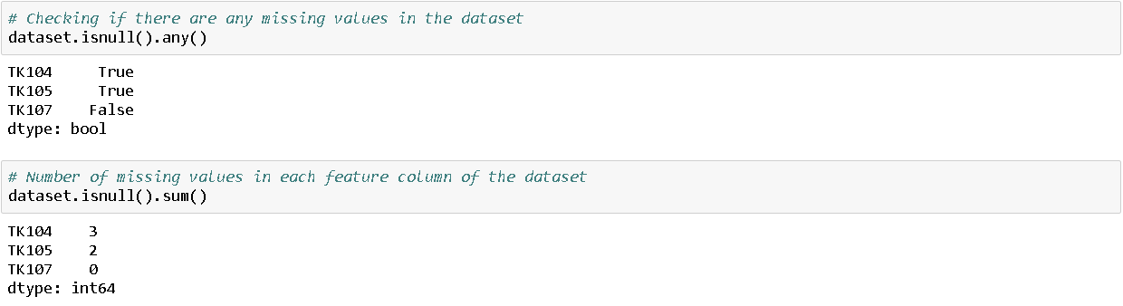
1. Data Deletion
Importing dataset
Summarizing missing value

Slide 5
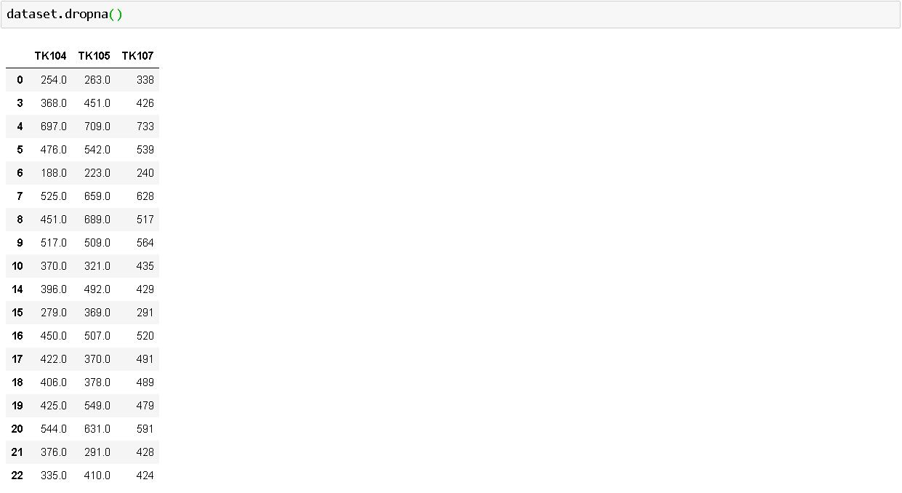
1.1 Drop Rows
1.1.1 Drop the rows where at least one element is missing.

Slide 6
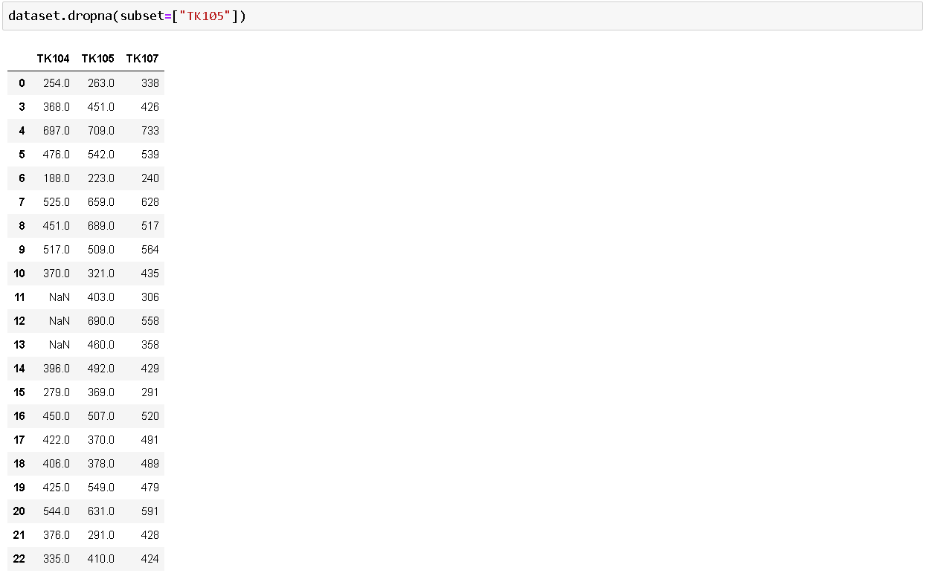
1.1 Drop Rows
1.1.2 Define in which columns to look for missing values.

Slide 7
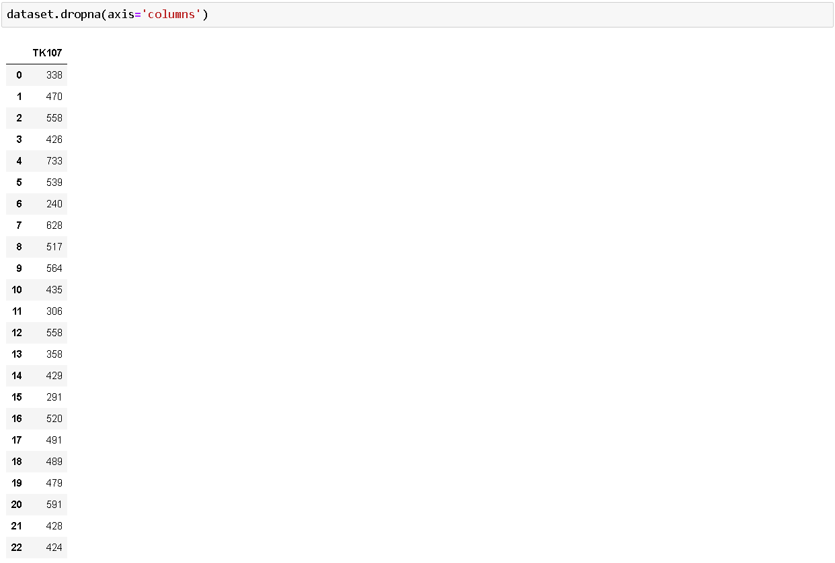
1.2 Drop columns
1.2.1 Drop the columns where at least one element is missing.

Slide 8
2. Data Imputation
2.1 Univariate Imputation
Importing dependencies:
Univariate imputation, imputes values in the i-th feature dimension using only non-missing values in that feature dimension

Slide 9
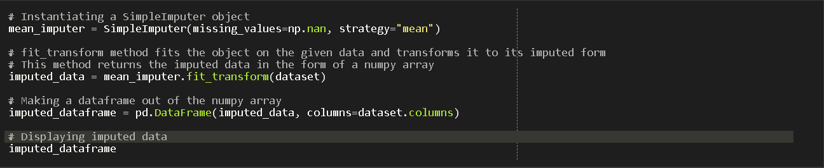
2.1.1 Mean Imputation
Mean imputation fills the missing values with the mean of the remaining values in that feature

Slide 10
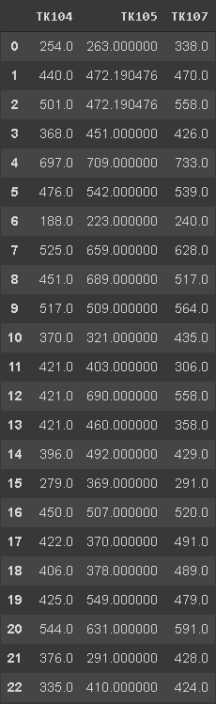
2.1.1 Mean Imputation
Input → Output

Slide 11
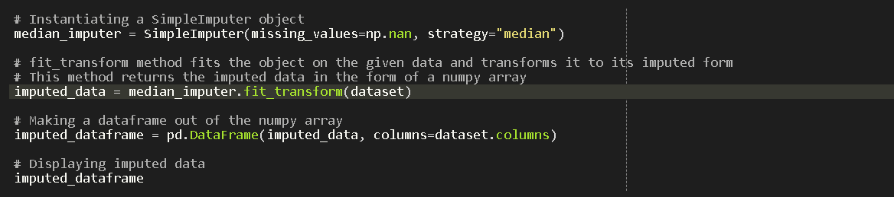
2.1.2 Median Imputation
Median imputation fills the missing values with the median of the remaining values in that feature

Slide 12
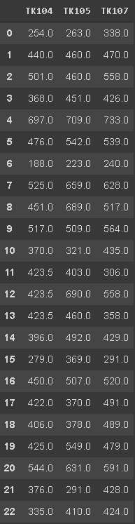
Data Imputation:
# UNIVARIATE IMPUTATION
Median imputed data

Slide 13
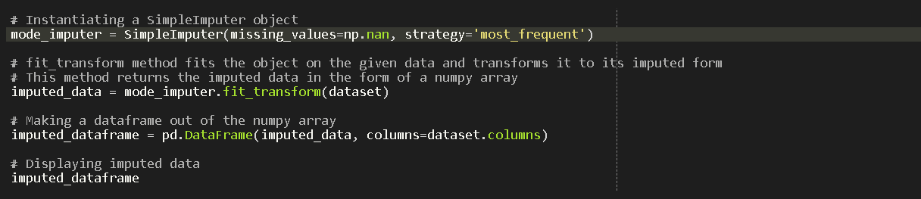
Data Imputation:
# UNIVARIATE IMPUTATION
Importing dependencies
3. Mode Imputation

Slide 14
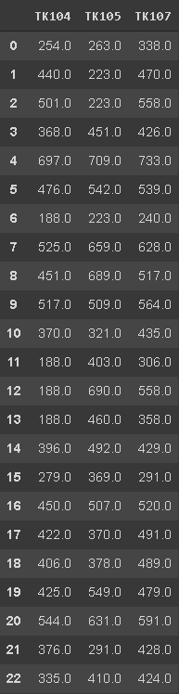
Data Imputation:
# UNIVARIATE IMPUTATION
Mode Imputed data

Slide 15
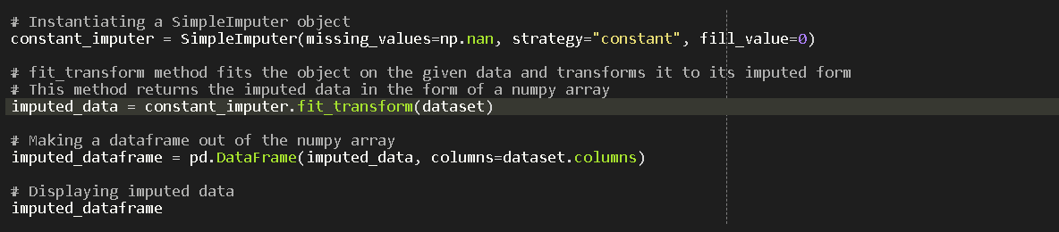
Data Imputation:
# UNIVARIATE IMPUTATION
Importing dependencies
4. Constant Imputation

Slide 16
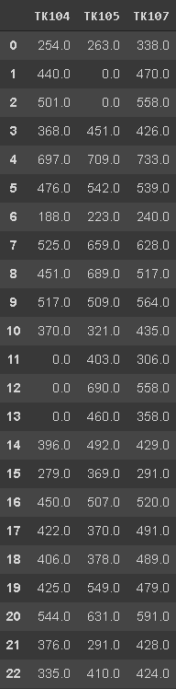
Data Imputation:
# UNIVARIATE IMPUTATION
Data imputation
with a constant

Slide 17
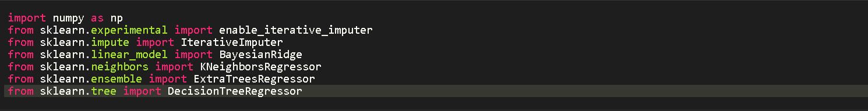
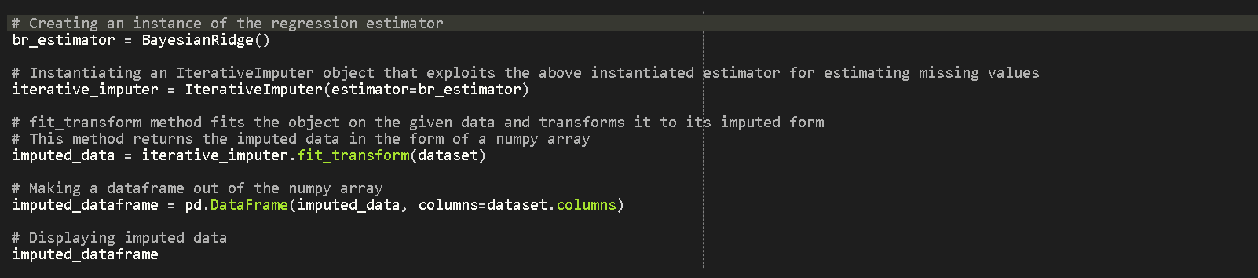
Data Imputation:
# MULTIVARIATE IMPUTATION (Iterative Regression Imputation)
Importing dependencies
1. Bayesian Ridge Regressor imputation

Slide 18
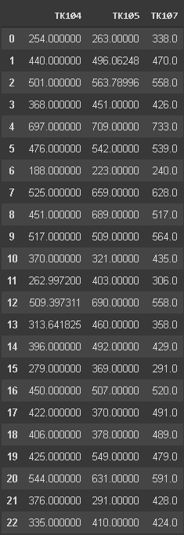
Data Imputation:
# MULTIVARIATE IMPUTATION
Bayesian Ridge
Imputed data

Slide 19
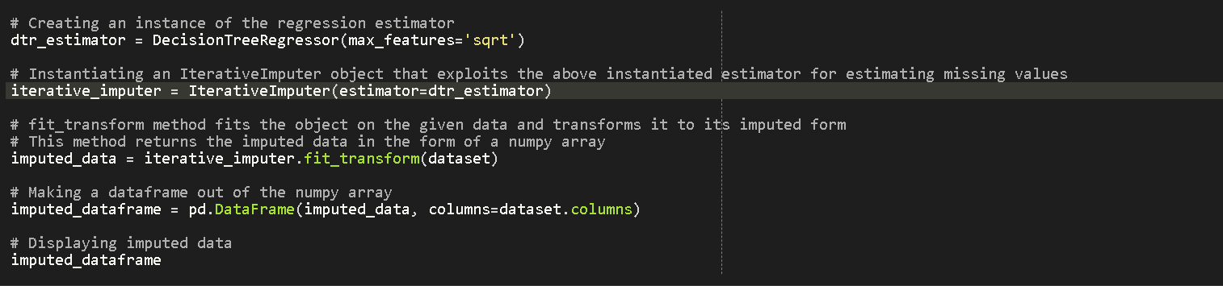
Data Imputation:
# MULTIVARIATE IMPUTATION (Iterative Regression Imputation)
Importing dependencies
2. Decision tree Regressor imputation

Slide 20
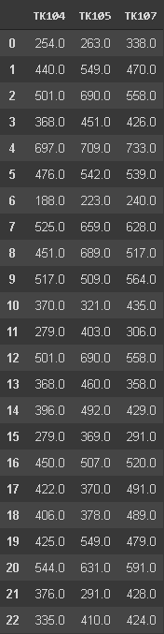
Data Imputation:
# MULTIVARIATE IMPUTATION
Decision tree
Imputed data

Slide 21
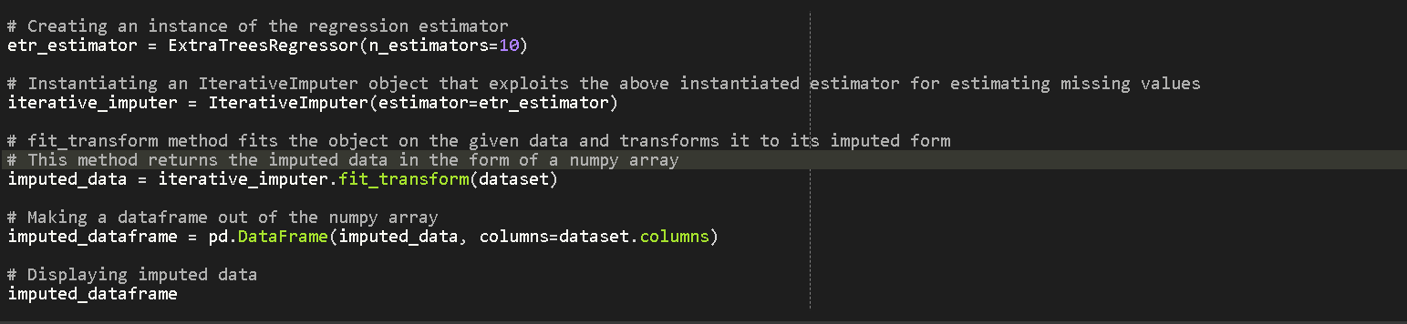
Data Imputation:
# MULTIVARIATE IMPUTATION (Iterative Regression Imputation)
Importing dependencies
3. Extra Trees Regressor imputation

Slide 22
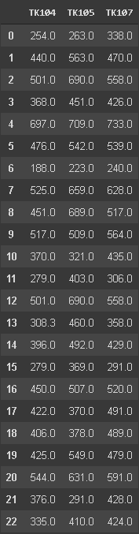
Data Imputation:
# MULTIVARIATE IMPUTATION
Extra trees
Imputed data

Slide 23
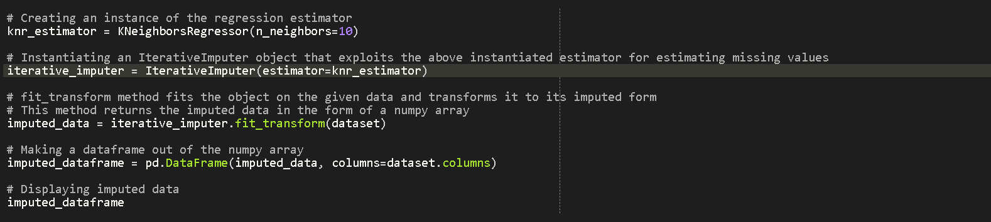
Data Imputation:
# MULTIVARIATE IMPUTATION (Iterative Regression Imputation)
Importing dependencies
4. K-Neighbors Regressor imputation

Slide 24
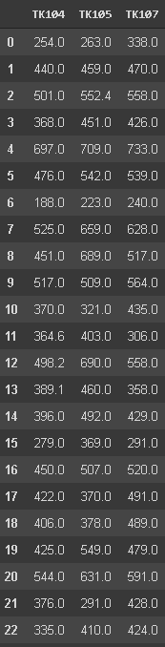
Data Imputation:
# MULTIVARIATE IMPUTATION
K-neighbors
Imputed data

