Slide 1
Audience Scoring for Direct Mail Marketing
Case Study Presentation – Bhargav Simha

Slide 2
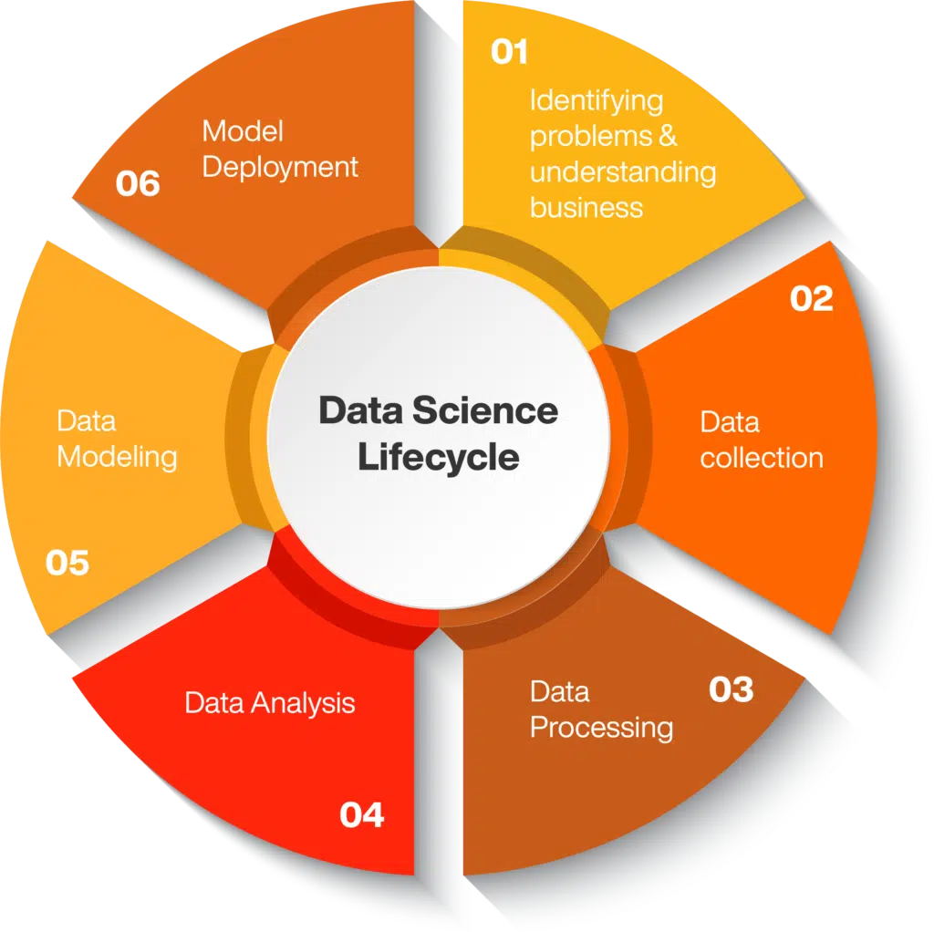
Understanding the Business Objective
Problem: Identify customers likely to respond to Direct Mail (DM) campaigns.
Goal: Predict influence probability to optimize targeting and maximize ROI.

Slide 3
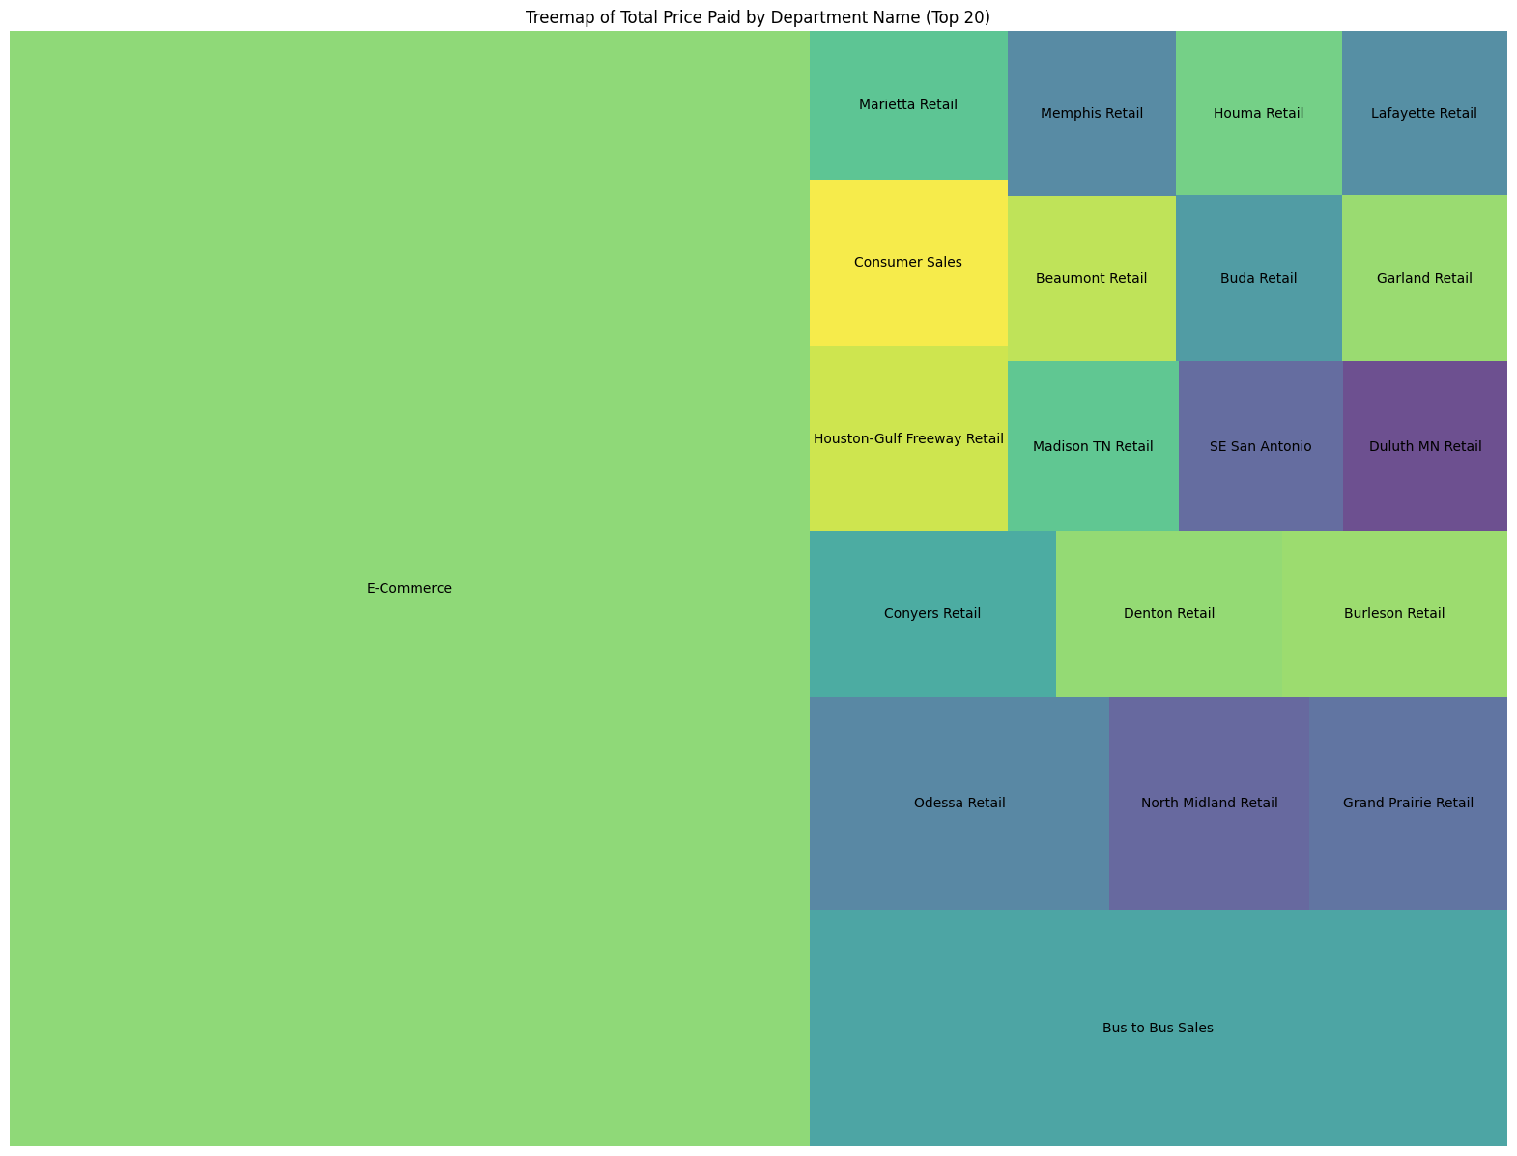
Exploratory Data Analysis – Customer Behavior
High variance in customer purchase behavior.
RFM metrics used: Recency, Frequency, Monetary.
Frequent customers tend to spend more.
Recency skewed toward customers transacting within 30 days pre-DM.

Slide 4
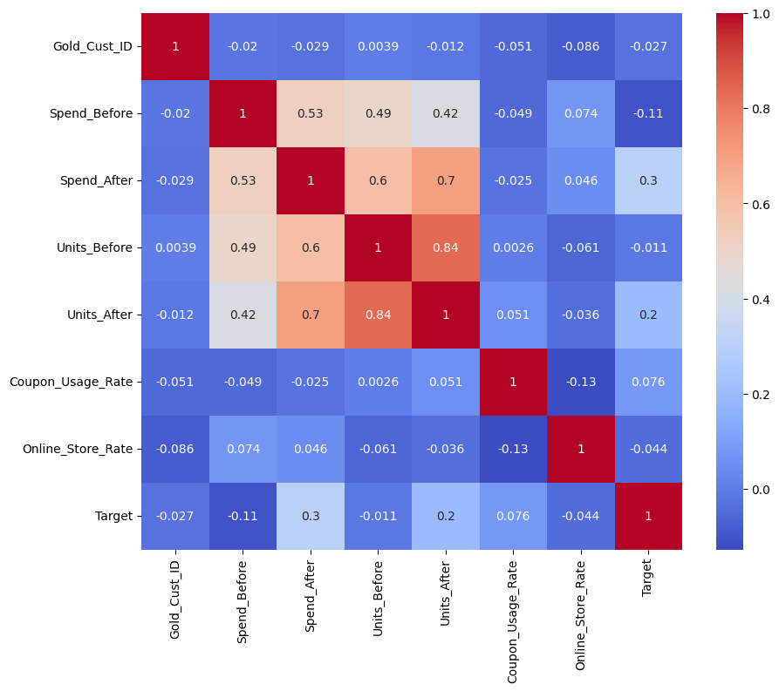
Feature Engineering Approach
Constructed RFM features from transaction history.
Merged DM and Sales data on Gold_Cust_ID.
Created 'Recency of Last Mailing' feature.
Handled missing values via max+1 strategy.

Slide 5
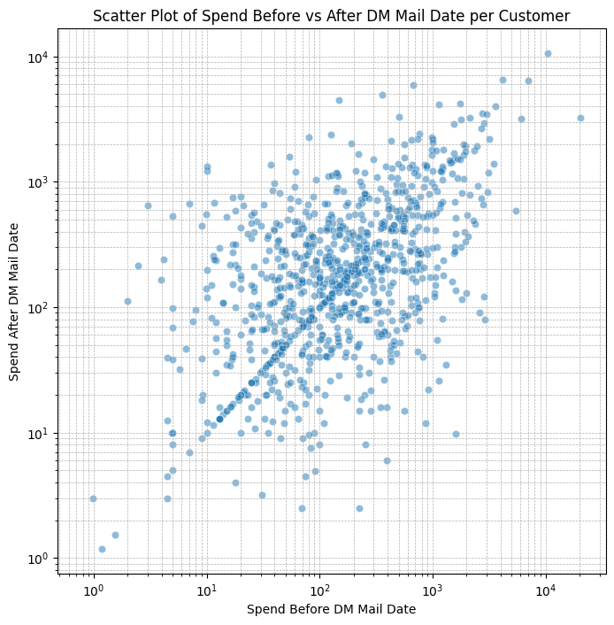
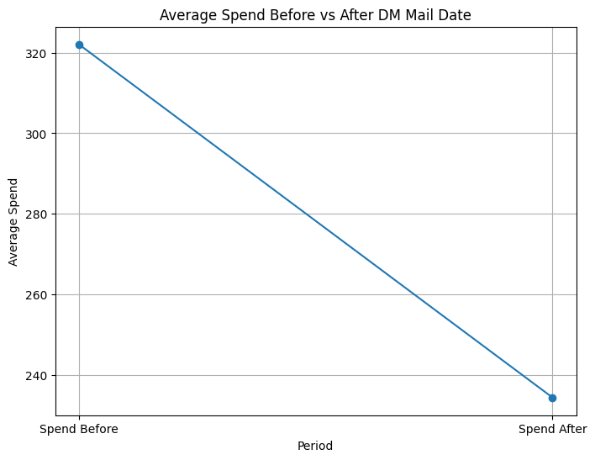
Defining the Target Variable
Target: Influenced = 1 if customer purchased within 30 days post-mailing.
Logic: (Tran_Dt > Last_Mailing_Date) & (Tran_Dt <= Last_Mailing_Date + 30)
Customer marked influenced if any qualifying transaction exists.

Slide 6
Predictive Modeling Workflow
Models: Logistic Regression, Decision Tree, Random Forest, Gradient Descent and Gradient Descent with tuning
Train-test split on engineered features.
Evaluated with AUC, precision, recall, and classification report.

Slide 7
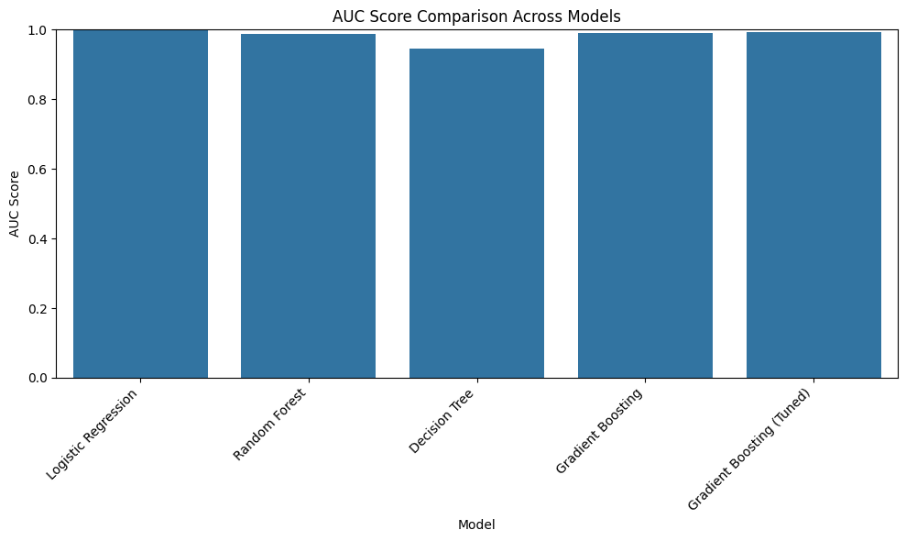
Model Evaluation Summary
Logistic Regression: Excellent baseline (AUC=0.9999).
Random Forest: Strong performance (AUC = 0.9871).
Decision Tree: Reasonable performance (AUC=0.9448).
Gradient Boosting (Tuned): Best performer (AUC=0.9935).

Slide 8
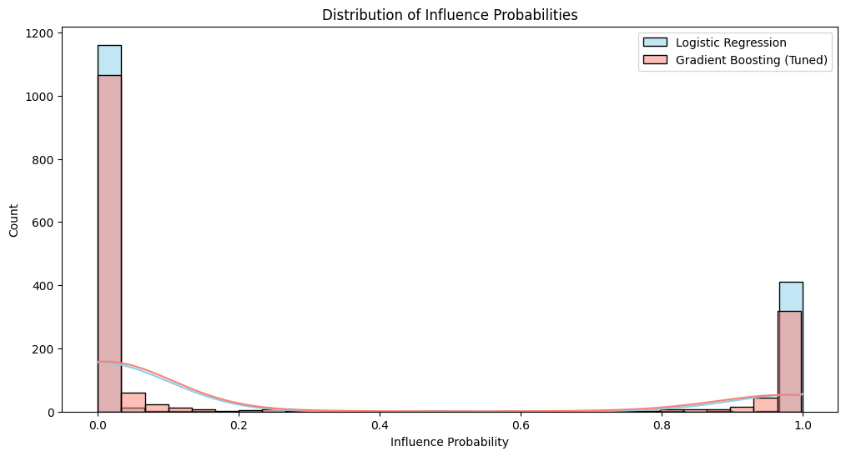
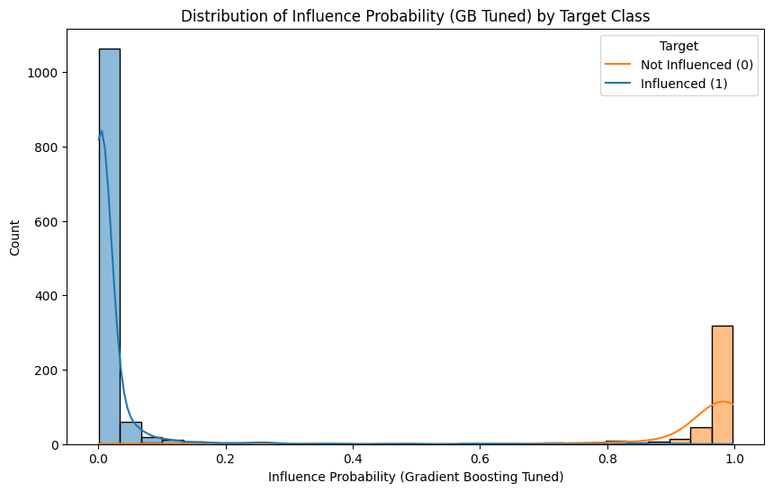
Strategic Marketing Recommendations
Target customers with predicted influence probability > 0.3.
Prioritize high-frequency and high-monetary customers.
Deploy personalized campaigns based on transaction patterns.

Slide 9
Limitations and Potential Improvements
Lack of demographic or external data sources.
Fixed 30-day influence window is a business assumption.
Enhance with deep learning or advanced time-series modeling.
Incorporate channel interaction data for better targeting.

