Slide 1

Medical Insurance Expenses Prediction and Analysis
Team member :
Harsha
Bhargav
sravan
Sakshi
Ajit
Jithendra
Manikanta
Using Exploratory Data Analysis and Regression Models

Slide 2

Objective
Analyze relationships between features in the insurance dataset.
Build regression models to predict medical expenses.
Help insurance companies make decisions on premium pricing.

Slide 3
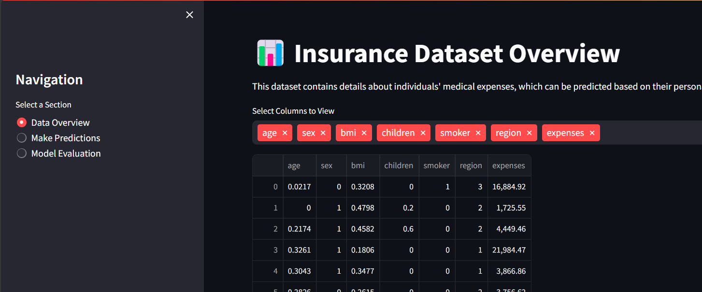
Dataset Overview
Dataset: `insurance.csv`
Rows: 1338, Columns: 7
Key Features:
- Age, BMI, Children, Smoker, Region, Expenses
- Target Variable: Expenses (Medical Costs)

Slide 4
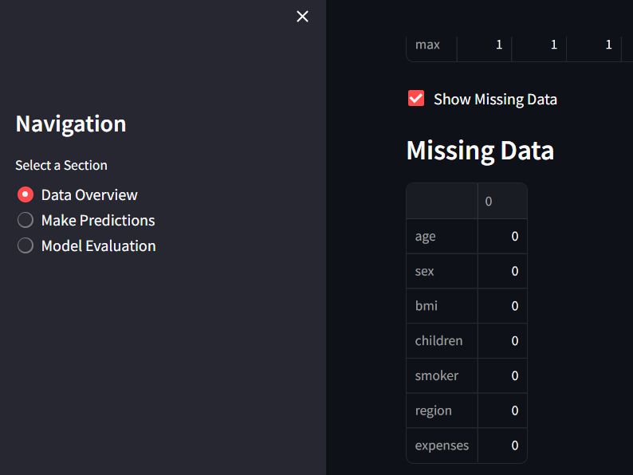

Slide 5
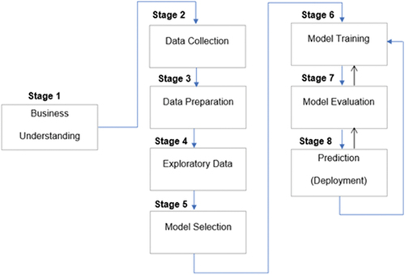
System flowchart

Slide 6
EDA Highlights
Correlation Heatmap reveals strong relationships.
Smokers incur significantly higher expenses than non-smokers.
Region-wise distribution shows variability in medical costs.
BMI has a positive correlation with expenses.

Slide 7
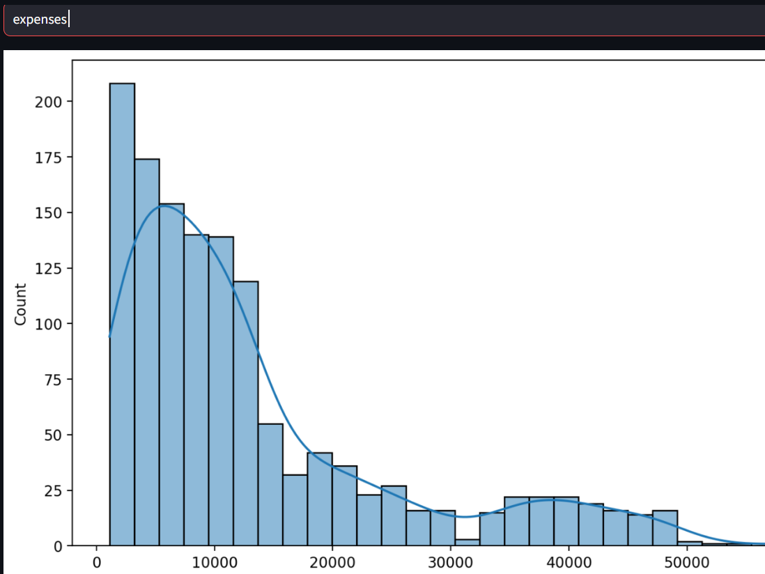
Expenses vs count

Slide 8
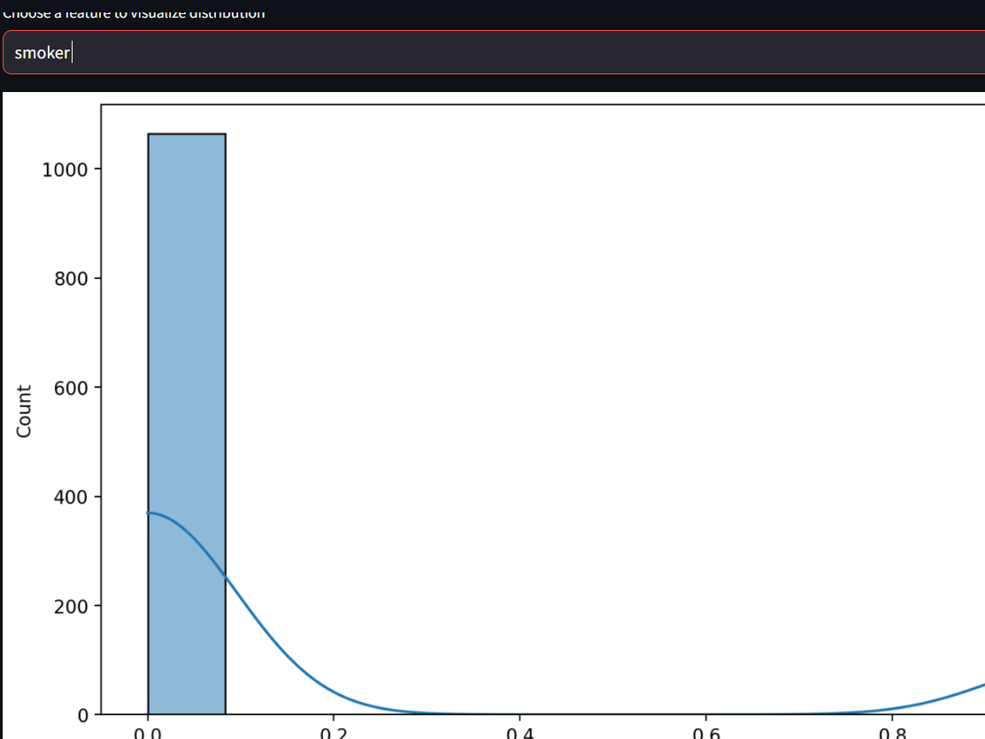
Smokers vs count

Slide 9
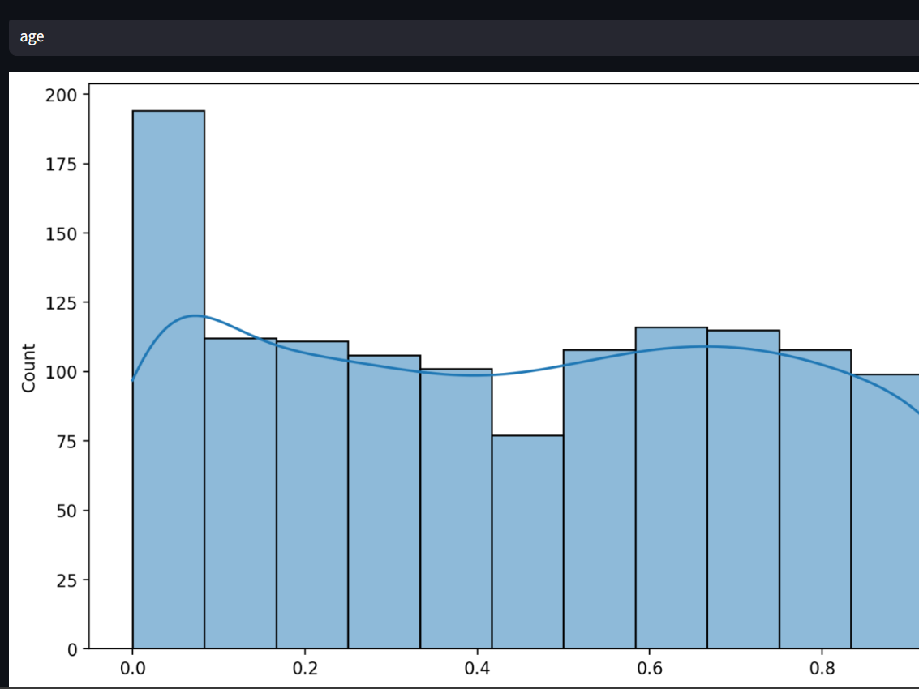
Age vs count

Slide 10
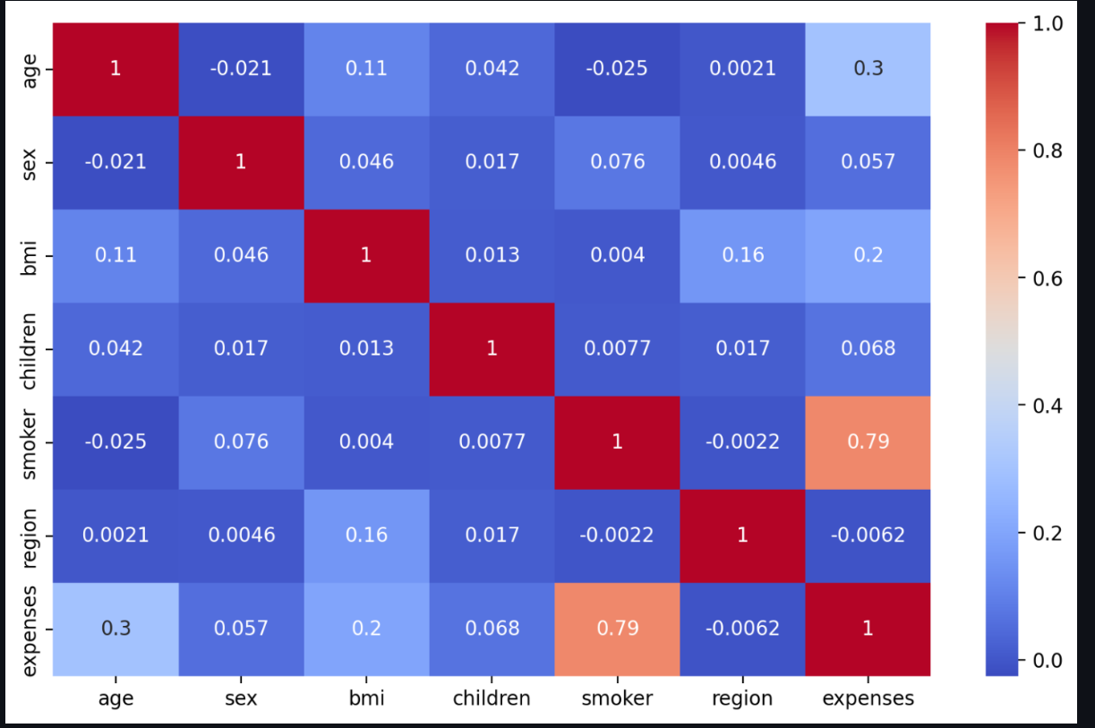
Heatmap of all columns

Slide 11
Model Building

Slide 12

Model Building

Slide 13
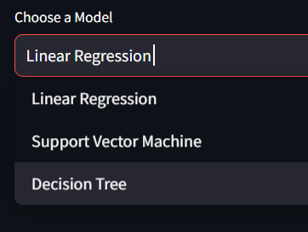

Slide 14
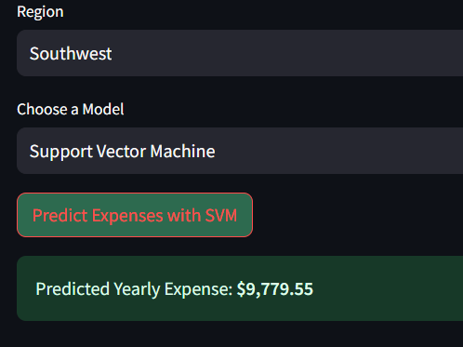

Slide 15
Model Evaluation

Slide 16
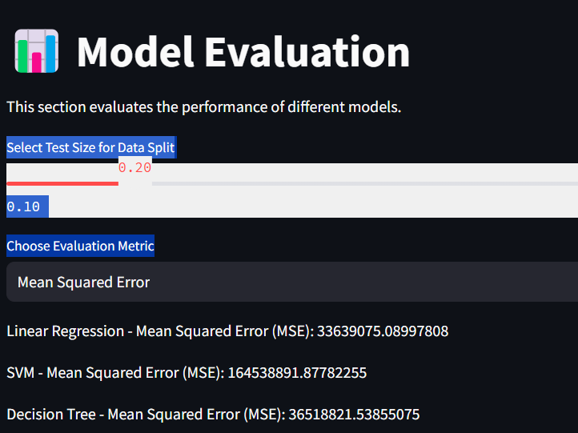

Slide 17
Model Comparison

Slide 18
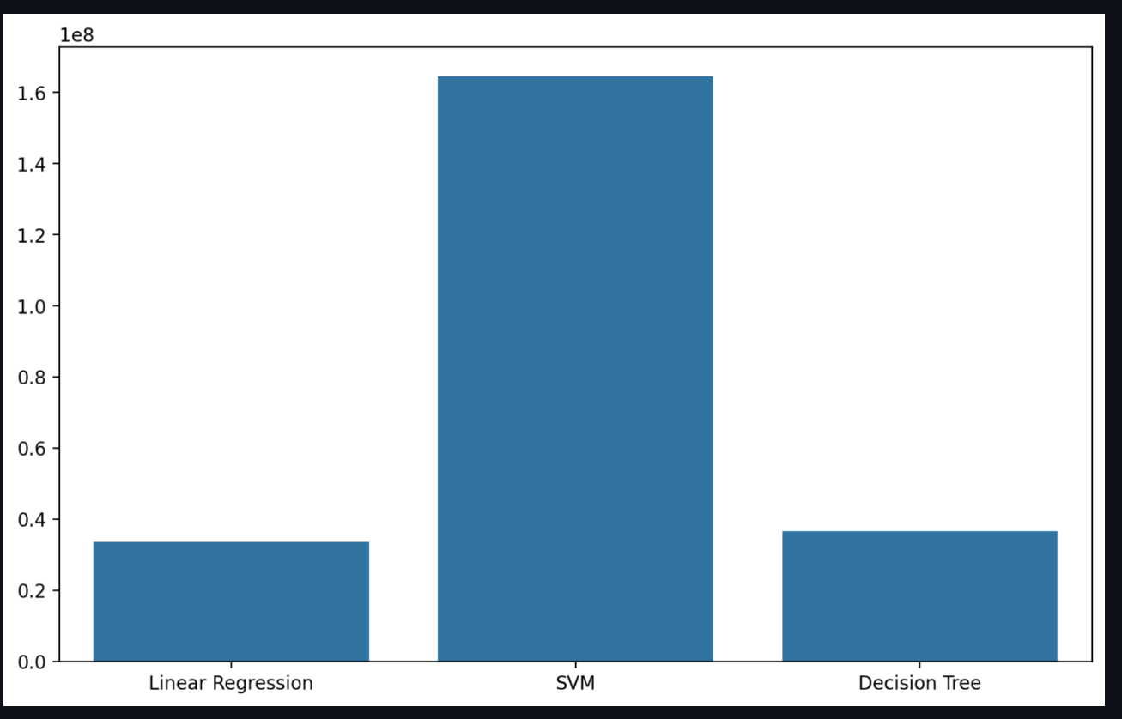
Model Comparison
Among all the models svm is show good results

Slide 19
Results
Performance Metrics:
- Best Model: Support Vector machine
- Mean Squared Error (MSE): Low
- R-squared: High (good fit)
Example Prediction:
Input Features -> Predicted Medical Expense

Slide 20
Challenges and Solutions
Working with an insurance dataset to predict medical expenses can present several challenges. Here are a few key difficulties and the ways to overcome them:
1. Handling Categorical Data:
- Challenge: Insurance datasets often contain categorical features such as gender, smoker status, and region, which need to be converted into numerical formats for machine learning models to process.
- Solution: One common approach is one-hot encoding, where each category is represented as a separate binary column. This allows the machine learning models to interpret categorical data while maintaining their distinctions. Tools like `pandas.get_dummies()` or `scikit-learn's OneHotEncoder` are frequently used.
2. Handling Missing Data:
- Challenge: The dataset might have missing or incomplete entries, which could lead to biased predictions or errors in analysis.
- Solution: Common strategies include imputation (e.g., filling missing values with the mean, median, or using machine learning models to predict missing data), or if a feature has too many missing values, it could be dropped entirely. Depending on the extent of missing data, imputation can be more reliable than removal as it retains information.

Slide 21
Conclusion
Identified key factors influencing medical expenses.
Developed multiple regression models to predict expenses.
Support Vector machine performed the best.
Useful for insurance companies to set premiums based on risk.

Slide 22
Future Work
Incorporate additional features (e.g., lifestyle habits, medical history).
Explore advanced machine learning models like Gradient Boosting.
Perform deeper analysis of outliers and unusual patterns.

Slide 23
Thank you

