Slide 1
Common Mistakes in Data Visualization
UNIT II · TOPIC 4
Data Visualization
Business Management Tools I (AE25UCBM001) · SAGE University, Bhopal
Notes:
This session shows five common chart mistakes side by side with a better version of each. Students should leave able to spot these mistakes in the news, in company decks and in their own work.

Slide 2
What you will learn
Identify five common mistakes: 3D, cut axes, too many slices, rainbow colours and dual axes.
Explain how each mistake changes what the reader believes.
Compute the lie factor to measure how much a chart exaggerates.
Fix each bad chart using a simple, honest alternative.
Judge the edge cases where a rule can bend, for example line charts.
BIG IDEA
5
mistakes cause most misleading charts. Most are accidents from default software settings, not lies.
Notes:
Say clearly that most bad charts are not made to cheat. They come from software defaults and habit. The effect on the reader is the same, so the analyst is still responsible.

Slide 3
Five common mistakes at a glance
Mistake | Why it misleads | Fix
3D effects | Depth distorts size and hides values | Use flat 2D bars
Truncated axis | Small gaps look huge | Start bars at zero
Too many slices | Angles cannot be compared | Sorted bar chart
Rainbow colours | Colour implies false categories | One colour plus one accent
Dual axes | Two scales can fake a link | Index both to 100
Each mistake is shown with a bad and a good version on the next slides.
Notes:
Treat this as the map for the session. Ask students which of the five they have used in a college assignment. Most will admit to at least one.

Slide 4
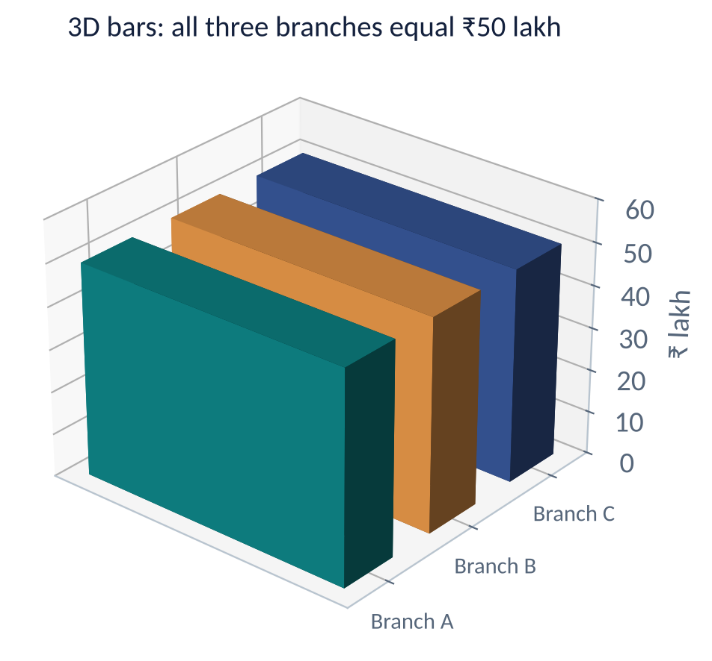
Mistake 1: 3D effects
WHAT GOES WRONG
All three bars equal ₹50 lakh, yet the back bars look smaller.
Perspective changes the size by distance, not by value.
The top of a 3D bar cannot be read against the axis.
Fix: a flat 2D bar chart. Never use 3D pies.
Notes:
This 3D picture is drawn from three equal values of 50. Ask students which branch looks biggest. Everyone says the front one. The flat charts on the next slides cost nothing and remove the problem. There is no native chart for this because the fix is to avoid 3D.

Slide 5
Mistake 2: truncated axis (bad)
WHAT GOES WRONG
The axis starts at 90, so the bars show only the part above 90.
Gwalior looks 3.5 times taller than Bhopal.
Real difference: 97 against 92, only 5.4% more.
Notes:
The bars drawn are 2, 4, 5 and 7 units tall above the baseline of 90. Ask students to guess how much bigger Gwalior is. They will say three or four times. The real gap is small.

Slide 6
Mistake 2: truncated axis (fixed)
WHY IT WORKS
Bars start at zero, so length equals value.
The four branches look nearly equal, which is the truth.
If small gaps matter, show the percent difference in a label.
Notes:
Same data, honest picture. A manager now sees that the branches are close. If the small gap is important, state it in words, for example Gwalior is 5.4% above Bhopal.

Slide 7
Measure the damage: lie factor
WORKED EXAMPLE
Use the branch sales: Bhopal ₹92 lakh and Gwalior ₹97 lakh, drawn on an axis that starts at ₹90 lakh.
Effect in the data: (97 - 92) / 92 = 5.4% more.
Bar heights drawn: from baseline 90, Bhopal is 2 units and Gwalior is 7 units.
Effect in the graphic: (7 - 2) / 2 = 250% taller.
Lie factor: 250 / 5.4 ≈ 46, against an honest value of 1.
RESULT
The truncated chart exaggerates the gap about 46 times. On a zero axis the lie factor is 1.
Notes:
Run the numbers: 5 / 92 = 0.0543. On a zero baseline the heights are 92 and 97 so the graphic shows 5.4% as well, giving a factor of 1. Ask students where they have seen axes cut in advertisements.

Slide 8
Mistake 3: too many slices (bad)
WHAT GOES WRONG
Nine slices need nine colours and a legend lookup.
Is slice D (12%) bigger than E (10%)? Hard to say.
Small slices of 4% and 5% are almost unreadable.
Notes:
Illustrative product category shares that add to 100. Ask the class to say which slice is larger, E or F. Few can do it quickly. People compare angles badly.

Slide 9
Mistake 3: too many slices (fixed)
WHY IT WORKS
Sorted bars show the ranking with no legend.
Every share can be read from its label.
Rule of thumb: use a pie only for 2 to 4 parts.
Notes:
The same nine numbers as a sorted horizontal bar. Look how easy it is to see that A is more than five times I. For long lists, group the smallest items as Other.

Slide 10
Mistake 4: rainbow colours (bad)
WHAT GOES WRONG
Six colours for one measure suggest six different things.
The eye jumps to red and yellow, not to the message.
Fix: one colour for all bars, and one accent for the point you want noticed, such as June.
Notes:
Orders grew every month from 120 to 190, which is +58%. The rainbow turns that simple growth story into decoration. Colour should carry meaning: use it to highlight, not to decorate. Also remember that red and green together fail for colour-blind readers.

Slide 11
Mistake 5: dual axes can fake a link
WORKED EXAMPLE
Six months of ad spend (₹ thousand): 40, 44, 48, 52, 56, 60. Orders: 1000, 1020, 1050, 1030, 1090, 1120 (illustrative).
Dual axes: put spend on the left axis and orders on a right axis chosen to overlap.
Picture: the two lines lie almost on top of each other. Changing the right scale changes the story.
Real change: spend rose 50% (60 / 40), but orders rose only 12% (1120 / 1000).
Honest fix: index both to 100 in month 1 and plot them on one axis.
RESULT
Indexed, spend reaches 150 while orders reach 112. The chart now shows that ads grew far faster than orders.
Notes:
The author of a dual-axis chart chooses the two scales, so the author can make any two lines match. Indexing divides each value by its first value and multiplies by 100. Check: 44 / 40 × 100 = 110 and 1020 / 1000 × 100 = 102.

Slide 12
Mistake 5: dual axes (fixed with an index)
WHY IT WORKS
One axis, one scale, no choice to manipulate.
Ad spend ends at 150 and orders at 112.
The gap tells the manager that extra spend is not turning into proportional orders.
Notes:
This is a line chart with a cut axis from 90. That is acceptable here because it is a line chart comparing growth, and the axis title says what it is. Compare this with the dual-axis picture where both lines seemed to move together.

Slide 13
Edge cases: when a rule can bend
1
Line charts may skip zero
2
Small pies can work
A line shows change, not length. An axis from 90 to 160 is fine if it is labelled. Bars must always start at zero.
Two or three slices, such as 70% against 30%, read well. The rule is about many slices, not pies as such.
3
Dual axes with care
4
Strong colour has a job
Sometimes two units must share a chart. Use clear axis colours and labels, or use two stacked charts.
Red for loss and green for gain is fine if labels also carry the meaning, so colour-blind readers are not lost.
Notes:
The point is judgement, not rules by rote. Ask the class: if you cut a line chart axis, how do you warn the reader? The answer is a clear axis label and perhaps a note under the chart.

Slide 14
Practice questions
A bar chart starts at ₹40 and shows bars for 45 and 50. The data gap is 11.1%. What is the lie factor?
1
Why is a pie with ten slices a poor choice, and what replaces it?
2
Ad spend rises from 20 to 30 (₹ thousand) and sales from 200 to 220. Index both to 100 in period 1.
3
Name two uses where a non-zero axis is acceptable and one where it is not.
4
Notes:
Question 1: (50 - 45) / 45 = 11.1%, drawn (10 - 5) / 5 = 100%, 100 / 11.1 = 9.0. Give about four minutes in pairs.
ANSWERS
1. Heights 5 and 10 give 100% taller. 100 / 11.1 ≈ 9.
2. Angles are hard to compare and the legend is hard to match. Use a sorted bar chart, or group small items as Other.
3. Spend: 30 / 20 × 100 = 150. Sales: 220 / 200 × 100 = 110.
4. Acceptable: line charts of growth or small changes, if labelled. Not acceptable: bar charts, where length equals value.

Slide 15
Key takeaways
3D: distorts size, so use flat charts.
✓
Cut axes: bars start at zero, and the lie factor should be near 1.
✓
Slices: a pie suits 2 to 4 parts, otherwise a sorted bar.
✓
Colour and dual axes: one colour plus an accent, and index to 100 to compare growth.
✓
Most bad charts come from defaults, so check every chart before sharing it.
✓
Next: Categorical Data Visualization

